Slide 1


polyglot
recreational computing
thanks to Mišo Forišek

Slide 2
a 7-language polyglot in 323 bytes https://people.ksp.sk/~misof/programy/polyglot7.html
(*a/*/ % #)(PostScript)/Helvetica 40 selectfont 9 400 moveto show%v"f"a0
true showpage quit%#) 2>/dev/null;echo bash;exit #*/);int main()/*>"eb"v
%a*0)unless print"perl\n"__END__*/{printf("C\n");/*>>#;"egnu">:#,_@;,,,<
*)begin writeln(*\output={\setbox0=\box255}\eject\shipout\hbox{\TeX}\end
*)('pascal');end.{*/return 0;}

Slide 3
C
(*a/*/ % #)(PostScript)/Helvetica 40 selectfont 9 400 moveto show%v"f"a0
true showpage quit%#) 2>/dev/null;echo bash;exit #*/);int main()/*>"eb"v
%a*0)unless print"perl\n"__END__*/{printf("C\n");/*>>#;"egnu">:#,_@;,,,<
*)begin writeln(*\output={\setbox0=\box255}\eject\shipout\hbox{\TeX}\end
*)('pascal');end.{*/return 0;}

Slide 4
Pascal
(*a/*/ % #)(PostScript)/Helvetica 40 selectfont 9 400 moveto show%v"f"a0
true showpage quit%#) 2>/dev/null;echo bash;exit #*/);int main()/*>"eb"v
%a*0)unless print"perl\n"__END__*/{printf("C\n");/*>>#;"egnu">:#,_@;,,,<
*)begin writeln(*\output={\setbox0=\box255}\eject\shipout\hbox{\TeX}\end
*)('pascal');end.{*/return 0;}

Slide 5
Postscript
(*a/*/ % #)(PostScript)/Helvetica 40 selectfont 9 400 moveto show%v"f"a0
true showpage quit%#) 2>/dev/null;echo bash;exit #*/);int main()/*>"eb"v
%a*0)unless print"perl\n"__END__*/{printf("C\n");/*>>#;"egnu">:#,_@;,,,<
*)begin writeln(*\output={\setbox0=\box255}\eject\shipout\hbox{\TeX}\end
*)('pascal');end.{*/return 0;}

Slide 6
TeX
(*a/*/ % #)(PostScript)/Helvetica 40 selectfont 9 400 moveto show%v"f"a0
true showpage quit%#) 2>/dev/null;echo bash;exit #*/);int main()/*>"eb"v
%a*0)unless print"perl\n"__END__*/{printf("C\n");/*>>#;"egnu">:#,_@;,,,<
*)begin writeln(*\output={\setbox0=\box255}\eject\shipout\hbox{\TeX}\end
*)('pascal');end.{*/return 0;}

Slide 7
Bash
(*a/*/ % #)(PostScript)/Helvetica 40 selectfont 9 400 moveto show%v"f"a0
true showpage quit%#) 2>/dev/null;echo bash;exit #*/);int main()/*>"eb"v
%a*0)unless print"perl\n"__END__*/{printf("C\n");/*>>#;"egnu">:#,_@;,,,<
*)begin writeln(*\output={\setbox0=\box255}\eject\shipout\hbox{\TeX}\end
*)('pascal');end.{*/return 0;}

Slide 8
Perl
(*a/*/ % #)(PostScript)/Helvetica 40 selectfont 9 400 moveto show%v"f"a0
true showpage quit%#) 2>/dev/null;echo bash;exit #*/);int main()/*>"eb"v
%a*0)unless print"perl\n"__END__*/{printf("C\n");/*>>#;"egnu">:#,_@;,,,<
*)begin writeln(*\output={\setbox0=\box255}\eject\shipout\hbox{\TeX}\end
*)('pascal');end.{*/return 0;}

Slide 9
Befunge 98
(*a/*/ % #)(PostScript)/Helvetica 40 selectfont 9 400 moveto show%v"f"a0
true showpage quit%#) 2>/dev/null;echo bash;exit #*/);int main()/*>"eb"v
%a*0)unless print"perl\n"__END__*/{printf("C\n");/*>>#;"egnu">:#,_@;,,,<
*)begin writeln(*\output={\setbox0=\box255}\eject\shipout\hbox{\TeX}\end
*)('pascal');end.{*/return 0;}

Slide 10
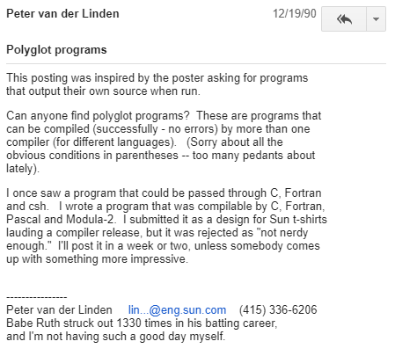
History
UseNet: rec.puzzles
https://ideology.com.au/polyglot/

Slide 11
polyglot challenge
https://codegolf.stackexchange.com/a/199178

