Slide 1

Operational Semantics
David J Stucki

Slide 2
Why?
Is meaning all that important?
Without a semantic specification it would be impossible for a compiler/interpreter to be developed. Why?
Without a semantic specification it would be impossible to determine whether a compiler/interpreter was correct. It defines what correctness means.
Without a semantic specification we would not be able to know whether a program was correct.
Without a semantic specification we would not be able to reason about program source code.

Slide 3
Verification
Formally proving that a program does the right thing.
Requires a relatively simple programming language
Requires a formal specification of the program’ desired behavior
Requires a formal semantic model for the programming language
Requires mental challenge to put these all together in a deductive framework
Is it really worth all this? Sometimes...
  Security & Encryption Healthcare Martian Rover
  Financial transactions Aviation & Military Hardware design (CPUs)

Slide 4
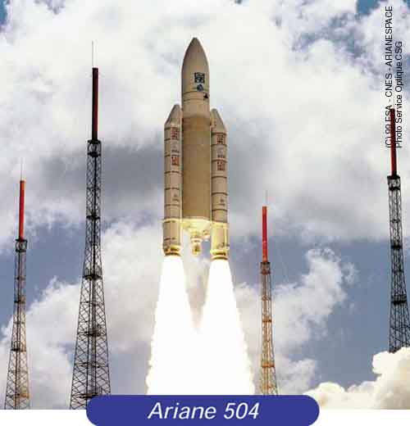
Double Int kills Ariane 5
The EU Space Agency spent ten years and $7B to produce Ariane 5, a giant rocket capable of putting a pair of three-ton satellites into orbit with each launch and intended to give Europe supremacy in the commercial space business
All it took to explode the rocket less than a minute into its maiden voyage in 1996 was a small computer program trying to stuff a 64-bit number into a 16-bit space.
A Bug and a Crash, by James Gleick

Slide 5

Intel Pentium Bug
In the mid 90’s a bug was found in the floating-point hardware in Intel’s latest Pentium microprocessor
Unfortunately, the bug was only found after many had been made and sold
The bug was subtle, effecting only the ninth decimal place of some computations
But users cared
Intel had to recall the chips, taking a $500M write-off

Slide 6
Approach
Can you give me some options?
Compile & Run
  Pro: simple, quick; Con: platform dependencies, not useful for reasoning
Informal Semantics
  Pro: easily communicated; Con: see next slide
Formal Semantics
  Pro: clear & precise; Con: more challenging to work with

Slide 7
Informal
What’s wrong with English?
Excerpt from the ANSI C Standard, 3.1.2.6:
Two types have compatible types if their types are the same.
Footnote: Two types need not be identical to be compatible.
In the first edition of The C Programming Language, by Kernighan & Richie (aka K&R C), the switch statement had a very relaxed definition requiring only that the body of the switch be a syntactically valid compound statement with case: labels can appear prefixing any statement. Recall switch implemented a fall-through semantics in the absence of breaks. Duff’s Device

Slide 8
Operational
As in, ‘How it Operates’
A model that describes the meaning of a program by specifying how statements affect the state of a machine (virtual or real) when executed.
Changes in the machine, including memory, registers, the stack, the heap, etc., define the meaning of a statement.
We can choose any number of virtual machine models in order to accomplish this, but to remain as simple as possible, I will use the σ representation of variable values that we introduced last time.

Slide 9
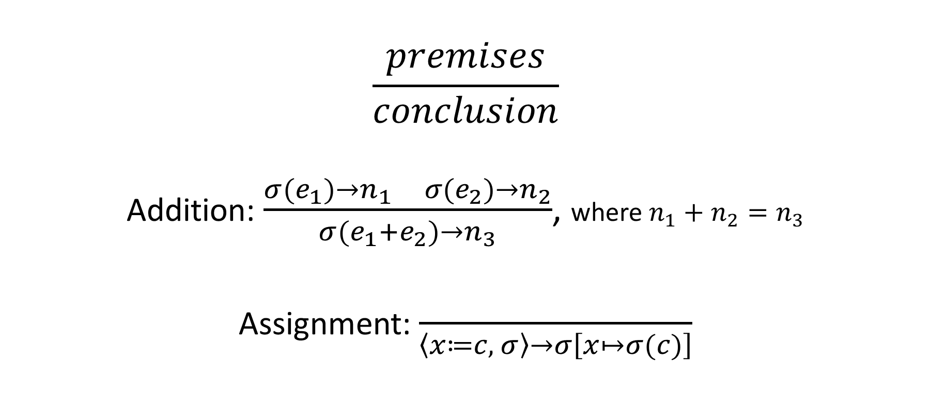
Post Systems
Notation borrowed from symbolic logic (philosophy)
[named after Emil Post]
$$\frac{premises}{conclusion}$$
Addition: $\frac{σ(e_{1})→n_{1} σ(e_{2})→n_{2}}{σ(e_{1}+e_{2})→n_{3}}$, where $n_{1}+n_{2}=n_{3}$
Assignment: $\frac{ }{\left\langle x≔c, σ\right\rangle →σ\left[x↦σ(c)\right]}$

Slide 10
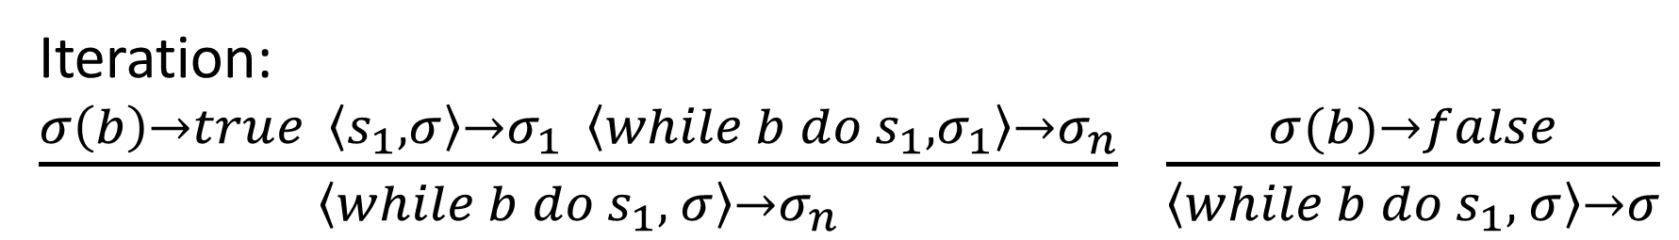
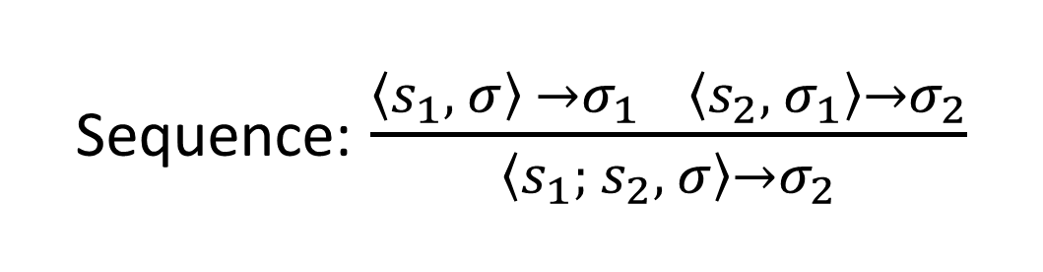
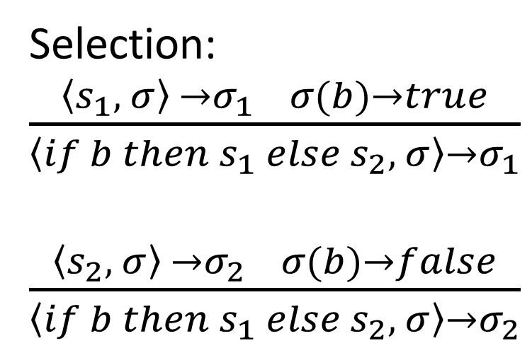
Control Constructs
All is vanity. (Ecclesiastes 1:2)
Selection: $\frac{\left\langle s_{1}, σ\right\rangle →σ_{1} σ(b)→true}{\left\langle if b then s_{1} else s_{2}, σ\right\rangle →σ_{1}}$
$\frac{\left\langle s_{2}, σ\right\rangle →σ_{2} σ(b)→false}{\left\langle if b then s_{1} else s_{2}, σ\right\rangle →σ_{2}}$
Sequence: $\frac{\left\langle s_{1}, σ\right\rangle →σ_{1} \left\langle s_{2}, { σ}_{1}\right\rangle →σ_{2}}{\left\langle s_{1}; s_{2}, σ\right\rangle →σ_{2}}$
Iteration:
$\frac{σ\left(b\right)→true \left\langle s_{1}, σ\right\rangle →σ_{1} \left\langle while b do s_{1}, σ_{1}\right\rangle →σ_{n}}{\left\langle while b do s_{1}, σ\right\rangle →σ_{n}}$ $\frac{σ(b)→false}{\left\langle while b do s_{1}, σ\right\rangle →σ}$

Slide 11

Example
$$σ=∅$$
n = 4
sum = 0
while n > 0 do
if n % 2 == 0 then
sum = sum + 1
else
sum = sum + n
n = n - 1

Slide 12

Example
$$σ=∅$$
n = 4
sum = 0
while n > 0 do
if n % 2 == 0 then
sum = sum + 1
else
sum = sum + n
n = n - 1
$$\frac{ }{\left\langle x≔c, σ\right\rangle →σ\left[x↦σ(c)\right]}$$

Slide 13

Example
$$σ=\left\{\left\langle n,4\right\rangle \right\}$$
n = 4
sum = 0
while n > 0 do
if n % 2 == 0 then
sum = sum + 1
else
sum = sum + n
n = n - 1
$$\frac{ }{\left\langle x≔c, σ\right\rangle →σ\left[x↦σ(c)\right]}$$

Slide 14
Example
$$σ=\left\{\left\langle n,4\right\rangle \right\}$$
n = 4
sum = 0
while n > 0 do
if n % 2 == 0 then
sum = sum + 1
else
sum = sum + n
n = n - 1
$$\frac{ }{\left\langle x≔c, σ\right\rangle →σ\left[x↦σ(c)\right]}$$

Slide 15

Example
$$σ=\left\{\left\langle n,4\right\rangle ,\left\langle sum,0\right\rangle \right\}$$
n = 4
sum = 0
while n > 0 do
if n % 2 == 0 then
sum = sum + 1
else
sum = sum + n
n = n - 1
$$\frac{ }{\left\langle x≔c, σ\right\rangle →σ\left[x↦σ(c)\right]}$$

Slide 16
Example
$$σ=\left\{\left\langle n,4\right\rangle ,\left\langle sum,0\right\rangle \right\}$$
n = 4
sum = 0
while n > 0 do
if n % 2 == 0 then
sum = sum + 1
else
sum = sum + n
n = n - 1

Slide 17

Example
$$σ=\left\{\left\langle n,4\right\rangle ,\left\langle sum,0\right\rangle \right\}$$
n = 4
sum = 0
while n > 0 do
if n % 2 == 0 then
sum = sum + 1
else
sum = sum + n
n = n - 1
Iteration:
$\frac{σ\left(b\right)→true \left\langle s_{1}, σ\right\rangle →σ_{1} \left\langle while b do s_{1}, σ_{1}\right\rangle →σ_{n}}{\left\langle while b do s_{1}, σ\right\rangle →σ_{n}}$ $\frac{σ(b)→false}{\left\langle while b do s_{1}, σ\right\rangle →σ}$

Slide 18

Example
$$σ=\left\{\left\langle n,4\right\rangle ,\left\langle sum,0\right\rangle \right\}$$
n = 4
sum = 0
while n > 0 do
if n % 2 == 0 then
sum = sum + 1
else
sum = sum + n
n = n - 1
Iteration:
$$\frac{σ\left(b\right)→true \left\langle s_{1}, σ\right\rangle →σ_{1} \left\langle while b do s_{1}, σ_{1}\right\rangle →σ_{n}}{\left\langle while b do s_{1}, σ\right\rangle →σ_{n}}$$

Slide 19

Example
$$σ=\left\{\left\langle n,4\right\rangle ,\left\langle sum,0\right\rangle \right\}$$
n = 4
sum = 0
while n > 0 do
if n % 2 == 0 then
sum = sum + 1
else
sum = sum + n
n = n - 1
Sequence:
$$\frac{\left\langle s_{1}, σ\right\rangle →σ_{1} \left\langle s_{2}, { σ}_{1}\right\rangle →σ_{2}}{\left\langle s_{1}; s_{2}, σ\right\rangle →σ_{2}}$$

Slide 20

Example
$$σ=\left\{\left\langle n,4\right\rangle ,\left\langle sum,0\right\rangle \right\}$$
n = 4
sum = 0
while n > 0 do
if n % 2 == 0 then
sum = sum + 1
else
sum = sum + n
n = n - 1
Selection:
$\frac{\left\langle s_{1}, σ\right\rangle →σ_{1} σ(b)→true}{\left\langle if b then s_{1} else s_{2}, σ\right\rangle →σ_{1}}$
$\frac{\left\langle s_{2}, σ\right\rangle →σ_{2} σ(b)→false}{\left\langle if b then s_{1} else s_{2}, σ\right\rangle →σ_{2}}$

Slide 21

Example
$$σ=\left\{\left\langle n,4\right\rangle ,\left\langle sum,0\right\rangle \right\}$$
n = 4
sum = 0
while n > 0 do
if n % 2 == 0 then
sum = sum + 1
else
sum = sum + n
n = n - 1
Selection:
$\frac{\left\langle s_{1}, σ\right\rangle →σ_{1} σ(b)→true}{\left\langle if b then s_{1} else s_{2}, σ\right\rangle →σ_{1}}$

Slide 22

Example
$$σ=\left\{\left\langle n,4\right\rangle ,\left\langle sum,0\right\rangle \right\}$$
n = 4
sum = 0
while n > 0 do
if n % 2 == 0 then
sum = sum + 1
else
sum = sum + n
n = n - 1
$$\frac{ }{\left\langle x≔c, σ\right\rangle →σ\left[x↦σ(c)\right]}$$

Slide 23

Example
$$σ=\left\{\left\langle n,4\right\rangle ,\left\langle sum,1\right\rangle \right\}$$
n = 4
sum = 0
while n > 0 do
if n % 2 == 0 then
sum = sum + 1
else
sum = sum + n
n = n - 1
$$\frac{ }{\left\langle x≔c, σ\right\rangle →σ\left[x↦σ(c)\right]}$$

Slide 24

Example
$$σ=\left\{\left\langle n,3\right\rangle ,\left\langle sum,1\right\rangle \right\}$$
n = 4
sum = 0
while n > 0 do
if n % 2 == 0 then
sum = sum + 1
else
sum = sum + n
n = n - 1
Iteration:
$\frac{σ\left(b\right)→true \left\langle s_{1}, σ\right\rangle →σ_{1} \left\langle while b do s_{1}, σ_{1}\right\rangle →σ_{n}}{\left\langle while b do s_{1}, σ\right\rangle →σ_{n}}$ $\frac{σ(b)→false}{\left\langle while b do s_{1}, σ\right\rangle →σ}$

Slide 25
Example
$$σ=\left\{\left\langle n,3\right\rangle ,\left\langle sum,1\right\rangle \right\}$$
n = 4
sum = 0
while n > 0 do
if n % 2 == 0 then
sum = sum + 1
else
sum = sum + n
n = n - 1
Iteration:
$$\frac{σ\left(b\right)→true \left\langle s_{1}, σ\right\rangle →σ_{1} \left\langle while b do s_{1}, σ_{1}\right\rangle →σ_{n}}{\left\langle while b do s_{1}, σ\right\rangle →σ_{n}}$$

Slide 26
Example
$$σ=\left\{\left\langle n,3\right\rangle ,\left\langle sum,1\right\rangle \right\}$$
n = 4
sum = 0
while n > 0 do
if n % 2 == 0 then
sum = sum + 1
else
sum = sum + n
n = n - 1
Sequence:
$$\frac{\left\langle s_{1}, σ\right\rangle →σ_{1} \left\langle s_{2}, { σ}_{1}\right\rangle →σ_{2}}{\left\langle s_{1}; s_{2}, σ\right\rangle →σ_{2}}$$

Slide 27
Example
$$σ=\left\{\left\langle n,3\right\rangle ,\left\langle sum,1\right\rangle \right\}$$
n = 4
sum = 0
while n > 0 do
if n % 2 == 0 then
sum = sum + 1
else
sum = sum + n
n = n - 1
Selection:
$\frac{\left\langle s_{1}, σ\right\rangle →σ_{1} σ(b)→true}{\left\langle if b then s_{1} else s_{2}, σ\right\rangle →σ_{1}}$
$\frac{\left\langle s_{2}, σ\right\rangle →σ_{2} σ(b)→false}{\left\langle if b then s_{1} else s_{2}, σ\right\rangle →σ_{2}}$

Slide 28

Example
$$σ=\left\{\left\langle n,3\right\rangle ,\left\langle sum,1\right\rangle \right\}$$
n = 4
sum = 0
while n > 0 do
if n % 2 == 0 then
sum = sum + 1
else
sum = sum + n
n = n - 1
Selection:
$\frac{\left\langle s_{2}, σ\right\rangle →σ_{2} σ(b)→false}{\left\langle if b then s_{1} else s_{2}, σ\right\rangle →σ_{2}}$

Slide 29
Example
$$σ=\left\{\left\langle n,3\right\rangle ,\left\langle sum,1\right\rangle \right\}$$
n = 4
sum = 0
while n > 0 do
if n % 2 == 0 then
sum = sum + 1
else
sum = sum + n
n = n - 1
$$\frac{ }{\left\langle x≔c, σ\right\rangle →σ\left[x↦σ(c)\right]}$$

Slide 30

Example
$$σ=\left\{\left\langle n,3\right\rangle ,\left\langle sum,4\right\rangle \right\}$$
n = 4
sum = 0
while n > 0 do
if n % 2 == 0 then
sum = sum + 1
else
sum = sum + n
n = n - 1
$$\frac{ }{\left\langle x≔c, σ\right\rangle →σ\left[x↦σ(c)\right]}$$

Slide 31

Example
$$σ=\left\{\left\langle n,2\right\rangle ,\left\langle sum,4\right\rangle \right\}$$
n = 4
sum = 0
while n > 0 do
if n % 2 == 0 then
sum = sum + 1
else
sum = sum + n
n = n - 1

Slide 32


Example
$$σ=\left\{\left\langle n,0\right\rangle ,\left\langle sum,6\right\rangle \right\}$$
n = 4
sum = 0
while n > 0 do
if n % 2 == 0 then
sum = sum + 1
else
sum = sum + n
n = n - 1
AND EVENTUALLY...
$$\frac{σ(b)→false}{\left\langle while b do s_{1}, σ\right\rangle →σ}$$

Slide 33
Example
$$σ=\left\{\left\langle n,0\right\rangle ,\left\langle sum,6\right\rangle \right\}$$
n = 4
sum = 0
while n > 0 do
if n % 2 == 0 then
sum = sum + 1
else
sum = sum + n
n = n - 1

Slide 34
Example
$$σ=∅$$
n = 100
sum = 0
while n > 0 do
if n % 2 == 0 then
sum = sum + 1
else
sum = sum + n
n = n - 1
What about now?

Slide 35

$$σ=∅$$

