Slide 1
Farey pairs, Enumerating Rationals,
& Matt Parker

Slide 2
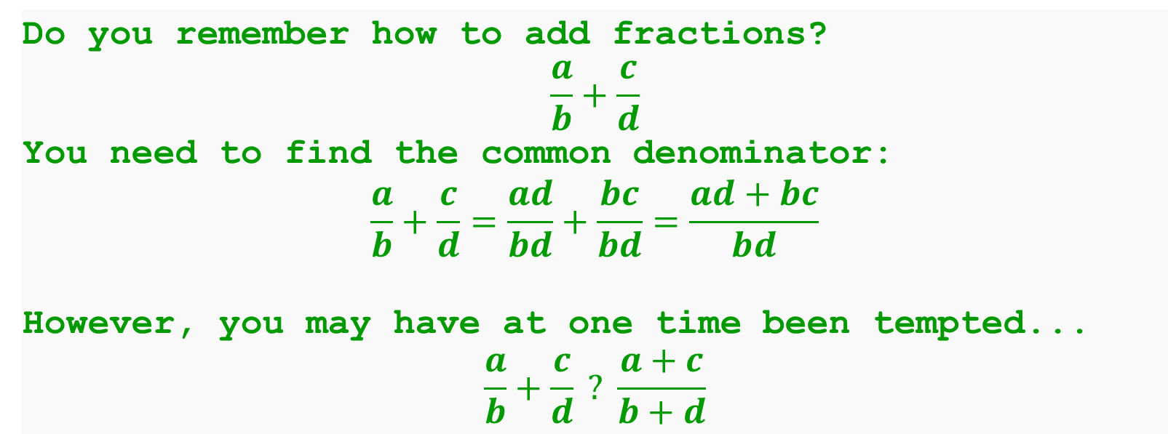
Adding Fractions
Do you remember how to add fractions?
$$\frac{a}{b}+\frac{c}{d}$$
You need to find the common denominator:
$$\frac{a}{b}+\frac{c}{d}=\frac{ad}{bd}+\frac{bc}{bd}=\frac{ad+bc}{bd}$$
However, you may have at one time been tempted...
$$\frac{a}{b}+\frac{c}{d} ? \frac{a+c}{b+d}$$

Slide 3
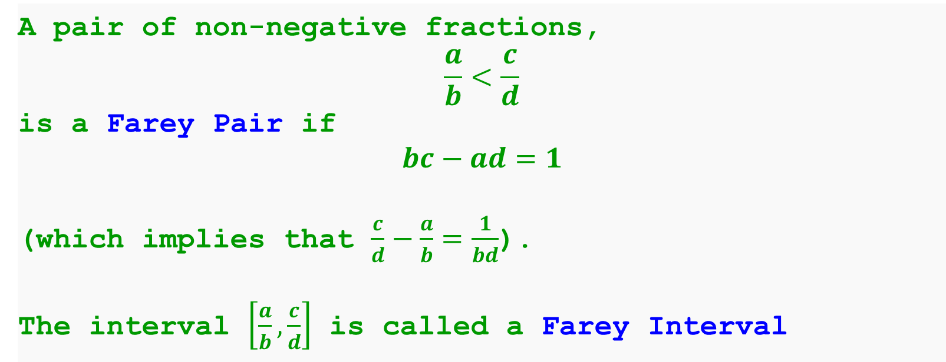
Farey Pairs
A pair of non-negative fractions,
$$\frac{a}{b}<\frac{c}{d}$$
is a Farey Pair if
$$bc−ad=1$$
(which implies that $\frac{c}{d}−\frac{a}{b}=\frac{1}{bd}$).
The interval $\left[\frac{a}{b},\frac{c}{d}\right]$ is called a Farey Interval

Slide 4
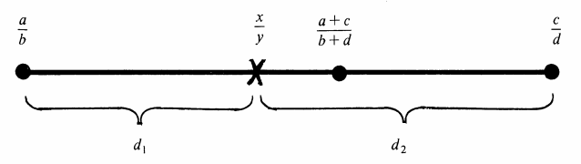
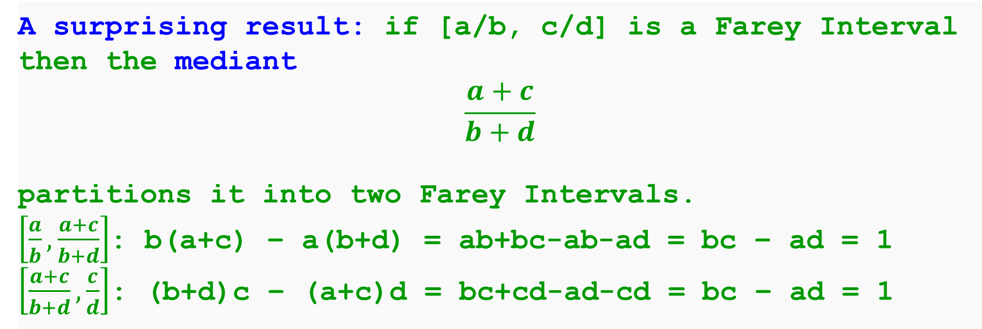
Farey Intervals
A surprising result: if [a/b, c/d] is a Farey Interval
then the mediant
$$\frac{a+c}{b+d}$$
partitions it into two Farey Intervals.
$\left[\frac{a}{b},\frac{a+c}{b+d}\right]$: b(a+c) – a(b+d) = ab+bc-ab-ad = bc – ad = 1
$\left[\frac{a+c}{b+d},\frac{c}{d}\right]$: (b+d)c – (a+c)d = bc+cd-ad-cd = bc – ad = 1
* Image from ‘Continued Fractions Without Tears’ by Ian Richard,
Mathematics Magazine vol. 54, No. 4, September 1981

Slide 5
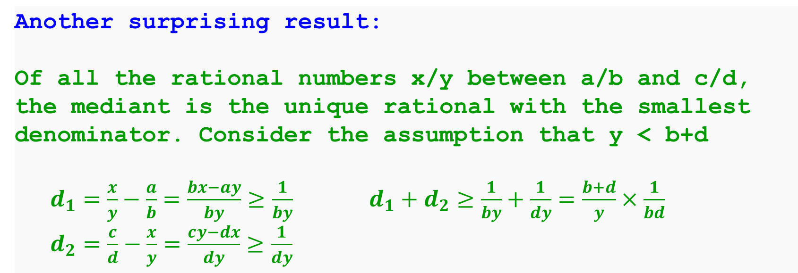
Farey Intervals
Another surprising result:
Of all the rational numbers x/y between a/b and c/d, the mediant is the unique rational with the smallest denominator. Consider the assumption that y < b+d
$d_{1}=\frac{x}{y}−\frac{a}{b}=\frac{bx−ay}{by}≥\frac{1}{by}$ $d_{1}+d_{2}≥\frac{1}{by}+\frac{1}{dy}=\frac{b+d}{y}×\frac{1}{bd}$
$d_{2}=\frac{c}{d}−\frac{x}{y}=\frac{cy−dx}{dy}≥\frac{1}{dy}$
* Image from ‘Continued Fractions Without Tears’ by Ian Richard,
Mathematics Magazine vol. 54, No. 4, September 1981

Slide 6
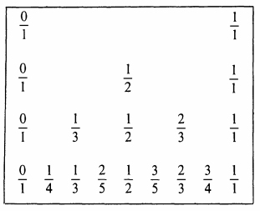
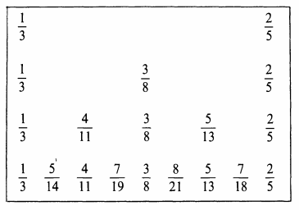
Enumerating Rationals
Every rational number in the Farey Interval [0,1]
appears in this process!

Slide 7


