Slide 1

Understanding Language Jargon
David J Stucki

Slide 2

Jargon?
Can you give me an example?
From Wikipedia:
Erlang is a general-purpose, concurrent, functional programming language, and a garbage-collected runtime system.
The Erlang programming language has immutable data, pattern matching, and functional programming. The sequential subset of the Erlang language supports eager evaluation, single assignment, and dynamic typing.

Slide 3

Oh, Jargon...
Can you give me another?
From Wikipedia:
Julia is a high-level, high-performance, dynamic programming language.
Julia's design include a type system with parametric polymorphism in a dynamic programming language; with multiple dispatch as its core programming paradigm.
Julia supports concurrent, (composable) parallel and distributed computing.

Slide 4
Primary Concerns
What are the big picture categories?
Programming Paradigms
Compiled vs. Interpreted
Static vs. Dynamic Semantics
Type
  Typed vs. Untyped
  Static vs. Dynamic Typing
  Weak vs. Strong Typing

Slide 5
Programming Paradigms
PARADIGM: an exemplar or model of puzzle-solving (Kuhn)
Imperative: specifies an algorithmic process for evolving the state of the program
  Structured (FORTRAN, ALGOL)
  Procedural (Pascal, C)
  Object-Oriented (Java, Smalltalk)
Declarative: specifies the desired result of a program’s computation, with no concept of state
  Functional (LISP, ML)
  Logic (Prolog)
  Data Query (SQL)
Multi-paradigmatic: Many modern languages don’t cleanly fit within a single paradigm, but rather have language that are reflective of many different paradigms.

Slide 6
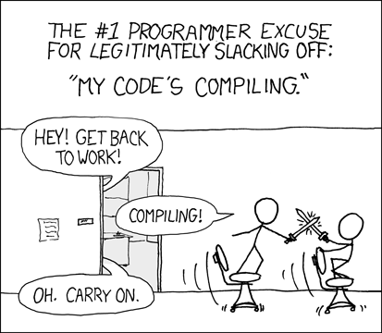
Translation
How do you want to pay for that?
What is a compiler?
  Name languages that are compiled (only)
What is an interpreter?
  Name languages that are interpreted (only)
What other options are there?
  Name languages...

Slide 7
Semantics
What do you mean?
Static semantics: any semantic rules that can be checked at compile time
  declare before use
  non-overlapping cases on switch
  type-safety
Dynamic semantics: aka execution semantics, governs how language constructs map to behavior at runtime
  more on this later...

Slide 8
Type Systems
Mapping representations into domains, or
How much do you trust the programmer (i.e., yourself)?
Defining, checking, and enforcing rules for how values and expressions interact
  Some languages are untyped, allowing ANY operation to be performed on ANY data (assembly, BCPL, Tcl, and Forth are untyped)
  Static typing requires that all expressions have a type that is knowable prior to the beginning of execution (C++, Java, Go). Generally the type-safety checks are performed on the AST before evaluation.
  Dynamic typing determines type-safety at runtime. Types are thus associated with values rather than ASTs. (LISP, Perl, Python, JavaScript)
  Weak typing is permissive in applying operators; strong typing is strict

Slide 9
end.

