Slide 1
Non-Regular Languages
COMP 3200

Slide 2
ALERTS
Programming Assignment #3 available
Optional Exercises Available
Midterm on Monday: Review
Project #2 Draft: NOW!
Project #1 Debrief
Finish non-regular languages introduction

Slide 3
Context Free Grammars
Recall: FSAs are language recognizers
Grammars are language generators
consisting of sets of substitution rules, or productions
For example {S → 0S1, S → ε} is a grammar
S ⇒ 0S1 ⇒
ooS11 ⇒
oooS111 ⇒
000111
S ⇒ ε
S ⇒ 0S1 ⇒ ... ⇒
00000000001111111111
What language does this grammar generate?

Slide 4
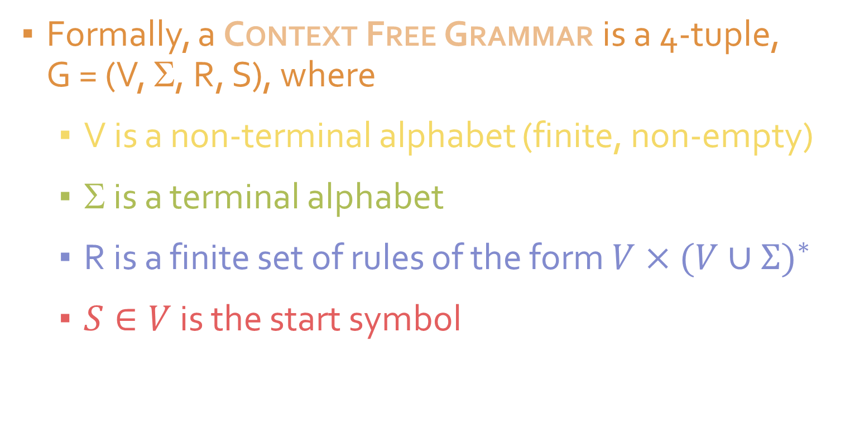
CFG: Formal Definition
Formally, a Context Free Grammar is a 4-tuple,
G = (V, Σ, R, S), where
V is a non-terminal alphabet (finite, non-empty)
Σ is a terminal alphabet
R is a finite set of rules of the form $V×{(V∪Σ)}^{∗}$
$S∈V$ is the start symbol

Slide 5
CFG: Derivation of a string
To derive a string in the language, always begin with the start symbol
Then repeatedly apply substitutions until no non-terminals remain in the string
If the left-most non-terminal is replaced at each step then it is called a left-derivation
If the right-most non-terminal is replaced at each step then it is called a right-derivation

Slide 6
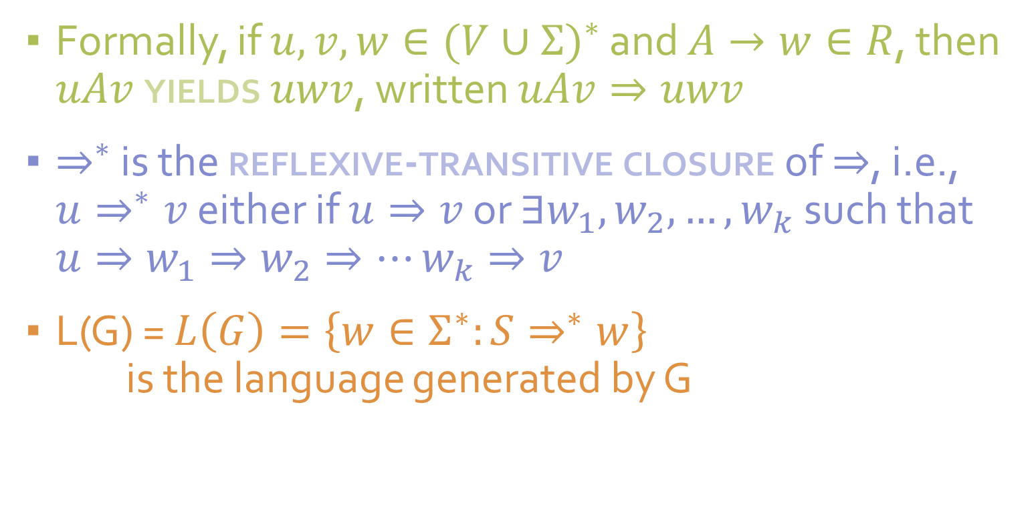
CFG: Reflexive-Transitive Closure
Formally, if $u,v,w∈{(V∪Σ)}^{∗}$ and $A→w∈R$, then $uAv$ yields $uwv$, written $uAv⇒uwv$
$⇒^{∗}$ is the reflexive-transitive closure of $⇒$, i.e., $u⇒^{∗}v$ either if $u⇒v$ or $∃w_{1},w_{2},…,w_{k}$ such that $u⇒w_{1}⇒w_{2}⇒…w_{k}⇒v$
L(G) = $L\left(G\right)=\left\{w∈Σ^{∗}:S⇒^{∗}w\right\}$
is the language generated by G

Slide 7
CFG: Examples
{ w | w is a palindrome}
S → aSa | bSb | ε
S → a | b
{ w | w consists of balanced parentheses}
S → (S) | SS | ε
{ w | w = o^{n}1^{n} or w = 1^{n}0^{n}, where n ≥ 0}
S → Q | R
Q →0Q1 | ε
R →1Ro | ε

