Slide 1
Lexical Analysis
Off-the-shelf tools: Jflex

Slide 2
Review
Lexical specification: regular expressions
Scanner generation using automata theory + extra book-keeping
Compiler
Source
text
txt
Executable
code
exe
Frontend
(analysis)
Semantic
Representation
Backend
(synthesis)

Slide 3

Scanning Scheme programs
tokens
LINE: ID(VALUE)
Scheme program text
(define foo
(lambda (x) (+ x 14)))
1: L_PAREN
1: SYMBOL(define)
1: SYMBOL(foo)
2: L_PAREN
2: SYMBOL(lambda)
2: L_PAREN
2: SYMBOL(x)
2: R_PAREN
2: L_PAREN
2: PLUS
2: SYMBOL(x)
2: INT(14)
...

Slide 4
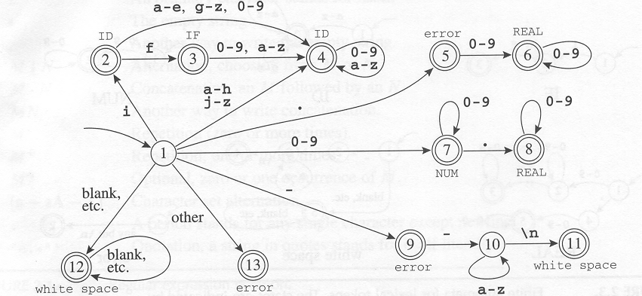
Scanner implementation
What are the outputs on the following inputs:
ifelse
if a
.75
89
89.94

Slide 5
Hand-written lexer...
Token nextToken()
{
  char c = getchar();
  switch (c){
  case `;`: return Token.SEMI;
  case `+`: c = getchar() ;
  switch (c) {
  case `+': return INCREMENT ;
  case '=’ return PLUSEQ;
  default: ungetc(c);
  return PLUS;
  }
  case `<`:
  …
}

Slide 6
Why not?
A lot of work
Boundary (pathological) cases
Error prone
Hard to debug
Exhausting
Boring
Hard to reuse
….

Slide 7
Scanner generator: history
LEX
  Lexical analyzer generator, written by Lesk and Schmidt at Bell Labs in 1975 for the UNIX operating system;
  It now exists for many operating systems;
  LEX produces a scanner which is a C program;
  LEX accepts regular expressions and allows actions (i.e., code to be executed) to be associated with each regular expression.
JLex
  Lex that generates a scanner written in Java;
  Itself is also implemented in Java.
There are many similar tools, for every programming language

Slide 8
Overall picture
String stream
Scanner generator
NFA
Java scanner program
RE
DFA
Minimize DFA
Simulate DFA
Tokens

Slide 9
Lexical analysis with JFlex
JFlex – fast lexical analyzer generator
  Recognizes lexical patterns in text
  Breaks input character stream into tokens
Input: scanner specification file
Output: a lexical analyzer (scanner)
  A Java program
text
Scheme.lex
JFlex
Lexer.java
javac
Lexical
analyzer
tokens

Slide 10
JFlex spec. file
Possible source of javac errors down the road
User code
  Copied directly to Java file
%%
DIGIT= [0-9]
LETTER= [a-zA-Z]
YYINITIAL
JFlex directives
  Define macros, state names
%%
Lexical analysis rules
  Optional state, regular expression, action
  How to break input to tokens
  Action when token matched
{LETTER}
({LETTER}|{DIGIT})*

Slide 11
Section 1: User code
package Scheme.Parser;
import Scheme.Parser.Symbol;
…
any scanner-helper Java code
…

Slide 12
Section 2: JFlex directives
Directives - control JFlex internals
  %line switches line counting on
  %char switches character counting on
  %class class-name changes default name
  %type token-class-name
  %public Makes generated class public (package by default)
  %function read-token-method
  %scanerror exception-type-name
State definitions
  %state state-name
Macro definitions
  macro-name = regex

Slide 13
Regular expressions
r $ | match reg. exp. r at end of a line
. (dot) | any character except the newline
"..." | verbatim string
{name} | macro expansion
* | zero or more repetitions
+ | one or more repetitions
? | zero or one repetitions
(...) | grouping within regular expressions
a|b | match a or b
[...] | class of characters - any one character enclosed in brackets
a–b | range of characters
[^…] | negated class – any one not enclosed in brackets
Notes:
- If the dollar sign ends a regular expression, the expression is matched only at the end of a line.

Slide 14
Example macros
ALPHA=[A-Za-z_]
DIGIT=[0-9]
ALPHA_NUMERIC={ALPHA}|{DIGIT}
IDENT={ALPHA}({ALPHA_NUMERIC})*
NUMBER=({DIGIT})+
NUMBER=[0-9]+

Slide 15
Section 3: Lexical analysis rules
Rule structure
  [states] regexp {action as Java code}
  regexp pattern - how to break input into tokens
  Action invoked when pattern matched
  Priority for rule matching longest string. This can be either good or bad, depending on context.
/**
@Javadoc
*/
Class A{…
/*end*/
Int a = 1000000000000

Slide 16
More than one match for same length – priority for rule appearing first!
  Example: ‘if’ matches identifiers and the reserved word
  Order leads to different automata
Important: rules given in a JFlex specification should match all possible inputs!

Slide 17
Rules Examples
<YYINITIAL> {DIGIT}+ {
return new Token(Token.NUMBER, yytext(), yyline);
}
<YYINITIAL> "-" {
return new Token(Token.MINUS, yytext(), yyline);
}
<YYINITIAL> [a-zA-Z] ([a-zA-Z0-9]) * {
return new Token(Token.ID, yytext(), yyline);
}

Slide 18
Action body
Java code
Can use special methods and vars
  yytext()– the actual token text
  yyline (when enabled)
  …
Scanner state transition
  yybegin(state-name)– tells JFlex to jump to the given state
  YYINITIAL – name given by JFlex to initial state

Slide 19
Rules – State
<YYINITIAL> "//" { yybegin(COMMENTS); }
<COMMENTS> [^\n] { }
<COMMENTS> [\n] { yybegin(YYINITIAL); }
YYINITIAL
COMMENTS
‘//’
^\n
\n

Slide 20
Example
import Token;
%%
%line
%char
%state COMMENTS
ALPHA=[A-Za-z_]
DIGIT=[0-9]
ALPHA_NUMERIC={ALPHA}|{DIGIT}
IDENT={ALPHA}({ALPHA_NUMERIC})*
NUMBER=({DIGIT})+
WHITE_SPACE=([\ \n\r\t\f])+
NEWLINE=\n
%{
private int lineCounter = 0;
%}
%eofval{
System.out.println("line number=" + lineCounter);
return new Symbol(sym.EOF);
%eofval}

Slide 21
%%
<YYINITIAL> {NEWLINE} { lineCounter++; }
<YYINITIAL> {NUMBER} {
return new Token(Token.NUMBER, yytext(), yyline));
}
<YYINITIAL> {WHITE_SPACE} { }
<YYINITIAL> "+" {
return new Token(Token.PLUS, yytext(), yyline);
}
<YYINITIAL> "-" {
return new Token(Token.MINUS, yytext(), yyline);
}
<YYINITIAL> "*" {
return new Token(Token.TIMES, yytext(), yyline);
}
...
<YYINITIAL> "//" { yybegin(COMMENTS); }
<COMMENTS> [^\n] { }
<COMMENTS> [\n] { yybegin(YYINITIAL); }
<YYINITIAL> . { return new Symbol(sym.error, null); }
Notes:
class Token defined elsewhere
Note:
state transitions YYINITIAL<->COMMENT
default rule (with the dot), as the last rule !

Slide 22
Running the scanner
import java.io.*;
import Token;
public class Main {
public static void main(String[] args) {
Token currToken;
try {
FileReader txtFile = new FileReader(args[0]);
Yylex scanner = new Yylex(txtFile);
do {
currToken = scanner.next_token();
// do something with currToken
} while (currToken.sym != Token.EOF);
} catch (Exception e) {
throw new RuntimeException(
"IO Error (brutal exit)” + e.toString());
}
}
}
(Just for testing scanner as stand-alone program)

Slide 23
Additional Example
https://jflex.de/manual.html#Example

