Slide 1
Redo next time with theme from Day10
Work from notes to build missing content

Slide 2
A language that is simple to parse for the compiler is also simple to parse for the human programmer.
N. Wirth

Slide 3
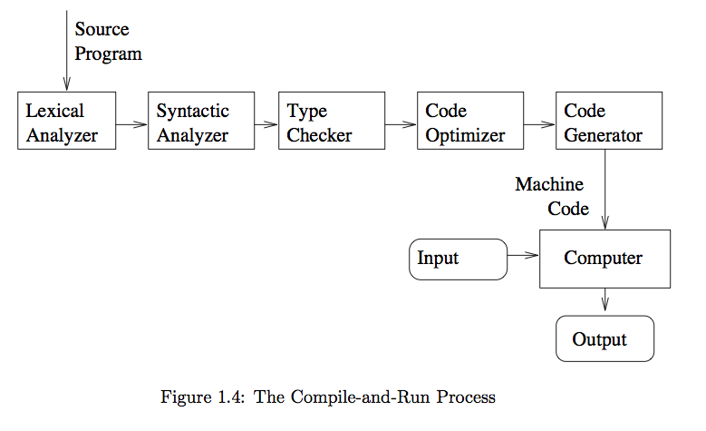
The Compiling Process

Slide 4
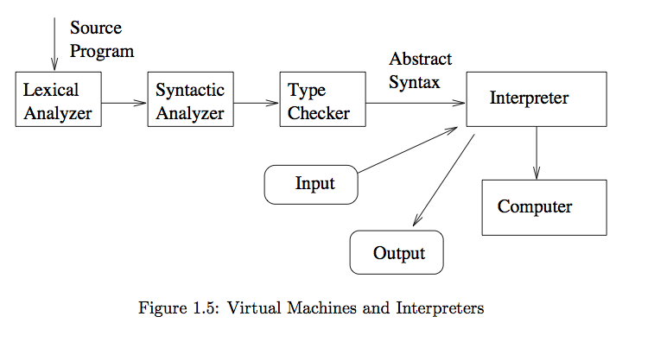
The Interpreting Process

Slide 5
