Slide 1
COMP 3200
Languages & Machines

Slide 2
ALERTS
Programming Assignment #1 (Python exercises) due Friday
Reading Assignment #2 available
Project #1 will be published on Wednesday so that you can see it
The draft for Project #1 will be on Friday
This will be the only time you see the assignment before the draft

Slide 3
Programming Languages
Which ones do you know something about?
How are they similar?
How are they different?

Slide 4
Programming Languages
What do you learn when you learn a foreign language?
Meta-linguistics:
syntax, semantics, pragmatics
Comparative structure of languages
A different way of thinking!!

Slide 5
Virtual Machines
Radical claim: The distinction between hardware and software is completely artificial!
What is hardware?
What is software?

Slide 6
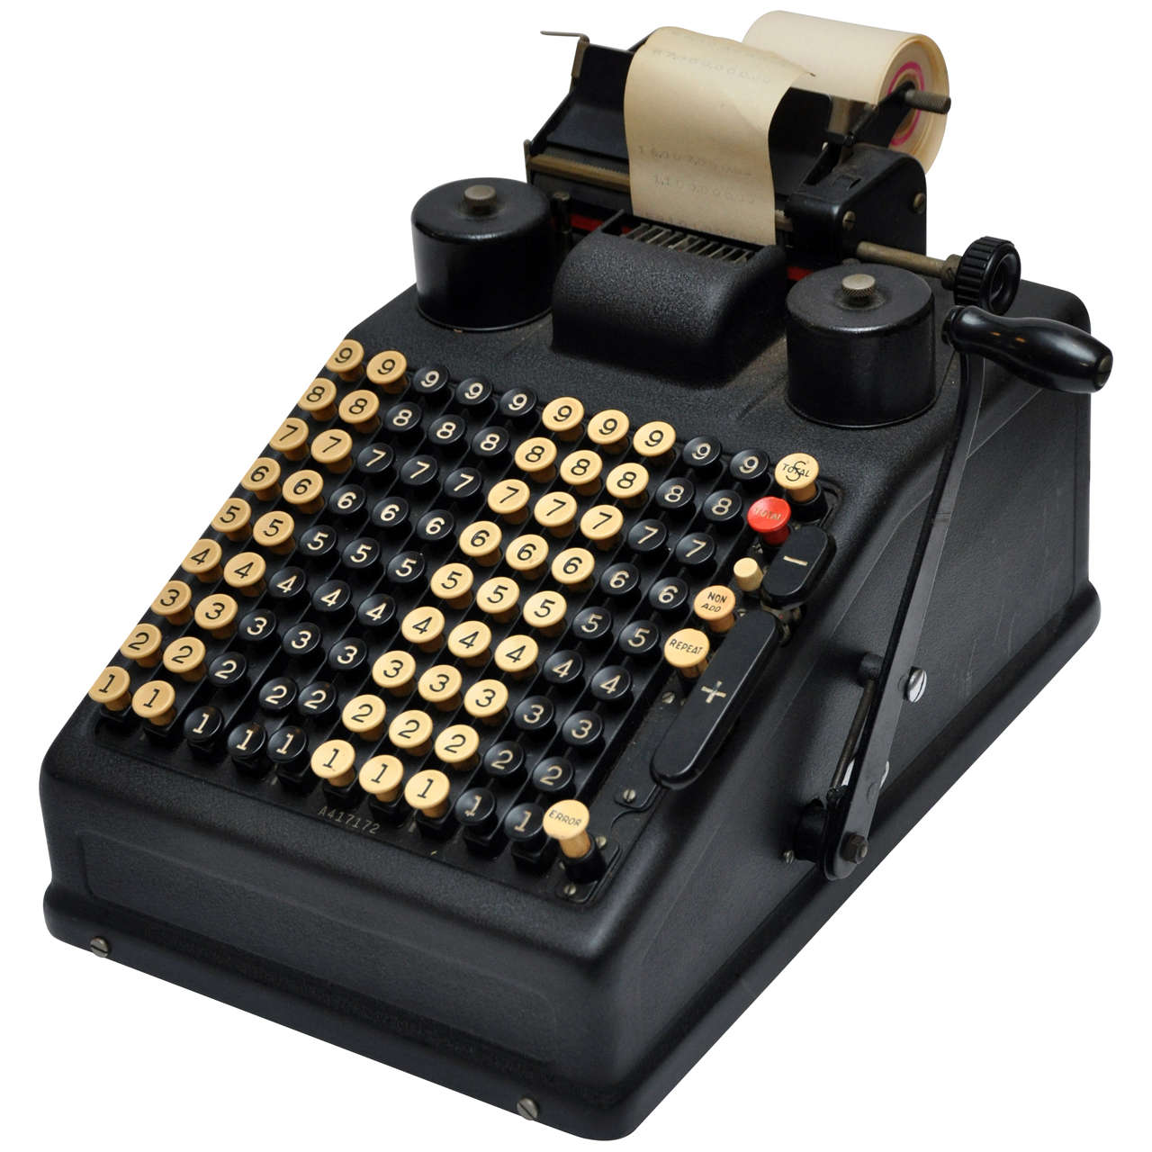
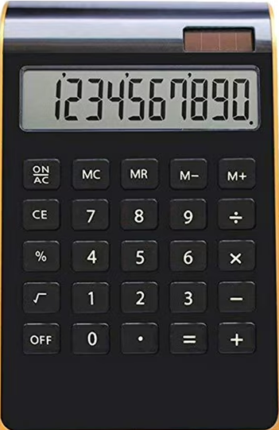
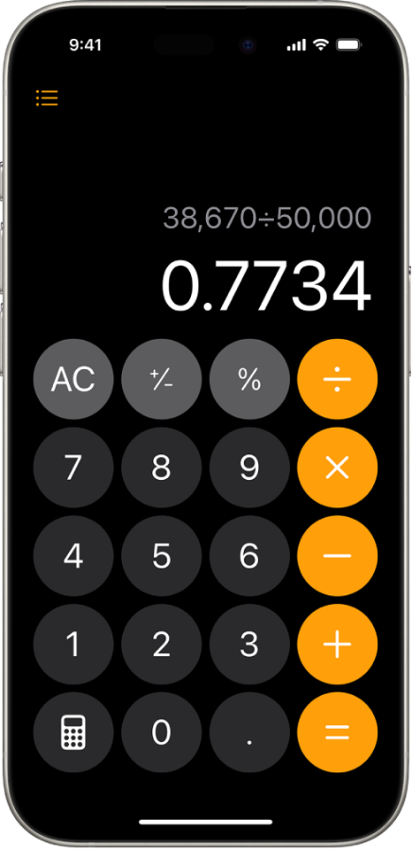
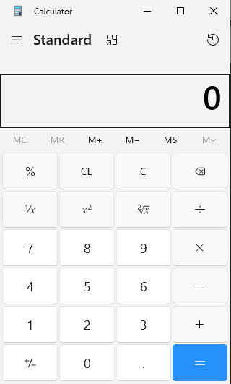
Virtual Machines
What is the difference between the items pictured here?

Slide 7
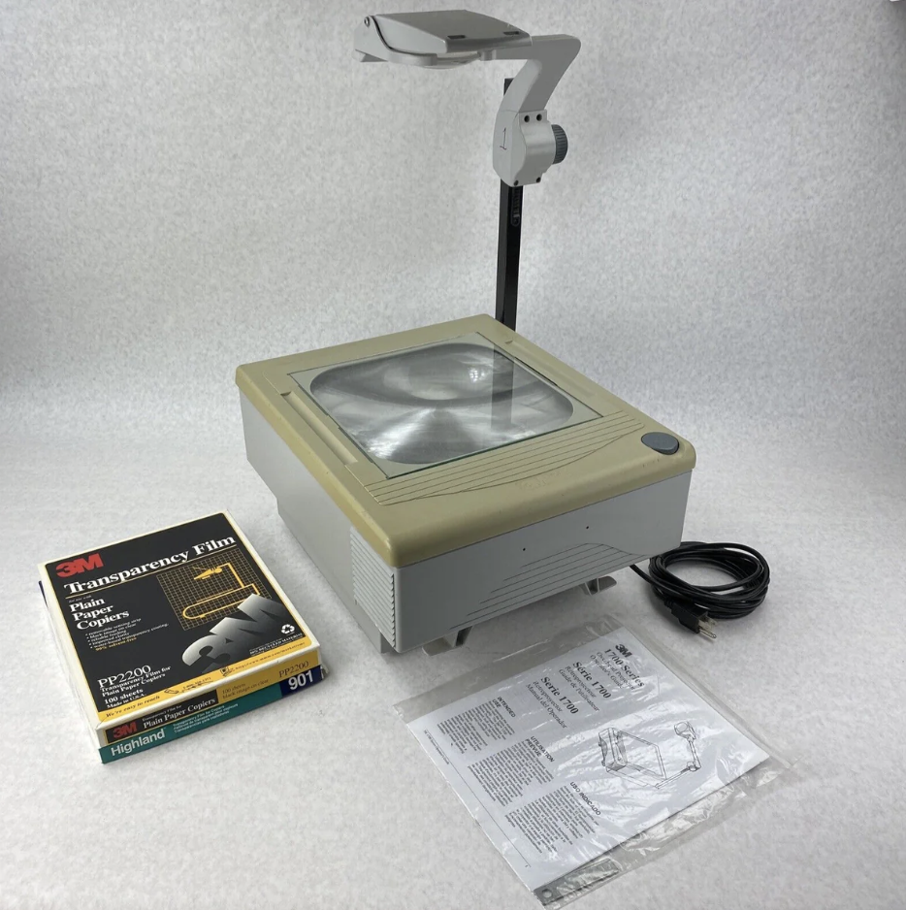
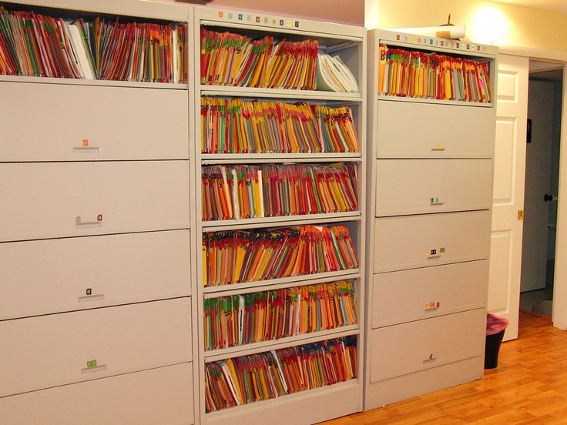
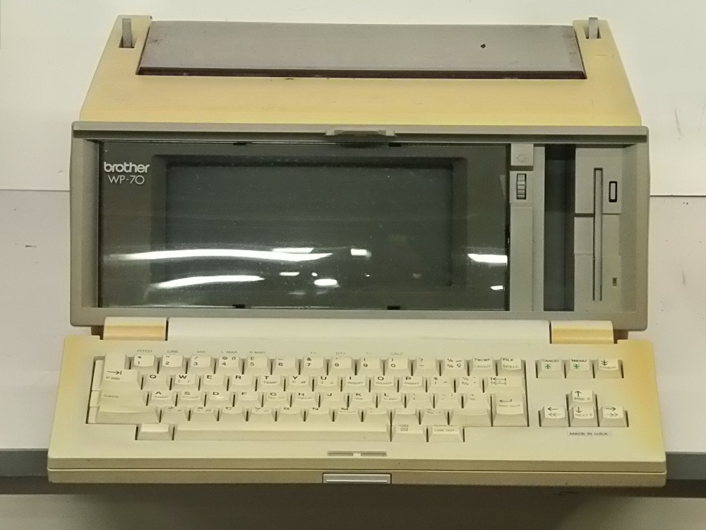
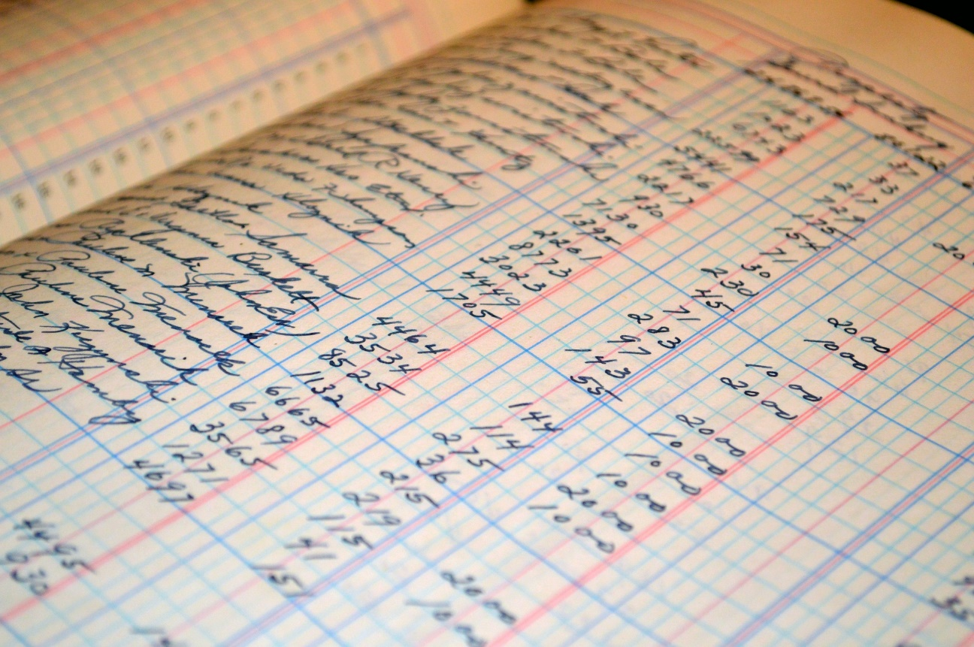
Virtual Machines
In the 1980's word processors were physical devices
Presentations were done via transparencies on overhead projectors
A file system was a cabinet with drawers full of folders and paper
A ledger was kept in a workbook

Slide 8
Virtual Machines
Are you familiar with VMWare, Oracle VirtualBox, or Hyper-V?
What are they?
What about Remote Desktop, LogMeIn, or QuickAssist?
What are they?
How about Docker, Azure, AWS, Kubernetes?
What are they?
Do you know of any other virtualization examples?

Slide 9
Programs as Virtual Machines
A program is a software representation/simulation/instantiation of a (potentially) physical machine
In other words a program is a virtual machine!!
This is possible because of the power of Alan Turing's Universal Turing Machine model of computation and John von Neumann's Stored Program RAM-Machine model of computation

Slide 10
Programs as Virtual Machines
It is also deeply connected to recursion and self-reference (sources of endless challenges) which in turn are connected to Alonzo Church's λ-calculus
In computers with random access memory (RAM) the dual nature of virtual machines as hardware and software is manifested in the arbitrary distinction between program and data

