Slide 1

Denotational Semantics
David J Stucki

Slide 2
Mathematics
meaning : syntax → semantics
The denotational semantics of a language defines the meaning of abstract language elements as a collection of state-transforming functions, M.
Originally developed by Scott & Strachey (1971) and based on recursive function theory.
Specifically, syntactic objects paired with state are mapped into domains of mathematical objects by the function M.

Slide 3
Semantic Domains
What exactly are we talking about?
A semantic domain is a set of values whose properties and operations are independently well-understood and upon which the rules that define the semantics of a language can be based.
Each sub-tree of the parse tree for a program can then be mapped to an object in this semantic domain.
In other words, there is a distinct definition of M for each non-terminal in the abstract grammar; M is the identity function for literals, and M(x) = σ(x) for variable x.

Slide 4
M
A meaning function is a mapping:
M : Program → State
M : Statement × State → State
M : Expression × State → Value

Slide 5
Integers
<int> → <digit> | <int><digit>
M(‘0’) = 0
M(‘1’) = 1 M(<int><digit>) = 10 * M(<int>) + M(<digit>)
M(‘2’) = 2
...
M(‘9’) = 9

Slide 6
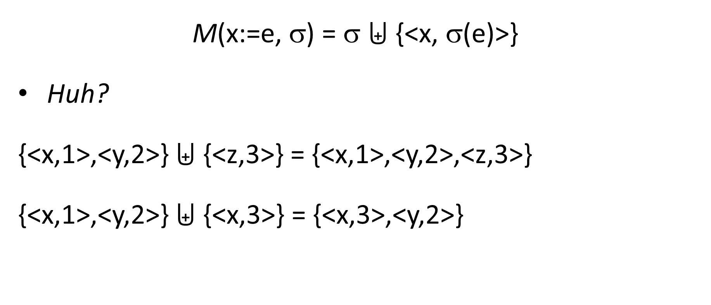
Assignment
States change via Overriding Union operator
M(x:=e, σ) = σ $⨄$ {<x, σ(e)>}
Huh?
{<x,1>,<y,2>} $⨄$ {<z,3>} = {<x,1>,<y,2>,<z,3>}
{<x,1>,<y,2>} $⨄$ {<x,3>} = {<x,3>,<y,2>}

Slide 7
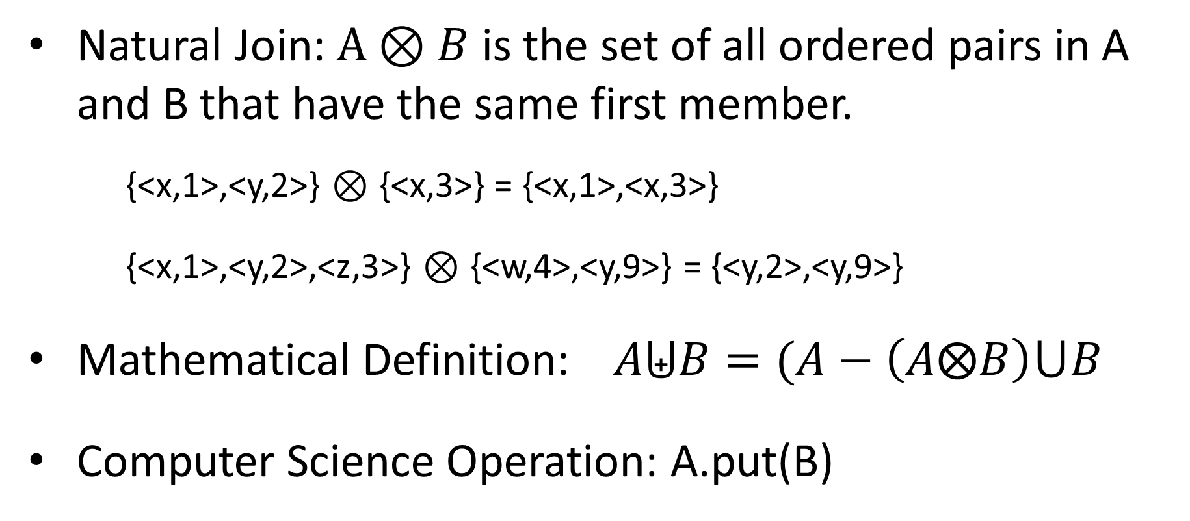
Overriding Union
What do onions have to do with sets?
Natural Join: $A⊗B$ is the set of all ordered pairs in A and B that have the same first member.
{<x,1>,<y,2>} $⊗$ {<x,3>} = {<x,1>,<x,3>}
{<x,1>,<y,2>,<z,3>} $⊗$ {<w,4>,<y,9>} = {<y,2>,<y,9>}
Mathematical Definition: $A⨄B=(A−\left(A⨂B\right)⋃B$
Computer Science Operation: A.put(B)

Slide 8
Conclusions
Denotational Semantics is the coolest
Can be used to prove correctness of programs.
Provides a rigorous way to think about programs.
Can be an aid to language design.
Has been used in compiler generation systems.
Can serve as the basis for an interpreter.

Slide 9
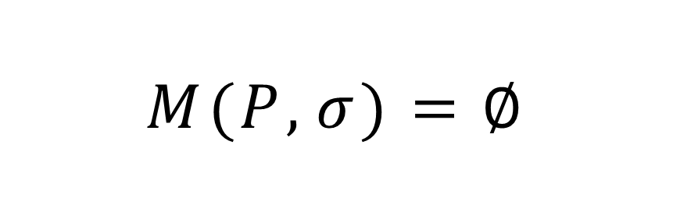
$$M(P,σ)=∅$$

