Slide 1
Parse Trees
COMP 3200
Languages
&
Machines
Fall 2023

Slide 2
ALERT
Reading assignment #10
Programming assignment #4 due Wednesday
Midterm Friday
Project #3 draft next Monday

Slide 3
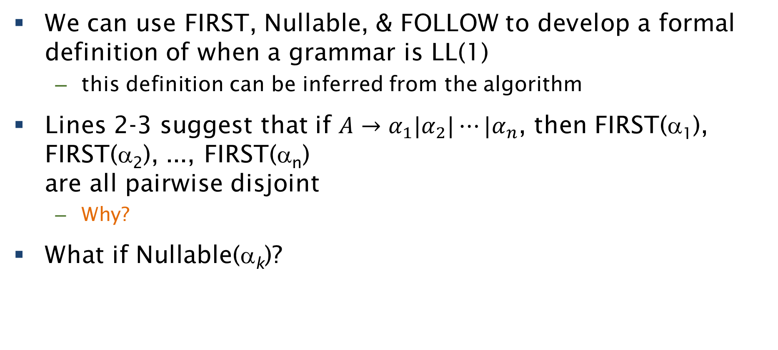
LL(1) Grammars
We can use FIRST, Nullable, & FOLLOW to develop a formal definition of when a grammar is LL(1)
  this definition can be inferred from the algorithm
Lines 2-3 suggest that if $A→α_{1}|α_{2}|⋯|α_{n}$, then FIRST(α₁), FIRST(α₂), ..., FIRST(α_{n})
are all pairwise disjoint
  Why?
What if Nullable(α_{k})?
for each rule A → α
for each a ∈ FIRST(α)
M[A, a].append(A → α)
if Nullable(α)
for each b ∈ FOLLOW(A)
M[A, b].append(A → α)
if $ ∈ FOLLOW(A)
M[A, $].append(A → α)

Slide 4
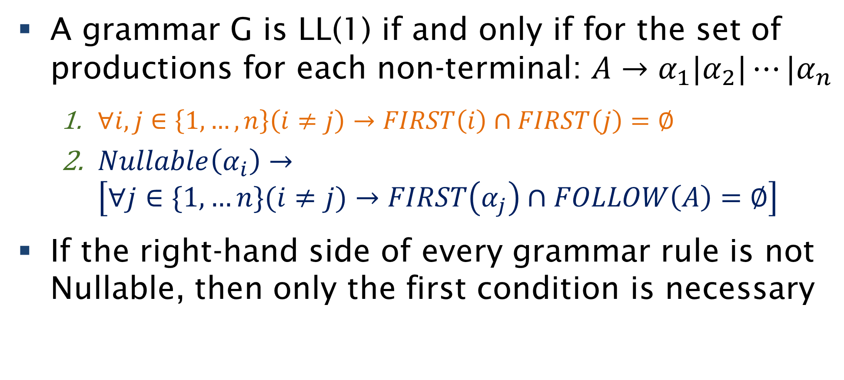
LL(1) Definition
A grammar G is LL(1) if and only if for the set of productions for each non-terminal: $A→α_{1}|α_{2}|⋯|α_{n}$
  $∀i,j∈\left\{1,…,n\right\}\left(i≠j\right)→FIRST\left(i\right)∩FIRST\left(j\right)=∅$
  $Nullable\left(α_{i}\right)→$
  $\left[∀j∈\{1,…n\}(i≠j)→FIRST\left(α_{j}\right)∩FOLLOW\left(A\right)=∅\right]$
If the right-hand side of every grammar rule is not Nullable, then only the first condition is necessary

Slide 5
LL(1) Facts
No left-recursive grammar is LL(1)
No ambiguous grammar is LL(1)
Some languages have no LL(1) grammar
An ε-free grammar where each production for A begins with a unique terminal is a simple LL grammar

Slide 6
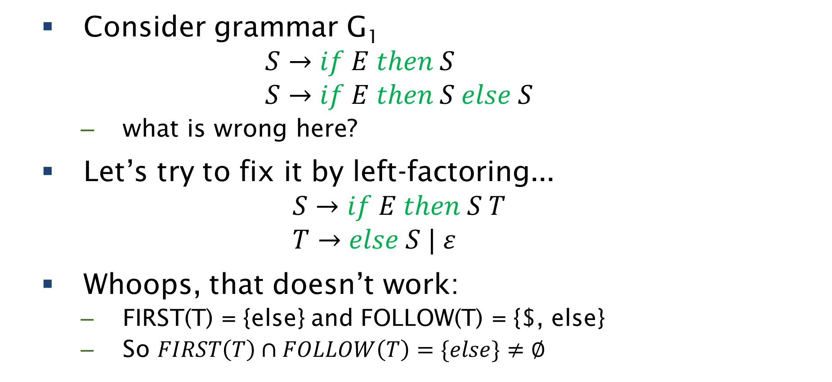
Non-LL(1) Example
Consider grammar G₁
$$S→if E then S \\ S→if E then S else S$$
  what is wrong here?
Let’s try to fix it by left-factoring...
$$S→if E then S T \\ T→else S | ε$$
Whoops, that doesn’t work:
  FIRST(T) = {else} and FOLLOW(T) = {$, else}
  So $FIRST\left(T\right)∩FOLLOW\left(T\right)=\{else\}≠∅$

Slide 7
Ok, let’s build the tree...
We will start with the algorithm from previously, and incrementally make changes so that the parse tree gets built along the way as we validate the syntax of the input.
The strategy is to have each node placed on the stack immediately below the non-terminal to which it corresponds.

Slide 8
Non-recursive predictive parsing
top ← 0
Stack[top] ← EOF
Stack[++top] ← S
token ← nextToken()
repeat
  X ← Stack[top]
  if X is a terminal or EOF then
    if X = token then
      pop X
      token ← nextToken()
    else error()
  else // X is a non-terminal
    if M[X,token] = X → Y₁Y₂Y_{k} then
      pop X
      push Y_{k},Y_{k-1},,Y₁ // Y₁ on top
      output: X → Y₁Y₂Y_{k}
    else error()
until X = EOF
Input:
a tokenized string w
a parsing table M for G
Aho, Sethi, & Ullman
Compilers, aka ‘The Dragon Book’
p. 187

Slide 9
Non-recursive predictive parsing
top ← 0
Stack[top] ← EOF
Stack[++top] ← S
token ← nextToken()
repeat
  X ← Stack[top]
  if X is a terminal or EOF then
    if X = token then
      pop X
      token ← nextToken()
    else error()
  else // X is a non-terminal
    if M[X,token] = X → Y₁Y₂Y_{k} then
      pop X
      push Y_{k},Y_{k-1},,Y₁ // Y₁ on top
      output: X → Y₁Y₂Y_{k}
    else error()
until X = EOF
Input:
a tokenized string w
a parsing table M for G
Aho, Sethi, & Ullman
Compilers, aka ‘The Dragon Book’
p. 187

Slide 10
Non-recursive predictive parsing
top ← 0
Stack[top] ← EOF
Stack[++top] ← root
Stack[++top] ← S
token ← nextToken()
repeat
  X ← Stack[top]
  if X is a terminal or EOF then
    if X = token then
      pop X
      token ← nextToken()
    else error()
  else // X is a non-terminal
    if M[X,token] = X → Y₁Y₂Y_{k} then
      pop X
      push Y_{k},Y_{k-1},,Y₁ // Y₁ on top
      output: X → Y₁Y₂Y_{k}
    else error()
until X = EOF
Input:
a tokenized string w
a parsing table M for G
Aho, Sethi, & Ullman
Compilers, aka ‘The Dragon Book’
p. 187

Slide 11
Non-recursive predictive parsing
top ← 0
Stack[top] ← EOF
Stack[++top] ← root
Stack[++top] ← S
token ← nextToken()
repeat
  X ← Stack[top]
  if X is a terminal or EOF then
    if X = token then
      pop X
      token ← nextToken()
    else error()
  else // X is a non-terminal
    if M[X,token] = X → Y₁Y₂Y_{k} then
      pop X
      push Y_{k},Y_{k-1},,Y₁ // Y₁ on top
      output: X → Y₁Y₂Y_{k}
    else error()
until X = EOF
Input:
a tokenized string w
a parsing table M for G
Aho, Sethi, & Ullman
Compilers, aka ‘The Dragon Book’
p. 187

Slide 12
Non-recursive predictive parsing
top ← 0
Stack[top] ← EOF
Stack[++top] ← root
Stack[++top] ← S
token ← nextToken()
repeat
  X ← Stack[top]
  if X is a terminal or EOF then
    if X = token then
      pop X
      token ← nextToken()
      pop node and update its state
    else error()
  else // X is a non-terminal
    if M[X,token] = X → Y₁Y₂Y_{k} then
      pop X
      push Y_{k},Y_{k-1},,Y₁ // Y₁ on top
      output: X → Y₁Y₂Y_{k}
    else error()
until X = EOF
Input:
a tokenized string w
a parsing table M for G
Aho, Sethi, & Ullman
Compilers, aka ‘The Dragon Book’
p. 187

Slide 13
Non-recursive predictive parsing
top ← 0
Stack[top] ← EOF
Stack[++top] ← root
Stack[++top] ← S
token ← nextToken()
repeat
  X ← Stack[top]
  if X is a terminal or EOF then
    if X = token then
      pop X
      token ← nextToken()
      pop node and update its state
    else error()
  else // X is a non-terminal
    if M[X,token] = X → Y₁Y₂Y_{k} then
      pop X
      push Y_{k},Y_{k-1},,Y₁ // Y₁ on top
    else error()
until X = EOF
Input:
a tokenized string w
a parsing table M for G
Aho, Sethi, & Ullman
Compilers, aka ‘The Dragon Book’
p. 187

Slide 14
Non-recursive predictive parsing
top ← 0
Stack[top] ← EOF
Stack[++top] ← root
Stack[++top] ← S
token ← nextToken()
repeat
  X ← Stack[top]
  if X is a terminal or EOF then
    if X = token then
      pop X
      token ← nextToken()
      pop node and update its state
    else error()
  else // X is a non-terminal
    if M[X,token] = X → Y₁Y₂Y_{k} then
      pop X
      push Y_{k},Y_{k-1},,Y₁ // Y₁ on top
    else error()
until X = EOF
Input:
a tokenized string w
a parsing table M for G
Aho, Sethi, & Ullman
Compilers, aka ‘The Dragon Book’
p. 187

Slide 15
Non-recursive predictive parsing
top ← 0
Stack[top] ← EOF
Stack[++top] ← root
Stack[++top] ← S
token ← nextToken()
repeat
  X ← Stack[top]
  if X is a terminal or EOF then
    if X = token then
      pop X
      token ← nextToken()
      pop node and update its state
    else error()
  else // X is a non-terminal
    if M[X,token] = X → Y₁Y₂Y_{k} then
      pop X
      pop node for X
      push Y_{k},Y_{k-1},,Y₁ // Y₁ on top
    else error()
until X = EOF
Input:
a tokenized string w
a parsing table M for G
Aho, Sethi, & Ullman
Compilers, aka ‘The Dragon Book’
p. 187

Slide 16
Non-recursive predictive parsing
top ← 0
Stack[top] ← EOF
Stack[++top] ← root
Stack[++top] ← S
token ← nextToken()
repeat
  X ← Stack[top]
  if X is a terminal or EOF then
    if X = token then
      pop X
      token ← nextToken()
      pop node and update its state
    else error()
  else // X is a non-terminal
    if M[X,token] = X → Y₁Y₂Y_{k} then
      pop X
      pop node for X
      for each child from the rhs
      instantiate node as child of X
      push Y_{k},Y_{k-1},,Y₁ // Y₁ on top
    else error()
until X = EOF
Input:
a tokenized string w
a parsing table M for G
Aho, Sethi, & Ullman
Compilers, aka ‘The Dragon Book’
p. 187

Slide 17
Non-recursive predictive parsing
top ← 0
Stack[top] ← EOF
Stack[++top] ← root
Stack[++top] ← S
token ← nextToken()
repeat
  X ← Stack[top]
  if X is a terminal or EOF then
    if X = token then
      pop X
      token ← nextToken()
      pop node and update its state
    else error()
  else // X is a non-terminal
    if M[X,token] = X → Y₁Y₂Y_{k} then
      pop X
      pop node for X
      for each symbol Y_{i} from the rhs
      instantiate node as child of X
      push n_{k},Y_{k},n_{k-1},Y_{k-1},,n₁,Y₁
    else error()
until X = EOF
Input:
a tokenized string w
a parsing table M for G
Aho, Sethi, & Ullman
Compilers, aka ‘The Dragon Book’
p. 187

