Slide 1
Predictive Parsing
COMP 3200
Languages
&
Machines
Fall 2023

Slide 2
ALERT
Project #2 Due Today
Reading assignment #9
Programming Assignment 4 due next Wednesday

Slide 3
A Parsing Taxonomy
Parser
Top-Down Parser
Bottom-Up Parser
Recursive Descent Parser
Predictive Parser
LL(1) Parser
Backtracking?
LR Parser
Shift-Reduce
Operator-Precedence
SLR Parser
LALR Parser
LR(k) Parser

Slide 4
Top-Down Parsing
What is the downside to our RDP approach?
  Coding the grammars by hand is tedious...
  Observation: our recursive descent parser encodes state information in its run-time stack
Using recursive procedure calls to implement a stack abstraction may not be particularly efficient
Other options?
  Explicit stack, hand-coded parser
  Stack-based, table-driven parser

Slide 5
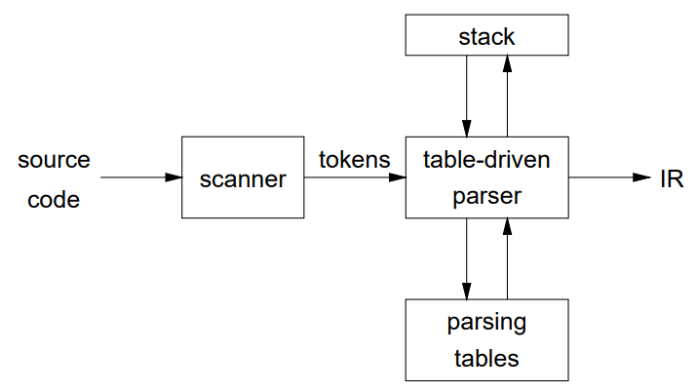
Table-Based Parsing
Rather than writing code, we build tables:
IR = Internal Representation
Building tables can be automated!

Slide 6
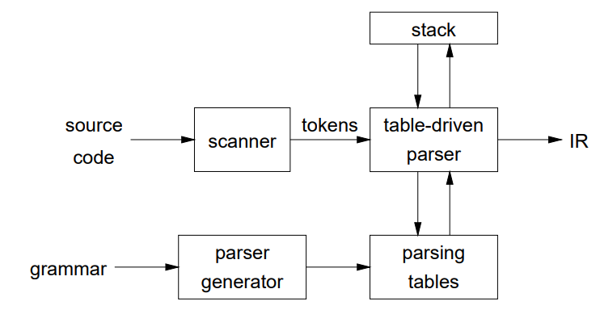
Table-Based Parsing
This scheme actually applies
equally to both top-down (LL)
and bottom-up (LR) parsers

Slide 7
Non-recursive predictive parsing
What we need now is
a parsing table M
Grammar:
  Start ::= Expr
  Expr ::= Term MoreTerms
  MoreTerms ::= + Expr
  MoreTerms ::= − Expr
  MoreTerms ::= ε
  Term ::= Factor MoreFacts
  MoreFacts ::= * Term
  MoreFacts ::= / Term
  MoreFacts ::= ε
  Factor ::= num
  Factor ::= id
 | id | num | + | − | * | / | EOF
Start | 1 | 1
Expr | 2 | 2
MoreTerms |  |  | 3 | 4 |  |  | 5
Term | 6 | 6
MoreFacts |  |  | 9 | 9 | 7 | 8 | 9
Factor | 11 | 10

Slide 8
Non-recursive predictive parsing
top ← 0
Stack[top] ← EOF
Stack[++top] ← S
token ← nextToken()
repeat
  X ← Stack[top]
  if X is a terminal or EOF then
    if X = token then
      pop X
      token ← nextToken()
    else error()
  else // X is a non-terminal
    if M[X,token] = X → Y₁Y₂Y_{k} then
      pop X
      push Y_{k},Y_{k-1},,Y₁ // Y₁ on top
      output: X → Y₁Y₂Y_{k}
    else error()
until X = EOF
Input:
a tokenized string w
a parsing table M for G
Output:
if w is in L(G),
a leftmost derivation of w
else an error
Aho, Sethi, & Ullman
Compilers, aka ‘The Dragon Book’
p. 187

Slide 9
Example: id+id*id
Stack | Input | Output
$Start | id + id * id$
$Expr | id + id * id$ | Start ::= Expr
$MoreTerms Term | id + id * id$ | Expr ::= Term MoreTerms
$MoreTerms MoreFacts Factor | id + id * id$ | Term ::= Factor MoreFacts
$MoreTerms MoreFacts id | id + id * id$ | Factor ::= id
$MoreTerms MoreFacts | + id * id$
$MoreTerms | + id * id$ | MoreFacts ::= ε
$Expr + | + id * id$ | MoreTerms ::= + Expr
$Expr | id * id$
$MoreTerms Term | id * id$ | Expr ::= Term MoreTerms
$MoreTerms MoreFacts Factor | id * id$ | Term ::= Factor MoreFacts
$MoreTerms MoreFacts id | id * id$ | Factor ::= id

Slide 10
Non-recursive predictive parsing
What we need now is
a parsing table M
Grammar:
  Start ::= Expr
  Expr ::= Term MoreTerms
  MoreTerms ::= + Expr
  MoreTerms ::= − Expr
  MoreTerms ::= ε
  Term ::= Factor MoreFacts
  MoreFacts ::= * Term
  MoreFacts ::= / Term
  MoreFacts ::= ε
  Factor ::= num
  Factor ::= id
 | id | num | + | − | * | / | EOF
Start | 1 | 1
Expr | 2 | 2
MoreTerms |  |  | 3 | 4 |  |  | 5
Term | 6 | 6
MoreFacts |  |  | 9 | 9 | 7 | 8 | 9
Factor | 11 | 10

Slide 11
Example: id+id*id
Stack | Input | Output
$MoreTerms MoreFacts | * id$
$MoreTerms Term * | * id$ | MoreFacts ::= * Term
$MoreTerms Term | id$
$MoreTerms MoreFacts Factor | id$ | Term ::= Factor MoreFacts
$MoreTerms MoreFacts id | id$ | Factor ::= id
$MoreTerms MoreFacts | $
$MoreTerms | $ | MoreFacts ::= ε
$ | $ | MoreTerms ::= ε

