Slide 1
What is gcd()?
exploring Rosetta Code

Slide 2
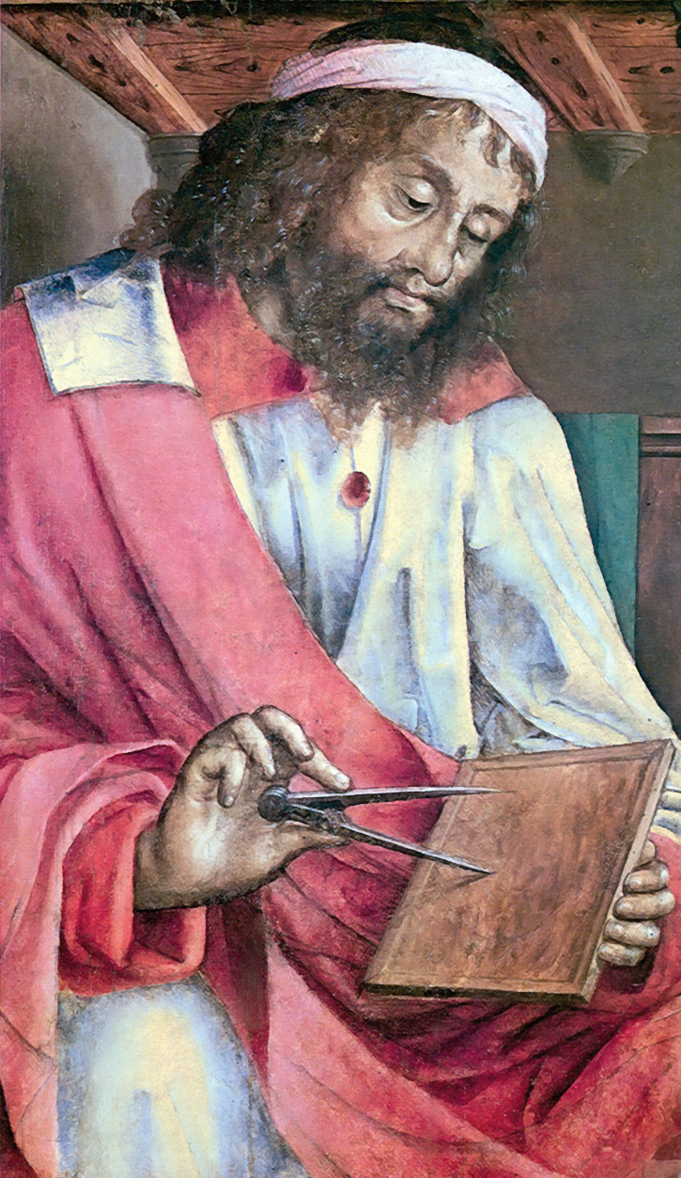
One Algorithm—Many Languages
Appeared in Euclid's Elements in 300 B.C.
Oldest known algorithm
Several variations exist
  Euclid's algorithm was based on subtraction
  The Euclidean Algorithm is based on modular division
  It can be thought of iteratively
  Or recursively
The following implementations are all of the
Euclidean Algorithm

Slide 3
Java
public static int gcd(int a, int b) {
//valid for positive integers.
while(b > 0){
int c = a % b;
a = b;
b = c;
}
return a;
}

Slide 4
Python
def gcd(u, v):
while v:
u, v = v, u % v
return abs(u)

Slide 5
Scheme
(define (gcd a b)
(if (= b 0)
a
(gcd b (modulo a b))))

Slide 6
Pascal
function gcd(u, v: longint): longint;
var t: longint;
begin
while v <> 0 do
begin
t := u;
u := v;
v := t mod v;
end;
gcd := abs(u);
end;

Slide 7
K
gcd:{:[~x;y;_f[y;x!y]]}

Slide 8
MIPS Assembly
gcd:
# a0 and a1 are the two integer parameters
# return value is in v0
move $t0, $a0
move $t1, $a1
loop:
beq $t1, $0, done
div $t0, $t1
move $t0, $t1
mfhi $t1
j loop
done:
move $v0, $t0
jr $ra

Slide 9
Lesson?
The syntax is essential (why?)
But ultimately expendable (why?)
Unlike lexical analysis in which every aspect of the regex survives into the lexer, in parsing we bifurcate into two grammars...
  A concrete grammar, and
  An abstract grammar
Let's look at an example...

Slide 10
Clite Concrete Grammar: Statements
Program → int main ( ) { Declarations Statements }
Declarations → { Declaration }
Declaration → Type Identifier [ [ Integer ] ] { , Identifier [ [ Integer ] ] }
Type → int | bool | float | char
Statements → { Statement }
Statement → ; | Block | Assignment | IfStatement | WhileStatement
Block → { Statements }
Assignment → Identifier [ [ Expression ] ] = Expression ;
IfStatement → if ( Expression ) Statement [ else Statement ]
WhileStatement → while ( Expression ) Statement

Slide 11
Clite Concrete Grammar: Expressions
Expression → Conjunction { || Conjunction }
Conjunction → Equality { && Equality }
Equality → Relation [ EquOp Relation ]
EquOp → == | !=
Relation → Addition [ RelOp Addition ]
RelOp → < | <= | > | >=
Addition → Term { AddOp Term }
AddOp → + | -
Term → Factor { MulOp Factor }
MulOp → * | / | %
Factor → [ UnaryOp ] Primary
UnaryOp → - | !
Primary → Identifier [ [ Expression ] ] | Literal | ( Expression ) | Type ( Expression )

Slide 12
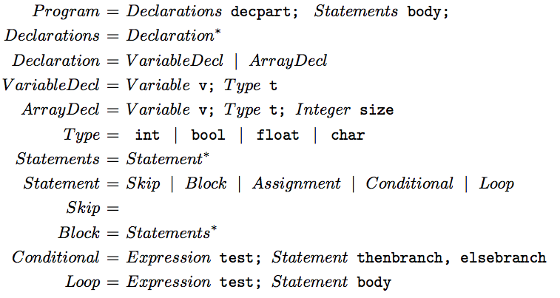
Abstract Syntax of Clite (Declarations and Statements)

Slide 13
Abstract Syntax of Clite Assignments
Assignment = Variable target; Expression source
Expression = VariableRef | Value | Binary | Unary
VariableRef = Variable | ArrayRef
Variable = String id
ArrayRef = String id; Expression index
Value = IntValue | BoolValue | FloatValue | CharValue
Binary = Operator op; Expression term1, term2
Unary = UnaryOp op; Expression term
Operator = ArithmeticOp | RelationalOp | BooleanOp
IntValue = Integer intValue
…

Slide 14
Parsing
Transform a program from a linear sequence (stream) of tokens into a non-linear tree of computational objects
Steps
  Validate syntax: use the concrete grammar to do this
  Build parse tree: use the abstract grammar for this
Principles
  Each syntactic category in the concrete grammar will be represented by a method that performs step one
  Each syntactic category in the abstract grammar will be represented by a class, whose instances are nodes in the parse tree
Recursive Descent Parsing

