Slide 1
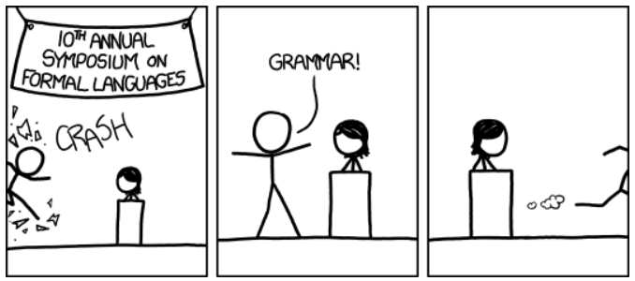
BNF & EBNF
https://xkcd.com/1090/

Slide 2
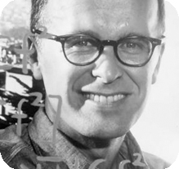
History
John Backus (IBM) directed the team that invented FORTRAN (FORmula TRANslator), 1954-58
He also invented a notation now called BNF
  He used it to describe ALGOL 58’s syntax
  By the 1970s had become the standard method
  for specifying programming language syntax
  Won the Turing Award for this in 1977

Slide 3
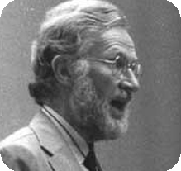
History
Peter Naur named and popularized BNF
  He used it to describe ALGOL 60's syntax (1960)
  He made some small notational changes from Backus
  Proposed that it be called Backus-Normal-Form
  In 1964 Knuth, in a letter to the CACM, suggested that BNF should stand for Backus-Naur Form
  Naur never was happy with this association
  He however won the Turing Award in 2005 for
  his work on Algol 60 and his use of BNF in the
  language report

Slide 4
BNF
<number> ::= <digit> | <number> <digit>
<digit> ::= 0 | 1 | 2 | 3 | 4 | 5 | 6 | 7 | 8 | 9
Anything delimited by <> is a nonterminal
All other non-meta symbols are terminals
Meta symbols include
  ::= which denotes ‘is defined as’
  | which denotes ‘or’
Notice that the production rules use structural recursion in order to perform iteration

Slide 6
BNF Examples
<while loop> ::= while ( <condition> ) <statement>
<assignment statement> ::= <variable> = <expression>
<statement list> ::= <statement> |
<statement list> <statement>
<unsigned integer> ::= <digit> | <unsigned integer><digit>
<expression> ::= <expression> + <term> |
<expression> - <term> | <term>
<term> ::= <term> * <factor> | <term> / <factor> | <factor>
<factor> ::= <primary> ^ <factor> | <primary>
<primary> ::= <primary> | <element>
<element> ::= ( <expression> ) | <variable> | <number>

Slide 7
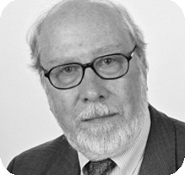
History
Niklaus Wirth used an Extended form of BNF to describe the syntax of his Pascal programming language (1976)
His suggested modifications included the addition of meta-symbols for representing optional and iterative elements in a grammar rule
He won the Turing Award in 1984 for
developing the sequence of languages
including Euler, Algol W, Pascal, Modula,
Modula-2, and Oberon

Slide 8
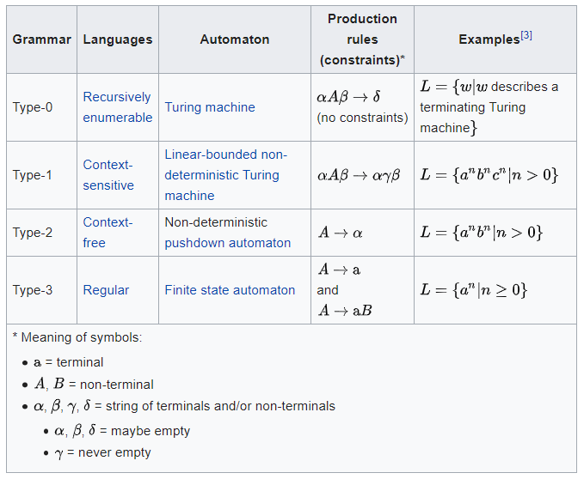
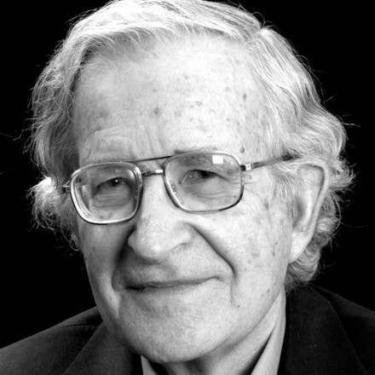
History
Noam Chomsky
(MIT linguist, philosopher, & activist)
  Invented a Hierarchy of Notations for Natural Languages
  4 levels: 0-3 with 0 being the most powerful
  BNF & EBNF are formalisms for languages at level 2
https://en.wikipedia.org/wiki/Chomsky_hierarchy

Slide 9
EBNF
The addition of several notations borrowed from regular expressions to make BNF rules more expressive, including:
  Kleene Star: * or {} 0 or more occurrences
  Kleene Cross: + 1 or more occurrences
  Optional: ? or [] 0 or 1 occurrences
  Parenthesis can be used for grouping

Slide 10
BNF vs. EBNF
BNF
  <expr> ::= -<num> | <num>
  <num> ::= <digits> | <digits>.<digits>
  <digits> ::= <digit> | <digit><digits>
  <digit> ::= 0 | 1 | 2 | 3 | 4 | 5 | 6 | 7 | 8 | 9
EBNF
  <expr> ::= -?<digit>+(.<digit>+)?
  <digit> ::= 0 | 1 | 2 | 3 | 4 | 5 | 6 | 7 | 8 | 9

Slide 11
Conversions BNF → EBNF
  <expr> ::= <digits>
  <digits> ::= <digit> | <digit> <digits>
can be replaced by
  <expr> ::= <digit>+
  <expr> ::= <digits> | ε
can be replaced by
  <expr> ::= <digit>*
  <id> ::= <letter> | <id><letter> | <id><digit>
can be replaced by
  <id> ::= <letter> (<letter> | <digit>)*

Slide 12
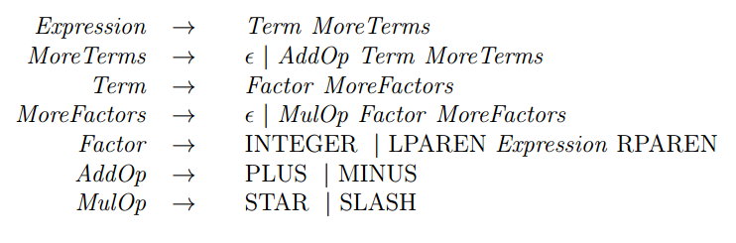
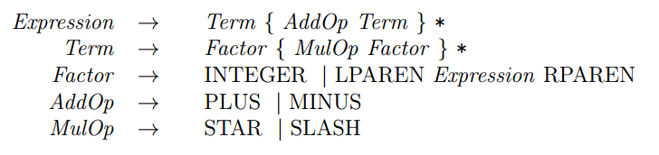
Examples

