Slide 1
PDAs & Parsing
COMP 3200

Slide 2
ALERTS
Programming Assignment #3 due Wednesday
Project 2 questions?
Homework #3, due Monday 10/23

Slide 3
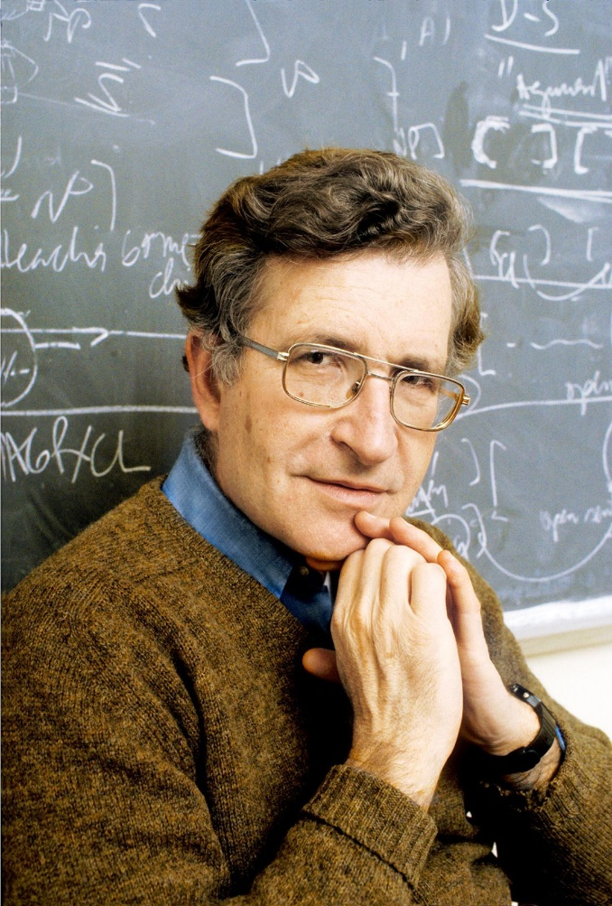
Noam Chomsky
Linguist: single-handedly reinvented the
entire field of linguistics in the 1950s
Prior to the 1950s the academic discipline
of linguistics was basically what we would
today call philology (J.R.R. Tolkein, anyone?)
After establishing himself as the leader of this new field he became a political activist...

Slide 4
Chomsky Hierarchy
Level | 3 | 2 | 1 | 0
Languages | Regular | Context Free | Context Sensitive | Recursively Enumerable
Machine | Finite State Automata | Push-down Automata | Linearly-bounded Turing Machine | Turing Machine
Grammar | A → bC A → ε | A → w | uAv → uwv | u → v
A is a non-terminal symbol
b is a terminal symbol
ε is the empty string
u, v, & w are arbitrary strings of terminal and non-terminal symbols

Slide 5
Push-down Automata
Similar to FSAs, but the transitions are labeled by three things rather than just one
The PDA, in addition to its states, has an external stack memory
The two additional labels represent the top of the stack before and after the transition
ε/ε/ε
0/ε/0
1/0/ε

Slide 6
Push-down Automata
ε/ε/ε
PDAs are non-deterministic
0/ε/0
1/0/ε
The first label is the normal character to be consumed from the input.
The remaining two labels are stack operations
ε/a represents push(a)
a/ε represents pop(a)

Slide 7
More PDAs
b/ε/b
b/b/ε
Palindromes, Σ = {a,b}
a/ε/ε
ε/ε/ε
b/ε/ε
a/ε/a
a/a/ε

Slide 8
More PDAs
Palindromes, Σ = {a,b}
o^{n}1^{2n}
ε/ε/ε
1/0/ε
0/ε/0
1/ε/ε

Slide 9
More PDAs
Palindromes, Σ = {a,b}
o^{n}1^{2n}
a(a+b)*a + b(a+b)*b
ε/ε/ε
1/0/ε
0/ε/0
1/ε/ε
a/ε/a
a/a/ε
b/ε/b
b/b/ε
a/ε/ε
b/ε/ε

Slide 10
Parse Trees:
2D visualization of derivations
S ⇒ 0S1 ⇒ 00S11 ⇒ 000S111 ⇒ 000111
vs
S
0
1
S
0
1
S
0
1
S
ε

Slide 11
Parse Trees: Ambiguity
E → E + E | E * E | N
N → 0 | 1 | 2 | 3 | 4 | 5 | 6 | 7 | 8 | 9
What about 6 + 7 * 8?
E
E
E
E
E
+
E
N
E
*
E
E
*
E
N
+
6
N
N
N
N
8
7
8
6
7

Slide 12
Parse Trees
Some Context Free Languages are inherently ambiguous!
But we would like, as a goal, to avoid ambiguity as much as possible. So ambiguous languages are somewhat taboo in practice.
Many languages for which an ambiguous grammar exists also have a non-ambiguous grammar!

Slide 13
Chomsky Normal Form (CNF)
All CFGs have an equivalent CFG in Chomsky Normal Form (CNF)
All productions in CNF must be of the form A → BC or A → d, where S never appears on the RHS of any production. S → ε is also allowed.
There is a simple algorithm for converting any CFG into its equivalent CNF CFG.

Slide 14
Chomsky Normal Form (CNF)
Add a new start symbol
Eliminate A → ε rules
Eliminate A → B rules
Convert the rest...
Let's look at an example
S → XSX | R
R → aTb | bTa
T → XTX | X | ε
X → a | b

