Slide 1
Grammars
COMP 3200

Slide 2
ALERTS
Programming Assignment #3 due next Wednesday
  Let's look at the Pascal example...
Midterm
Project #1 Debrief, part 2

Slide 3
Grammar Strategies
Questions?
Strategies for constructing grammars
CFLs are closed under union
      What is the negation of o⁺1⁺?
      o* + 1* +(0+1)*10(0+1)* WHY?
S → A | B | C
A → D1oD
D → oD | 1D | ε
B → oB | ε
C → 1C | ε

Slide 4
Grammar Strategies
The class of regular languages is a subset of the class of context free languages (REG ⊆ CFL)
For each transition δ(q, a) = p, add a rule Q → aP
Link the start symbol to the start state: S = s
For each final state r ∈ F, add a rule R → ε
S → 1S | 0A | ε
A → 1A | oS
S → 1S | 0A0S | ε
A →1A | ε
S
0
A
0
1
1

Slide 5
Grammar Strategies
If you are working with a language in which strings have linkages between parts on the left and parts on the right (e.g., B, palindromes, parenthesis, etc.) then you need a rule of the form
  R → uRv
  where u and v are strings made up of terminal and non-terminal characters.

Slide 6
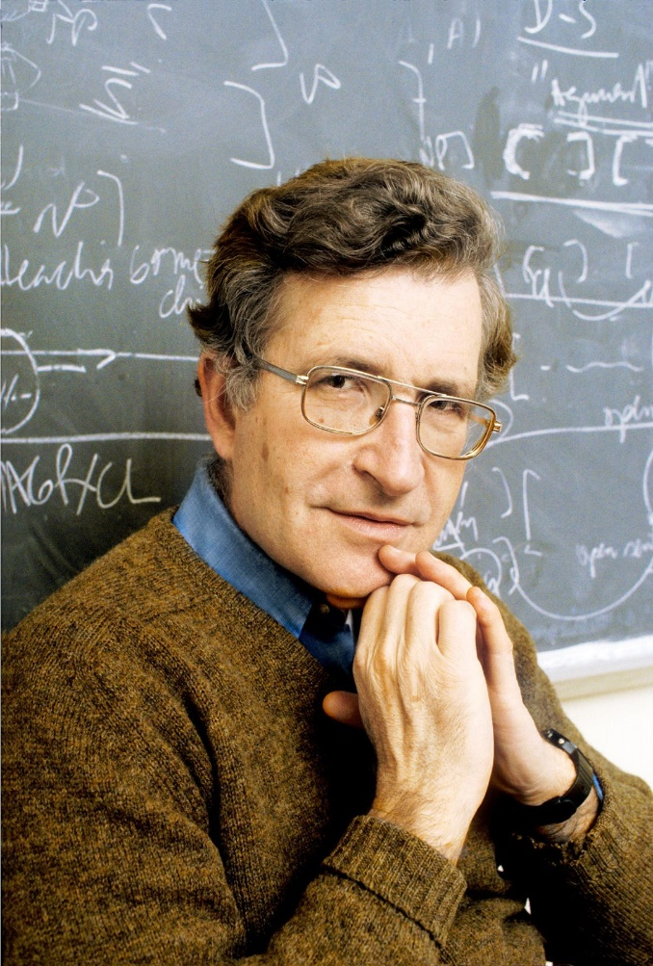
Noam Chomsky
Linguist: single-handedly reinvented the
entire field of linguistics in the 1950s
Prior to the 1950s the academic discipline
of linguistics was basically what we would
today call philology (J.R.R. Tolkein, anyone?)
After establishing himself as the leader of this new field he became a political activist...

Slide 7
Chomsky Hierarchy
Level | 3 | 2 | 1 | 0
Languages | Regular | Context Free | Context Sensitive | Recursively Enumerable
Machine | Finite State Automata | Push-down Automata | Linearly-bounded Turing Machine | Turing Machine
Grammar | A → bC A → ε | A → w | uAv → uwv | u → v
A is a non-terminal symbol
b is a terminal symbol
ε is the empty string
u, v, & w are arbitrary strings of terminal and non-terminal symbols

Slide 8
Push-down Automata
Similar to FSAs, but the transitions are labeled by three things rather than just one
The PDA, in addition to its states, has an external stack memory
The two additional labels represent the top of the stact before and after the transition
ε/ε/ε
0/ε/0
1/0/ε

Slide 9
Push-down Automata
ε/ε/ε
PDAs are non-deterministic
0/ε/0
1/0/ε
The first label is the normal character to be consumed from the input.
The remaining two labels are stack operations
ε/a represents push(a)
a/ε represents pop(a)

