Slide 1
Lexical Analysis
COMP 3200

Slide 2
ALERTS
Programming Assignment #2 due Wednesday, 9/29
  NFA Emulator
Project #1 questions?

Slide 3
Building a Lexer: Where to go from here?
We need a collection of algorithms:
  Regular expression to NFA generator
  NFA to DFA converter
  DFA Minimization
  DFA Emulator (DFA data structures and algorithm)
  THEN: off-the-shelf tools...

Slide 4
DFA Minimization
In order to minimize a DFA, the following should be considered:
  Unreachable states can be pruned immediately
  If all paths from states A & B have the same accept/reject results, then A & B are redundant and can be merged.
  In other words, if processing a string starting in state A leads to an accepting state if and only if processing the same string starting in state B leads to an accepting state, then A & B are redundant
In order to compute redundant states we will form partition groups of states that are known to be different
  Initially, the only two partitions are the set of accepting states and the set of rejecting states.
  We will iterate the algorithm on the next slide until the partition sets are stable
  Partitions sets are of size one are always stable

Slide 5
DFA Minimization
Partition Q into accepting and rejecting groups
Generate transition tables for groups larger than one
Form new groups from consistent rows
Q1 = {E}
Q2 = {A, B, C, D, F}
b
a
A
B
C
a
Q2 | a | b
A | Q2 | Q2
B | Q2 | Q1
C | Q2 | Q2
D | Q2 | Q1
F | Q2 | Q2
a
b
a
b
b
D
b
E
b
E
F
a
a

Slide 6
DFA Minimization
Partition Q into accepting and rejecting groups
Generate transition tables for groups larger than one
Form new groups from consistent rows
Q1 = {E}
Q2 = {A, B, C, D, F}
b
a
A
B
B
C
a
Q2 | a | b
A | Q2 | Q2
B | Q2 | Q1
C | Q2 | Q2
D | Q2 | Q1
F | Q2 | Q2
a
b
a
b
b
D
b
E
b
D
F
a
a
Q3 = {A, C, F}
Q4 = {B, D}

Slide 7
DFA Minimization
Partition Q into accepting and rejecting groups
Generate transition tables for groups larger than one
Form new groups from consistent rows
Q1 = {E}
Q3 = {A, C, F}
Q4 = {B, D}
b
a
A
B
C
a
Q3 | a | b
A | Q4 | Q4
C | Q3 | Q3
F | Q3 | Q3
a
b
a
b
b
D
b
E
b
F
Q4 | a | b
B | Q3 | Q1
D | Q3 | Q1
a
a

Slide 8
DFA Minimization
Partition Q into accepting and rejecting groups
Generate transition tables for groups larger than one
Form new groups from consistent rows
Q1 = {E}
Q3 = {A, C, F}
Q4 = {B, D}
b
a
A
B
B
C
a
Q3 | a | b
A | Q4 | Q4
C | Q3 | Q3
F | Q3 | Q3
a
b
a
b
b
D
b
E
b
D
F
Q4 | a | b
B | Q3 | Q1
D | Q3 | Q1
a
a
Q5 = {A} Q6 = {C, F}

Slide 9
DFA Minimization
Partition Q into accepting and rejecting groups
Generate transition tables for groups larger than one
Form new groups from consistent rows
Q1 = {E} Q5 = {A}
Q4 = {B, D} Q6 = {C, F}
b
a
A
B
B
C
a
Q4 | a | b
B | Q6 | Q1
D | Q6 | Q1
a
b
a
b
b
D
b
E
b
D
F
Q6 | a | b
C | Q6 | Q6
F | Q6 | Q6
a
a

Slide 10
DFA Minimization
Partition Q into accepting and rejecting groups
Generate transition tables for groups larger than one
Form new groups from consistent rows
a, b
Q1 = {E} Q5 = {A}
Q4 = {B, D} Q6 = {C, F}
a, b
a
Q5
Q4
Q6
a
Q4 | a | b
B | Q6 | Q1
D | Q6 | Q1
b
b
Q1
Q6 | a | b
C | Q6 | Q6
F | Q6 | Q6

Slide 11
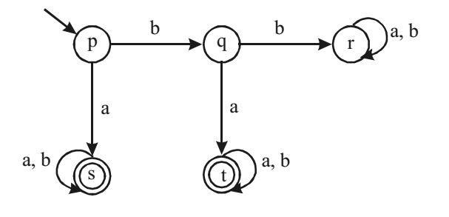
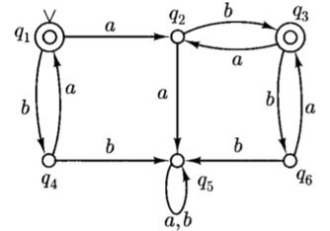
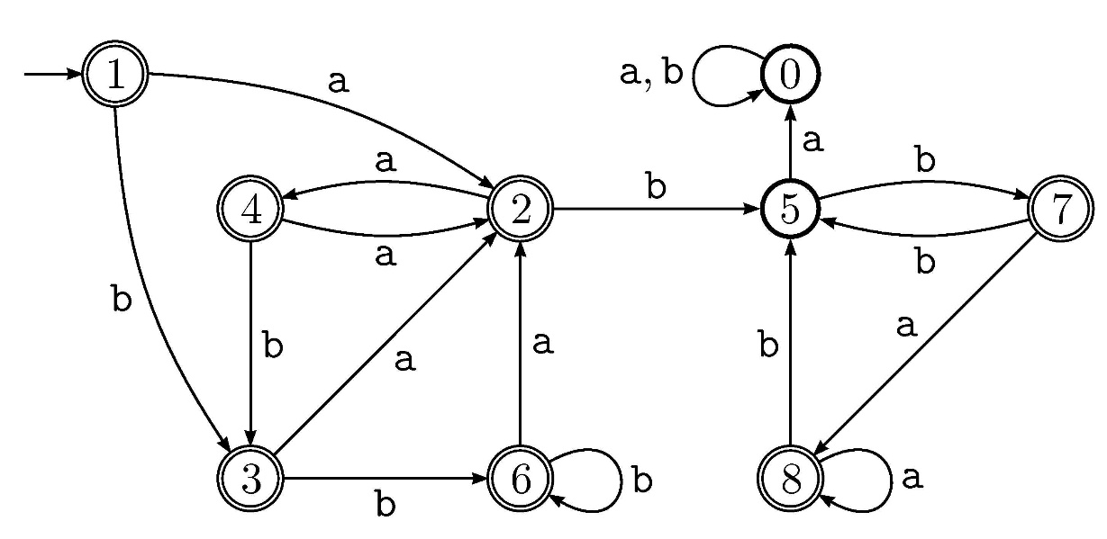
DFA Minimization: More Examples

Slide 12
Building a Lexer: Where to go from here?
We need a collection of algorithms:
  Regular expression to NFA generator
  NFA to DFA converter
  DFA Minimization
  DFA Emulator (DFA data structures and algorithm)
  Next Time: off-the-shelf tools...

