Slide 1
Lexical Analysis
COMP 3200

Slide 2
ALERTS
Homework #2 due today
Project #1 questions?

Slide 3
Building a Lexer: Where to go from here?
We need a collection of algorithms:
  Regular expression to NFA generator
  NFA to DFA converter
  DFA Minimization
  DFA Emulator (DFA data structures and algorithm)
  THEN: off-the-shelf tools...

Slide 4
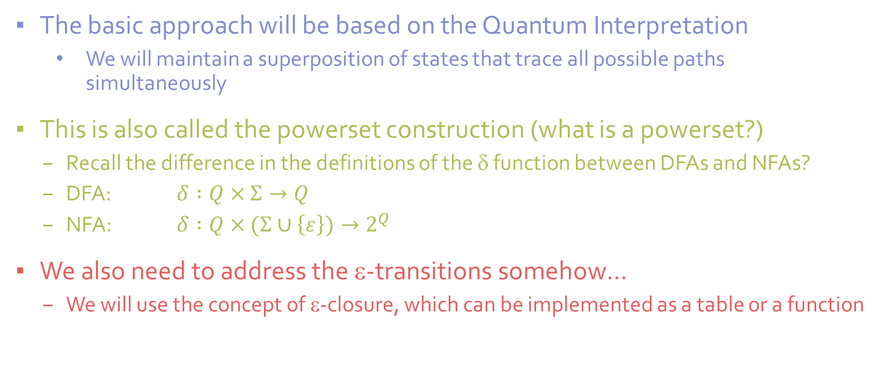
NFA-2-DFA
The basic approach will be based on the Quantum Interpretation
  We will maintain a superposition of states that trace all possible paths simultaneously
This is also called the powerset construction (what is a powerset?)
  Recall the difference in the definitions of the δ function between DFAs and NFAs?
  DFA: $δ :Q×Σ→Q$
  NFA: $δ :Q×(Σ∪\left\{ε\right\})→2^{Q}$
We also need to address the ε-transitions somehow...
  We will use the concept of ε-closure, which can be implemented as a table or a function

Slide 5
NFA-2-DFA
The ε-closure of a state is
all the states you can get
to from that state on
ε-transitions (for free)
[there is an implicit ε from each state to itself]
ε
A
B
b
ε-closure
ε(A) = {A, B, C}
ε(B) = {B, C}
ε(C) = {C}
ε(D) = {D}
ε(E) = {D, E}
a
b
ε
a
E
ε
a
C
D
b
a

Slide 6
NFA-2-DFA
ε-closure
ε(A) = {A, B, C}
ε(B) = {B, C}
ε(C) = {C}
ε(D) = {D}
ε(E) = {D, E}
Algorithm
Compute ε-closures
Begin new DFA with a start state labeled with the ε-closure of the NFA start state
For each missing transition, compute the transition, adding a new state if necessary
Stop when there are no more missing transitions
{A,B,C}
a
{C}
a
∅
a, b
b
b
{B,C,
D,E}
b
{B,C,D}
A
ε
B
b
a,b
a
a
b
ε
a
E
Questions/Observations??
ε
a
C
D
b
a

Slide 7
NFA-2-DFA
The states of the DFA will be accepting if ANY of the states it is labeled with are accepting in the NFA
The state labeled by the empty set is always a trap reject state
To compute a transition on symbol α
  For each state in the label
    Look up where the NFA goes from that state on α, call it β
    For each state in β
      compute the ε-closure
  Perform the union of all the ε-closures computed in the inner loop
How many states will the DFA have if the NFA has n states?

Slide 8
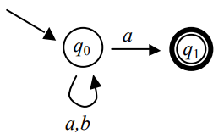
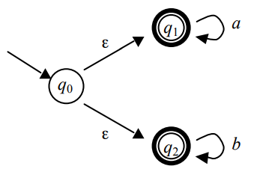
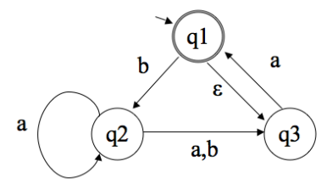
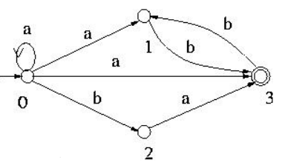
NFA-2-DFA More Examples

Slide 9
Building a Lexer: Where to go from here?
We need a collection of algorithms:
  Regular expression to NFA generator
  NFA to DFA converter
  DFA Minimization
  DFA Emulator (DFA data structures and algorithm)
  THEN: off-the-shelf tools...

Slide 10
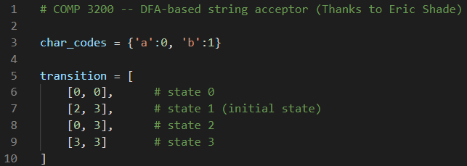
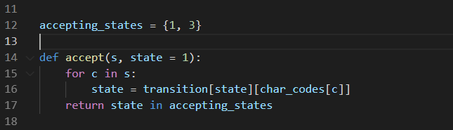
DFA Emulator in Python

