Slide 1
Lexical Analysis
COMP 3200

Slide 2
ALERTS
Homework #2 due Friday
Reading Assignment #4 available
  In particular, Chapter 2 of the 'Basics of Compiler Design' by Mogensen
Project #1 due Friday, Sept 24

Slide 3

Building a Lexer: There are options...
Write a program by hand:
  $This is difficult (and even harder to maintain)$
  See JavaScript example...
Build a DFA for each token type:
  $Run them sequentially on input to find a match$
  SLOW
Build a single DFA that checks all token types at once:
  Sounds hard, but with the right tools its the best option

Slide 4
Building a Lexer: DFA
Write regex's for each token type
Construct an NFA for each regex
Mark accepting states with names of tokens that they acept
Combine NFAs into a single machine using ε-transitions from a new start state

Slide 5
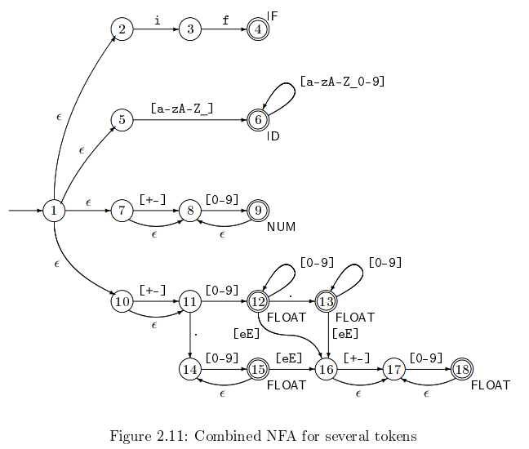
Building a Lexer:
NFA intermediate step

Slide 6
Building a Lexer: DFA
Write regex's for each token type
Construct an NFA for each regex
Mark accepting states with names of tokens that they acept
Combine NFAs into a single machine using ε-transitions from a new start state
Convert this NFA into an equivalent DFA
Minimize the DFA
Ensure that accepting states are still marked with names of accepted tokens

Slide 7
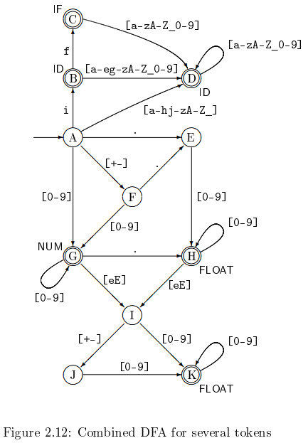
Building a Lexer:
DFA Final Step

Slide 8
Building a Lexer: DFA
What if there are overlapping cases?
  Priority is specified in top-down fashion in the order in which the regexs are defined.
  Longest matching prefix is what is selected

Slide 9
Building a Lexer: Where to go from here?
We need a collection of algorithms:
  Regular expression to NFA generator
  NFA to DFA converter
  DFA Minimization
  DFA Emulator (DFA data structures and algorithm)
  THEN: off-the-shelf tools...

Slide 10
Regex-2-NFA
Recall that there are 6 parts to the regex definition (3 base & 3 recursive)
∅
ε
a ∈ Σ
a + b
ab
a*
a
ε
ε
b
ε
a
ε
b
a
ε
a
ε

Slide 11
Regex-2-NFA
Recall that there are 6 parts to the regex definition (3 base & 3 recursive)
a + b: build an NFA for each part, then add a new start state
with an ε-transition to each of their start states
ab: build an NFA for each part, then add an ε-transition
from all the accepting states of the first to the start
state of the second; the accept states of the first
become non-accepting
a*: build an NFA for the part, then add ε-transitions
from all its accepting states back to its start state;
then add a new accepting start state with an
ε-transition to the old start state

Slide 12
Regex-2-NFA
Examples
(a+b)*
ab*
(a+b)*aba(a+b)*
(bab)*a
aba + bb
∅*
ab + ε
(a + ε)(bb)*

