Slide 1
A language that is simple to parse for the compiler is also simple to parse for the human programmer.
N. Wirth

Slide 2
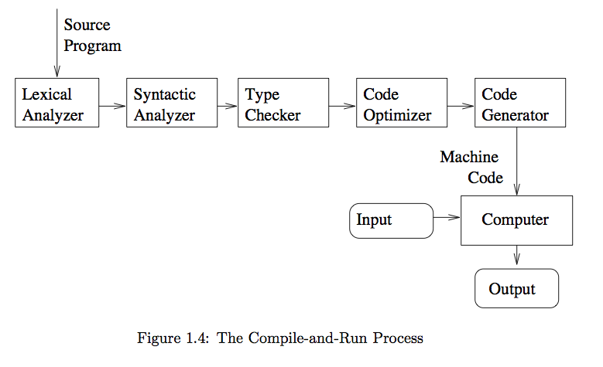
The Compiling Process

Slide 3
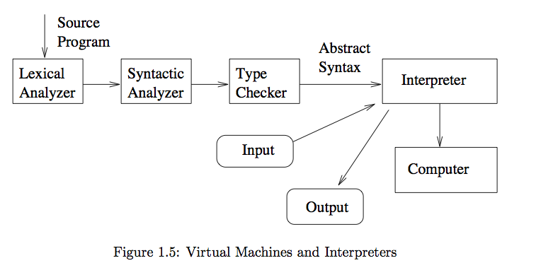
The Interpreting Process

