Slide 1
Regular Expressions
COMP 3200

Slide 2
ALERTS
Project #1 Reveal !! (draft on Friday)
  Due 9/22 (you have three weeks)
Python assignment due Friday
Don't forget to read...

Slide 3
Formal Regular Expressions
A mathematical formalism for languages
The definition is an example of structural recursion
  There are 3 base case parts of the definition
  There are 3 recursive case parts of the definition

Slide 4

def RegEx
Base Cases
  ∅ is a regex denoting {}
  ε is a regex denoting {ε} = ∅*
  For each a ∈ Σ,
  a is a regex denoting {a}
Recursive Cases
If r & s are regexs denoting
R & S, respectively
  (rs) is a regex denoting RS
  (r+s) is a regex denoting R $$ S
  (r)* is a regex denoting R*

Slide 5
Examples
Let Σ = {0, 1}
0* = {ε, 0, 00, 000, 0000, ...}
01 + 1001 = {01, 1001}
(0+1)* = {ε, 0, 1, 00, 01, 10, 11, 000, ...}
= Σ*
01* = {0, 01, 011, 0111, 01111, ...}
(01)* = {ε, 01, 0101, 010101, ...}
Let Σ = {a, b, c}
(a+b)*c = {c, ac, bc, aac, abc, bac, ...}
b(a+cc)* = {b, ba, bcc, baa, bacc, bcca, ...}
a*b*c* = {ε, a, b, c, ab, ac, bc, aa, abbc, ...}
(a+b)c* = {a, b, ac, bc, accc, bcccccc, ...}
(ab)* + (cc)* = {ε, ab, ababab, cc, cccc, ...}

Slide 6
Python re
Python has a package that can be imported called re
There is a tutorial available in addition to the Python library reference that was assigned in the reading:
  http://docs.python.org/howto/regex.html#regex-howto
This library is based not on the formal regex specification we just introduced, but on a practical regex specification called POSIX

Slide 7


Practical RegEx
Introduction to POSIX

Slide 8



Unless otherwise noted, the content of this course material is licensed under a Creative Commons Attribution 3.0 License.
http://creativecommons.org/licenses/by/3.0/
Derived from materials from the following:
Regular Expressions: Copyright 2011- Charles Severance
Regular Expressions: Andrzej (AJ) Bieszczad
UNIX for Programmers and Users, 3rd Ed. Prentice-Hall, Graham Class & King Ables
Kumoh National University of Technology
NYU

Slide 9
Regular Expressions
Really clever "wild card" expressions for matching and parsing strings.
https://www.regular-expressions.info/posix.html
http://en.wikipedia.org/wiki/Regular_expression

Slide 10
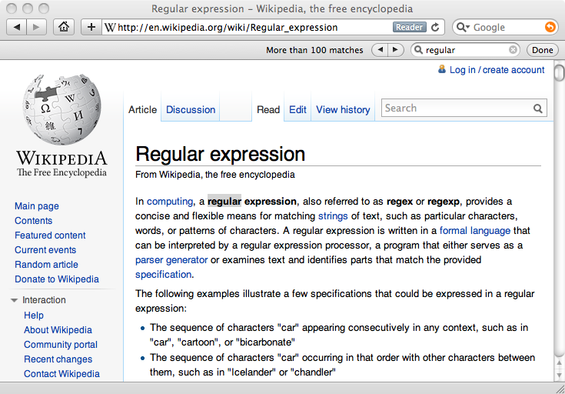
Really smart "Find" or "Search"

Slide 11
Introduction to Regular Expressions
A regular expression (regex) describes a pattern to match multiple input strings.
Regular expressions descend from a fundamental concept in Computer Science called finite automata theory
Regular expressions are endemic to Unix
Some utilities/programs that use them:
  vi, ed, sed, and emacs
  awk, tcl, perl and Python
  grep, egrep, fgrep
  compilers
The simplest regular expression is a string of literal characters to match.
The string matches the regular expression if it contains the substring.

Slide 12
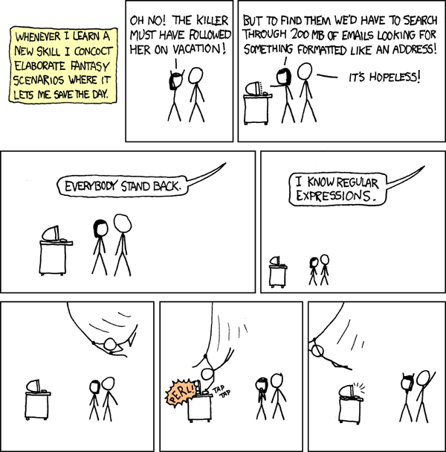
http://xkcd.com/208/

Slide 13
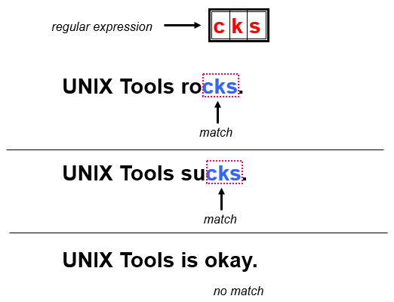
Examples
Regular Expressions: Exact Matches

Slide 14
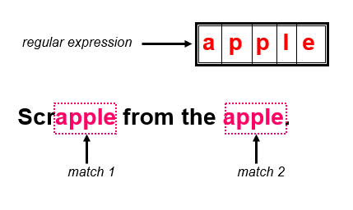
Examples
Regular Expressions: Multiple Matches

Slide 15
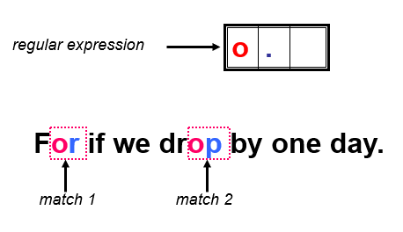
Examples
Regular Expressions: Matching Any Character

Slide 16
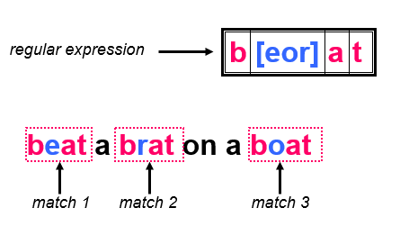
Examples
Regular Expressions: Alternate Character Classes

Slide 17
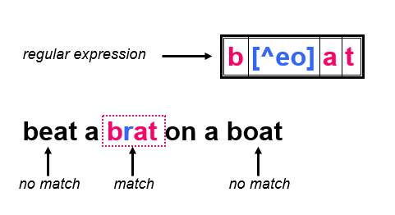
Examples
Regular Expressions: Negated Character Classes

Slide 18
Regular Expression Quick Guide
^ Matches the beginning of a line
$ Matches the end of the line
. Matches any character
\s Matches whitespace
\S Matches any non-whitespace character
* Repeats a character zero or more times
*? Repeats a character zero or more times (non-greedy)
+ Repeats a chracter one or more times
+? Repeats a character one or more times (non-greedy)
[aeiou] Matches a single character in the listed set
[^XYZ] Matches a single character not in the listed set
[a-z0-9] The set of characters can include a range
( Indicates where string extraction is to start
) Indicates where string extraction is to end

Slide 19
The Regular Expression Module
Before you can use regular expressions in your program, you must import the library using "import re"
You can use re.search() to see if a string matches a regular expression similar to using the find() method for strings
You can use re.findall() extract portions of a string that match your regular expression similar to a combination of find() and slicing: var[5:10]

Slide 20
Using re.search() like find()
import re
hand = open('mbox-short.txt')
for line in hand:
line = line.rstrip()
if re.search('From:', line) :
print line
hand = open('mbox-short.txt')
for line in hand:
line = line.rstrip()
if line.find('From:') >= 0:
print line

Slide 21
Using re.search() like startswith()
import re
hand = open('mbox-short.txt')
for line in hand:
line = line.rstrip()
if re.search('^From:', line) :
print line
hand = open('mbox-short.txt')
for line in hand:
line = line.rstrip()
if line.startswith('From:') :
print line
We fine-tune what is matched by adding special characters to the string

Slide 22
Wild-Card Characters
The dot character matches any character
If you add the asterisk character, the character is "any number of times"
X-Sieve: CMU Sieve 2.3
X-DSPAM-Result: Innocent
X-DSPAM-Confidence: 0.8475
X-Content-Type-Message-Body: text/plain
^X.*:

Slide 23
Wild-Card Characters
The dot character matches any character
If you add the asterisk character, the character is "any number of times"
Match the start of the line
Many times
X-Sieve: CMU Sieve 2.3
X-DSPAM-Result: Innocent
X-DSPAM-Confidence: 0.8475
X-Content-Type-Message-Body: text/plain
^X.*:
Match any character

Slide 24
Fine-Tuning Your Match
Depending on how "clean" your data is and the purpose of your application, you may want to narrow your match down a bit
Match the start of the line
Many times
X-Sieve: CMU Sieve 2.3
X-DSPAM-Result: Innocent
X-Plane is behind schedule: two weeks
^X.*:
Match any character

Slide 25
Fine-Tuning Your Match
Depending on how "clean" your data is and the purpose of your application, you may want to narrow your match down a bit
One or more times
Match the start of the line
X-Sieve: CMU Sieve 2.3
X-DSPAM-Result: Innocent
X-Plane is behind schedule: two weeks
^X-\S+:
Match any non-whitespace character

Slide 26
Matching and Extracting Data
The re.search() returns a True/False depending on whether the string matches the regular expression
If we actually want the matching strings to be extracted, we use re.findall()
>>> import re
>>> x = 'My 2 favorite numbers are 19 and 42'
>>> y = re.findall('[0-9]+',x)
>>> print y
['2', '19', '42']
[0-9]+
One or more digits

Slide 27
Matching and Extracting Data
When we use re.findall() it returns a list of zero or more sub-strings that match the regular expression
>>> import re
>>> x = 'My 2 favorite numbers are 19 and 42’
>>> y = re.findall('[0-9]+’,x)
>>> print y
['2', '19', '42']
>>> y = re.findall('[AEIOU]+',x)
>>> print y
[]

Slide 28
Warning: Greedy Matching
The repeat characters (* and +) push outward in both directions (greedy) to match the largest possible string
One or more characters
>>> import re
>>> x = 'From: Using the : character'
>>> y = re.findall('^F.+:', x)
>>> print y
['From: Using the :']
^F.+:
First character in the match is an F
Last character in the match is a :
Why not 'From:'?

Slide 29
Non-Greedy Matching
Not all regular expression repeat codes are greedy! If you add a ? character the + and * chill out a bit...
One or more characters but not greedily
>>> import re
>>> x = 'From: Using the : character'
>>> y = re.findall('^F.+?:', x)
>>> print y
['From:']
^F.+?:
First character in the match is an F
Last character in the match is a :

Slide 30
Fine Tuning String Extraction
You can refine the match for re.findall() and separately determine which portion of the match that is to be extracted using parenthesis
From stephen.marquard@uct.ac.za Sat Jan 5 09:14:16 2008
\S+@\S+
>>> y = re.findall('\S+@\S+',x)
>>> print y
['stephen.marquard@uct.ac.za']>>> y = re.findall('^From:.*? (\S+@\S+)',x)>>> print y['stephen.marquard@uct.ac.za']
At least one non-whitespace character

Slide 31
Fine Tuning String Extraction
Parenthesis are not part of the match - but they tell where to start and stop what string to extract
From stephen.marquard@uct.ac.za Sat Jan 5 09:14:16 2008
>>> y = re.findall('\S+@\S+',x)
>>> print y
['stephen.marquard@uct.ac.za']
>>> y = re.findall('^From (\S+@\S+)',x)
>>> print y
['stephen.marquard@uct.ac.za']
^From (\S+@\S+)

Slide 32
21
31
From stephen.marquard@uct.ac.za Sat Jan 5 09:14:16 2008
>>> data = 'From stephen.marquard@uct.ac.za Sat Jan 5 09:14:16 2008'
>>> atpos = data.find('@')
>>> print atpos
21
>>> sppos = data.find(' ',atpos)
>>> print sppos
31
>>> host = data[atpos+1 : sppos]
>>> print host
uct.ac.za
Extracting a host name - using find and string slicing.

Slide 33
The Double Split Version
Sometimes we split a line one way and then grab one of the pieces of the line and split that piece again
From stephen.marquard@uct.ac.za Sat Jan 5 09:14:16 2008

Slide 34
The Double Split Version
Sometimes we split a line one way and then grab one of the pieces of the line and split that piece again
From stephen.marquard@uct.ac.za Sat Jan 5 09:14:16 2008
words = line.split()
email = words[1]
pieces = email.split('@')
print pieces[1]
stephen.marquard@uct.ac.za
['stephen.marquard', 'uct.ac.za']
'uct.ac.za'

Slide 35
The Regex Version
From stephen.marquard@uct.ac.za Sat Jan 5 09:14:16 2008
import re
lin = 'From stephen.marquard@uct.ac.za Sat Jan 5 09:14:16 2008'
y = re.findall('@([^ ]*)',lin)
print y
['uct.ac.za']
'@([^ ]*)'
Look through the string until you find an at-sign

Slide 36
The Regex Version
From stephen.marquard@uct.ac.za Sat Jan 5 09:14:16 2008
import re
lin = 'From stephen.marquard@uct.ac.za Sat Jan 5 09:14:16 2008'
y = re.findall('@([^ ]*)',lin)
print y
['uct.ac.za']
'@([^ ]*)'
Match non-blank character
Match many of them

Slide 37
The Regex Version
From stephen.marquard@uct.ac.za Sat Jan 5 09:14:16 2008
import re
lin = 'From stephen.marquard@uct.ac.za Sat Jan 5 09:14:16 2008'
y = re.findall('@([^ ]*)',lin)
print y
['uct.ac.za']
'@([^ ]*)'
Extract the non-blank characters

Slide 38
Even Cooler Regex Version
From stephen.marquard@uct.ac.za Sat Jan 5 09:14:16 2008
import re
lin = 'From stephen.marquard@uct.ac.za Sat Jan 5 09:14:16 2008'
y = re.findall('^From .*@([^ ]*)',lin)
print y
['uct.ac.za']
'^From .*@([^ ]*)'
Starting at the beginning of the line, look for the string 'From '

Slide 39
Even Cooler Regex Version
From stephen.marquard@uct.ac.za Sat Jan 5 09:14:16 2008
import re
lin = 'From stephen.marquard@uct.ac.za Sat Jan 5 09:14:16 2008'
y = re.findall('^From .*@([^ ]*)',lin)
print y
['uct.ac.za']
'^From .*@([^ ]*)'
Skip a bunch of characters, looking for an at-sign

Slide 40
Even Cooler Regex Version
From stephen.marquard@uct.ac.za Sat Jan 5 09:14:16 2008
import re
lin = 'From stephen.marquard@uct.ac.za Sat Jan 5 09:14:16 2008'
y = re.findall('^From .*@([^ ]*)',lin)
print y
['uct.ac.za']
'^From .*@([^ ]*)'
Start 'extracting'

Slide 41
Even Cooler Regex Version
From stephen.marquard@uct.ac.za Sat Jan 5 09:14:16 2008
import re
lin = 'From stephen.marquard@uct.ac.za Sat Jan 5 09:14:16 2008'
y = re.findall('^From .*@([^ ]*)',lin)
print y
['uct.ac.za']
'^From .*@([^ ]*)'
Match non-blank character
Match many of them

Slide 42
Even Cooler Regex Version
From stephen.marquard@uct.ac.za Sat Jan 5 09:14:16 2008
import re
lin = 'From stephen.marquard@uct.ac.za Sat Jan 5 09:14:16 2008'
y = re.findall('^From .*@([^ ]*)',lin)
print y
['uct.ac.za']
'^From .*@([^ ]*)'
Stop 'extracting'

Slide 43
Spam Confidence
import re
hand = open('mbox-short.txt')
numlist = list()
for line in hand:
line = line.rstrip()
stuff = re.findall('^X-DSPAM-Confidence: ([0-9.]+)', line)
if len(stuff) != 1 : continue
num = float(stuff[0])
numlist.append(num)
print 'Maximum:', max(numlist)
python ds.py
Maximum: 0.9907

Slide 44
Regular Expression Quick Guide
^ Matches the beginning of a line
$ Matches the end of the line
. Matches any character
\s Matches whitespace
\S Matches any non-whitespace character
* Repeats a character zero or more times
? Repeats a character zero or one time
*? Repeats a character zero or more times (non-greedy)
+ Repeats a chracter one or more times
+? Repeats a character one or more times (non-greedy)
[aeiou] Matches a single character in the listed set
[^XYZ] Matches a single character not in the listed set
[a-z0-9] The set of characters can include a range
( Indicates where string extraction is to start
) Indicates where string extraction is to end

Slide 45
Escape Character
If you want a special regular expression character to just behave normally (most of the time) you prefix it with '\'
>>> import re
>>> x = 'We just received $10.00 for cookies.'
>>> y = re.findall('\$[0-9.]+',x)
>>> print y
['$10.00']
At least one or more
\$[0-9.]+
A real dollar sign
A digit or period

Slide 46
Summary
Regular expressions are a cryptic but powerful language for matching strings and extracting elements from those strings
Regular expressions have special characters that indicate intent

