Slide 1
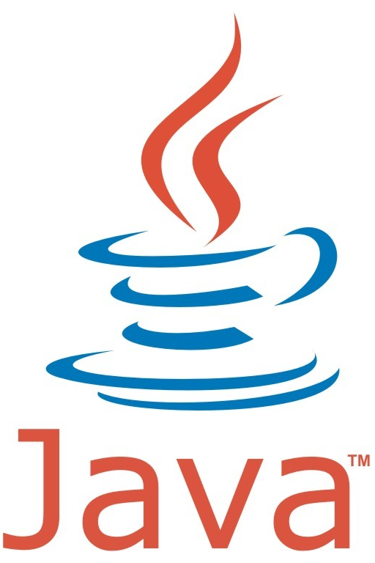
Python & Java side-by-side
COMP 3200

Slide 2
Key Words / Reserved Words
Python Key Words
and del from not while
as elif global or with
assert else if pass yield
break except import print
class exec in raise
continue finally is return
def for lambda try
Notes:
Words in green are not reserved in Java and
can be used as identifiers, etc.
There are also some type and constant names:
int, float, True, False, None, etc.
that correspond to reserved words in Java
maybe with different spelling or capitalization:
int, float, true, false, null, etc.
Java Reserved Words
abstract default goto* package this
assert do if private throw
boolean double implements protected throws
break else import public transient
byte enum instanceof return true
case extends int short try
catch false interface static void
char final long strictfp volatile
class finally native super while
const* float new switch
continue for null synchronized
* Are reserved words, but are not used.
Notes:
Words in black have generally the same
semantics in Java as they do in Python.
If you have been using any of the red words in
Python, you will need to avoid using them in Java

Slide 3
Primitive Data Types
Numeric Data Types
---
---
---
int Integers
long Large Integers
float Real Numbers (Decimal)
---
complex Complex Numbers (R + I * j)
Numeric Data Types
byte 8 Bit Numbers
char 16 Bit Unicode Characters
short 16 Bit Numbers
int 32 Bit Numbers
long 64 Bit Numbers
float Real Numbers (Decimal)
double Larger/Smaller Real Numbers
Other Data Types
boolean Logical “True” or “False” values
class Any defined class as a type
string An array of characters
---
Other Data Types
boolean Logical “true” or “false” values
Class Any defined class as a type
String A somewhat special class
Interface Any defined interface as a type

Slide 4
Variables
Declarations
All variables are “reference” types
Variables do not need to be declared.
A variable is created by initializing it
and its type is determined by the type
of the value assigned:
i = 10 # i is an int
Its type can be changed later:
i = 10.5 # i is a float now
A variable can be deleted (undefined):
del i
Using i in an expression is invalid now
unless it is initialized again.
Declarations
There are primitive and reference variables.
All variables must be declared before use.
A variable is created by declaring it with its
data type and optionally initializing it.
A primitive variable is of a built in data type
int i = 10; // i is an int
Its type can not be changed later:
i = 10.5; // compilation error
A reference variable is to a class instance object or is to an array or string: Integer n = new Integer(5);
String myString = “Hello”;
int [ ] myNumbers = new int[10];
A variable can not be deleted (undefined).

Slide 5
Operators
Arithmetic Operators
+ add, e.g. 4 + 2 is 6
- subtract, e.g. 4 – 2 is 2
* multiply, e.g. 4 * 2 is 8
/ divide, e.g. 4 / 2 is 2 (dividend)
% modulo, e.g. 4 % 2 is 0 (remainder)
** exponentiation, e.g. 4 ** 2 is 16
Note: ++ and -- are NOT Python operators
Arithmetic Operators
+ add, e.g. 4 + 2 is 6
- subtract, e.g. 4 – 2 is 2
* multiply, e.g. 4 * 2 is 8
/ divide, e.g. 4 / 2 is 2 (dividend)
% modulo, e.g. 4 % 2 is 0 (remainder)
Note: ** is NOT a Java operator
++ pre/post increment by one
-- pre/post decrement by one
Logical Operators
and and (between boolean values)
or or (between boolean values)
not not (of a boolean value)
& Bitwise and (between int values)
| Bitwise or (between int values)
^ Bitwise exclusive or (between int values)
<< Bitwise Left Shift (of an int value)
>> Bitwise Right Shift (of an int value)
Logical Operators
&& and (between boolean values)
|| or (between boolean values)
! not (of a boolean value)
& Bitwise and (between int values)
| Bitwise or (between int values)
^ Bitwise exclusive or (between int values)
<< Bitwise Left Shift (of an int value)
>> Bitwise Right Shift (of an int value)

Slide 6
Expressions
Operator Precedence
Same in Python and Java (Algebraic)
Override precedence with parentheses ( )
Operator Precedence
Same in Python and Java (Algebraic)
Override precedence with parentheses ( )
Casting / Conversions
Numeric Casting/Conversions
Automatic widening type conversions,
e.g. 1 + 3.0 results in a float 4.0
Functions required for narrowing conversions,
e.g. 1 + int(3.0) results in an int 4
Non-numeric Conversions
Need to use conversion functions,
e.g int(“string of digits”) which
raises an Error for non-digit characters
Casting / Conversions
Numeric Casting/Conversions
Automatic widening type conversions,
e.g. 1 + 3.0 results in a double 4.0
Casting required for narrowing conversions,
e.g. 1 + (int) 3.0 results in an int 4
Non-numeric Conversions
Need to use wrapper class static methods,
e.g Integer.parseInt(“string of digits”) which
throws an Exception for non-digit characters

Slide 7
Stand-alone Functions / Methods
Function Definition
def function (parameters):
statements
return value
Invoking a Function
# no context of an object or class is required
returnValue = function( . . .)
e.g.
length = len(myString)
// using a function defined in the library
returnValue = packageName.function(. . .)
e.g.
import math # library package name
c = math.sqrt(2.0) # 1.414…
No Equivalent in Java
A function can only be defined as a method
within the context of a class or an interface.
(See Classes)
Invoking a Method
// the context of an object or class is required
// instance method (non static)
type returnValue = object.method( . . .);
e.g.
int length = myString.length();
// static method (defined in a class, e.g. Math)
type returnValue = Class.method( . . .);
e.g.
// Note: Math class is automatically imported
double root = Math.sqrt(2.0); // 1.414…

Slide 8
String Data Type
Strings
myString = “Hello World”
myString = ‘Hello World’
myString = “””Hello World”””
Note: “\n” is newline in a string
String Class / char
String myString = “Hello World”;
char c = ‘a’; // ‘a’ = char constant for letter a
Note: ‘\n’ is newline in a char
Note: “\n” is newline in a String
String Functions
n = len(myString) # n = 11
c = myString[0] # c = “H”
s = myString[0 : 2] # s = “He”
s = myString.upper() # s = “HELLO”
String Methods / char
int n = myString.length(); // n = 11
char c = myString.charAt(0); // c = ‘H’
String s = myString.substring(0, 2); // s = “He”
s = myString.toUpperCase(); // “HELLO”
String Operations
s = myString + “!” # Concatenation
s = myString + str(42) # HelloWorld42
myString == “Hello World” # True
String Operations
s = myString + “!”; // Concatenation
s = myString + 42; // HelloWorld42
myString.equals(”Hello World”) // true

Slide 9
Flow of Control Statements
If / Else
if boolean expression:
statement1 or block1
else: # optional
statement2 or block2
May nest “if” or “else” inside “if” or “else”
Conditional Expression Evaluation
Not supported in Python
Conditional Boolean Operators
== equal
!= not equal
> greater than
< less than
If / Else
if (boolean expression)
statement1; or {block1}
else // optional
statement2; or {block2}
May nest “if/else” inside “if” or “else”
Python “elif” must be “else if” in Java
Conditional Expression Evaluation
boolean expression ? true expr : false expr
Conditional Boolean Operators
== equal
!= not equal
> greater than
< less than

Slide 10
Flow of Control Statements
For
for i in range(0, 10, 1):
statement or block using i
for item in items: # items is a list
statement or block using item
For
for (int i = 0; i < 10; i++)
single statement; or {block}
// sometimes referred to as a “for-each” loop
for (type item : items) // items is an array
single statement; or {block}
While
while boolean expression:
statement or block for body of loop
Note: Loops may be nested in Python and Java
While
while (boolean expression)
single statement; or {block}
Do . . . while
do // always executes body once
single statement; or {block}
while (boolean expression);

Slide 11
Input / Output
Typed Outputs to User
print (“Text String”)
Typed Outputs to User
System.out.println(“Text String”);
User Prompt/Response
s = input(“Prompt”) // token
n = int(input(“Prompt:”)) // integer
f = float(input(“Prompt:”)) // real
User Prompt/Response
import java.util.Scanner; // at beginning of file
. . .
Scanner keyboard = new Scanner(System.in);
System.out.println(“Prompt:”);
String s = keyboard.next(); // token
int n = keyboard.nextInt(); // integer
float f = keyboard.nextFloat(); // real
double d = keyboard.nextDouble(); // double
boolean b = keyboard.nextBoolean(); // boolean

Slide 12
New Features
Built-in lists and dictionaries
Lists: [1,2,3]
Dictionaries: {‘a’:1, ‘b’:2, ‘c’:5}
Indexing: 0-based, but bi-directional...
Slicing
for: iterates over a collection
ranges
multi-assignment
test-cases as comments

