Slide 1
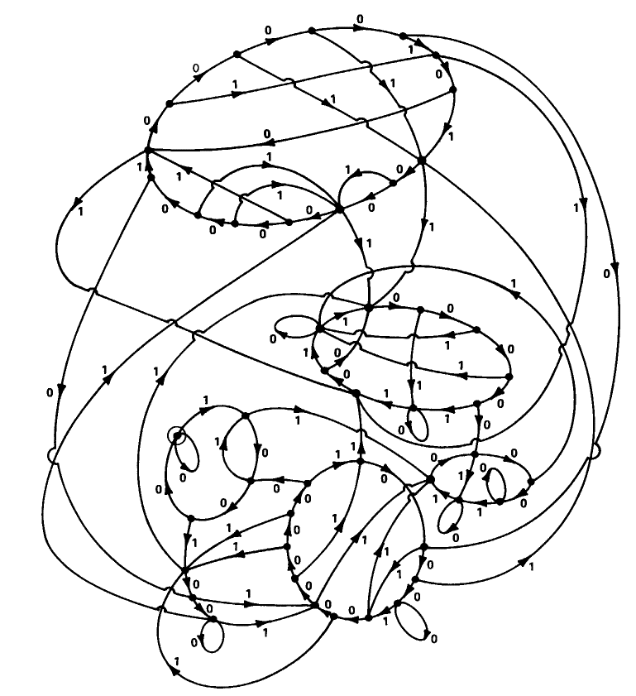
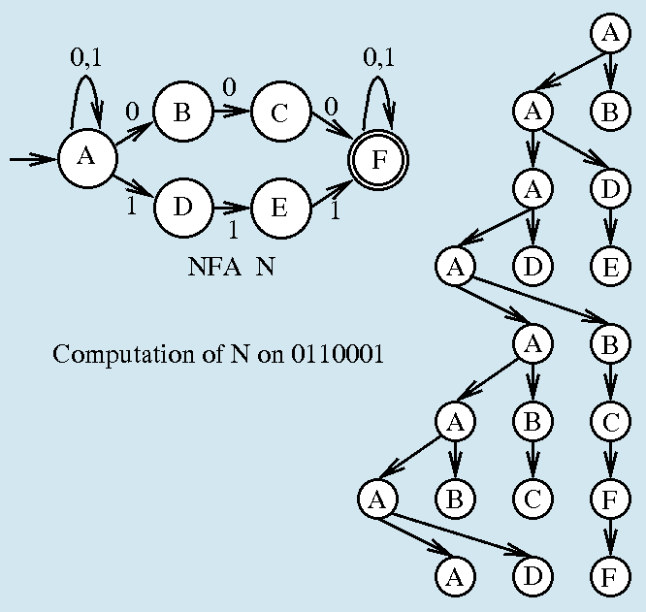
COMP 3200
Languages & Machines
Prof. Stucki

Slide 2
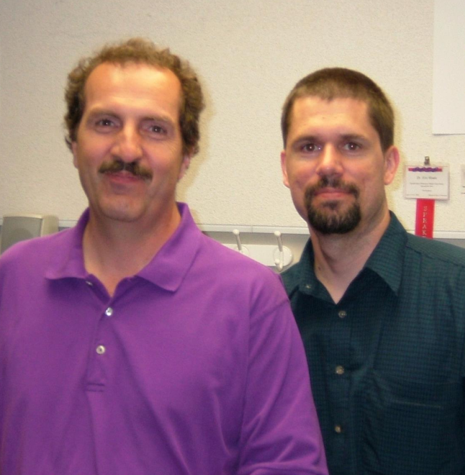
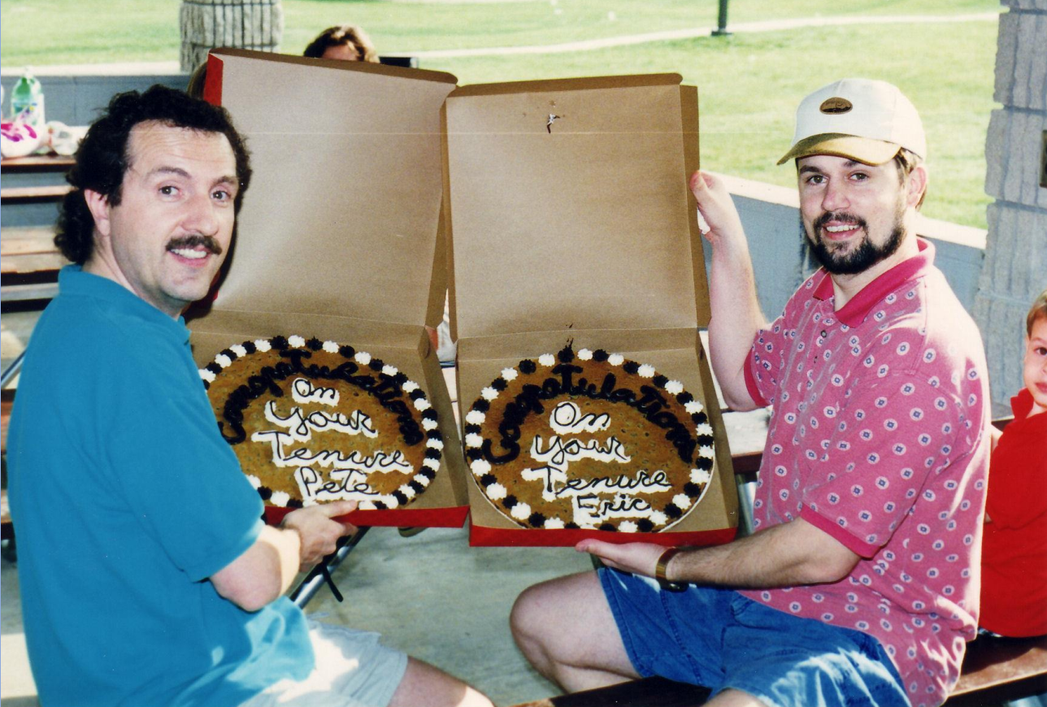
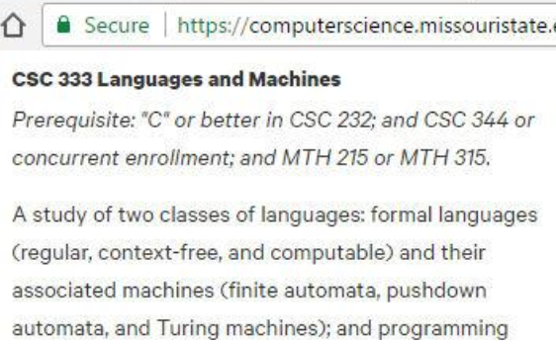
Eric Shade
(1965-2015)

Slide 3
Course Info
Syllabus
  Description & Objectives
    Time to take off the training wheels...
  Materials
  Work
  Grades
Course Web Site
Course platform
Computers/Languages?

Slide 4
First Reading Assignment
https://web.archive.org/web/20190108113122/https://wiki.c2.com/?BlubParadox
https://en.wikipedia.org/wiki/Virtual_machine
https://web.archive.org/web/20161218010652/http://wiki.c2.com/?ModelsOfComputation
http://mathworld.wolfram.com/Church-TuringThesis.html

Slide 5
Review
What have we done in C SC so far?
  PROGRAMMING!
    We have written programs in a language
  ALGORITHMS!
    Programs implement algorithms
  COMPUTATION!
    Algorithms represent computation
  More…?

Slide 6
Review
So what are all these things?
  What is an algorithm?
    COMP 1500…
  What is a program?
    It depends on perspective…
    A sequence of instructions?
    A sequence of characters?
    A sequence of bits? ☺
    A pattern of burn marks on a DVD?
    Others?
    An algorithm expressed in a specific language!

Slide 7
What is Computation?
We don’t know yet – that’s what the course is about!
But it is very difficult to answer.
Branches of Theory of Computation:
  Complexity – How hard is a given problem, in terms of resources used?
  Computability – What kinds of problems can be solved?
  Automata – What kinds of computation are there? (There are many models)

Slide 8
Languages & Machines
There is a
and
relationship between the notions of
deep
complex
language
&
computation
machine

Slide 9
Abstraction Hierarchy
Ideal Realm (à la Plato)
:
Mathematical Notation
Algorithms
Programming Languages
Assembly Languages
Machine Languages
Microcode
“The GAP”
Von Neumann Machine
Functional Components
Digital Circuits
Electronic Devices
:
Physical Reality

Slide 10
Programming Languages
Which ones do you know something about?
How are they similar?
How are they different?

Slide 11
Programming Languages
What do you learn when you learn a foreign language?
  Meta-linguistics:
    syntax, semantics, pragmatics
  Comparative structure of languages
  A different way of thinking!!

Slide 12
The End

Slide 13
Formal Definition of Algorithm
A well-ordered collection of unambiguous and effectively computable operations that, when executed, produces a result and halts in a finite amount of time

Slide 14
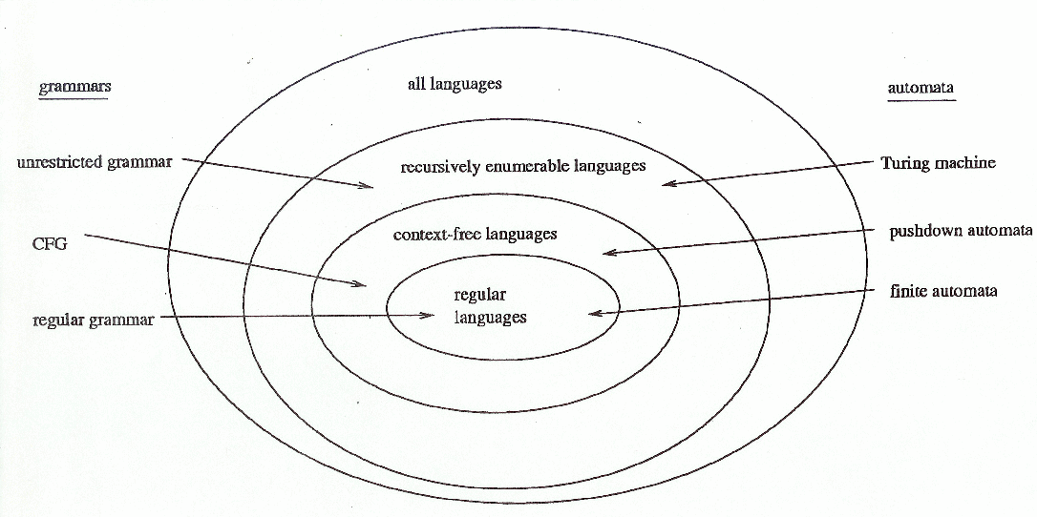
Major Concepts
Languages: models of representation
Grammars: models of language structure
Automata: models of computation

Slide 15
Mathematical Assumptions
Set theory (1.1)
Relations and functions (1.2)
Graph Theory (1.3)
Cardinality (1.4)
Proof (1.5)
It is my assumption that you know this material. If this is not the case, you will need to review/study/see me for help.

