Slide 1
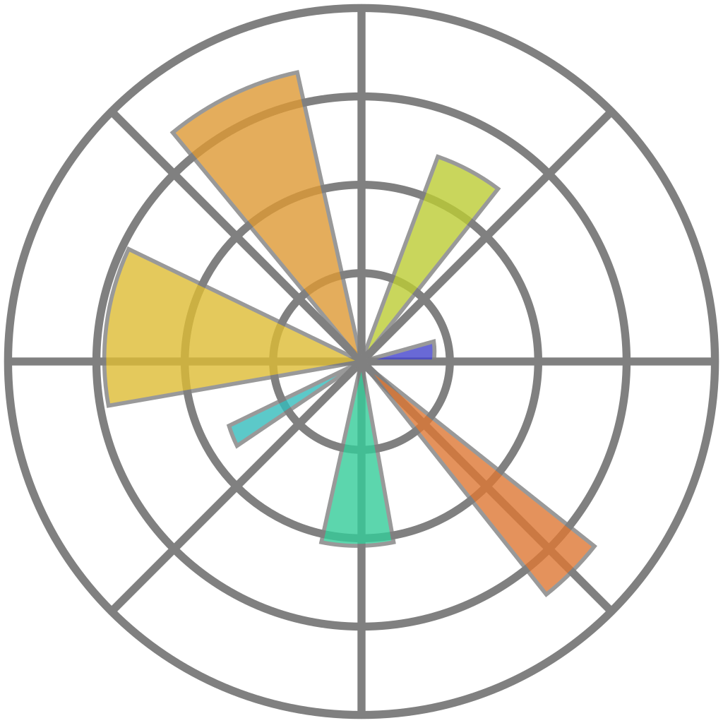
matplotlib
Data Analytics in Python
COMP 2800
Otterbein University

Slide 2
Alerts
Assignment 6 on Friday
Questions?

Slide 3
Data Visualization
The following TED talks provide some important principles of data visualization, as well as some common themes
Turning Bad Charts into Compelling Data Stories | Dominic Bohan | TEDxYouth@Singapore (youtube.com)
https://www.youtube.com/watch?v=edAf1jx1wh8
The Evolution Of Data Visualization | Dustin Cabral | TEDxBryantU (youtube.com)
https://www.youtube.com/watch?v=sOJet45-kcY
How algorithms shape our world - Kevin Slavin (youtube.com)
https://www.youtube.com/watch?v=ENWVRcMGDoU

Slide 4
Questions?

Slide 5
Next time
Assignment 6 work day

