Slide 1
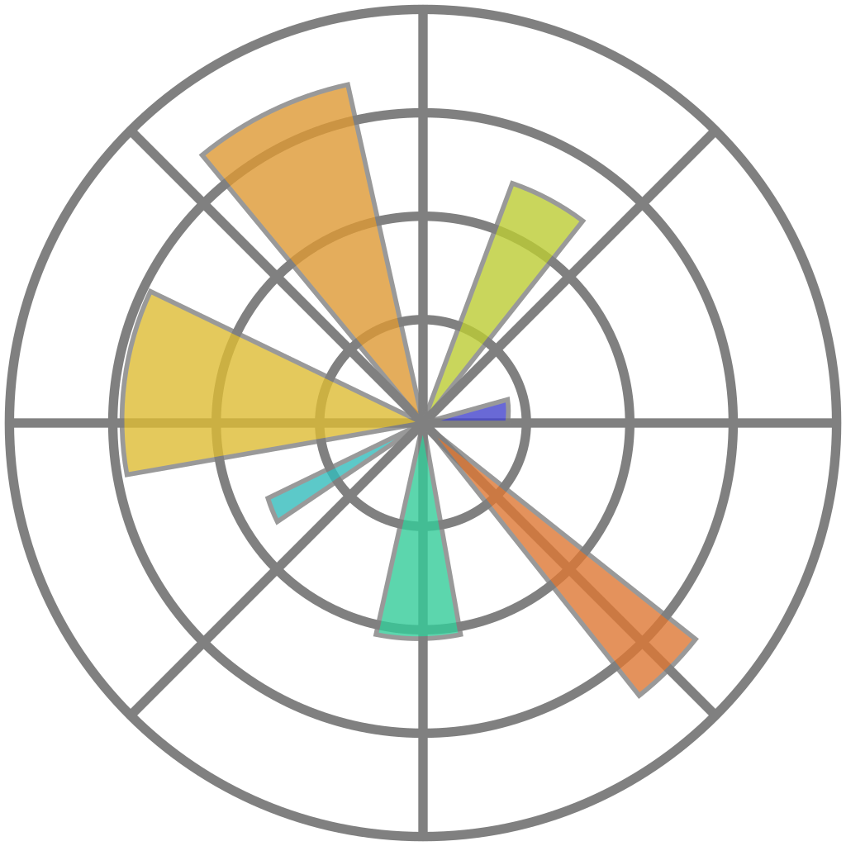
matplotlib
Data Analytics in Python
COMP 2800
Otterbein University

Slide 2
Alerts
How was spring break?
Grading update...
Questions?

Slide 3
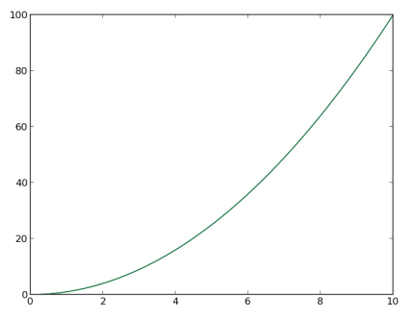
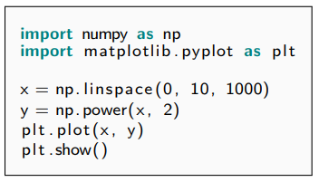
matplotlib
2D plotting library
produces publication quality figures
can be saved/exported to large variety of file formats
originally inspired by MATLAB
works well with NumPy
object-oriented
hierarchical organization of components

Slide 4
Activity
The matplotlib online documentation includes a tutorial that is much more comprehensive than our textbook
  Spend the rest of today's class reading through and trying out the code samples of this tutorial
  Play with the options and customize the plots that are provided
  Ask questions as you go if you need help
Using Matplotlib — Matplotlib 3.8.3 documentation
  https://matplotlib.org/stable/users/index.html#users-guide-index

Slide 5
Questions?

Slide 6
Next time
plotting with pandas and seaborn

