Slide 1
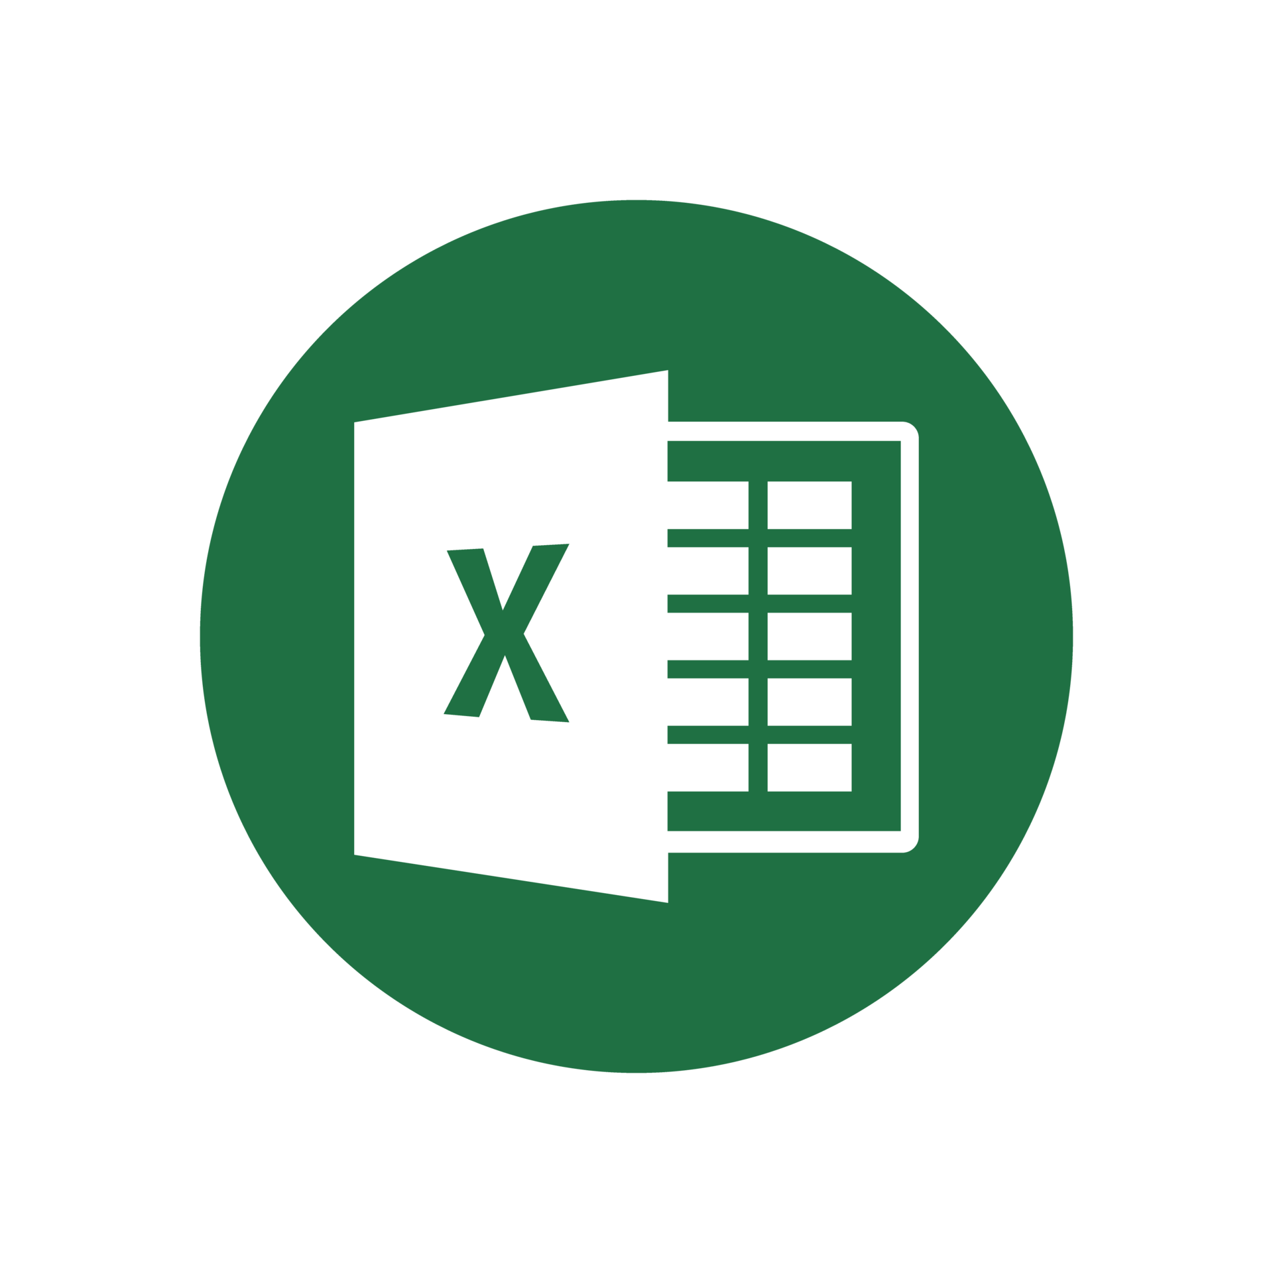
Python Packages for .
Data Analytics in Python
COMP 2800
Otterbein University

Slide 2
Alerts
Assignment 5: available later today, due next Friday before 11:59pm
Midterm
  Take home exam: given Wednesday, due Friday, before class
  Individual work – no collaboration
  Open book/open notes/open static online resources (no ChatGPT, or other generative AI; no interactive forums)
Questions?

Slide 3

The structure of an Excel document is hierarchical:
A document is called a workbook
A workbook consists of a collection of worksheets
A worksheet contains a 2D matrix of cells
Groups of cells are called ranges
Cells can contain text, values, or formulas
  a cell can be read in three ways: text (as formatted string), value2 (double, boolean, string, empty, error), and
  value (same as value2 but with currency and date/time converted to those data types

Slide 4
xlwings
A package that supports native interaction with Excel documents via a live Excel session.
  How is that different from what we can already do in pandas?
To use xlwings, you need to first pip or conda it
Then import xlwings as xw
Let's look at some of the basic commands...
  xlwings quick reference guide is on the course web page
The xlwings website has a lot of good resources...

Slide 5
Questions?

Slide 6
Next time
More Python packages for Excel

