Slide 1
Data Analytics in Python
NumPy, part 2
COMP 2800
David J Stucki
Otterbein University

Slide 2
Alerts
Assignment 2: Due Friday before 11:59pm
Assignment 3: available on Friday
Questions?

Slide 3
Review: Indexing
One dimensional arrays are simple: they act like lists
  arr = np.arange(10)
  arr[5]
  arr[5:8]
Except when they don't...
  arr[5:8] = 12
  arr
  s = arr[6:]
  s[1] = 0
  s[:] = -1
In other words, slices are views on the original array
  So assignments to a slice are reflected in the array
Two or more dimensional arrays are much richer than lists in how they can be indexed
  arr = np.arange(32).reshape((8, 4))
  arr[5][1]
  arr[5, 1]
Here are some basics:
  x[0,0] # top-left element
  x[0,-1] # first row, last column
  x[0,:] # first row (many entries)
  x[:,0] # first column (many entries)
  Like lists, arrays are zero indexed and can use negative indices

Slide 4
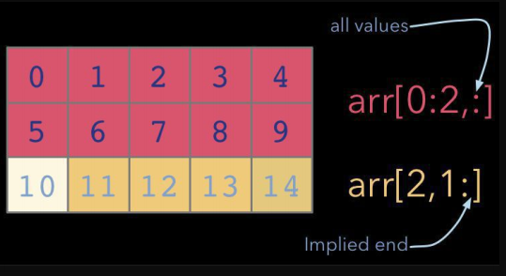
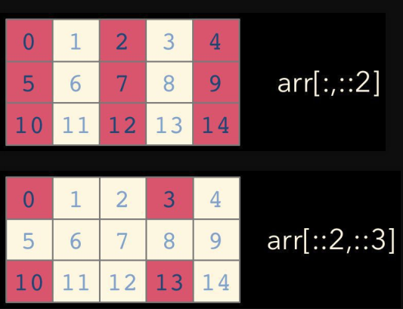
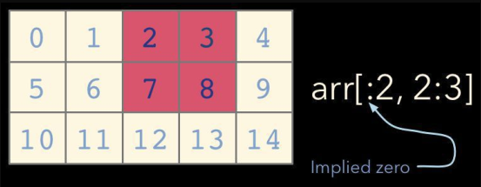
Indexing and Slicing

Slide 5
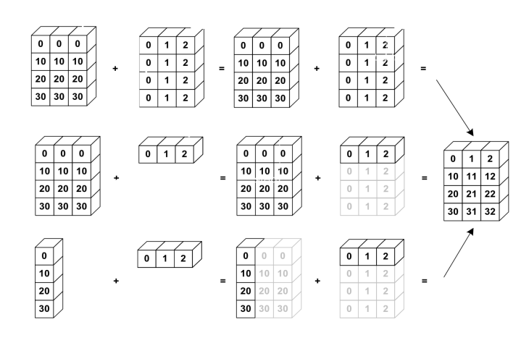
More Indexing & Slicing
Let's play with it in IDLE a bit
Summing an array
Boolean Indexing
Fancy Indexing
Broadcasting

Slide 6
Broadcasting
a = a + 1 # add one to every element
When operating on multiple arrays, broadcasting rules are used.
Each dimension must match, from right-to-left
Dimensions of size 1 will broadcast (as if the value was repeated).
Otherwise, the dimension must have the same shape.
Extra dimensions of size 1 are added to the left as needed.

Slide 7
Broadcasting example
Suppose we want to add a color value to an image
a.shape is 100, 200, 3
b.shape is 3
a + b will pad b with two extra dimensions so it has an effective shape of 1 x 1 x 3.
So, the addition will broadcast over the first and second dimensions.

Slide 8
More Indexing & Slicing
Let's play with it in IDLE a bit
Summing an array
Boolean Indexing
Fancy Indexing
Broadcasting
Statistical & Mathematical methods

Slide 9
Questions?

Slide 10
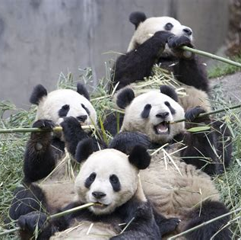
Next Time...
pandas

