Slide 1
Data Analytics in Python
NumPy
COMP 2800
David J Stucki
Otterbein University

Slide 2
Alerts
Assignment 1: Due Friday before 11:59pm
Assignment 2: available on Friday
Questions?

Slide 3
WhAT IS NumPy?
NumPy is at the core of nearly every scientific Python application
  A powerful N-dimensional array class (optimized for speed)
    1000 x 1000 matrix multiply: list triple-nested loop (>10 minutes) vs. ndarray (<0.1 second)
  Sophisticated indexing, slicing, reshaping, and manipulation techniques with simple syntax
  Universal functions for computing over arrays without loops
  Random number, linear algebra, and Fourier transform capabilities
  Tools for integrating C/C++ and Fortran code
  Tools for optimized File I/O of large data sets

Slide 4
Arrays vs lists
Arrays in NumPy have the following characteristics
Arrays can have any number of dimensions, including zero (a scalar).
Arrays are typed: np.uint8, np.int64, np.float32, np.float64, etc.
Arrays are dense. Each element of the array exists, and the array occupies a contiguous block of memory.
Arrays are homogeneous, containing only elements of the same type.
import numpy as np
a = np.array([[1,2,3],[4,5,6]],dtype=np.float32)
print a, a.ndim, a.shape, a.dtype

Slide 5
Arrays
Structured lists of numbers.
Vectors
Matrices
Images
Tensors
ConvNets (CNNs)

Slide 6

Arrays
$$\left[\begin{matrix}p_{x} \\ p_{y} \\ p_{z}\end{matrix}\right]$$
$$\left[\begin{matrix}a_{11} & ⋯ & a_{1n} \\ ⋮ & ⋱ & ⋮ \\ a_{m1} & ⋯ & a_{mn}\end{matrix}\right]$$
Structured lists of numbers.
Vectors
Matrices
Images
Tensors
ConvNets (CNNs)

Slide 7

Arrays
Structured lists of numbers.
Vectors
Matrices
Images
Tensors
ConvNets (CNNs)

Slide 8
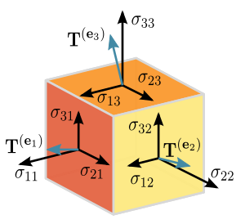
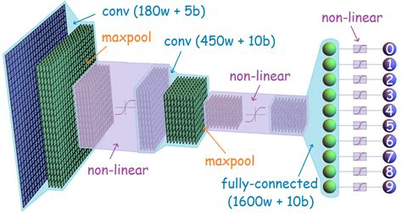
Arrays
Structured lists of numbers.
Vectors
Matrices
Images
Tensors
ConvNets (CNNs)

Slide 9
Creating Arrays
from lists
  data1 = [2, 4, 6, 8, 10]
  arr1 = np.array(data1)
  data2 = [[1, 2, 3, 4], [5, 6, 7, 8]]
  arr2 = np.array(data2)
from array functions
  np.zeros(10)
  np.zeros((3,5))
  np.ones((2,3,4))
  np.eye(3)
  np.empty((4,2))
from arange
  arr3 = np.arange(15, 20)
  arr4 = np.arange(0,12,3)
from random values
  np.random.random((5,2))
  np.random.randint(0, 10, (3,3))
from concatenation
  A = np.ones((4,1))
  B = np.zeros((4,2)
  np.concatentate ([A,B], axis=1)

Slide 10
Shaping & Transposition
Arrays can be reshaped to other dimensions
  The total number of elements can't change
  -1 can be used to have NumPy infer an axis shape from the others
a = np.array([1,2,3,4,5,6])
a = a.reshape(3,2)
a = a.reshape(2,-1)
a = a.ravel()
Transpose is when you exchange axes with each other
  a.Transpose allows you to select which axes
  a.T transposes the first two axes
a = np.arange(10).reshape(5,2)
a = a.T
a = a.transpose((1,0))

Slide 11
Return values
Numpy functions return either views or copies.
Views share data with the original array.
  Altering entries of a view changes the same entries in the original.
The numpy documentation says which functions return views or copies
Np.copy, np.view make explicit copies and views.
>>> x = np.array([1,2,3,4])
>>> y = x
>>> x is y
True
>>> id(x), id(y)
(139814289111920, 139814289111920)
>>> x[0] = 9
>>> y
array([9, 2, 3, 4])
>>> x[0] = 1
>>> z = x[:]
>>> x is z
False
>>> id(x), id(z)
(139814289111920, 139814289112080)
>>> x[0] = 8
>>> z
array([8, 2, 3, 4])
>>> x = np.array([1,2,3,4])
>>> y = x.copy()
>>> x is y
False
>>> id(x), id(y)
(139814289111920, 139814289111840)
>>> x[0] = 9
>>> x
array([9, 2, 3, 4])
>>> y
array([1, 2, 3, 4])

Slide 12

Mathematical Operators
Arithmetic operators are applied element-wise
  a = np.array([[1,2,3],[4,5,6]])
  b = np.array([[9,8,7],[6,5,4]])
  a + b
  b – a
  b * b + a
  a ** 3
In-place operations modify the array
  a *= 2
  b /= a
Logical operators return a Boolean array
  a > 5
  b > a
Universal functions (ufunc)
  NumPy ufunc documentation
  a = np.sqrt(a)
  np.floor(a)

Slide 13
Indexing
One dimensional arrays are simple: they act like lists
  arr = np.arange(10)
  arr[5]
  arr[5:8]
Except when they don't...
  arr[5:8] = 12
  arr
  s = arr[6:]
  s[1] = 0
  s[:] = -1
In other words, slices are views on the original array
  So assignments to a slice are reflected in the array
Two or more dimensional arrays are much richer than lists in how they can be indexed
  arr = np.arange(32).reshape((8, 4))
  arr[5][1]
  arr[5, 1]
Here are some basics:
  x[0,0] # top-left element
  x[0,-1] # first row, last column
  x[0,:] # first row (many entries)
  x[:,0] # first column (many entries)
  Like lists, arrays are zero indexed and can use negative indices

Slide 14
Next Time...
More NumPy

