Slide 1
Data Analytics in Python
COMP 2800
David J Stucki
Otterbein University

Slide 2
Course Info
Syllabus
Course Web Site
Python Environment
  Python 3.12.1 is most current stable release. Please make sure you are using at least 3.10.
  Jupyter/IPython
  VS Code (Visual Studio Code)
  Questions?

Slide 3
What Do We Have In Common?
Major/Minor: Business Analytics, Data Science, Computer Science...
COMP 1800: when?
  Spring '21, Spring '22, Spring '23, Fall '23
Other Python experience?
Statistics?
ASCI 2000 (Data Science in R)?
Exposure to large data sets?
Databases?

Slide 4
What Is Data Analytics?
Ideas?
"... concerned with the nuts and bolts of manipulating, processing, cleaning, and crunching data." —Wes McKinney
  What does that mean?
Emphasis in this course is Python and Python libraries and how to use them
  We will touch on data science methods, statistics, analytical models, etc., but it is not the purpose of this course for those to be the main topics of study
  We will also be using a variety of large data sets from various sources, and learning how to represent, model, and interact with those.

Slide 5


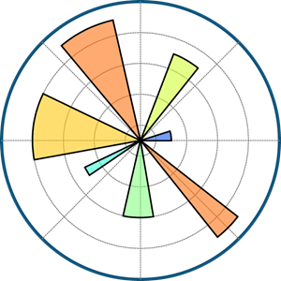



Essential Python Packages for Data Analyics
NumPy: n-dimensional arrays, fast, numerical computation on arrays, linear algebra
pandas: tabular data (as in spreadsheets/relational databases); slice, dice, subset, aggregate, etc.
matplotlib: plots and data visualizations
SciPy: scientific computing tools (numerical calculus, linear algebra, optimization, probability distributions, etc.)
scikit-learn: machine-learning toolkit (classification, regression, clustering, etc.)
statsmodels: extensive statistical analysis tools

Slide 6
Next Time...
Begin a review of Python
(read chapter 2 before class)

