Slide 1
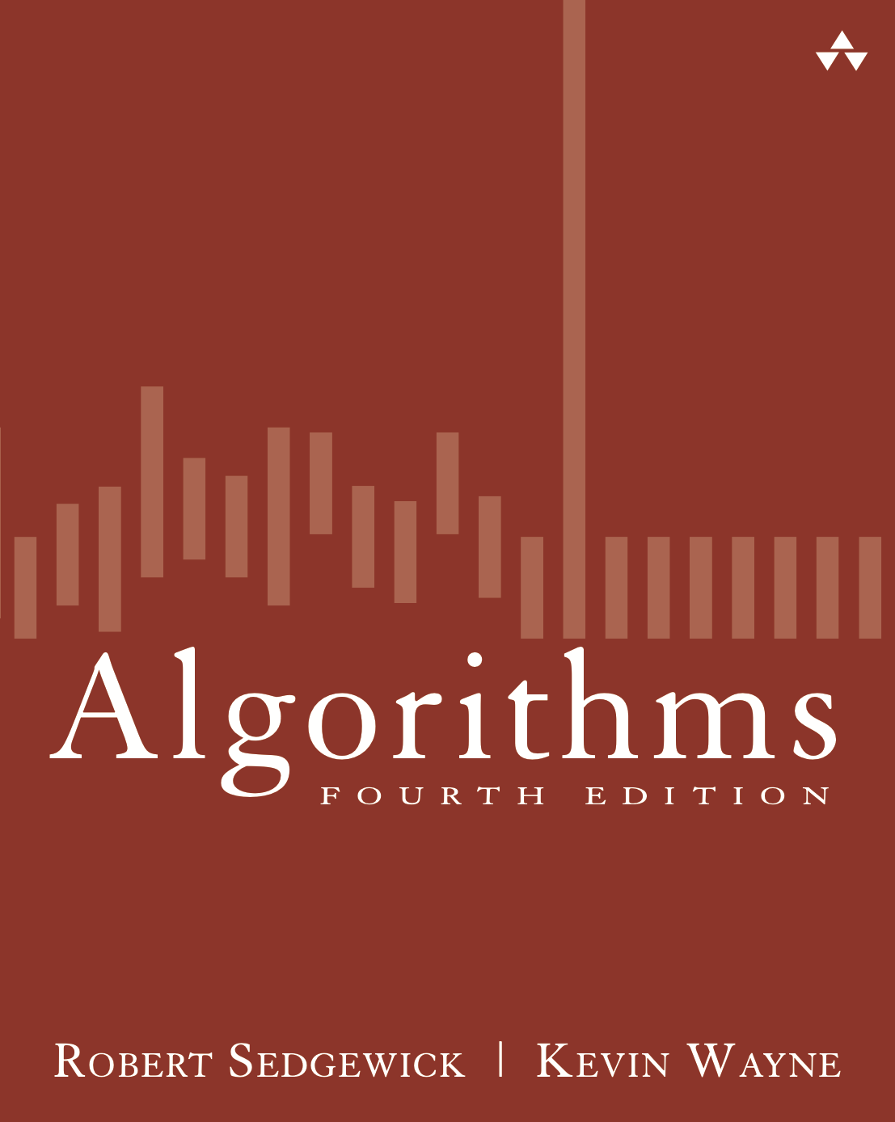
5.2 Trie construction Demo
Algorithms
Robert Sedgewick | Kevin Wayne
http://algs4.cs.princeton.edu

Slide 2
Trie construction demo
trie

Slide 3
Trie construction demo
put("she", 0)
s
h
e
0
key is sequence
of characters from
root to value
value is in node
corresponding to
last character

Slide 4
Trie construction demo
trie
s
h
e
0

Slide 5
Trie construction demo
put("sells", 1)
s
s
e
h
l
e
0
l
s
1

Slide 6
Trie construction demo
trie
s
e
h
l
e
0
l
s
1

Slide 7
Trie construction demo
put("sea", 2)
s
s
e
e
h
a
2
l
e
0
l
s
1

Slide 8
Trie construction demo
put("shells", 3)
s
s
e
h
h
a
l
e
2
e
0
l
l
s
1
l
s
3

Slide 9
Trie construction demo
put("by", 4)
b
s
y
4
e
h
a
2
l
e
0
l
l
s
1
l
s
3

Slide 10
Trie construction demo
put("the", 5)
b
s
t
y
4
e
h
h
a
2
l
e
0
e
5
l
l
s
1
l
s
3

Slide 11
Trie construction demo
put("sea", 6)
b
s
s
t
y
e
4
e
h
h
a
a
2
l
e
0
e
5
6
l
l
overwrite
old value with
new value
s
1
l
s
3

Slide 12
Trie construction demo
put("shore", 7)
b
s
s
t
y
e
h
h
4
h
a
6
l
e
0
o
e
5
l
l
r
s
1
l
e
7
s
3

Slide 13
Trie construction demo
trie
b
s
t
y
4
e
h
h
a
6
l
e
0
o
e
5
l
l
r
s
1
l
e
7
s
3

