Slide 1

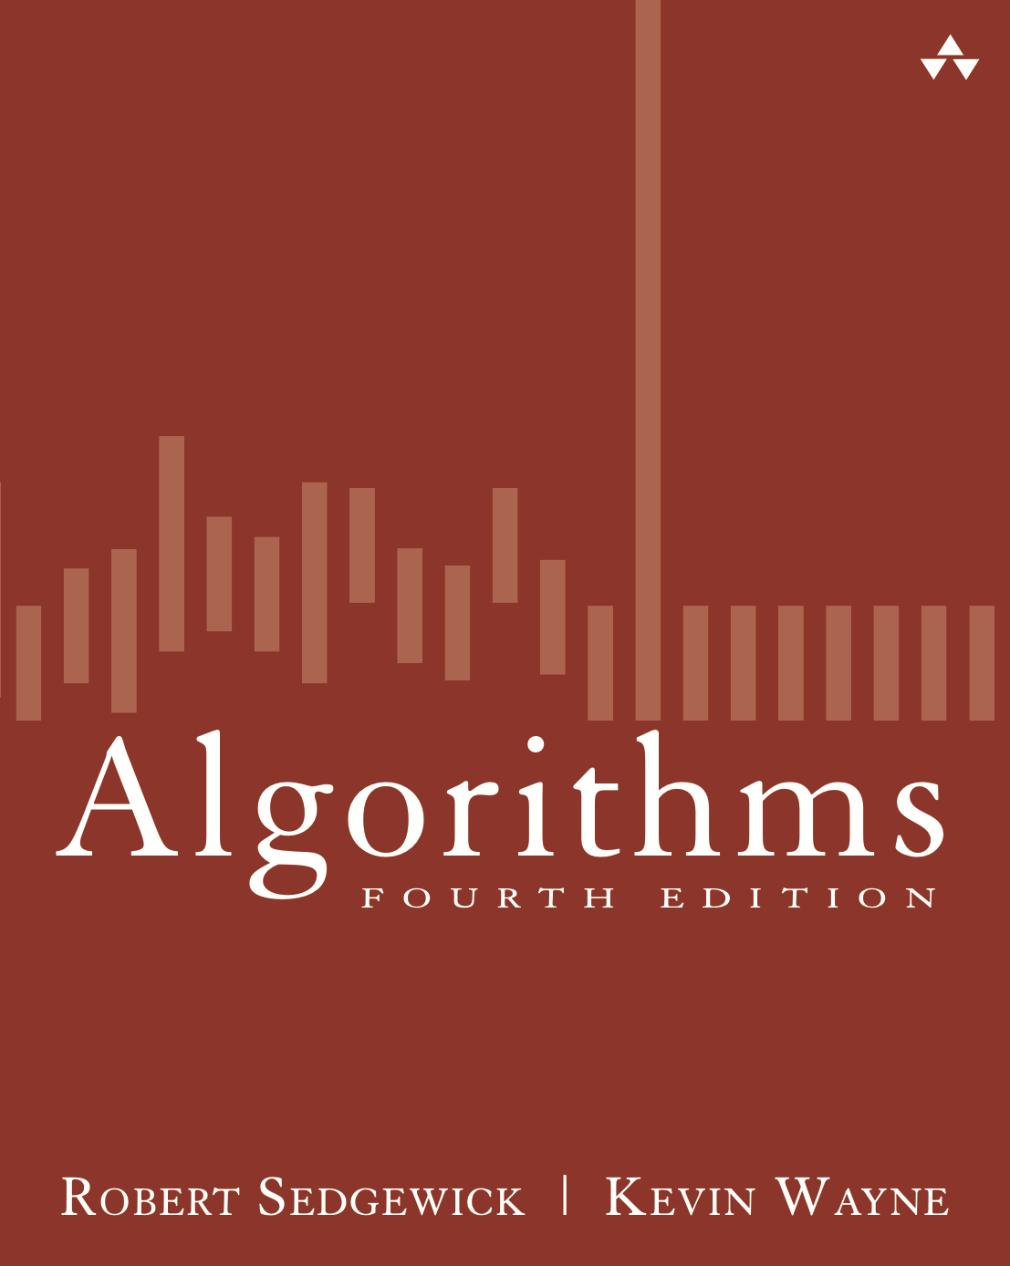
5.2 TST Construction Demo
Algorithms
Robert Sedgewick | Kevin Wayne
http://algs4.cs.princeton.edu

Slide 2
Ternary search trie construction demo
put("she", 0)
s
h
e
0
key is sequence
of characters from
root to value
using middle links
value is in node
corresponding to
last character

Slide 3
Ternary search trie construction demo
put("sells", 1)
s
s
h
h
e
l
e
0
l
s
1

Slide 4
Ternary search trie construction demo
put("sea", 2)
s
s
h
h
e
e
l
e
l
0
2
a
l
s
1

Slide 5
Ternary search trie construction demo
put("shells", 3)
s
s
h
h
e
l
e
e
0
2
a
l
l
s
1
l
s
3

Slide 6
Ternary search trie construction demo
put("by", 4)
s
s
b
y
4
h
e
l
e
0
2
a
l
l
s
1
l
s
3

Slide 7
Ternary search trie construction demo
put("the", 5)
s
s
b
t
y
4
h
h
e
l
e
0
e
5
2
a
l
l
s
1
l
s
3

Slide 8
Ternary search trie construction demo
put("sea", 6)
s
s
b
t
y
h
h
4
h
e
e
l
e
e
l
0
5
a
6
2
a
l
l
overwrite
old value with
new value
s
1
l
s
3

Slide 9
Ternary search trie construction demo
put("shore", 7)
s
s
b
t
y
h
h
4
h
e
l
e
e
0
e
5
6
a
o
l
l
r
s
1
l
e
7
s
3

Slide 10
Ternary search trie construction demo
ternary search trie
s
b
t
y
4
h
h
e
l
e
0
e
5
6
a
o
l
l
r
s
1
l
e
7
s
3

