Slide 1
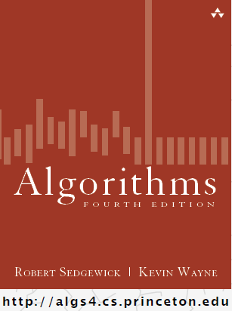
If at 1st you don’t succeed...
COMP 2100
Otterbein University

Slide 2
Alerts
Homework #10 due Monday, 11/28
Lab 7 due Wednesday, 11/30
Project #3 due Friday, 12/2
Final Exam: Friday, December 9
  Exam will be at 10:15am

Slide 3
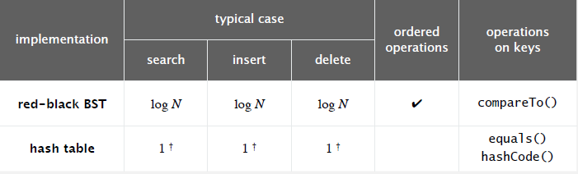
Performance of symbol-table implementations
Order of growth of the frequency of operations.
Q. Can we do better?
A. Yes, if we can avoid examining the entire key, as with string sorting.
  † under uniform hashing assumption
Notes:
can design algorithms that can compete and even beat these classic algorithms

Slide 4
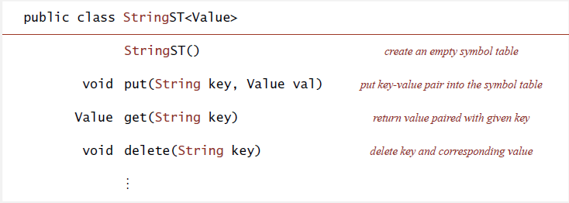
String symbol table basic API
String symbol table. Symbol table specialized to string keys.
Goal. Faster than hashing, more flexible than BSTs.

Slide 5
Tries
Tries. [from retrieval, but pronounced "try"]
  Store characters in nodes (not keys).
  Each node has R children, one for each possible character.
  (for now, we do not draw null links)
link to trie for all keys
that start with s
root
link to trie for all keys
that start with she
key | value
by | 4
sea | 6
sells | 1
she | 0
shells | 3
shore | 7
the | 5
b
s
t
y
4
e
h
h
a
6
l
e
0
o
e
5
l
l
r
value for she in node
corresponding to last
key character
s
1
l
e
7
s
3
Notes:
success story in design of algorithms
trie = wordplay because data structure is for information retrieval, but we pronounce it "try" to avoid confusion with "tree"
As usual, R = alphabet size.

Slide 6
Search in a trie
Follow links corresponding to each character in the key.
  Search hit: node where search ends has a non-null value.
  Search miss: reach null link or node where search ends has null value.
get("shells")
b
s
t
s
y
e
h
h
4
h
a
l
e
o
e
6
e
0
5
l
l
r
l
s
l
e
1
l
7
return value associated
with last key character
(return 3)
s
s
3
3

Slide 7
Search in a trie
Follow links corresponding to each character in the key.
  Search hit: node where search ends has a non-null value.
  Search miss: reach null link or node where search ends has null value.
get("she")
b
s
t
s
y
e
h
h
4
h
a
l
e
o
e
e
0
6
0
5
l
l
r
search may terminated
at an intermediate node
(return 0)
s
1
l
e
7
s
3

Slide 8
Search in a trie
Follow links corresponding to each character in the key.
  Search hit: node where search ends has a non-null value.
  Search miss: reach null link or node where search ends has null value.
get("shell")
b
s
t
s
y
e
h
h
4
h
a
l
e
o
e
6
e
0
5
l
l
r
l
s
l
e
1
l
7
no value associated
with last key character
(return null)
s
3

Slide 9
Search in a trie
Follow links corresponding to each character in the key.
  Search hit: node where search ends has a non-null value.
  Search miss: reach null link or node where search ends has null value.
get("shelter")
b
s
t
s
y
e
h
h
4
h
a
l
e
o
e
6
e
0
5
l
l
r
l
s
1
l
e
7
s
3
no link to t
(return null)

Slide 10
Insertion into a trie
Follow links corresponding to each character in the key.
  Encounter a null link: create new node.
  Encounter the last character of the key: set value in that node.
put("shore", 7)
b
s
t
s
y
e
h
h
4
h
a
6
l
e
0
o
e
5
l
l
r
s
1
l
e
7
s
3

Slide 11

Trie construction demo
trie
Notes:
run 52DemoTrie.key

Slide 12
Trie construction demo
trie
b
s
t
y
4
e
h
h
a
6
l
e
0
o
e
5
l
l
r
s
1
l
e
7
s
3

Slide 13
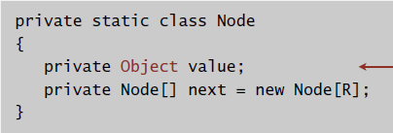
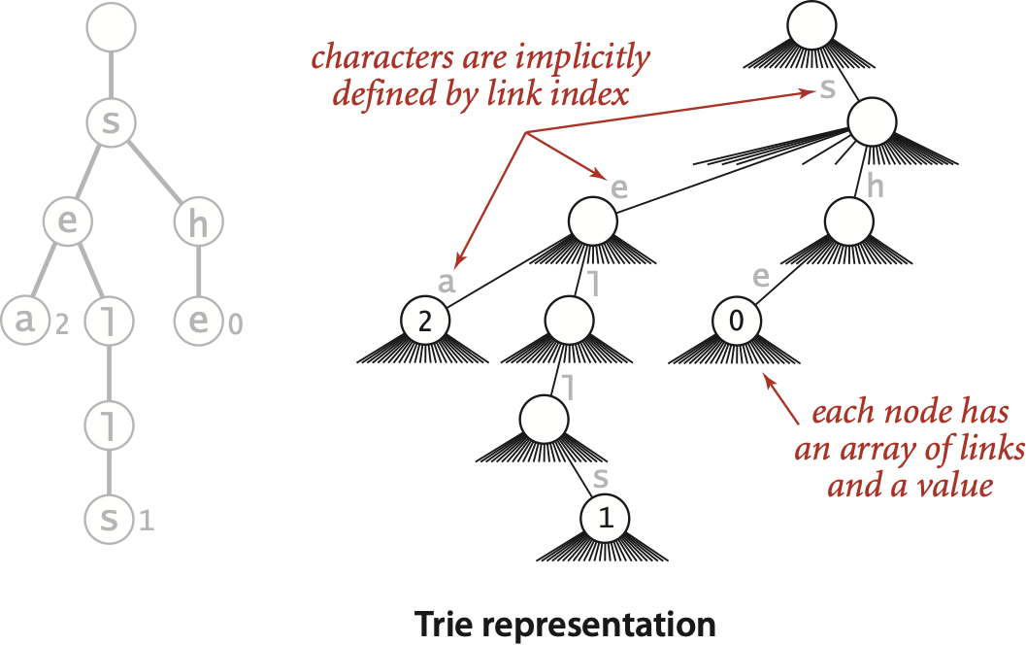
Trie representation: Java implementation
Node. A value, plus references to R nodes.
use Object instead of Value since
no generic array creation in Java
neither keys nor
characters are
explicitly stored
Notes:
Node is static because type of value is Object instead of Value

Slide 14
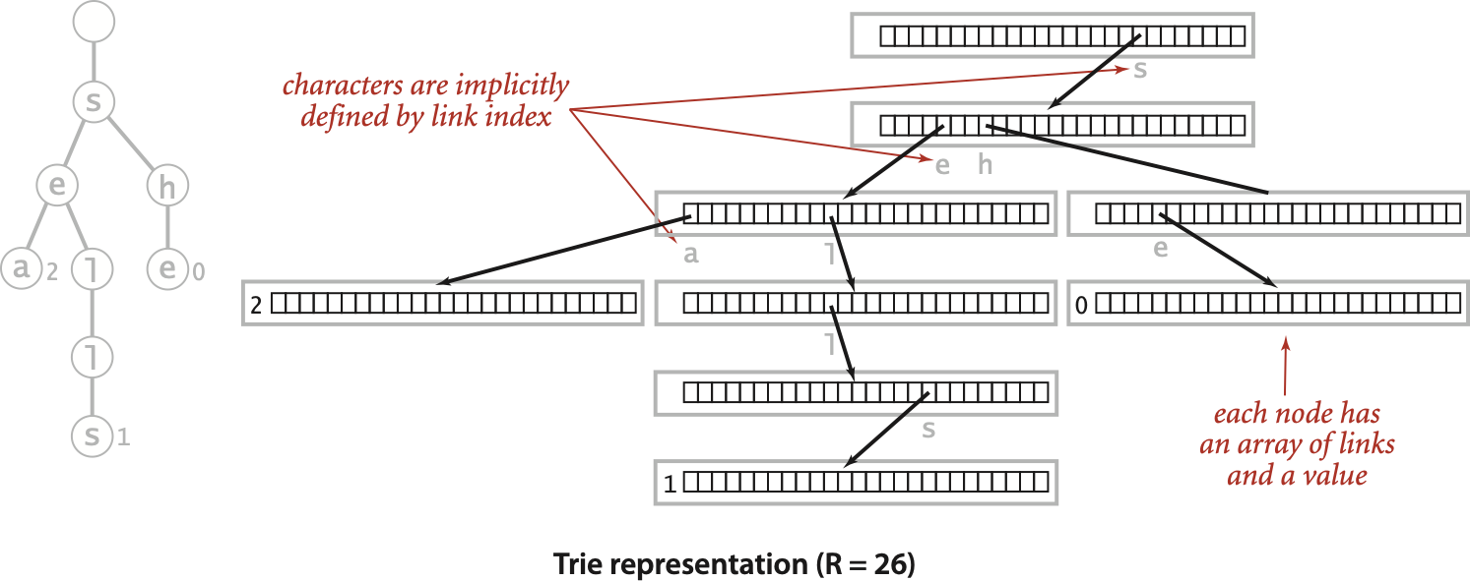
Trie representation: Java implementation
Node. A value, plus references to R nodes.
use Object instead of Value since
no generic array creation in Java
Notes:
keys not explicitly stored

Slide 15
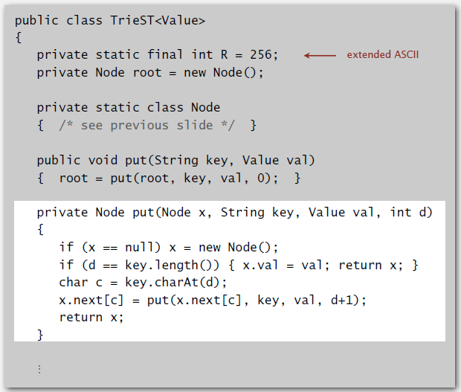
R-way trie: Java implementation

Slide 16
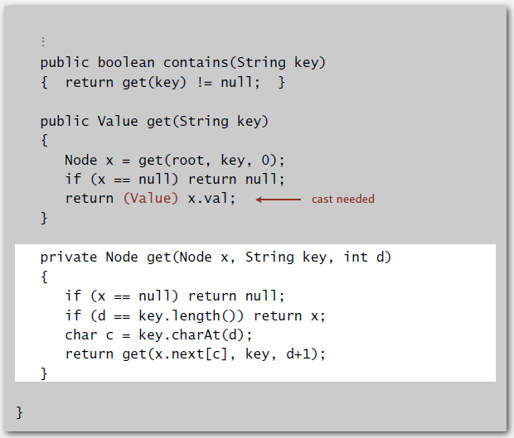
R-way trie: Java implementation (continued)

Slide 17
Trie performance
Search hit. Need to examine all L characters for equality.
Search miss.
  Could have mismatch on first character.
  Typical case: examine only a few characters (sublinear).
Space. R null links at each leaf.
(but sublinear space possible if many short strings share common prefixes)
Bottom line. Fast search hit and even faster search miss, but wastes space.
Notes:
Examine one character to move down one level in the trie.
Stay tuned for ways to address space waste.

Slide 18
Deletion in an R-way trie
To delete a key-value pair:
  Find the node corresponding to key and set value to null.
  If node has null value and all null links, remove that node (and recur).
delete("shells")
b
s
t
s
y
e
h
h
4
h
a
l
e
o
e
6
e
0
5
l
l
r
l
s
l
e
1
l
7
s
s
3
set value to null
Notes:
null links suppressed

Slide 19
Deletion in an R-way trie
To delete a key-value pair:
  Find the node corresponding to key and set value to null.
  If node has null value and all null links, remove that node (and recur).
delete("shells")
b
s
t
s
y
4
e
h
h
a
6
l
e
0
o
e
5
l
l
r
s
1
l
e
7
null value and links
(delete node)
s

Slide 20
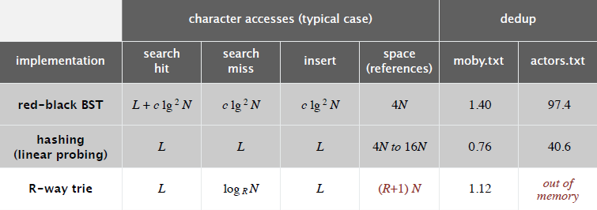
String symbol table implementations cost summary
R-way trie.
  Method of choice for small R.
  Too much memory for large R.
Challenge. Use less memory, e.g., 65,536-way trie for Unicode!

Slide 21
Digression: out of memory?
“ 640 K ought to be enough for anybody. ”
— (mis)attributed to Bill Gates, 1981
(commenting on the amount of RAM in personal computers)
“ 64 MB of RAM may limit performance of some Windows XP
features; therefore, 128 MB or higher is recommended for
best performance. ” — Windows XP manual, 2002
“ 64 bit is coming to desktops, there is no doubt about that.
But apart from Photoshop, I can't think of desktop applications
where you would need more than 4GB of physical memory, which
is what you have to have in order to benefit from this technology.
Right now, it is costly. ” — Bill Gates, 2003

Slide 22
Digression: out of memory?
A short (approximate) history.
machine | year | address bits | addressable memory | typical actual memory | cost
PDP-8 | 1960s | 12 | 6 KB | 6 KB | $16K
PDP-10 | 1970s | 18 | 256 KB | 256 KB | $1M
IBM S/360 | 1970s | 24 | 4 MB | 512 KB | $1M
VAX | 1980s | 32 | 4 GB | 1 MB | $1M
Pentium | 1990s | 32 | 4 GB | 1 GB | $1K
Xeon | 2000s | 64 | enough | 4 GB | $100
?? | future | 128+ | enough | enough | $1
“ 512-bit words ought to be enough for anybody. ”
— Kevin Wayne, 1995

Slide 23
A modest proposal
Number of atoms in the universe (estimated). ≤ 2²⁶⁶.
Age of universe (estimated). 14 billion years ∼ 2⁵⁹ seconds ≤ 2⁸⁹ nanoseconds.
Q. How many bits address every atom that ever existed?
A. Use a unique 512-bit address for every atom at every time quantum.
Ex. Use 256-way trie to map each atom to location.
  Represent atom as 64 8-bit chars (512 bits).
  256-way trie wastes 255/256 actual memory.
  Need better use of memory.
266 bits
89 bits
157 bits
atom
time
cushion for whatever
Notes:
current plan: IPV6 place (128 bits) + machine (64 bits)
Can access anything in 64 steps
Wastes 255/256 actual memory (maybe ok for Bill Gates)

Slide 24
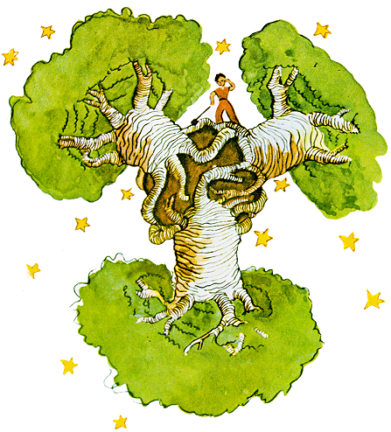
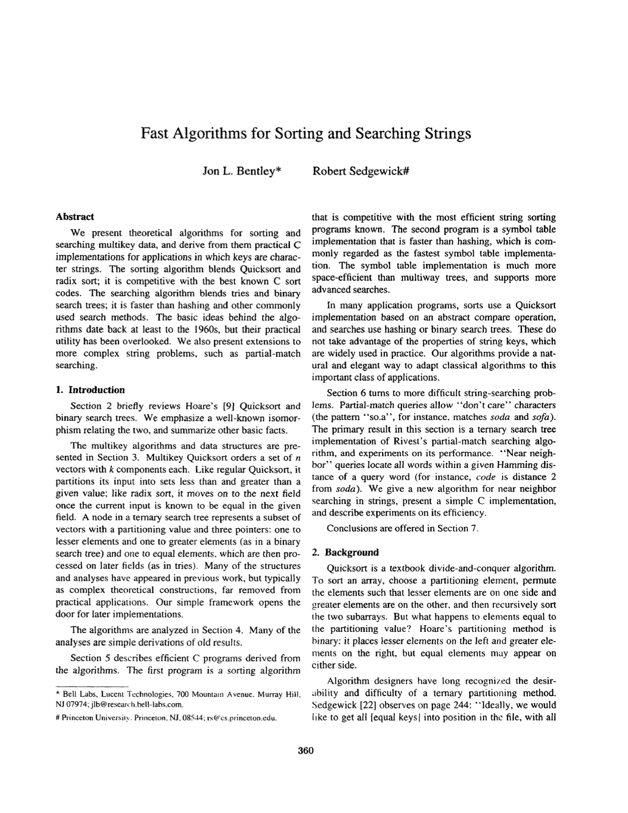
Ternary search tries
  Store characters and values in nodes (not keys).
  Each node has 3 children: smaller (left), equal (middle), larger (right).

Slide 25
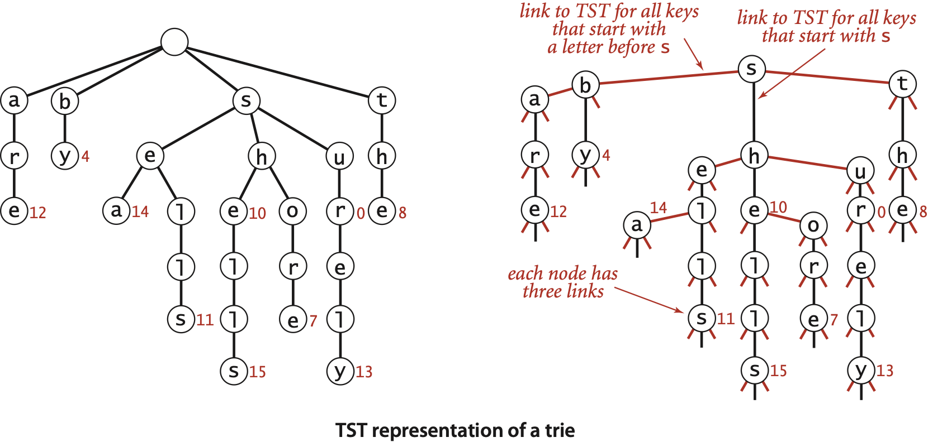
Ternary search tries
  Store characters and values in nodes (not keys).
  Each node has 3 children: smaller (left), equal (middle), larger (right).
Notes:
Observation. Only three null links in leaves!
Black links are the same as for R-way trie; nodes connected by red links form mini BSTs (consider mini BST at root with 4 nodes)

Slide 26
Search hit in a TST
get("sea")
s
s
b
t
y
h
4
h
h
e
e
l
l
e
0
e
5
a
o
6
a
6
l
l
r
return value associated
with last key character
s
1
l
e
7
s
3

Slide 27
Search miss in a TST
get("shelter")
s
s
b
t
y
h
4
h
h
e
l
e
e
0
e
5
6
a
o
l
l
l
r
s
l
1
l
e
7
s
3
no link to t
(return null)

Slide 28
Ternary search trie construction demo
ternary search trie
Notes:
run 52DemoTST.key

Slide 29
Ternary search trie construction demo
ternary search trie
s
b
t
y
4
h
h
e
l
e
0
e
5
6
a
o
l
l
r
s
1
l
e
7
s
3

Slide 30
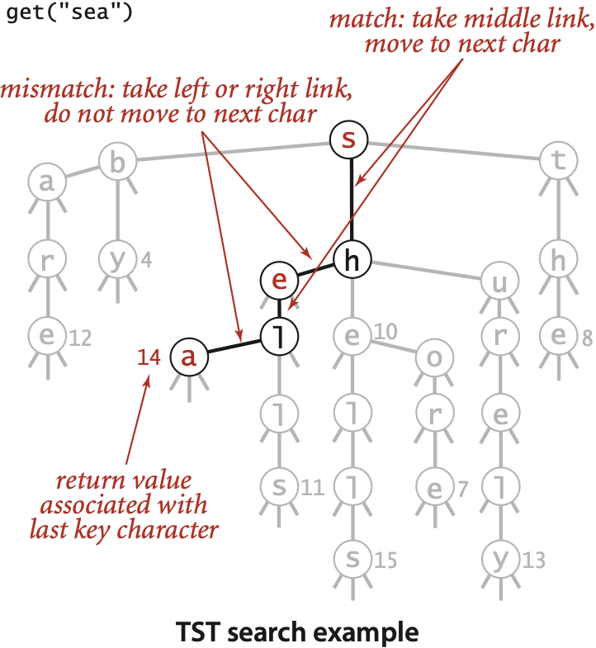
Search in a TST
Follow links corresponding to each character in the key.
  If less, take left link; if greater, take right link.
  If equal, take the middle link and move to the next key character.
Search hit. Node where search ends has a non-null value.
Search miss. Reach a null link or node where search ends has null value.

Slide 31
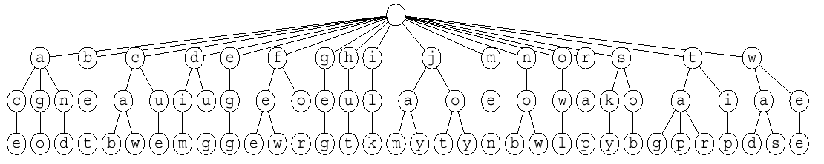
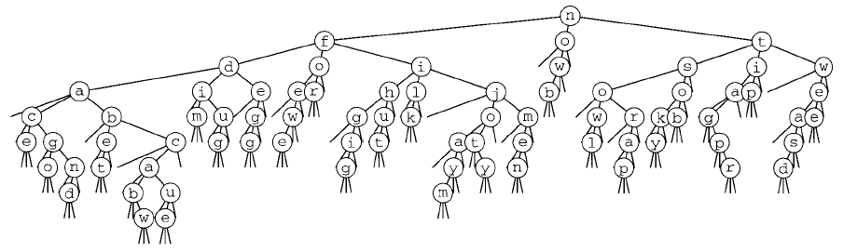
26-way trie vs. TST
now
for
tip
ilk
dim
tag
jot
sob
nob
sky
hut
ace
bet
men
egg
few
jay
owl
joy
rap
gig
wee
was
cab
wad
caw
cue
fee
tap
ago
tar
jam
dug
and
26-way trie. 26 null links in each leaf.
TST. 3 null links in each leaf.
26-way trie (1035 null links, not shown)
TST (155 null links)

Slide 32
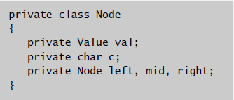
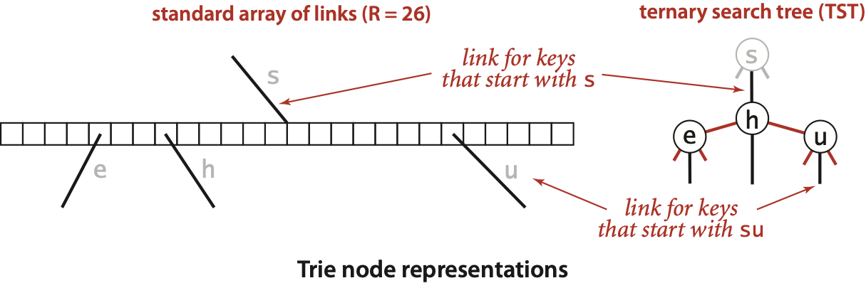
TST representation in Java
A TST node is five fields:
  A value.
  A character c.
  A reference to a left TST.
  A reference to a middle TST.
  A reference to a right TST.
Notes:
Keys not explicitly stored but characters are.
Can use non-static Node class (with Value instead of Object) now because no generic array creation.

Slide 33
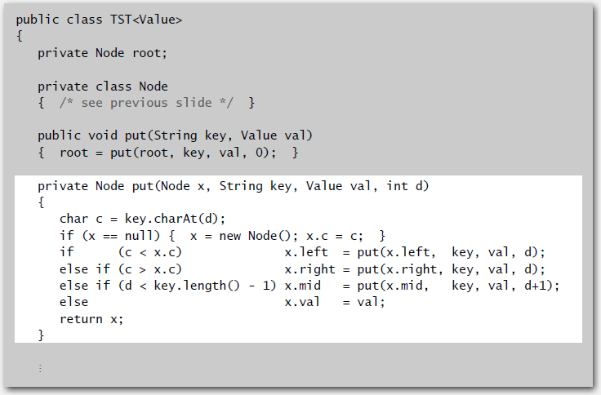
TST: Java implementation
Notes:
Recursive code practically writes itself!
can't handle empty string

Slide 34
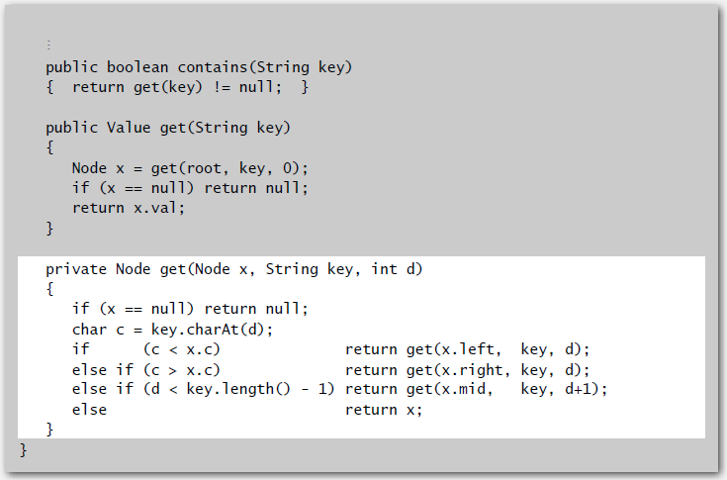
TST: Java implementation (continued)

Slide 35
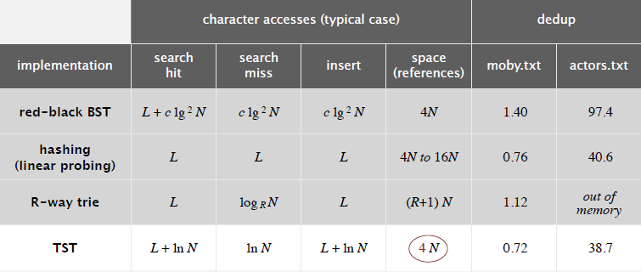
String symbol table implementation cost summary
Remark. Can build balanced TSTs via rotations to achieve L + log N
worst-case guarantees.
Bottom line. TST is as fast as hashing (for string keys), space efficient.
Notes:
timings were done in C

Slide 36
TST vs. hashing
Hashing.
  Need to examine entire key.
  Search hits and misses cost about the same.
  Performance relies on hash function.
  Does not support ordered symbol table operations.
TSTs.
  Works only for string (or digital) keys.
  Only examines just enough key characters.
  Search miss may involve only a few characters.
  Supports ordered symbol table operations (plus extras!).
Bottom line. TSTs are:
  Faster than hashing (especially for search misses).
  More flexible than red-black BSTs. [stay tuned]

Slide 37
String symbol table API
Character-based operations. The string symbol table API supports several useful character-based operations.
Prefix match. Keys with prefix sh: she, shells, and shore.
Wildcard match. Keys that match .he: she and the.
Longest prefix. Key that is the longest prefix of shellsort: shells.
key | value
by | 4
sea | 6
sells | 1
she | 0
shells | 3
shore | 7
the | 5

Slide 38
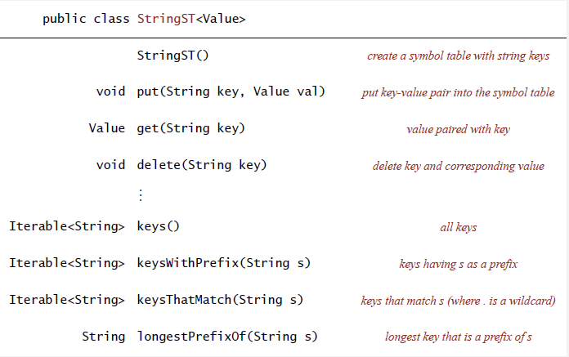
String symbol table API
Remark. Can also add other ordered ST methods, e.g., floor() and rank().

Slide 39
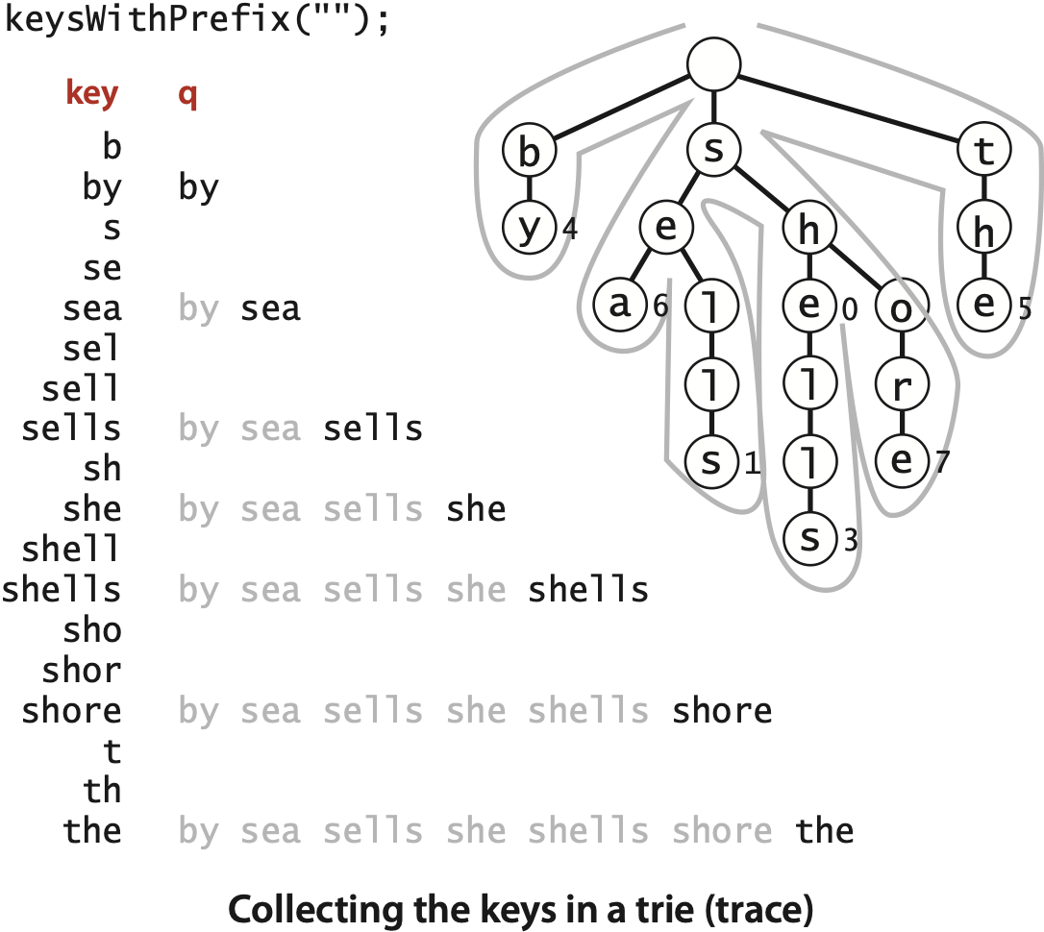
Warmup: ordered iteration
To iterate through all keys in sorted order:
  Do inorder traversal of trie; add keys encountered to a queue.
  Maintain sequence of characters on path from root to node.
keys()

Slide 40
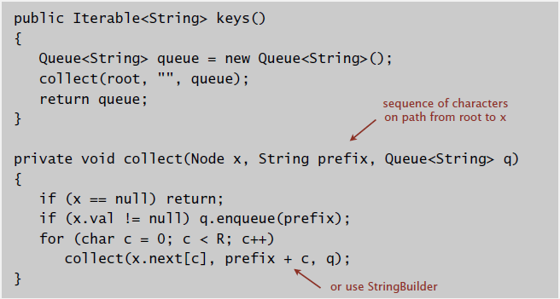
Ordered iteration: Java implementation
To iterate through all keys in sorted order:
  Do inorder traversal of trie; add keys encountered to a queue.
  Maintain sequence of characters on path from root to node.

Slide 41
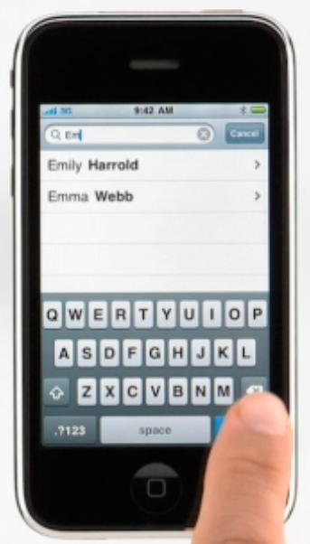
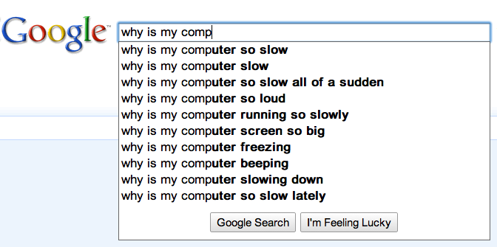
Prefix matches
Find all keys in a symbol table starting with a given prefix.
Ex. Autocomplete in a cell phone, search bar, text editor, or shell.
  User types characters one at a time.
  System reports all matching strings.

Slide 42
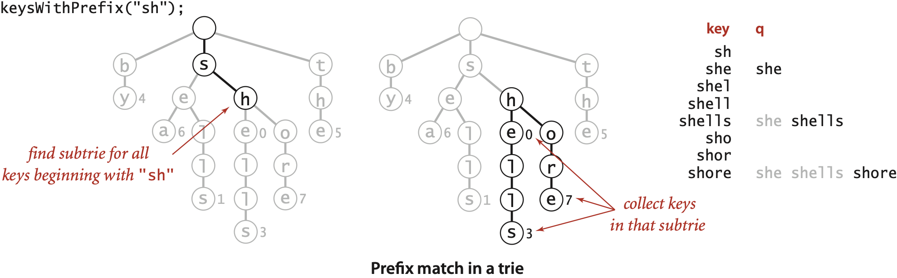
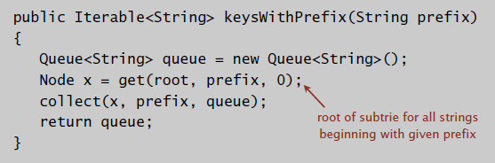
Prefix matches in an R-way trie
Find all keys in a symbol table starting with a given prefix.
key queue

Slide 43
Wildcard matches
Use wildcard . to match any character in alphabet.
co....er
coalizer
coberger
codifier
cofaster
cofather
cognizer
cohelper
colander
coleader
...
compiler
...
composer
computer
cowkeper
.c...c.
acresce
acroach
acuracy
octarch
science
scranch
scratch
scrauch
screich
scrinch
scritch
scrunch
scudick
scutock
Notes:
add figure to describe how to compute wildcard match

Slide 44
Wildcard matches in an R-way trie
Search as usual if character is not a period;
go down all R branches if query character is a period.
public Iterable<String> keysThatMatch(String pat)
{
Queue<String> queue = new Queue<String>();
collect(root, "", 0, pat, queue);
return queue;
}
private void collect(Node x, String prefix, String pat, Queue<String> q)
{
if (x == null) return;
int d = prefix.length();
if (d == pat.length() && x.val != null) q.enqueue(prefix);
if (d == pat.length()) return;
char next = pat.charAt(d);
for (char c = 0; c < R; c++)
if (next == '.' || next == c)
collect(x.next[c], prefix + c, pat, q);
}

Slide 45
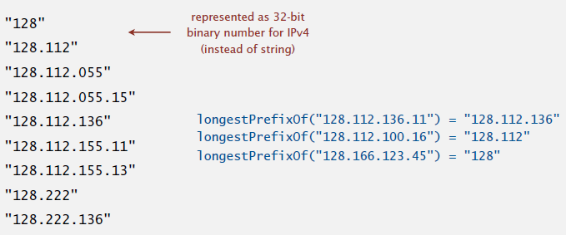
Longest prefix
Find longest key in symbol table that is a prefix of query string.
Ex. To send packet toward destination IP address, router chooses IP address in routing table that is longest prefix match.
Note. Not the same as floor:
floor("128.112.100.16") = "128.112.055.15"
Notes:
Q. Why isn't longest prefix match the same as floor or ceiling?
A. prefix("128.112.100.16") = 128, floor("128.112.100.16") = 128.112.055.15, ceil("128.112.100.16") = 128.112.136
"Each packet that arrives at the router will have the IP address in its destination address field compared against each entry in the routing table, and then will be forwarded to the best next hop. The entry in the routing table with the longest match of its leading bits with the destination address will be used. In practical terms, the concept of longest prefix match means that the most specific route to the destination will be chosen."

Slide 46
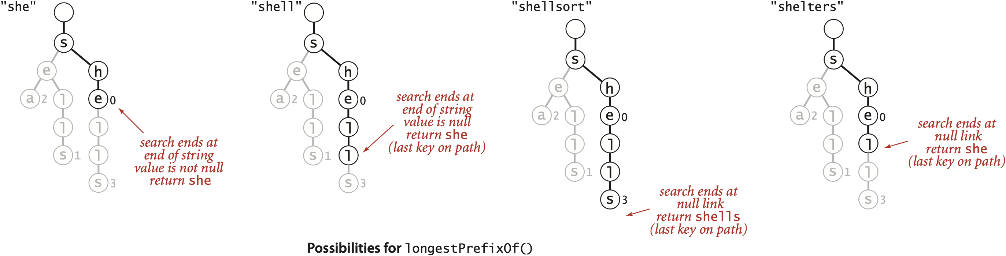
Longest prefix in an R-way trie
Find longest key in symbol table that is a prefix of query string.
  Search for query string.
  Keep track of longest key encountered.
Possibilities for longestPrefixOf()

Slide 47
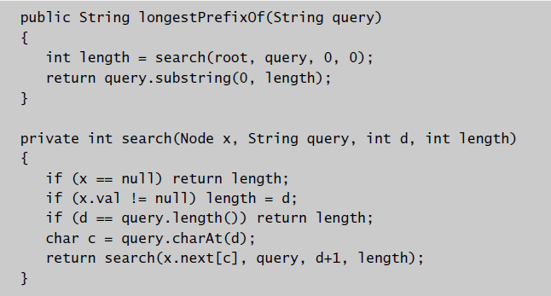
Longest prefix in an R-way trie: Java implementation
Find longest key in symbol table that is a prefix of query string.
  Search for query string.
  Keep track of longest key encountered.

Slide 48
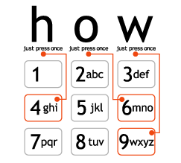
T9 texting
Goal. Type text messages on a phone keypad.
Multi-tap input. Enter a letter by repeatedly pressing a key.
Ex. hello: 4 4 3 3 5 5 5 5 5 5 6 6 6
T9 text input.
  Find all words that correspond to given
  sequence of numbers.
  Press 0 to see all completion options.
Ex. hello: 4 3 5 5 6
Q. How to implement?
"a much faster and more fun way to enter text"
www.t9.com
Notes:
A. To implement use an 8-way trie, with one branch for each of the digits 2-9.
When displaying results, if there are multiple matches, might want to list in order of importance (frequency of word as it appears in standard text)
[wayne s14] probably worth using a example different from "hello" so that there are more than one words that match the T9 input

Slide 49
A letter to t9.com
To: info@t9support.com
Date: Tue, 25 Oct 2005 14:27:21 -0400 (EDT)
Dear T9 texting folks,
I enjoyed learning about the T9 text system
from your webpage, and used it as an example
in my data structures and algorithms class.
However, one of my students noticed a bug
in your phone keypad
http://www.t9.com/images/how.gif
Somehow, it is missing the letter 's'. (!)
Just wanted to bring this information to
your attention and thank you for your website.
Regards,
Kevin
where the @#$% is the 's' ???

Slide 50
A world without 's' ?
To: "'Kevin Wayne'" <wayne@CS.Princeton.EDU>
Date: Tue, 25 Oct 2005 12:44:42 -0700
Thank you Kevin.
I am glad that you find T9 o valuable for your
cla. I had not noticed thi before. Thank for
writing in and letting u know.
Take care,
Brooke nyder
OEM Dev upport
AOL/Tegic Communication
1000 Dexter Ave N. uite 300
eattle, WA 98109
ALL INFORMATION CONTAINED IN THIS EMAIL IS CONSIDERED
CONFIDENTIAL AND PROPERTY OF AOL/TEGIC COMMUNICATIONS

Slide 51
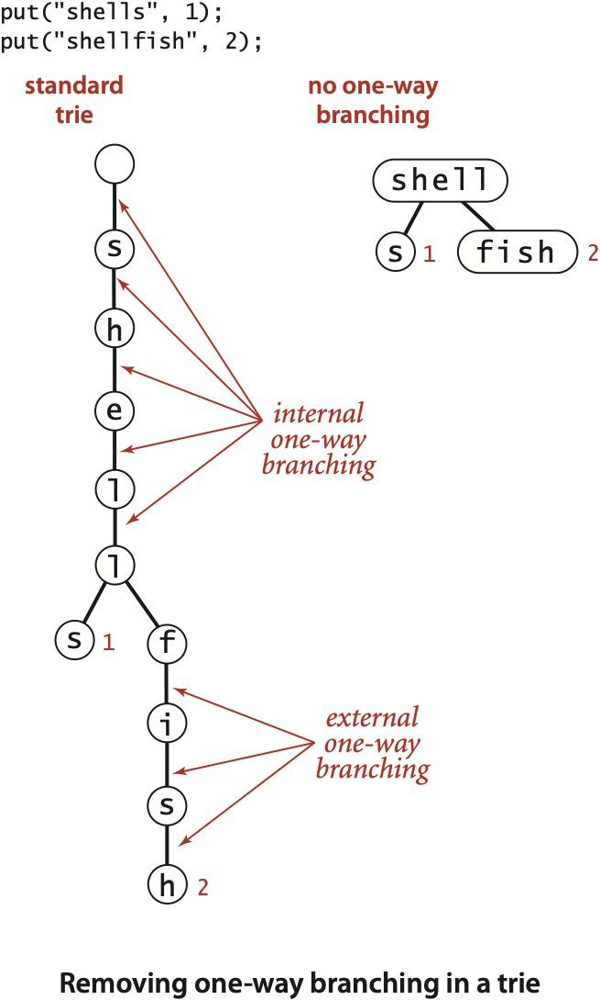
Patricia trie
Patricia trie. [Practical Algorithm to Retrieve Information Coded in Alphanumeric]
  Remove one-way branching.
  Each node represents a sequence of characters.
  Implementation: one step beyond this course.
Applications.
  Database search.
  P2P network search.
  IP routing tables: find longest prefix match.
  Compressed quad-tree for N-body simulation.
  Efficiently storing and querying XML documents.
Also known as: crit-bit tree, radix tree.
Notes:
each node with only 1 child is merged with its child
patricia tries are very space efficient
also known as radix tree and crit-bit tree
sometimes PATRICIA refers only to binary trie

Slide 52
Suffix tree
Suffix tree.
  Patricia trie of suffixes of a string.
  Linear-time construction: well beyond scope of this course.
Applications.
  Linear-time: longest repeated substring, longest common substring,
  longest palindromic substring, substring search, tandem repeats, ….
  Computational biology databases (BLAST, FASTA).
suffix tree for BANANAS
BANANAS
A
NA
S
NA
S
S
NAS
NAS
S
Notes:
Note: suffixes are not in sorted order (mississippi is to the left of ippi)
Suffix tree also maintains a suffix pointer in each internal node that points to the next smaller (in terms of length) suffix, e.g., issi[ssippi$] points to ssi[ssippi$]
Uses $ as string termination character.

Slide 53
String symbol tables summary
A success story in algorithm design and analysis.
Red-black BST.
  Performance guarantee: log N key compares.
  Supports ordered symbol table API.
Hash tables.
  Performance guarantee: constant number of probes.
  Requires good hash function for key type.
Tries. R-way, TST.
  Performance guarantee: log N characters accessed.
  Supports character-based operations.
Bottom line. You can get at anything by examining 50-100 bits (!!!)
Notes:
[wayne s14] note that performance guarantees make different assumptions

