Slide 1
More Shortest Paths
COMP 2100
Otterbein University

Slide 2
Alerts
Lab 7 due Wednesday, 11/30
Project #3 due Friday, 12/2
Homework #9 due Friday, 11/18
Meet in Point 140 on Friday for Science Lecture Series
Final Exam: Friday, December 9
Exam will be at 10:15am

Slide 3
Generic shortest-paths algorithm
Efficient implementations. How to choose which edge to relax?
Ex 1. Dijkstra's algorithm (nonnegative weights).
Ex 2. Topological sort algorithm (no directed cycles).
Ex 3. Bellman-Ford algorithm (no negative cycles).
Generic algorithm (to compute SPT from s)
Initialize distTo[s] = 0 and distTo[v] = ∞ for all other vertices.
Repeat until optimality conditions are satisfied: − Relax any edge.

Slide 4
Dijkstra's algorithm: correctness proof 2
Invariant. For v in T, distTo[v] is the length of the shortest path from s to v.
Proof: [ by induction on | T | ]
Let w be next vertex added to T.
Let P* be the s ↝ w path through v.
Consider any other s ↝ w path P; let x be first vertex on path outside T.
P is already as long as P* as soon as it reaches x by greedy choice.
Thus, distTo[w] is the length of the shortest path from s to w.
assuming that edge weights are nonnegative
P
x
s
P*
T
v
w

Slide 5
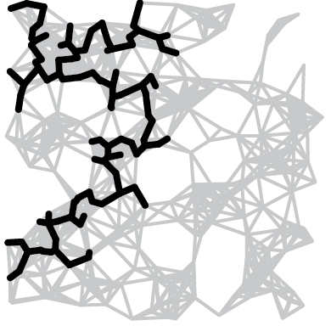
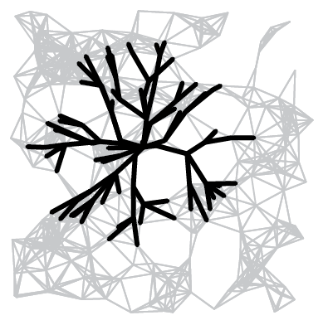
Computing a spanning tree in a graph
Dijkstra's algorithm seem familiar?
Prim's algorithm is essentially the same algorithm.
Both are in a family of algorithms that compute a spanning tree.
Main distinction: Rule used to choose next vertex for the tree.
Prim: Closest vertex to the tree (via an undirected edge).
Dijkstra: Closest vertex to the source (via a directed path).
Note: DFS and BFS are also in this family of algorithms.

Slide 6
Priority-first search
Insight. Four of our graph-search methods are the same algorithm!
Maintain a set of explored vertices S.
Grow S by exploring edges with exactly one endpoint leaving S.
DFS. Take edge from vertex which was discovered most recently.
BFS. Take edge from vertex which was discovered least recently.
Prim. Take edge of minimum weight.
Dijkstra. Take edge to vertex that is closest to S.
Challenge. Express this insight in reusable Java code.
e
w
S
v
s

Slide 7
Content-aware resizing
Seam carving. [Avidan and Shamir] Resize an image without distortion for display on cell phones and web browsers.
http://www.youtube.com/watch?v=vIFCV2spKtg

Slide 8
Content-aware resizing
Seam carving. [Avidan and Shamir] Resize an image without distortion for display on cell phones and web browsers.
Notes:
also known as image retargeting, content-aware image resizing, content-aware scaling, liquid resizing, or liquid rescaling

Slide 9
Content-aware resizing
To find vertical seam:
Grid DAG: vertex = pixel; edge = from pixel to 3 downward neighbors.
Weight of pixel = energy function of 8 neighboring pixels.
Seam = shortest path (sum of vertex weights) from top to bottom.

Slide 10
Content-aware resizing
To find vertical seam:
Grid DAG: vertex = pixel; edge = from pixel to 3 downward neighbors.
Weight of pixel = energy function of 8 neighboring pixels.
Seam = shortest path (sum of vertex weights) from top to bottom.
seam
Notes:
[wayne f12] add reduction from edge weights to vertex weights? Multiple source and multiple sink to single source and single sink.

Slide 11
Content-aware resizing
To remove vertical seam:
Delete pixels on seam (one in each row).
seam

Slide 12
Content-aware resizing
To remove vertical seam:
Delete pixels on seam (one in each row).

Slide 13
Shortest path variants
Q1. How to model both vertex and edge weights?
Q2. How to model multiple sources and sinks?
x
a
c
a
c
v
d
v
x
v'
d
b
e
b
e
Notes:
A1. vertex splitting trick. (Note: if want to model only vertex weights and no edge weights, can make every edge pointing to v have weight equal to the weight of vertex v.)
A2. Supersource and supersink trick.
Q3. Undirected graph. Replace every edge with two antiparallel edges (assuming edges are nonnegative).

Slide 14
Shortest paths with negative weights: failed attempts
Dijkstra. Doesn’t work with negative edge weights.
Re-weighting. Add a constant to every edge weight doesn’t work.
Conclusion. Need a different algorithm.
0
6
1
2
4
-8
Dijkstra selects vertex 3 immediately after 0.
But shortest path from 0 to 3 is 0→1→2→3.
3
3
2
0
14
1
Adding 8 to each edge weight changes the shortest path from 0→1→2→3 to 0→3.
10
12
0
3
11
2
Notes:
first thing to notice is that easy ideas don't work
reweighting doesn't work because it changes the relative weights of paths of different lengths

Slide 15
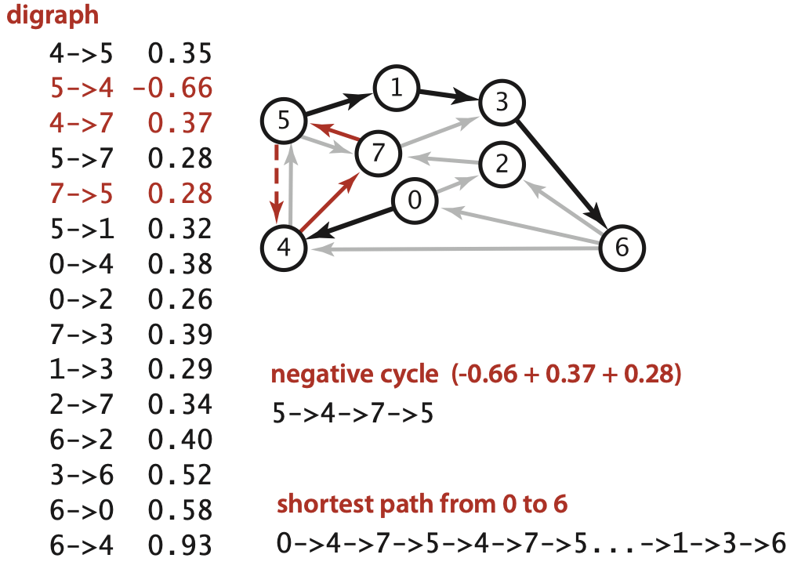
Negative cycles
Def. A negative cycle is a directed cycle whose sum of edge weights is negative.
Proposition. A SPT exists iff no negative cycles.
s
assuming all vertices reachable from s
Notes:
If all vertices not reachable from s, then SPT exists iff no negative cycle reachable from s.

Slide 16
Bellman-Ford algorithm

Slide 17
Bellman-Ford algorithm demo
Repeat V times: relax all E edges.
0→1 5.0
0→4 9.0
0→7 8.0
1→2 12.0
1→3 15.0
1→7 4.0
2→3 3.0
2→6 11.0
3→6 9.0
4→5 4.0
4→6 20.0
4→7 5.0
5→2 1.0
5→6 13.0
7→5 6.0
7→2 7.0
1
15
3
5
4
s
0
12
3
8
7
7
2
9
9
6
1
11
5
5
4
13
4
20
6
an edge-weighted digraph
Notes:
run 44DemoBellmanFord.key

Slide 18
Bellman-Ford algorithm demo
Repeat V times: relax all E edges.
1
3
v distTo[] edgeTo[]
0 0.0 -
1 5.0 0→1
2 14.0 5→2
3 17.0 2→3
4 9.0 0→4
5 13.0 4→5
6 25.0 2→6
7 8.0 0→7
s
0
7
2
5
4
6
shortest-paths tree from vertex s

Slide 19
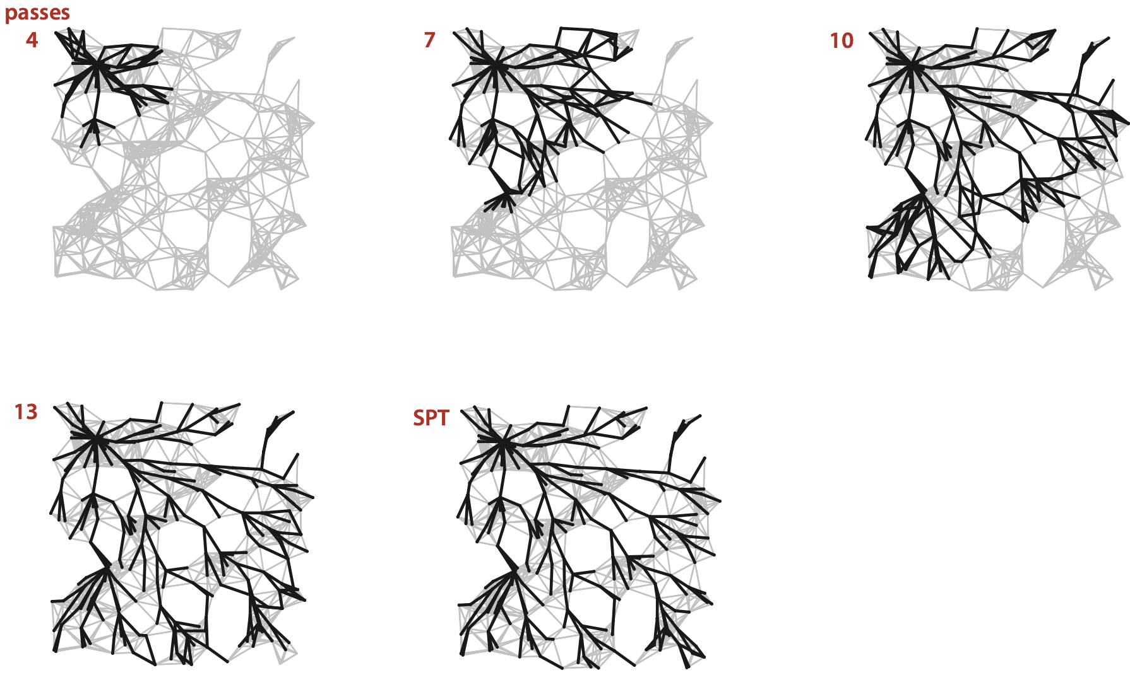
Bellman-Ford algorithm: visualization
Notes:
250 vertices

Slide 20
Bellman-Ford algorithm: analysis
Proposition. Dynamic programming algorithm computes SPT in any edge-weighted digraph with no negative cycles in time proportional to E × V.
Proof idea: After pass i, found shortest path to each vertex v for which the shortest path from s to v contains i edges (or fewer).
Bellman-Ford algorithm
Initialize distTo[s] = 0 and distTo[v] = ∞ for all other vertices.
Repeat V times: − Relax each edge.
Notes:
See textbook for details.

Slide 21
Bellman-Ford algorithm: practical improvement
Observation. If distTo[v] does not change during pass i, no need to relax any edge pointing from v in pass i+1.
FIFO implementation. Maintain queue of vertices whose distTo[] changed.
Overall effect.
The running time is still proportional to E × V in worst case.
But much faster than that in practice.
be careful to keep at most one copy
of each vertex on queue (why?)
Notes:
if we allow inserting a vertex on queue multiple times, the running time may blow up exponentially

Slide 22
Bellman-Ford algorithm
http://xkcd.com/69

Slide 23
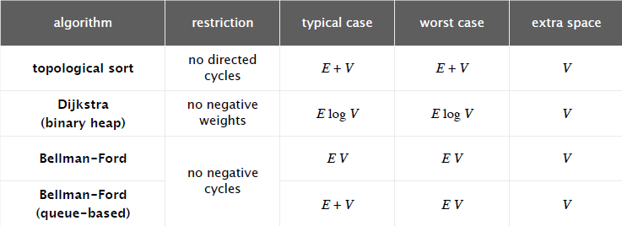
Single source shortest-paths implementation: cost summary
Remark 1. Directed cycles make the problem harder.
Remark 2. Negative weights make the problem harder.
Remark 3. Negative cycles makes the problem intractable.
Notes:
running times assume graph is connected so E >= V -1.

