Slide 1
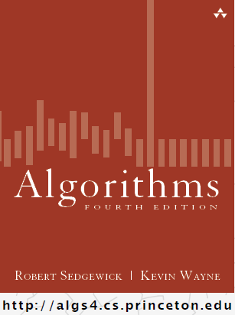
Shortest Paths
COMP 2100
Otterbein University

Slide 2
Alerts
Lab 7 due Wednesday, 11/30
Project #3 due Friday, 12/2
Homework #9 due Friday, 11/18
Final Exam: Friday, December 9
  Exam will be at 10:15am

Slide 3
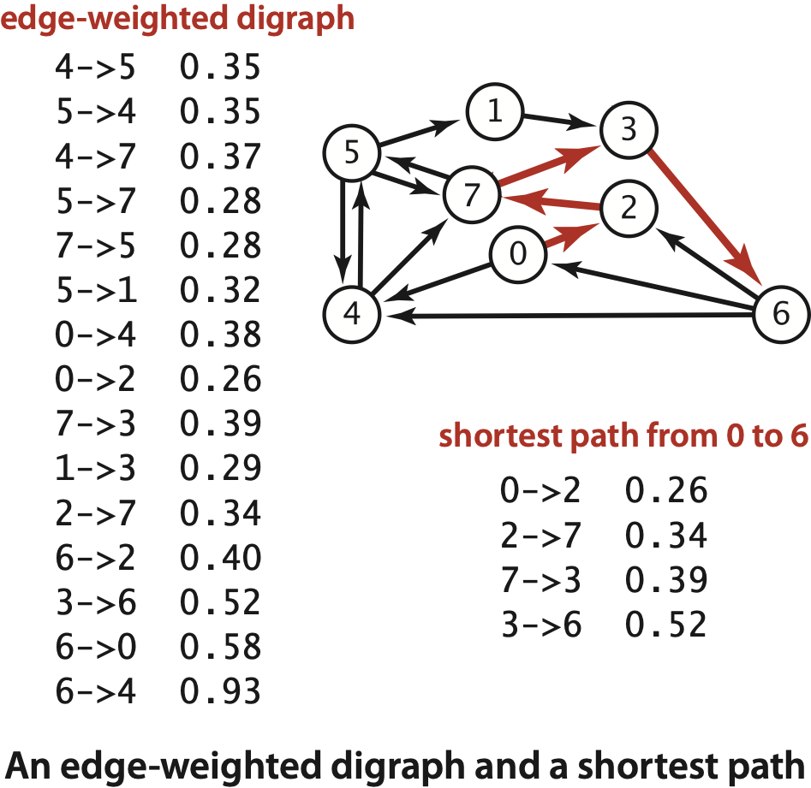
Shortest paths in an edge-weighted digraph
Given an edge-weighted digraph, find the shortest path from s to t.
Notes:
Cost of path = sum of weights of edges in part
Note: weights are arbitrary numbers not necessarily distances; need not satisfy the triangle inequality
Ex: airline fares [stay tuned for others]

Slide 4
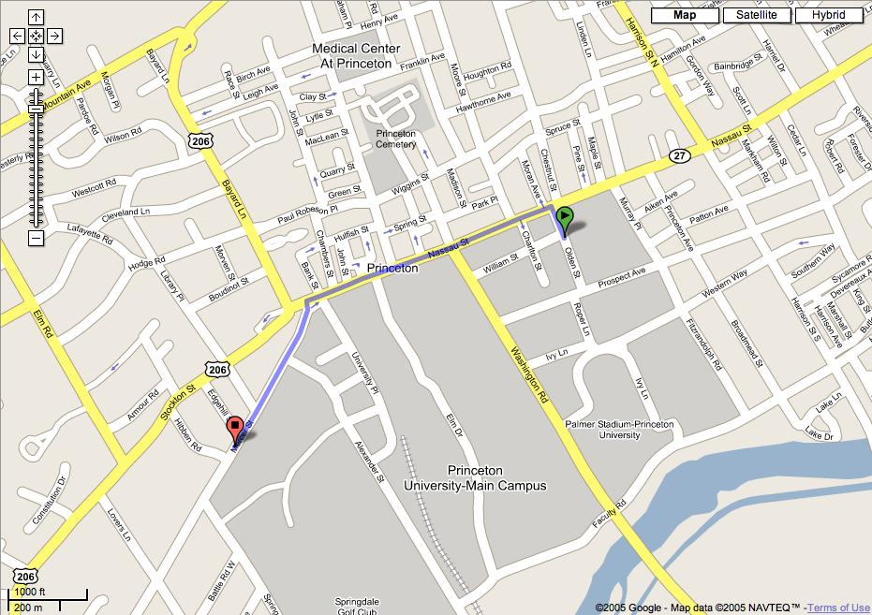
Google maps
Notes:
Princeton CS dept to Einstein's house

Slide 5
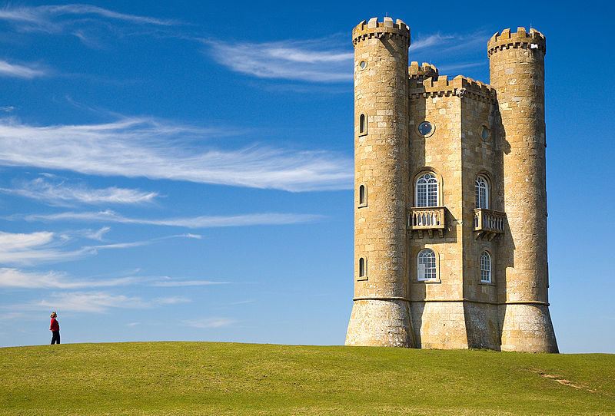
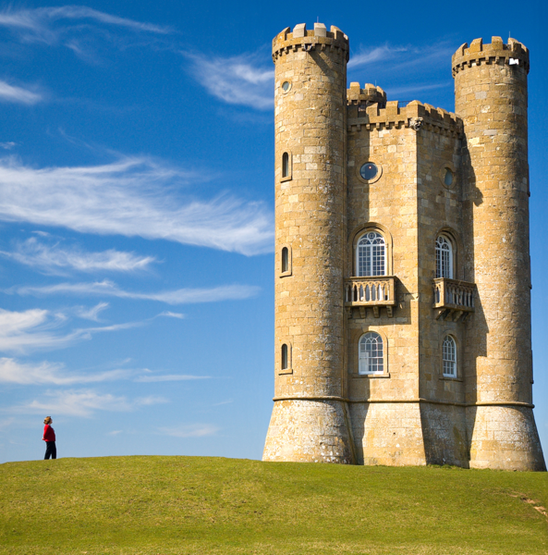
Shortest path applications
  PERT/CPM.
  Map routing.
  Seam carving.
  Texture mapping.
  Robot navigation.
  Typesetting in TeX.
  Urban traffic planning.
  Optimal pipelining of VLSI chip.
  Telemarketer operator scheduling.
  Routing of telecommunications messages.
  Network routing protocols (OSPF, BGP, RIP).
  Exploiting arbitrage opportunities in currency exchange.
  Optimal truck routing through given traffic congestion pattern.
http://en.wikipedia.org/wiki/Seam_carving
Reference: Network Flows: Theory, Algorithms, and Applications, R. K. Ahuja, T. L. Magnanti, and J. B. Orlin, Prentice Hall, 1993.
Notes:
Shortest-paths is a broadly useful problem-solving model.
We'll talk about seam carving and arbitrage later in this lecture.
Most applications were taken from Ahuja, Magnanti, Orlin
OSPF = routing Internet Protocol within a domain, e.g., Princeton

Slide 6

Shortest path variants
Which vertices?
  Single source: from one vertex s to every other vertex.
  Single sink: from every vertex to one vertex t.
  Source-sink: from one vertex s to another t.
  All pairs: between all pairs of vertices.
Restrictions on edge weights?
  Nonnegative weights.
  Euclidean weights.
  Arbitrary weights.
Cycles?
  No directed cycles.
  No "negative cycles."
Simplifying assumption. Shortest paths from s to each vertex v exist.
which variant?
Notes:
Which version? Single sink with nonnegative weights.

Slide 7
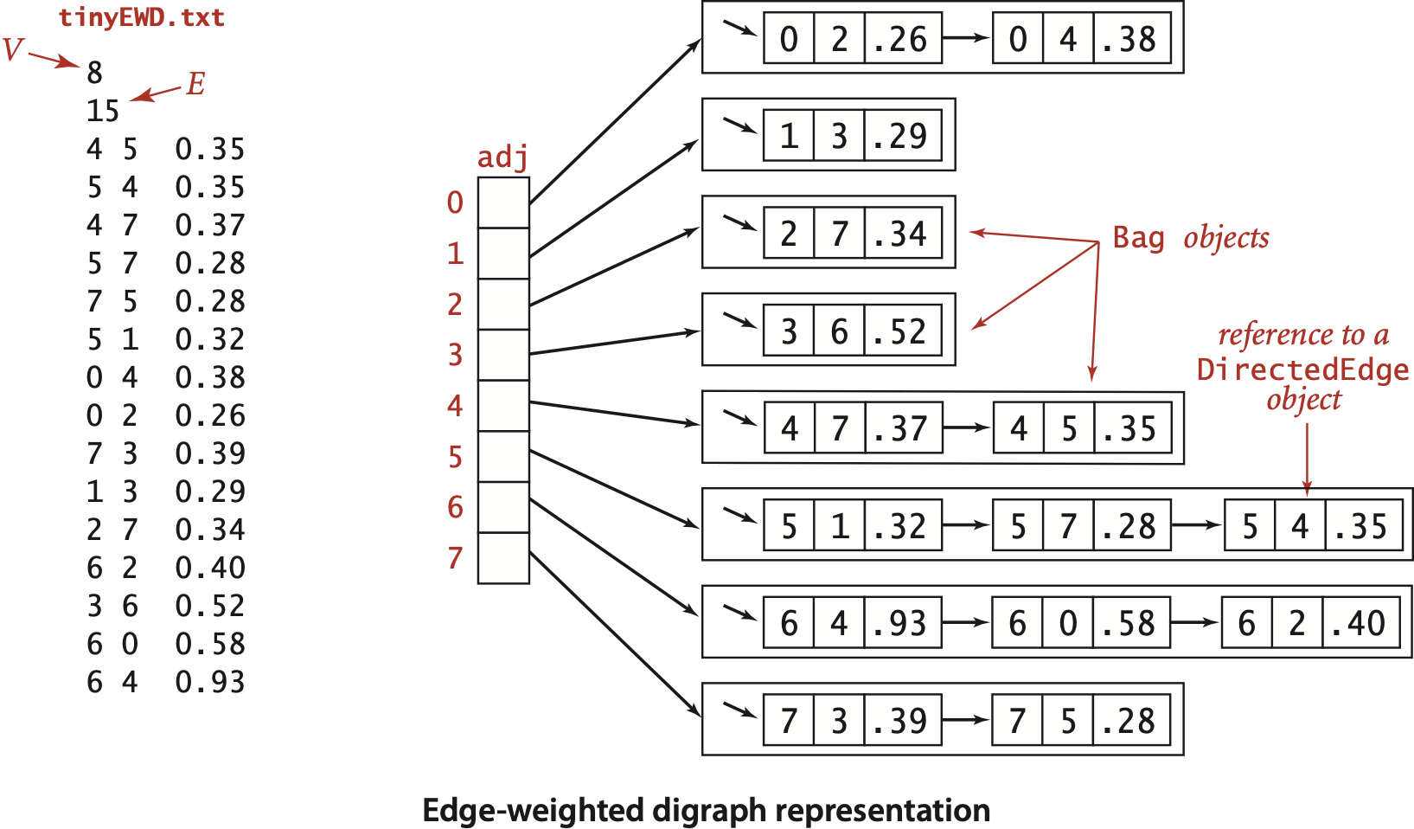
Edge-weighted digraph:adjacency-lists representation

Slide 8
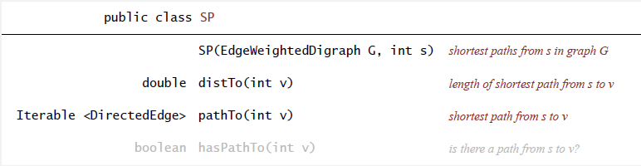
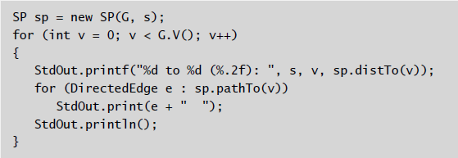
Single-source shortest paths API
Goal. Find the shortest path from s to every other vertex.

Slide 9
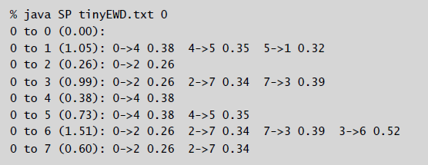
Single-source shortest paths API
Goal. Find the shortest path from s to every other vertex.

Slide 10
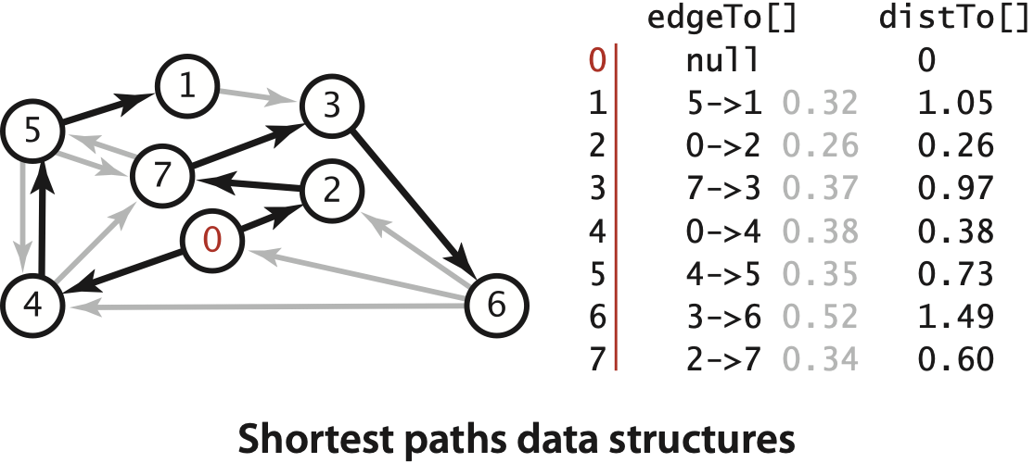
Data structures for single-source shortest paths
Goal. Find the shortest path from s to every other vertex.
Observation. A shortest-paths tree (SPT) solution exists. Why?
Consequence. Can represent the SPT with two vertex-indexed arrays:
  distTo[v] is length of shortest path from s to v.
  edgeTo[v] is last edge on shortest path from s to v.
shortest-paths tree from 0
parent-link representation
Notes:
Why? If two shortest paths from s to v, delete last edge on one of the paths. Repeat until solution is a tree.
Note: this also implies that there is shortest paths that is simple (no repeated vertices).
This implies that we can use parent-link representation to store SPT.
Recall we are assuming all vertices are reachable from s.

Slide 11
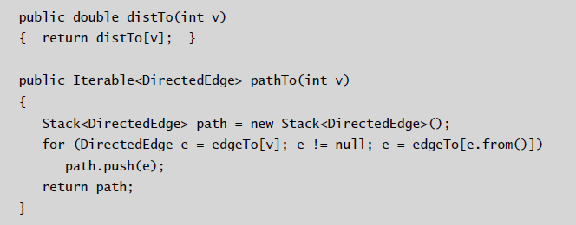
Data structures for single-source shortest paths
Goal. Find the shortest path from s to every other vertex.
Observation. A shortest-paths tree (SPT) solution exists. Why?
Consequence. Can represent the SPT with two vertex-indexed arrays:
  distTo[v] is length of shortest path from s to v.
  edgeTo[v] is last edge on shortest path from s to v.

Slide 12
Edge relaxation
Relax edge e = v→w.
  distTo[v] is length of shortest known path from s to v.
  distTo[w] is length of shortest known path from s to w.
  edgeTo[w] is last edge on shortest known path from s to w.
  If e = v→w gives shorter path to w through v,
  update both distTo[w] and edgeTo[w].
v→w successfully relaxes
v
3.1
1.3
s
w
7.2
4.4
black edges
are in edgeTo[]

Slide 13
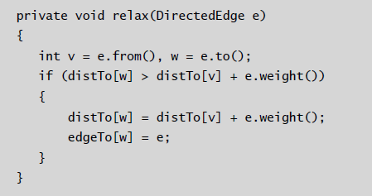
Edge relaxation
Relax edge e = v→w.
  distTo[v] is length of shortest known path from s to v.
  distTo[w] is length of shortest known path from s to w.
  edgeTo[w] is last edge on shortest known path from s to w.
  If e = v→w gives shorter path to w through v,
  update both distTo[w] and edgeTo[w].

Slide 14
Shortest-paths optimality conditions
Proposition. Let G be an edge-weighted digraph.
Then distTo[] are the shortest path distances from s iff:
  distTo[s] = 0.
  For each vertex v, distTo[v] is the length of some path from s to v.
  For each edge e = v→w, distTo[w] ≤ distTo[v] + e.weight().
Proof: ⇐ [ necessary ]
  Suppose that distTo[w] > distTo[v] + e.weight() for some edge e = v→w.
  Then, e gives a path from s to w (through v) of length less than distTo[w].
v
3.1
distTo[v]
1.3
s
w
7.2
distTo[w]
Notes:
let's just talk about distances (the argument for the paths is similar)
our algorithms will always ensure that distTo[v] is the length of some path from s to v

Slide 15
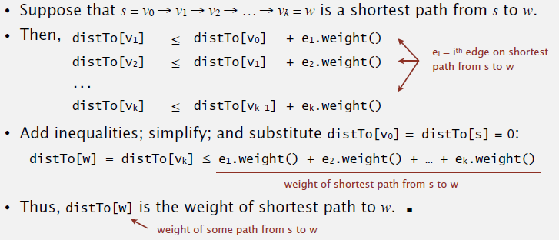
Shortest-paths optimality conditions
Proposition. Let G be an edge-weighted digraph.
Then distTo[] are the shortest path distances from s iff:
  distTo[s] = 0.
  For each vertex v, distTo[v] is the length of some path from s to v.
  For each edge e = v→w, distTo[w] ≤ distTo[v] + e.weight().
Proof: ⇒ [ sufficient ]
Notes:
[wayne s14] font: times vs. lucida sans
Suppose that inequality is satisfied for all edges e.

Slide 16
Generic shortest-paths algorithm
Proposition. Generic algorithm computes SPT (if it exists) from s.
Proof sketch.
  The entry distTo[v] is always the length of a simple path from s to v.
  Each successful relaxation decreases distTo[v] for some v.
  The entry distTo[v] can decrease at most a finite number of times. 
Generic algorithm (to compute SPT from s)
Initialize distTo[s] = 0 and distTo[v] = ∞ for all other vertices.
Repeat until optimality conditions are satisfied:
− Relax any edge.
Notes:
Note: SPT exists iff all vertices reachable from s and no negative cycles
some care is needed to argue that edgeTo[] gives SPT because during updates edgeTo[v] may lead back to path of length strictly less than distTo[v].
distTo[v] decreases at most a finite number of times because it is the length of some simple path (and there are a finite number of simple paths)

Slide 17
Generic shortest-paths algorithm
Efficient implementations. How to choose which edge to relax?
Ex 1. Dijkstra's algorithm (nonnegative weights).
Ex 2. Topological sort algorithm (no directed cycles).
Ex 3. Bellman-Ford algorithm (no negative cycles).
Generic algorithm (to compute SPT from s)
Initialize distTo[s] = 0 and distTo[v] = ∞ for all other vertices.
Repeat until optimality conditions are satisfied:
− Relax any edge.

Slide 18
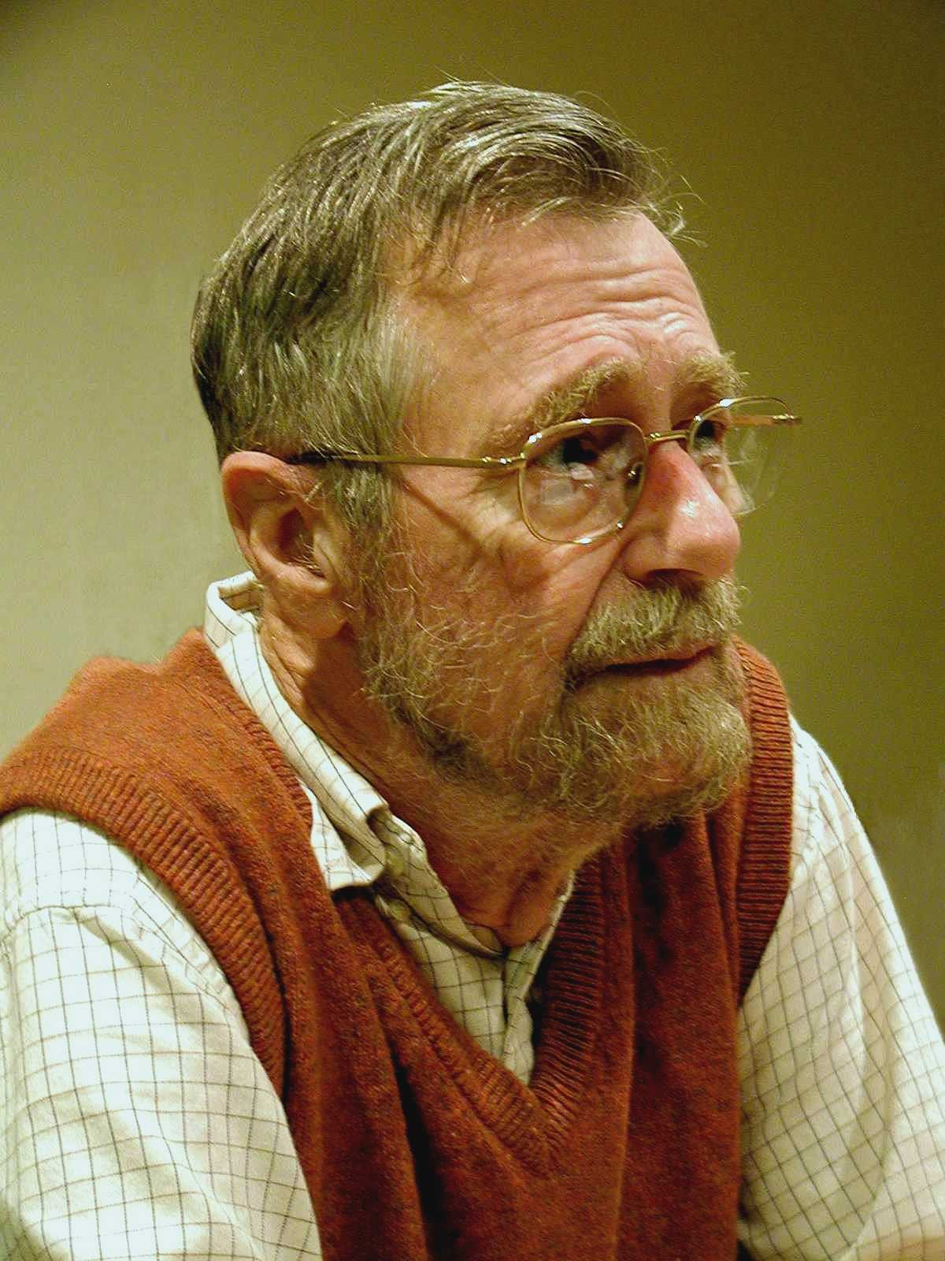
Edsger W. Dijkstra: select quotes
“ Do only what only you can do. ”
“ In their capacity as a tool, computers will be but a ripple on the
surface of our culture. In their capacity as intellectual challenge,
they are without precedent in the cultural history of mankind. ”
“ The use of COBOL cripples the mind; its teaching should,
therefore, be regarded as a criminal offence. ”
“ It is practically impossible to teach good programming to
students that have had a prior exposure to BASIC: as potential
programmers they are mentally mutilated beyond hope of
regeneration. ”
“ APL is a mistake, carried through to perfection. It is the
language of the future for the programming techniques
of the past: it creates a new generation of coding bums. ”
Edsger W. Dijkstra
Turing award 1972
Notes:
Dijkstra is a famous figure in computer science
you can amuse yourself by reading some of his famous quotes
COBOL is a programming language for business that tried to make code look like English

Slide 19
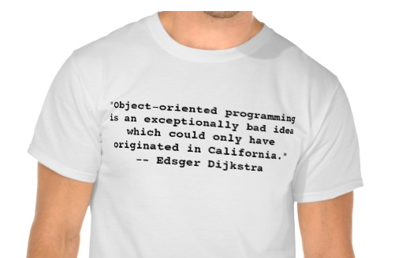
Edsger W. Dijkstra: select quotes
Notes:
http://www.zazzle.com/dijkstra_on_object_oriented_programming_and_cali_tshirt-235725459155842241

Slide 20

Dijkstra's algorithm demo
  Consider vertices in increasing order of distance from s
  (non-tree vertex with the lowest distTo[] value).
  Add vertex to tree and relax all edges pointing from that vertex.
0→1 5.0
0→4 9.0
0→7 8.0
1→2 12.0
1→3 15.0
1→7 4.0
2→3 3.0
2→6 11.0
3→6 9.0
4→5 4.0
4→6 20.0
4→7 5.0
5→2 1.0
5→6 13.0
7→5 6.0
7→2 7.0
1
15
3
5
4
s
0
12
3
8
7
7
2
9
9
6
1
11
5
5
4
13
4
20
6
an edge-weighted digraph
Notes:
run 44Dijkstra.key demo

Slide 21
Dijkstra's algorithm demo
  Consider vertices in increasing order of distance from s
  (non-tree vertex with the lowest distTo[] value).
  Add vertex to tree and relax all edges pointing from that vertex.
1
3
v distTo[] edgeTo[]
0 0.0 -
1 5.0 0→1
2 14.0 5→2
3 17.0 2→3
4 9.0 0→4
5 13.0 4→5
6 25.0 2→6
7 8.0 0→7
s
0
7
2
5
4
6
shortest-paths tree from vertex s

Slide 22
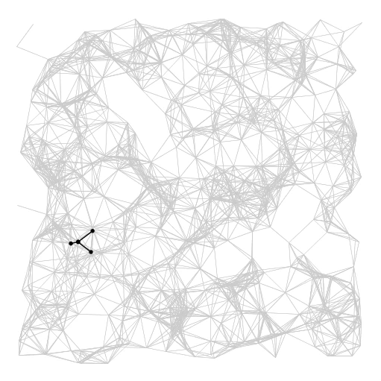
Dijkstra's algorithm visualization
Notes:
this graph is undirected but we specified Dijkstra on digraphs
can think of the empty spaces as lakes

Slide 23
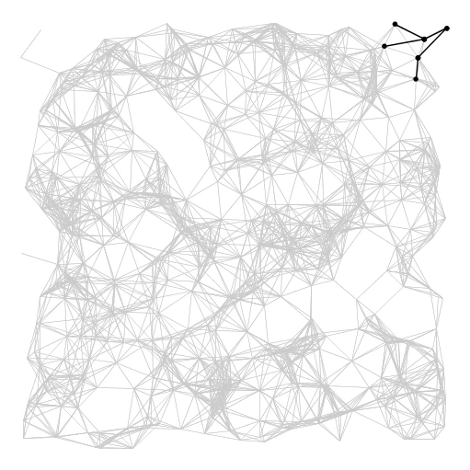
Dijkstra's algorithm visualization
Notes:
if you happen to live at a corner of the earth, it takes a bit longer to get to the opposite corner

Slide 24
Dijkstra's algorithm: correctness proof 1
Proposition. Dijkstra's algorithm computes a SPT in any edge-weighted digraph with nonnegative weights.
Proof:
  Each edge e = v→w is relaxed exactly once (when vertex v is relaxed),
  leaving distTo[w] ≤ distTo[v] + e.weight().
  Inequality holds until algorithm terminates because:
    distTo[w] cannot increase
    distTo[v] will not change
  Thus, upon termination, shortest-paths optimality conditions hold. 
distTo[] values are monotone decreasing
we choose lowest distTo[] value at each step
(and edge weights are nonnegative)
Notes:
distTo[] values change only during edge relaxation, and edge relaxation cannot increase a distTo[] value
distTo[v] does not decrease because when it is relaxed, it can set only distTo[] values that are greater than or equal to that of distTo[v]

Slide 25
Dijkstra's algorithm: correctness proof 2
Invariant. For v in T, distTo[v] is the length of the shortest path from s to v.
Proof: [ by induction on | T | ]
  Let w be next vertex added to T.
  Let P* be the s ↝ w path through v.
  Consider any other s ↝ w path P; let x be first vertex on path outside T.
  P is already as long as P* as soon as it reaches x by greedy choice.
  Thus, distTo[w] is the length of the shortest path from s to w.
assuming that edge
weights are nonnegative
P
x
s
P*
T
v
w

Slide 26
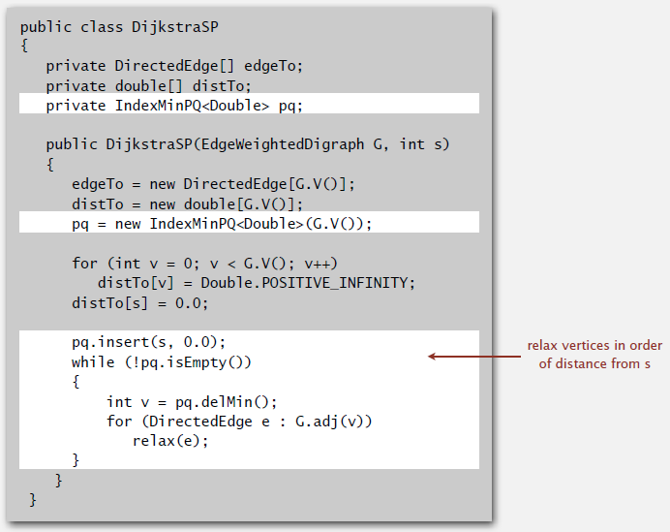
Dijkstra's algorithm: Java implementation
Notes:
note similarity to Prim's implementation

Slide 27
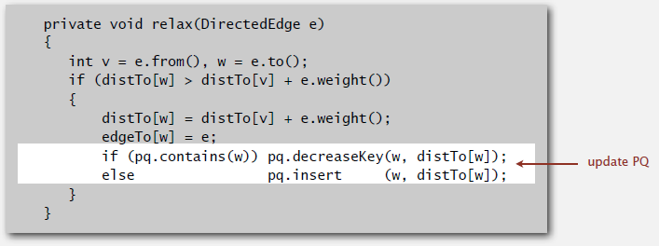
Dijkstra's algorithm: Java implementation

Slide 28
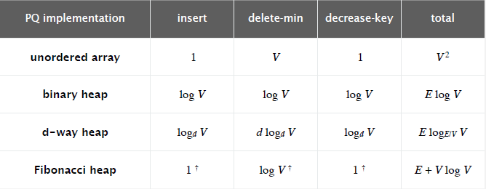
Dijkstra's algorithm: which priority queue?
Depends on PQ implementation: V insert, V delete-min, E decrease-key.
Bottom line.
  Array implementation optimal for dense graphs.
  Binary heap much faster for sparse graphs.
  4-way heap worth the trouble in performance-critical situations.
  Fibonacci heap best in theory, but not worth implementing.
† amortized
Notes:
Same as for Prim's algorithm.
since most frequent operation is decrease-key, can use d-way heap to slightly improve running time
Open problem. Linear-time worst-case guarantee?
There is a natural V log V sorting lower bound for implementing Dijkstra's algorithm because it processes vertices in increasing order of distance from source (but do not need to only use compares and adds).
Andrew Goldberg: d-way heap with d = 4 seems to be sweet spot for Prim/Dijkstra

