Slide 1
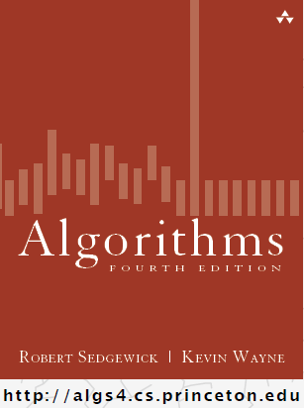
Minimum Spanning Trees
COMP 2100
Otterbein University

Slide 2
Alerts
Lab 7 due Wednesday, 11/30
Project #3 due Friday, 12/2
Homework #9 due next Friday
Final Exam: Friday, December 9
  Exam will be at 10:15am

Slide 3
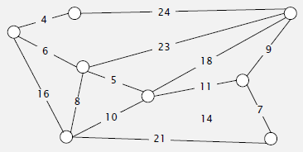
Weighted Graphs
A weighted graph is one is which each edge has a numeric value
We will assume weights are positive integers
The function w(u,v) returns the weight of the edge connecting vertices u & v. If there is no edge between u & v, then w(u,v)=∞

Slide 4

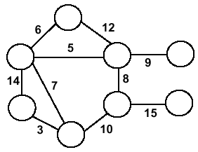
Minimum Spanning Trees
Undirected, weighted, connected graph G = (V,E), w : E → $ℕ$⁺
A spanning tree is a subgraph of G that
  Is a tree (contains no cycles)
  Contains all the vertices of G
A minimum spanning tree is a spanning tree with minimum total weight (i.e., ).
So if T = (V^{T}, E^{T}) is a minimum spanning tree of G,
then V = V^{T}, E^{T} ⊆ E, and |E^{T}| = |V | – 1.

Slide 5
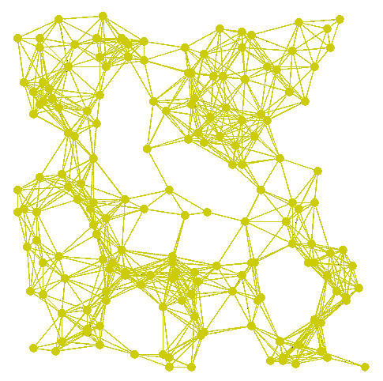
Sample Graph

Slide 6
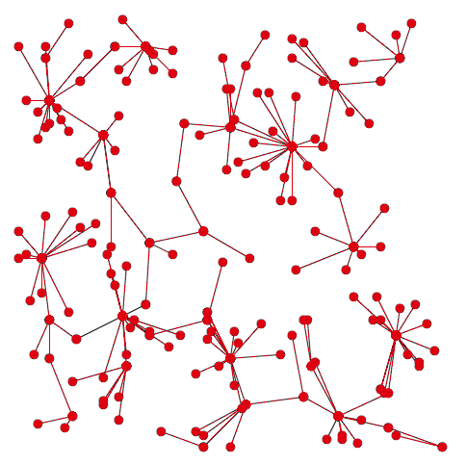
Sample Spanning Tree

Slide 7
Sample Graph

Slide 8
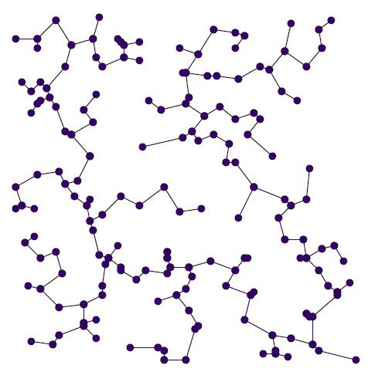
Minimum Spanning Tree

Slide 9
MST of bicycle routes in North Seattle
http://www.flickr.com/photos/
ewedistrict/21980840

Slide 10
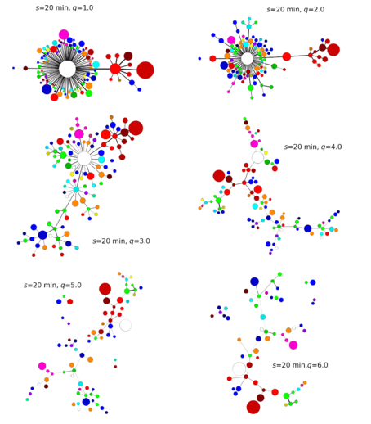
Analysis of US Stock Market by Nuclear Physicists, in the journal Physical Review E
https://journals.aps.org/pre/
abstract/10.1103/PhysRevE.95.052313

Slide 11
Greedy Approach
Two algorithms, Prim’s and Kruskal’s, both use a greedy strategy.
Both accumulate edges, one at each step.
Both require interesting data structures:
  To represent the graph (vertices, edges, weights)
  To represent the tree (or forest of trees)
  Additional bookkeeping structures (priority queues, disjoint sets, etc.)

Slide 12
Generic MST Algorithm
Generic-MST(G, w)
1 A←∅ // Contains edges that belong to a MST
2 while A does not form a spanning tree do
3 Find an edge (u,v) that is safe for A
4 A←A∪{(u,v)}
5 return A
Safe edge – edge that does not destroy A’s feasibility
The algorithm manages a set of edges A maintaining the following loop invariant
Prior to each iteration, A is a subset of some minimum spanning tree.
At each step, an edge is determined that can be added to A without violating this invariant. Such an edge is called a Safe Edge.

Slide 13
Prim’s Algorithm
Vertex based algorithm
Grows one tree T, one vertex at a time
A cloud covering the portion of T already computed
Label the vertices v outside the cloud with key[v], the minimum weight of an edge connecting v to a vertex in the cloud, key[v] = ∞, if no such edge exists
Start with an arbitrary vertex, r.

Slide 14
Prim’s Algorithm
6
2
4
MST-Prim (G, w, r)
1 Q ← V[G];
2 for each u ∈ Q
3 key[u] ← ∞;
4 key[r] ← 0;
5 π[r] ← NULL;
6 while (Q not empty)
7 u ← ExtractMin(Q);
8 for each v ∈ Adj[u]
9 if (v ∈ Q and w(u,v) < key[v])
10 π[v] ← u;
11 key[v] ← w(u,v);
5
9
1
3
4
14
2
10
15
5
7
8
3
6
8
Run on example graph
key π

Slide 15
Prim’s Algorithm
6
∞
4
MST-Prim (G, w, r)
1 Q ← V[G];
2 for each u ∈ Q
3 key[u] ← ∞;
4 key[r] ← 0;
5 π[r] ← NULL;
6 while (Q not empty)
7 u ← ExtractMin(Q);
8 for each v ∈ Adj[u]
9 if (v ∈ Q and w(u,v) < key[v])
10 π[v] ← u;
11 key[v] ← w(u,v);
5
9
∞
∞
∞
14
2
10
15
∞
∞
∞
3
∞
8
Initialize key[] and π[]
V
1
2
3
4
5
6
7
8
key π
∞
∞
∞
∞
∞
∞
∞
∞

Slide 16
Prim’s Algorithm
6
∞
4
MST-Prim (G, w, r)
1 Q ← V[G];
2 for each u ∈ Q
3 key[u] ← ∞;
4 key[r] ← 0;
5 π[r] ← NULL;
6 while (Q not empty)
7 u ← ExtractMin(Q);
8 for each v ∈ Adj[u]
9 if (v ∈ Q and w(u,v) < key[v])
10 π[v] ← u;
11 key[v] ← w(u,v);
5
9
∞
∞
∞
14
2
10
15
r
0
∞
∞
3
∞
8
Pick a start vertex r
V
1
2
3
4
5
6
7
8
key π
∞
∞
∞
∞
0 null
∞
∞
∞

Slide 17
Prim’s Algorithm
6
∞
4
MST-Prim (G, w, r)
1 Q ← V[G];
2 for each u ∈ Q
3 key[u] ← ∞;
4 key[r] ← 0;
5 π[r] ← NULL;
6 while (Q not empty)
7 u ← ExtractMin(Q);
8 for each v ∈ Adj[u]
9 if (v ∈ Q and w(u,v) < key[v])
10 π[v] ← u;
11 key[v] ← w(u,v);
5
9
∞
∞
∞
14
2
10
15
u
0
∞
∞
3
∞
8
Navy vertices have been removed from Q
V
1
2
3
4
5
6
7
8
key π
∞
∞
∞
∞
0 null
∞
∞
∞

Slide 18
Prim’s Algorithm
6
∞
4
MST-Prim (G, w, r)
1 Q ← V[G];
2 for each u ∈ Q
3 key[u] ← ∞;
4 key[r] ← 0;
5 π[r] ← NULL;
6 while (Q not empty)
7 u ← ExtractMin(Q);
8 for each v ∈ Adj[u]
9 if (v ∈ Q and w(u,v) < key[v])
10 π[v] ← u;
11 key[v] ← w(u,v);
5
9
∞
∞
∞
14
2
10
15
u
0
∞
∞
3
3
8
Navy arrows indicate parent pointers
V
1
2
3
4
5
6
7
8
key π
∞
∞
∞
∞
0 null
3 5
∞
∞

Slide 19
Prim’s Algorithm
6
∞
4
MST-Prim (G, w, r)
1 Q ← V[G];
2 for each u ∈ Q
3 key[u] ← ∞;
4 key[r] ← 0;
5 π[r] ← NULL;
6 while (Q not empty)
7 u ← ExtractMin(Q);
8 for each v ∈ Adj[u]
9 if (v ∈ Q and w(u,v) < key[v])
10 π[v] ← u;
11 key[v] ← w(u,v);
5
9
14
∞
∞
14
2
10
15
u
0
∞
∞
3
3
8
V
1
2
3
4
5
6
7
8
key π
14 5
∞
∞
∞
0 null
3 5
∞
∞

Slide 20
Prim’s Algorithm
6
∞
4
MST-Prim (G, w, r)
1 Q ← V[G];
2 for each u ∈ Q
3 key[u] ← ∞;
4 key[r] ← 0;
5 π[r] ← NULL;
6 while (Q not empty)
7 u ← ExtractMin(Q);
8 for each v ∈ Adj[u]
9 if (v ∈ Q and w(u,v) < key[v])
10 π[v] ← u;
11 key[v] ← w(u,v);
5
9
14
∞
∞
14
2
10
15
0
∞
∞
3
3
8
u
V
1
2
3
4
5
6
7
8
key π
14 5
∞
∞
∞
0 null
3 5
∞
∞

Slide 21
Prim’s Algorithm
6
∞
4
MST-Prim (G, w, r)
1 Q ← V[G];
2 for each u ∈ Q
3 key[u] ← ∞;
4 key[r] ← 0;
5 π[r] ← NULL;
6 while (Q not empty)
7 u ← ExtractMin(Q);
8 for each v ∈ Adj[u]
9 if (v ∈ Q and w(u,v) < key[v])
10 π[v] ← u;
11 key[v] ← w(u,v);
5
9
14
∞
∞
14
2
10
15
0
8
∞
3
3
8
u
V
1
2
3
4
5
6
7
8
key π
14 5
∞
∞
∞
0 null
3 5
8 6
∞

Slide 22
Prim’s Algorithm
6
∞
4
MST-Prim (G, w, r)
1 Q ← V[G];
2 for each u ∈ Q
3 key[u] ← ∞;
4 key[r] ← 0;
5 π[r] ← NULL;
6 while (Q not empty)
7 u ← ExtractMin(Q);
8 for each v ∈ Adj[u]
9 if (v ∈ Q and w(u,v) < key[v])
10 π[v] ← u;
11 key[v] ← w(u,v);
5
9
10
∞
∞
14
2
10
15
0
8
∞
3
3
8
u
V
1
2
3
4
5
6
7
8
key π
10 6
∞
∞
∞
0 null
3 5
8 6
∞

Slide 23
Prim’s Algorithm
6
∞
4
MST-Prim (G, w, r)
1 Q ← V[G];
2 for each u ∈ Q
3 key[u] ← ∞;
4 key[r] ← 0;
5 π[r] ← NULL;
6 while (Q not empty)
7 u ← ExtractMin(Q);
8 for each v ∈ Adj[u]
9 if (v ∈ Q and w(u,v) < key[v])
10 π[v] ← u;
11 key[v] ← w(u,v);
5
9
10
∞
∞
14
2
10
15
0
8
∞
3
3
8
u
V
1
2
3
4
5
6
7
8
key π
10 6
∞
∞
∞
0 null
3 5
8 6
∞

Slide 24
Prim’s Algorithm
6
∞
4
MST-Prim (G, w, r)
1 Q ← V[G];
2 for each u ∈ Q
3 key[u] ← ∞;
4 key[r] ← 0;
5 π[r] ← NULL;
6 while (Q not empty)
7 u ← ExtractMin(Q);
8 for each v ∈ Adj[u]
9 if (v ∈ Q and w(u,v) < key[v])
10 π[v] ← u;
11 key[v] ← w(u,v);
5
9
10
2
∞
14
2
10
15
0
8
∞
3
3
8
u
V
1
2
3
4
5
6
7
8
key π
10 6
∞
2 7
∞
0 null
3 5
8 6
∞

Slide 25
Prim’s Algorithm
6
∞
4
MST-Prim (G, w, r)
1 Q ← V[G];
2 for each u ∈ Q
3 key[u] ← ∞;
4 key[r] ← 0;
5 π[r] ← NULL;
6 while (Q not empty)
7 u ← ExtractMin(Q);
8 for each v ∈ Adj[u]
9 if (v ∈ Q and w(u,v) < key[v])
10 π[v] ← u;
11 key[v] ← w(u,v);
5
9
10
2
∞
14
2
10
15
0
8
15
3
3
8
u
V
1
2
3
4
5
6
7
8
key π
10 6
∞
2 7
∞
0 null
3 5
8 6
15 7

Slide 26
Prim’s Algorithm
∞
u
6
4
MST-Prim (G, w, r)
1 Q ← V[G];
2 for each u ∈ Q
3 key[u] ← ∞;
4 key[r] ← 0;
5 π[r] ← NULL;
6 while (Q not empty)
7 u ← ExtractMin(Q);
8 for each v ∈ Adj[u]
9 if (v ∈ Q and w(u,v) < key[v])
10 π[v] ← u;
11 key[v] ← w(u,v);
5
9
10
2
∞
14
2
10
15
0
8
15
3
3
8
V
1
2
3
4
5
6
7
8
key π
10 6
∞
2 7
∞
0 null
3 5
8 6
15 7

Slide 27
Prim’s Algorithm
∞
u
6
4
MST-Prim (G, w, r)
1 Q ← V[G];
2 for each u ∈ Q
3 key[u] ← ∞;
4 key[r] ← 0;
5 π[r] ← NULL;
6 while (Q not empty)
7 u ← ExtractMin(Q);
8 for each v ∈ Adj[u]
9 if (v ∈ Q and w(u,v) < key[v])
10 π[v] ← u;
11 key[v] ← w(u,v);
5
9
10
2
9
14
2
10
15
0
8
15
3
3
8
V
1
2
3
4
5
6
7
8
key π
10 6
∞
2 7
9 3
0 null
3 5
8 6
15 7

Slide 28
Prim’s Algorithm
4
u
6
4
MST-Prim (G, w, r)
1 Q ← V[G];
2 for each u ∈ Q
3 key[u] ← ∞;
4 key[r] ← 0;
5 π[r] ← NULL;
6 while (Q not empty)
7 u ← ExtractMin(Q);
8 for each v ∈ Adj[u]
9 if (v ∈ Q and w(u,v) < key[v])
10 π[v] ← u;
11 key[v] ← w(u,v);
5
9
10
2
9
14
2
10
15
0
8
15
3
3
8
V
1
2
3
4
5
6
7
8
key π
10 6
4 3
2 7
9 3
0 null
3 5
8 6
15 7

Slide 29
Prim’s Algorithm
4
u
6
4
MST-Prim (G, w, r)
1 Q ← V[G];
2 for each u ∈ Q
3 key[u] ← ∞;
4 key[r] ← 0;
5 π[r] ← NULL;
6 while (Q not empty)
7 u ← ExtractMin(Q);
8 for each v ∈ Adj[u]
9 if (v ∈ Q and w(u,v) < key[v])
10 π[v] ← u;
11 key[v] ← w(u,v);
5
9
5
2
9
14
2
10
15
0
8
15
3
3
8
V
1
2
3
4
5
6
7
8
key π
5 3
4 3
2 7
9 3
0 null
3 5
8 6
15 7

Slide 30
Prim’s Algorithm
u
6
4
4
MST-Prim (G, w, r)
1 Q ← V[G];
2 for each u ∈ Q
3 key[u] ← ∞;
4 key[r] ← 0;
5 π[r] ← NULL;
6 while (Q not empty)
7 u ← ExtractMin(Q);
8 for each v ∈ Adj[u]
9 if (v ∈ Q and w(u,v) < key[v])
10 π[v] ← u;
11 key[v] ← w(u,v);
5
9
5
2
9
14
2
10
15
0
8
15
3
3
8
V
1
2
3
4
5
6
7
8
key π
5 3
4 3
2 7
9 3
0 null
3 5
8 6
15 7

Slide 31
Prim’s Algorithm
u
4
6
4
MST-Prim (G, w, r)
1 Q ← V[G];
2 for each u ∈ Q
3 key[u] ← ∞;
4 key[r] ← 0;
5 π[r] ← NULL;
6 while (Q not empty)
7 u ← ExtractMin(Q);
8 for each v ∈ Adj[u]
9 if (v ∈ Q and w(u,v) < key[v])
10 π[v] ← u;
11 key[v] ← w(u,v);
5
9
5
2
9
14
2
10
15
0
8
15
3
3
8
V
1
2
3
4
5
6
7
8
key π
5 3
4 3
2 7
9 3
0 null
3 5
8 6
15 7

Slide 32
Prim’s Algorithm
u
6
4
4
MST-Prim (G, w, r)
1 Q ← V[G];
2 for each u ∈ Q
3 key[u] ← ∞;
4 key[r] ← 0;
5 π[r] ← NULL;
6 while (Q not empty)
7 u ← ExtractMin(Q);
8 for each v ∈ Adj[u]
9 if (v ∈ Q and w(u,v) < key[v])
10 π[v] ← u;
11 key[v] ← w(u,v);
5
9
5
2
9
14
2
10
15
0
8
15
3
3
8
V
1
2
3
4
5
6
7
8
key π
5 3
4 3
2 7
9 3
0 null
3 5
8 6
15 7

Slide 33
Prim’s Algorithm
6
4
4
MST-Prim (G, w, r)
1 Q ← V[G];
2 for each u ∈ Q
3 key[u] ← ∞;
4 key[r] ← 0;
5 π[r] ← NULL;
6 while (Q not empty)
7 u ← ExtractMin(Q);
8 for each v ∈ Adj[u]
9 if (v ∈ Q and w(u,v) < key[v])
10 π[v] ← u;
11 key[v] ← w(u,v);
5
9
5
2
9
14
2
u
10
15
0
8
15
3
3
8
V
1
2
3
4
5
6
7
8
key π
5 3
4 3
2 7
9 3
0 null
3 5
8 6
15 7

Slide 34
Analysis: Prim’s Algorithm
MST-Prim (G, w, r)
1 Q ← V[G];
2 for each u ∈ Q
3 key[u] ← ∞;
4 key[r] ← 0;
5 π[r] ← NULL;
6 while (Q not empty)
7 u ← ExtractMin(Q);
8 for each v ∈ Adj[u]
9 if (v ∈ Q and w(u,v) < key[v])
10 π[v] ← u;
11 key[v] ← w(u,v);
What is misleading in this code?
DecreaseKey(r,0);
DecreaseKey(v, w(u,v));`

Slide 35
Analysis: Prim’s Algorithm
How often is ExtractMin() called?
How often is DecreaseKey() called?
What will be the running time?
O(|E| lg |V|)
MST-Prim (G, w, r)
1 Q ← V[G];
2 for each u ∈ Q
3 key[u] ← ∞;
4 DecreaseKey(r,0);
5 π[r] ← NULL;
6 while (Q not empty)
7 u ← ExtractMin(Q);
8 for each v ∈ Adj[u]
9 if (v ∈ Q and w(u,v) < key[v])
10 π[v] ← u;
11 DecreaseKey(v, w(u,v));

Slide 36
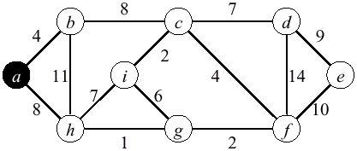
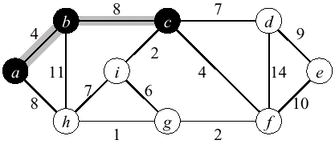
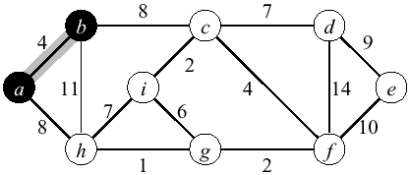
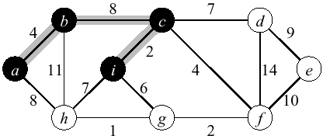
Prim Example

Slide 37
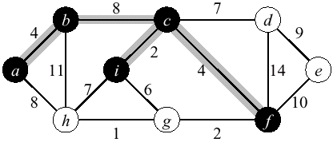
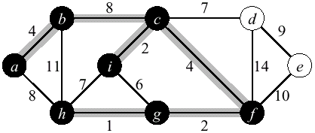
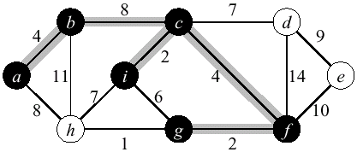
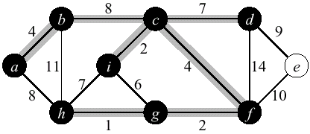
Prim Example

Slide 38
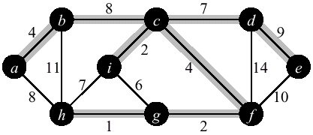
Prim Example

Slide 39
Kruskal's Algorithm
Edge based algorithm
Add the edges one at a time, in increasing weight order
The algorithm maintains S – a forest of trees.
An edge is accepted it if connects vertices of distinct trees
We need a data structure that represents the forest: a collection of disjoint sets (a partition of the vertices).
  We will use the Union-Find representation for disjoint sets

Slide 40
Kruskal's Algorithm
The algorithm adds the cheapest edge that connects two trees of the forest
MST-Kruskal(G,w)
01 T ← ∅
02 for each vertex v ∈ V[G]
03 Make-Set(v)
04 sort the edges of E by non-decreasing weight w
05 for each edge (u,v) ∈ E, in sorted order
06 if (Find-Set(u) ≠ Find-Set(v))
07 T ← T ∪ {(u,v)}
08 Union(u,v)
09 return T

Slide 41
Kruskal’s Algorithm
Run the algorithm:
2
19
9
14
17
8
25
5
21
13
1
MST-Kruskal(G,w)
01 T ← ∅
02 for each vertex v ∈ V[G]
03 Make-Set(v)
04 sort the edges of E by non-decreasing weight w
05 for each edge (u,v) ∈ E, in sorted order
06 if (Find-Set(u) ≠ Find-Set(v))
07 T ← T ∪ {(u,v)}
08 Union(u,v)
09 return T

Slide 42
Kruskal’s Algorithm
Run the algorithm:
2
19
9
14
17
8
25
5
21
13
1
MST-Kruskal(G,w)
01 T ← ∅
02 for each vertex v ∈ V[G]
03 Make-Set(v)
04 sort the edges of E by non-decreasing weight w
05 for each edge (u,v) ∈ E, in sorted order
06 if (Find-Set(u) ≠ Find-Set(v))
07 T ← T ∪ {(u,v)}
08 Union(u,v)
09 return T

Slide 43
Kruskal’s Algorithm
Run the algorithm:
2
19
9
14
17
8
25
5
21
13
1
MST-Kruskal(G,w)
01 T ← ∅
02 for each vertex v ∈ V[G]
03 Make-Set(v)
04 sort the edges of E by non-decreasing weight w
05 for each edge (u,v) ∈ E, in sorted order
06 if (Find-Set(u) ≠ Find-Set(v))
07 T ← T ∪ {(u,v)}
08 Union(u,v)
09 return T

Slide 44
Kruskal’s Algorithm
Run the algorithm:
2
19
9
14
17
8
25
5
21
13
1?
MST-Kruskal(G,w)
01 T ← ∅
02 for each vertex v ∈ V[G]
03 Make-Set(v)
04 sort the edges of E by non-decreasing weight w
05 for each edge (u,v) ∈ E, in sorted order
06 if (Find-Set(u) ≠ Find-Set(v))
07 T ← T ∪ {(u,v)}
08 Union(u,v)
09 return T

Slide 45
Kruskal’s Algorithm
Run the algorithm:
2
19
9
14
17
8
25
5
21
13
1
MST-Kruskal(G,w)
01 T ← ∅
02 for each vertex v ∈ V[G]
03 Make-Set(v)
04 sort the edges of E by non-decreasing weight w
05 for each edge (u,v) ∈ E, in sorted order
06 if (Find-Set(u) ≠ Find-Set(v))
07 T ← T ∪ {(u,v)}
08 Union(u,v)
09 return T

Slide 46
Kruskal’s Algorithm
Run the algorithm:
2?
19
9
14
17
8
25
5
21
13
1
MST-Kruskal(G,w)
01 T ← ∅
02 for each vertex v ∈ V[G]
03 Make-Set(v)
04 sort the edges of E by non-decreasing weight w
05 for each edge (u,v) ∈ E, in sorted order
06 if (Find-Set(u) ≠ Find-Set(v))
07 T ← T ∪ {(u,v)}
08 Union(u,v)
09 return T

Slide 47
Kruskal’s Algorithm
Run the algorithm:
2
19
9
14
17
8
25
5
21
13
1
MST-Kruskal(G,w)
01 T ← ∅
02 for each vertex v ∈ V[G]
03 Make-Set(v)
04 sort the edges of E by non-decreasing weight w
05 for each edge (u,v) ∈ E, in sorted order
06 if (Find-Set(u) ≠ Find-Set(v))
07 T ← T ∪ {(u,v)}
08 Union(u,v)
09 return T

Slide 48
Kruskal’s Algorithm
Run the algorithm:
2
19
9
14
17
8
25
5?
21
13
1
MST-Kruskal(G,w)
01 T ← ∅
02 for each vertex v ∈ V[G]
03 Make-Set(v)
04 sort the edges of E by non-decreasing weight w
05 for each edge (u,v) ∈ E, in sorted order
06 if (Find-Set(u) ≠ Find-Set(v))
07 T ← T ∪ {(u,v)}
08 Union(u,v)
09 return T

Slide 49
Kruskal’s Algorithm
Run the algorithm:
2
19
9
14
17
8
25
5
21
13
1
MST-Kruskal(G,w)
01 T ← ∅
02 for each vertex v ∈ V[G]
03 Make-Set(v)
04 sort the edges of E by non-decreasing weight w
05 for each edge (u,v) ∈ E, in sorted order
06 if (Find-Set(u) ≠ Find-Set(v))
07 T ← T ∪ {(u,v)}
08 Union(u,v)
09 return T

Slide 50
Kruskal’s Algorithm
Run the algorithm:
2
19
9
14
17
8?
25
5
21
13
1
MST-Kruskal(G,w)
01 T ← ∅
02 for each vertex v ∈ V[G]
03 Make-Set(v)
04 sort the edges of E by non-decreasing weight w
05 for each edge (u,v) ∈ E, in sorted order
06 if (Find-Set(u) ≠ Find-Set(v))
07 T ← T ∪ {(u,v)}
08 Union(u,v)
09 return T

Slide 51
Kruskal’s Algorithm
Run the algorithm:
2
19
9
14
17
8
25
5
21
13
1
MST-Kruskal(G,w)
01 T ← ∅
02 for each vertex v ∈ V[G]
03 Make-Set(v)
04 sort the edges of E by non-decreasing weight w
05 for each edge (u,v) ∈ E, in sorted order
06 if (Find-Set(u) ≠ Find-Set(v))
07 T ← T ∪ {(u,v)}
08 Union(u,v)
09 return T

Slide 52
Kruskal’s Algorithm
Run the algorithm:
2
19
9?
14
17
8
25
5
21
13
1
MST-Kruskal(G,w)
01 T ← ∅
02 for each vertex v ∈ V[G]
03 Make-Set(v)
04 sort the edges of E by non-decreasing weight w
05 for each edge (u,v) ∈ E, in sorted order
06 if (Find-Set(u) ≠ Find-Set(v))
07 T ← T ∪ {(u,v)}
08 Union(u,v)
09 return T

Slide 53
Kruskal’s Algorithm
Run the algorithm:
2
19
9
14
17
8
25
5
21
13
1
MST-Kruskal(G,w)
01 T ← ∅
02 for each vertex v ∈ V[G]
03 Make-Set(v)
04 sort the edges of E by non-decreasing weight w
05 for each edge (u,v) ∈ E, in sorted order
06 if (Find-Set(u) ≠ Find-Set(v))
07 T ← T ∪ {(u,v)}
08 Union(u,v)
09 return T

Slide 54
Kruskal’s Algorithm
Run the algorithm:
2
19
9
14
17
8
25
5
21
13?
1
MST-Kruskal(G,w)
01 T ← ∅
02 for each vertex v ∈ V[G]
03 Make-Set(v)
04 sort the edges of E by non-decreasing weight w
05 for each edge (u,v) ∈ E, in sorted order
06 if (Find-Set(u) ≠ Find-Set(v))
07 T ← T ∪ {(u,v)}
08 Union(u,v)
09 return T

Slide 55
Kruskal’s Algorithm
Run the algorithm:
2
19
9
14
17
8
25
5
21
13
1
MST-Kruskal(G,w)
01 T ← ∅
02 for each vertex v ∈ V[G]
03 Make-Set(v)
04 sort the edges of E by non-decreasing weight w
05 for each edge (u,v) ∈ E, in sorted order
06 if (Find-Set(u) ≠ Find-Set(v))
07 T ← T ∪ {(u,v)}
08 Union(u,v)
09 return T

Slide 56
Kruskal’s Algorithm
Run the algorithm:
2
19
9
14?
17
8
25
5
21
13
1
MST-Kruskal(G,w)
01 T ← ∅
02 for each vertex v ∈ V[G]
03 Make-Set(v)
04 sort the edges of E by non-decreasing weight w
05 for each edge (u,v) ∈ E, in sorted order
06 if (Find-Set(u) ≠ Find-Set(v))
07 T ← T ∪ {(u,v)}
08 Union(u,v)
09 return T

Slide 57
Kruskal’s Algorithm
Run the algorithm:
2
19
9
14
17
8
25
5
21
13
1
MST-Kruskal(G,w)
01 T ← ∅
02 for each vertex v ∈ V[G]
03 Make-Set(v)
04 sort the edges of E by non-decreasing weight w
05 for each edge (u,v) ∈ E, in sorted order
06 if (Find-Set(u) ≠ Find-Set(v))
07 T ← T ∪ {(u,v)}
08 Union(u,v)
09 return T

Slide 58
Kruskal’s Algorithm
Run the algorithm:
2
19
9
14
17?
8
25
5
21
13
1
MST-Kruskal(G,w)
01 T ← ∅
02 for each vertex v ∈ V[G]
03 Make-Set(v)
04 sort the edges of E by non-decreasing weight w
05 for each edge (u,v) ∈ E, in sorted order
06 if (Find-Set(u) ≠ Find-Set(v))
07 T ← T ∪ {(u,v)}
08 Union(u,v)
09 return T

Slide 59
Kruskal’s Algorithm
Run the algorithm:
2
19?
9
14
17
8
25
5
21
13
1
MST-Kruskal(G,w)
01 T ← ∅
02 for each vertex v ∈ V[G]
03 Make-Set(v)
04 sort the edges of E by non-decreasing weight w
05 for each edge (u,v) ∈ E, in sorted order
06 if (Find-Set(u) ≠ Find-Set(v))
07 T ← T ∪ {(u,v)}
08 Union(u,v)
09 return T

Slide 60
Kruskal’s Algorithm
Run the algorithm:
2
19
9
14
17
8
25
5
21?
13
1
MST-Kruskal(G,w)
01 T ← ∅
02 for each vertex v ∈ V[G]
03 Make-Set(v)
04 sort the edges of E by non-decreasing weight w
05 for each edge (u,v) ∈ E, in sorted order
06 if (Find-Set(u) ≠ Find-Set(v))
07 T ← T ∪ {(u,v)}
08 Union(u,v)
09 return T

Slide 61
Kruskal’s Algorithm
Run the algorithm:
2
19
9
14
17
8
25?
5
21
13
1
MST-Kruskal(G,w)
01 T ← ∅
02 for each vertex v ∈ V[G]
03 Make-Set(v)
04 sort the edges of E by non-decreasing weight w
05 for each edge (u,v) ∈ E, in sorted order
06 if (Find-Set(u) ≠ Find-Set(v))
07 T ← T ∪ {(u,v)}
08 Union(u,v)
09 return T

Slide 62
Kruskal’s Algorithm
Run the algorithm:
2
19
9
14
17
8
25
5
21
13
1
MST-Kruskal(G,w)
01 T ← ∅
02 for each vertex v ∈ V[G]
03 Make-Set(v)
04 sort the edges of E by non-decreasing weight w
05 for each edge (u,v) ∈ E, in sorted order
06 if (Find-Set(u) ≠ Find-Set(v))
07 T ← T ∪ {(u,v)}
08 Union(u,v)
09 return T

Slide 63
Kruskal’s Algorithm
Run the algorithm:
2
19
9
14
17
8
25
5
21
13
1
MST-Kruskal(G,w)
01 T ← ∅
02 for each vertex v ∈ V[G]
03 Make-Set(v)
04 sort the edges of E by non-decreasing weight w
05 for each edge (u,v) ∈ E, in sorted order
06 if (Find-Set(u) ≠ Find-Set(v))
07 T ← T ∪ {(u,v)}
08 Union(u,v)
09 return T

Slide 64
Analysis: Kruskal’s Algorithm
What will affect the running time?
MST-Kruskal(G,w)
01 T ← ∅
02 for each vertex v ∈ V[G]
03 Make-Set(v)
04 sort the edges of E by non-decreasing weight w
05 for each edge (u,v) ∈ E, in sorted order
06 if (Find-Set(u) ≠ Find-Set(v))
07 T ← T ∪ {(u,v)}
08 Union(u,v)
09 return T

Slide 65
Analysis: Kruskal’s Algorithm
What will affect the running time?
O(|V |) calls to MakeSet()
1 call to Sort(E)
O(|E|) calls to FindSet()
O(|V |) calls to Union()
MST-Kruskal(G,w)
01 T ← ∅
02 for each vertex v ∈ V[G]
03 Make-Set(v)
04 sort the edges of E by non-decreasing weight w
05 for each edge (u,v) ∈ E, in sorted order
06 if (Find-Set(u) ≠ Find-Set(v))
07 T ← T ∪ {(u,v)}
08 Union(u,v)
09 return T

Slide 66
Analysis: Kruskal’s Algorithm
Expensive operations:
  Sort edges: O(|E| lg |E|)
  O(|V |) MakeSet()’s
  O(|E|) FindSet()’s
  O(|V |) Union()’s
Upshot:
  The complexity of Kruskal comes down to the efficiency of the disjoint-set operations, particularly Union()

Slide 67
Analysis: Kruskal’s Algorithm
What will be the running time?
O(|V |) calls to MakeSet() - O(|V |)
1 call to Sort(E) - O(|E| lg |E|)
O(|E|) calls to FindSet() - O(|E|)
O(|V |) calls to Union() - O (|V | lg |V |)
Total: O(|E| lg |E| + |V | lg |V |)
MST-Kruskal(G,w)
01 T ← ∅
02 for each vertex v ∈ V[G]
03 Make-Set(v)
04 sort the edges of E by non-decreasing weight w
05 for each edge (u,v) ∈ E, in sorted order
06 if (Find-Set(u) ≠ Find-Set(v))
07 T ← T ∪ {(u,v)}
08 Union(u,v)
09 return T

Slide 68
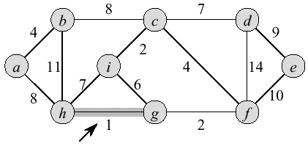
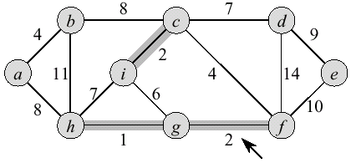
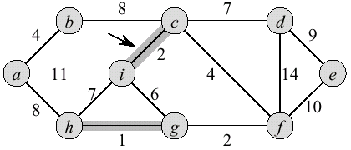
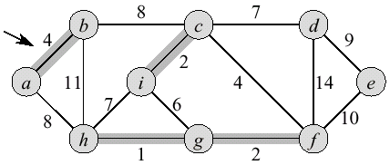
Kruskal Example

Slide 69
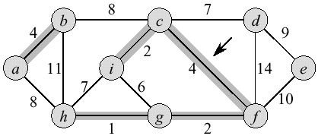
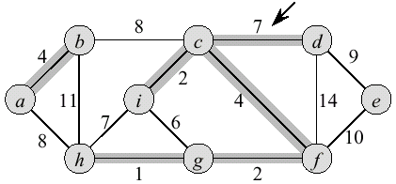
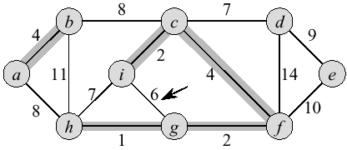
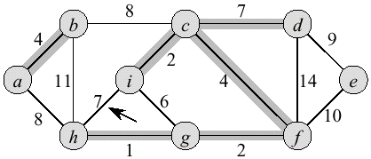
Kruskal Example

Slide 70
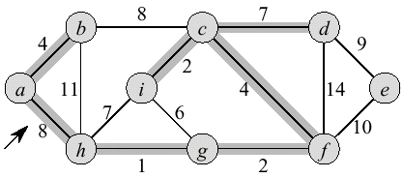
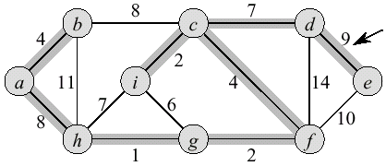
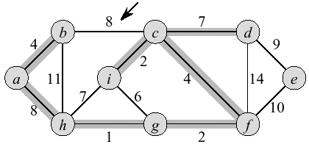
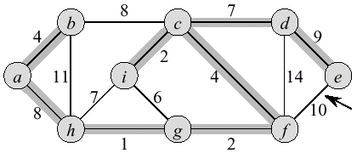
Kruskal Example

Slide 71
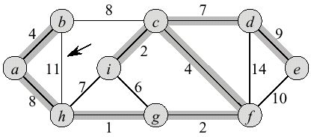
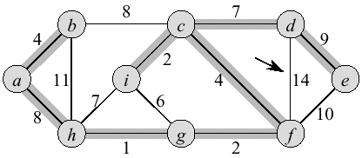
Kruskal Example

