Slide 1
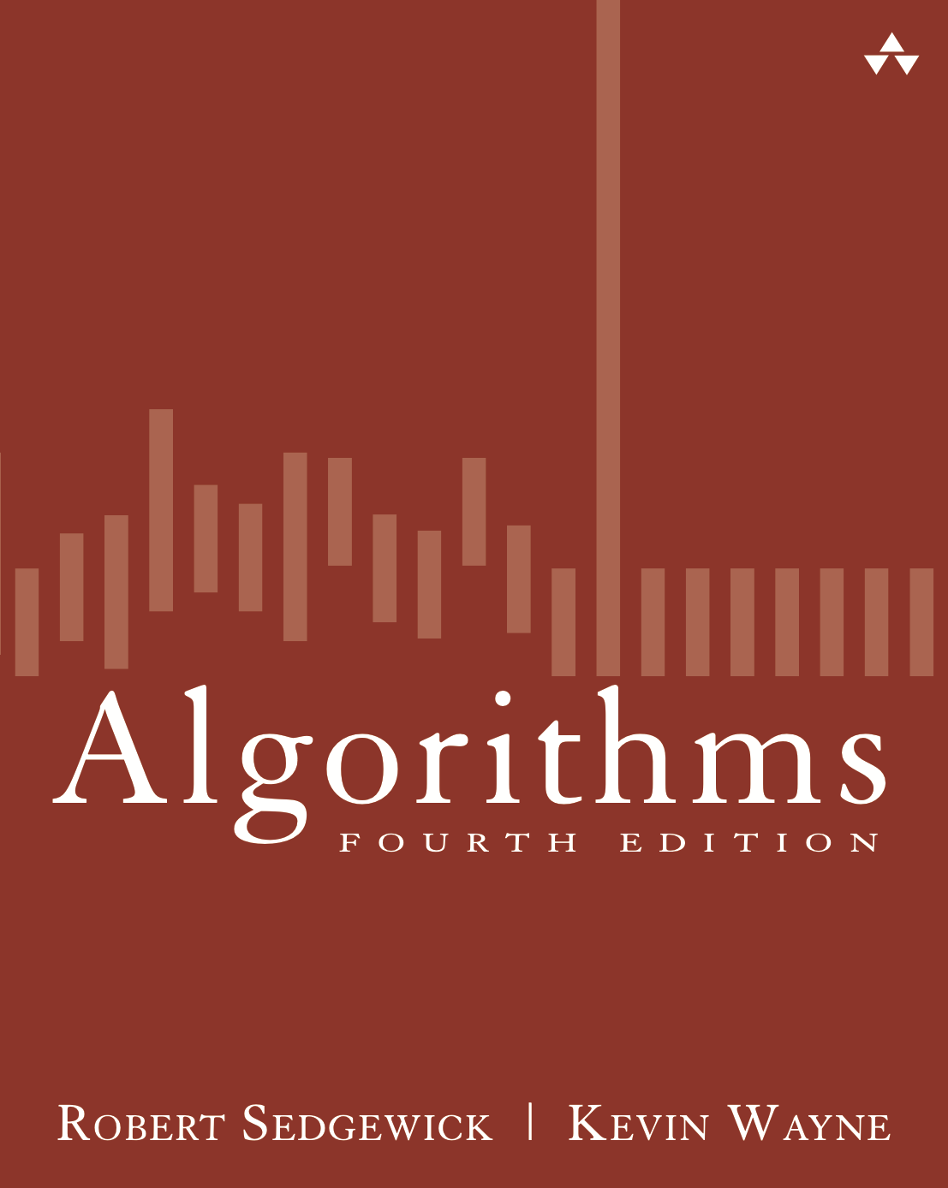
4.2 Kosaraju-Sharir Demo
Algorithms
Robert Sedgewick | Kevin Wayne
http://algs4.cs.princeton.edu

Slide 2
Kosaraju-Sharir algorithm demo
Phase 1. Compute reverse postorder in G^{R}.
Phase 2. Run DFS in G, visiting unmarked vertices in reverse
postorder of G^{R}.
4→2
2→3
3→2
6→0
0→1
2→0
11→12
12→9
9→10
9→11
7→9
10→12
11→4
4→3
3→5
6→8
8→6
5→4
0→5
6→4
6→9
7→6
0
0
6
6
8
8
7
7
2
1
2
1
3
3
9
9
10
10
4
4
5
5
11
11
12
12
digraph G

Slide 3
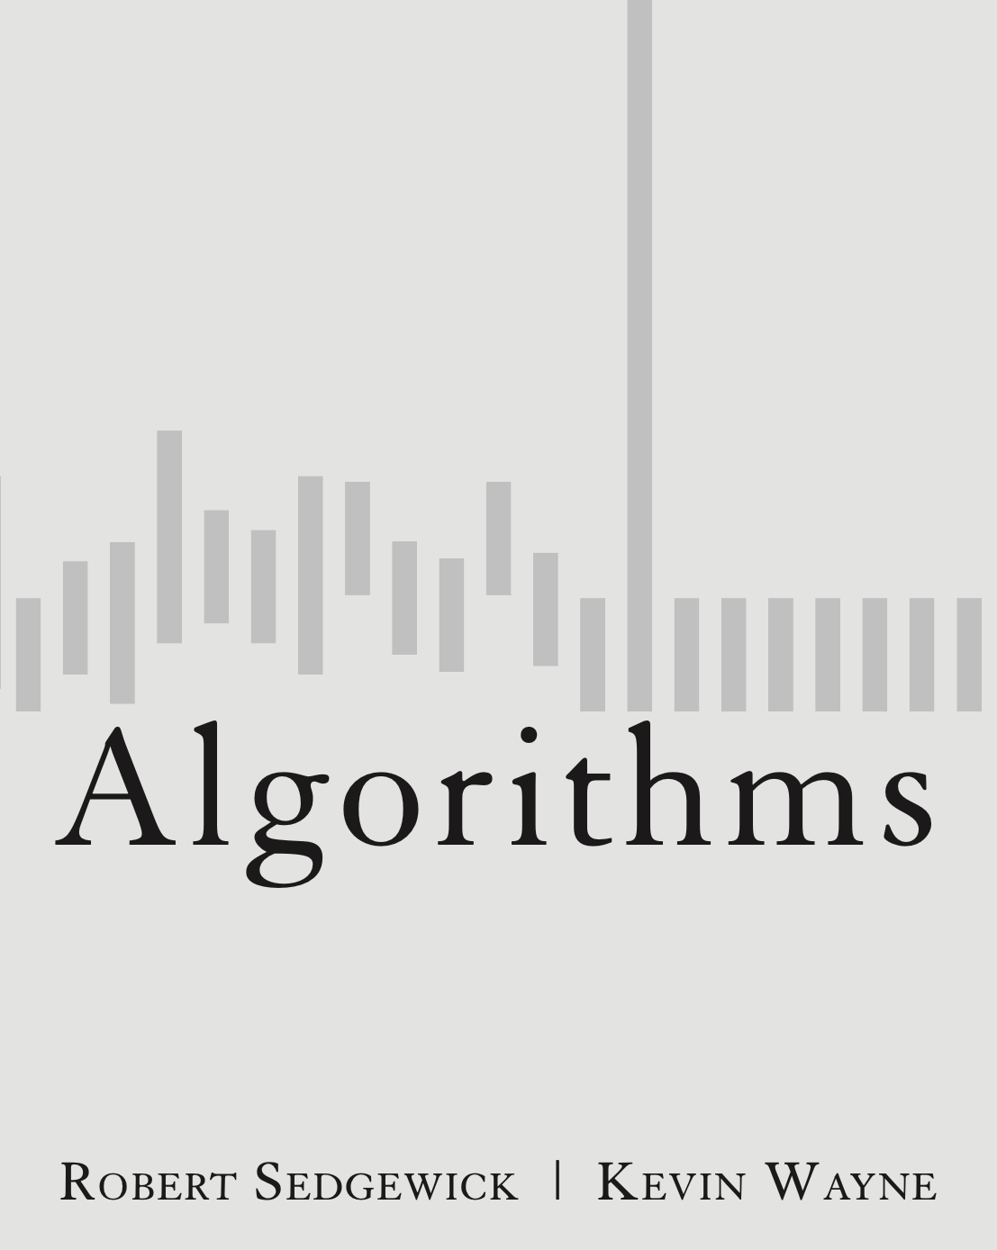
4.2 Kosaraju-Sharir Demo
DFS in reverse graph
DFS in original graph
http://algs4.cs.princeton.edu

Slide 4
Kosaraju-Sharir algorithm demo
Phase 1. Compute reverse postorder in G^{R}.
0
0
6
6
8
8
7
7
2
1
2
1
3
3
9
9
10
10
4
4
5
5
11
11
12
12
digraph G

Slide 5
Kosaraju-Sharir algorithm demo
Phase 1. Compute reverse postorder in G^{R}.
0
0
v
marked[]
6
6
8
8
7
7
0
1
2
3
4
5
6
7
8
9
10
11
12
–
–
–
–
–
–
–
–
–
–
–
–
–
2
1
2
1
1
1
3
3
9
9
10
10
4
4
5
5
11
11
12
12
reverse digraph G^{R}

Slide 6
Kosaraju-Sharir algorithm demo
Phase 1. Compute reverse postorder in G^{R}.
0
0
v
marked[]
6
6
8
8
7
7
0
1
2
3
4
5
6
7
8
9
10
11
12
T
F
F
F
F
F
F
F
F
F
F
F
F
2
1
2
1
1
1
3
3
9
9
10
10
4
4
5
5
11
11
12
12
visit 0: check 6 and check 2

Slide 7
Kosaraju-Sharir algorithm demo
Phase 1. Compute reverse postorder in G^{R}.
0
0
v
marked[]
6
6
8
8
7
7
0
1
2
3
4
5
6
7
8
9
10
11
12
T
F
F
F
F
F
T
F
F
F
F
F
F
2
1
2
1
1
1
3
3
9
9
10
10
4
4
5
5
11
11
12
12
visit 6: check 8 and check 7

Slide 8
Kosaraju-Sharir algorithm demo
Phase 1. Compute reverse postorder in G^{R}.
0
0
v
marked[]
6
6
8
8
7
7
0
1
2
3
4
5
6
7
8
9
10
11
12
T
F
F
F
F
F
T
F
T
F
F
F
F
2
1
2
1
1
1
3
3
9
9
10
10
4
4
5
5
11
11
12
12
visit 8: check 6

Slide 9
Kosaraju-Sharir algorithm demo
Phase 1. Compute reverse postorder in G^{R}.
8
0
0
v
marked[]
6
6
6
8
8
7
7
0
1
2
3
4
5
6
7
8
9
10
11
12
T
F
F
F
F
F
T
F
T
F
F
F
F
2
1
2
1
1
1
3
3
9
9
10
10
4
4
5
5
11
11
12
12
8 done

Slide 10
Kosaraju-Sharir algorithm demo
Phase 1. Compute reverse postorder in G^{R}.
8
0
0
v
marked[]
6
6
8
7
7
0
1
2
3
4
5
6
7
8
9
10
11
12
T
F
F
F
F
F
T
F
T
F
F
F
F
2
1
2
1
1
1
3
3
9
9
10
10
4
4
5
5
11
11
12
12
visit 6: check 8 and check 7

Slide 11
Kosaraju-Sharir algorithm demo
Phase 1. Compute reverse postorder in G^{R}.
8
0
0
v
marked[]
6
6
8
7
7
0
1
2
3
4
5
6
7
8
9
10
11
12
T
F
F
F
F
F
T
T
T
F
F
F
F
2
1
2
1
1
1
3
3
9
9
10
10
4
4
5
5
11
11
12
12
visit 7

Slide 12
Kosaraju-Sharir algorithm demo
Phase 1. Compute reverse postorder in G^{R}.
7 8
0
0
v
marked[]
6
6
6
8
7
7
0
1
2
3
4
5
6
7
8
9
10
11
12
T
F
F
F
F
F
T
T
T
F
F
F
F
2
1
2
1
1
1
3
3
9
9
10
10
4
4
5
5
11
11
12
12
7 done

Slide 13
Kosaraju-Sharir algorithm demo
Phase 1. Compute reverse postorder in G^{R}.
6 7 8
0
0
0
v
marked[]
6
6
8
7
0
1
2
3
4
5
6
7
8
9
10
11
12
T
F
F
F
F
F
T
T
T
F
F
F
F
2
1
2
1
1
1
3
3
9
9
10
10
4
4
5
5
11
11
12
12
6 done

Slide 14
Kosaraju-Sharir algorithm demo
Phase 1. Compute reverse postorder in G^{R}.
6 7 8
0
0
v
marked[]
6
8
7
0
1
2
3
4
5
6
7
8
9
10
11
12
T
F
F
F
F
F
T
T
T
F
F
F
F
2
1
2
1
1
1
3
3
9
9
10
10
4
4
5
5
11
11
12
12
visit 0: check 6 and check 2

Slide 15
Kosaraju-Sharir algorithm demo
Phase 1. Compute reverse postorder in G^{R}.
6 7 8
0
0
v
marked[]
6
8
7
0
1
2
3
4
5
6
7
8
9
10
11
12
T
F
T
F
F
F
T
T
T
F
F
F
F
2
1
2
1
1
1
3
3
9
9
10
10
4
4
5
5
11
11
12
12
visit 2: check 4 and check 3

Slide 16
Kosaraju-Sharir algorithm demo
Phase 1. Compute reverse postorder in G^{R}.
6 7 8
0
0
v
marked[]
6
8
7
0
1
2
3
4
5
6
7
8
9
10
11
12
T
F
T
F
T
F
T
T
T
F
F
F
F
2
1
2
1
1
1
3
3
9
9
10
10
4
4
5
5
11
11
12
12
visit 4: check 11, check 6, and check 5

Slide 17
Kosaraju-Sharir algorithm demo
Phase 1. Compute reverse postorder in G^{R}.
6 7 8
0
0
v
marked[]
6
8
7
0
1
2
3
4
5
6
7
8
9
10
11
12
T
F
T
F
T
F
T
T
T
F
F
T
F
2
1
2
1
1
1
3
3
9
9
10
10
4
4
5
5
11
11
12
12
visit 11: check 9

Slide 18
Kosaraju-Sharir algorithm demo
Phase 1. Compute reverse postorder in G^{R}.
6 7 8
0
0
v
marked[]
6
8
7
0
1
2
3
4
5
6
7
8
9
10
11
12
T
F
T
F
T
F
T
T
T
T
F
T
F
2
1
2
1
1
1
3
3
9
9
10
10
4
4
5
5
11
11
12
12
visit 9: check 12, check 7, and check 6

Slide 19
Kosaraju-Sharir algorithm demo
Phase 1. Compute reverse postorder in G^{R}.
6 7 8
0
0
v
marked[]
6
8
7
0
1
2
3
4
5
6
7
8
9
10
11
12
T
F
T
F
T
F
T
T
T
T
F
T
T
2
1
2
1
1
1
3
3
9
9
10
10
4
4
5
5
11
11
12
12
visit 12: check 11 and check 10

Slide 20
Kosaraju-Sharir algorithm demo
Phase 1. Compute reverse postorder in G^{R}.
6 7 8
0
0
v
marked[]
6
8
7
0
1
2
3
4
5
6
7
8
9
10
11
12
T
F
T
F
T
F
T
T
T
T
F
T
T
2
1
2
1
1
1
3
3
9
9
10
10
4
4
5
5
11
11
12
12
visit 12: check 11 and check 10

Slide 21
Kosaraju-Sharir algorithm demo
Phase 1. Compute reverse postorder in G^{R}.
6 7 8
0
0
v
marked[]
6
8
7
0
1
2
3
4
5
6
7
8
9
10
11
12
T
F
T
F
T
F
T
T
T
T
T
T
T
2
1
2
1
1
1
3
3
9
9
10
10
4
4
5
5
11
11
12
12
visit 10: check 9

Slide 22
Kosaraju-Sharir algorithm demo
Phase 1. Compute reverse postorder in G^{R}.
10 6 7 8
0
0
v
marked[]
6
8
7
0
1
2
3
4
5
6
7
8
9
10
11
12
T
F
T
F
T
F
T
T
T
T
T
T
T
2
1
2
1
1
1
3
3
9
9
10
10
4
4
5
5
11
11
12
12
12
10 done

Slide 23
Kosaraju-Sharir algorithm demo
Phase 1. Compute reverse postorder in G^{R}.
12 10 6 7 8
0
0
v
marked[]
6
8
7
0
1
2
3
4
5
6
7
8
9
10
11
12
T
F
T
F
T
F
T
T
T
T
T
T
T
2
1
2
1
1
1
3
3
9
9
9
10
4
4
5
5
11
11
12
12
12 done

Slide 24
Kosaraju-Sharir algorithm demo
Phase 1. Compute reverse postorder in G^{R}.
12 10 6 7 8
0
0
v
marked[]
6
8
7
0
1
2
3
4
5
6
7
8
9
10
11
12
T
F
T
F
T
F
T
T
T
T
T
T
T
2
1
2
1
1
1
3
3
9
9
10
4
4
5
5
11
11
12
visit 9: check 12, check 7 and check 6

Slide 25
Kosaraju-Sharir algorithm demo
Phase 1. Compute reverse postorder in G^{R}.
12 10 6 7 8
0
0
v
marked[]
6
8
7
0
1
2
3
4
5
6
7
8
9
10
11
12
T
F
T
F
T
F
T
T
T
T
T
T
T
2
1
2
1
1
1
3
3
9
9
10
4
4
5
5
11
11
12
visit 9: check 12, check 7, and check 6

Slide 26
Kosaraju-Sharir algorithm demo
Phase 1. Compute reverse postorder in G^{R}.
9 12 10 6 7 8
0
0
v
marked[]
6
8
7
0
1
2
3
4
5
6
7
8
9
10
11
12
T
F
T
F
T
F
T
T
T
T
T
T
T
2
1
2
1
1
1
3
3
9
9
10
4
4
5
5
11
11
11
12
9 done

Slide 27
Kosaraju-Sharir algorithm demo
Phase 1. Compute reverse postorder in G^{R}.
11 9 12 10 6 7 8
0
0
v
marked[]
6
8
7
0
1
2
3
4
5
6
7
8
9
10
11
12
T
F
T
F
T
F
T
T
T
T
T
T
T
2
1
2
1
1
1
3
3
9
10
4
4
4
5
5
11
11
12
11 done

Slide 28
Kosaraju-Sharir algorithm demo
Phase 1. Compute reverse postorder in G^{R}.
11 9 12 10 6 7 8
0
0
v
marked[]
6
8
7
0
1
2
3
4
5
6
7
8
9
10
11
12
T
F
T
F
T
F
T
T
T
T
T
T
T
2
1
2
1
1
1
3
3
9
10
4
4
5
5
11
12
visit 4: check 11, check 6, and check 5

Slide 29
Kosaraju-Sharir algorithm demo
Phase 1. Compute reverse postorder in G^{R}.
11 9 12 10 6 7 8
0
0
v
marked[]
6
8
7
0
1
2
3
4
5
6
7
8
9
10
11
12
T
F
T
F
T
F
T
T
T
T
T
T
T
2
1
2
1
1
1
3
3
9
10
4
4
5
5
11
12
visit 4: check 11, check 6, and check 5

Slide 30
Kosaraju-Sharir algorithm demo
Phase 1. Compute reverse postorder in G^{R}.
11 9 12 10 6 7 8
0
0
v
marked[]
6
8
7
0
1
2
3
4
5
6
7
8
9
10
11
12
T
F
T
F
T
T
T
T
T
T
T
T
T
2
1
2
1
1
1
3
3
9
10
4
4
5
5
11
12
visit 5: check 3 and check 0

Slide 31
Kosaraju-Sharir algorithm demo
Phase 1. Compute reverse postorder in G^{R}.
11 9 12 10 6 7 8
0
0
v
marked[]
6
8
7
0
1
2
3
4
5
6
7
8
9
10
11
12
T
F
T
T
T
T
T
T
T
T
T
T
T
2
1
2
1
1
1
3
3
9
10
4
4
5
5
11
12
visit 3: check 4 and check 2

Slide 32
Kosaraju-Sharir algorithm demo
Phase 1. Compute reverse postorder in G^{R}.
11 9 12 10 6 7 8
0
0
v
marked[]
6
8
7
0
1
2
3
4
5
6
7
8
9
10
11
12
T
F
T
T
T
T
T
T
T
T
T
T
T
2
1
2
1
1
1
3
3
9
10
4
4
5
5
11
12
visit 3: check 4 and check 2

Slide 33
Kosaraju-Sharir algorithm demo
Phase 1. Compute reverse postorder in G^{R}.
3 11 9 12 10 6 7 8
0
0
v
marked[]
6
8
7
0
1
2
3
4
5
6
7
8
9
10
11
12
T
F
T
T
T
T
T
T
T
T
T
T
T
2
1
2
1
1
1
3
3
9
10
4
4
5
5
5
11
12
3 done

Slide 34
Kosaraju-Sharir algorithm demo
Phase 1. Compute reverse postorder in G^{R}.
3 11 9 12 10 6 7 8
0
0
v
marked[]
6
8
7
0
1
2
3
4
5
6
7
8
9
10
11
12
T
F
T
T
T
T
T
T
T
T
T
T
T
2
1
2
1
1
1
3
9
10
4
4
5
5
11
12
visit 5: check 3 and check 0

Slide 35
Kosaraju-Sharir algorithm demo
Phase 1. Compute reverse postorder in G^{R}.
5 3 11 9 12 10 6 7 8
0
0
v
marked[]
6
8
7
0
1
2
3
4
5
6
7
8
9
10
11
12
T
F
T
T
T
T
T
T
T
T
T
T
T
2
1
2
1
1
1
3
9
10
4
4
4
5
5
11
12
5 done

Slide 36
Kosaraju-Sharir algorithm demo
Phase 1. Compute reverse postorder in G^{R}.
4 5 3 11 9 12 10 6 7 8
0
0
v
marked[]
6
8
7
0
1
2
3
4
5
6
7
8
9
10
11
12
T
F
T
T
T
T
T
T
T
T
T
T
T
2
2
1
2
1
1
1
3
9
10
4
4
5
11
12
4 done

Slide 37
Kosaraju-Sharir algorithm demo
Phase 1. Compute reverse postorder in G^{R}.
4 5 3 11 9 12 10 6 7 8
0
0
v
marked[]
6
8
7
0
1
2
3
4
5
6
7
8
9
10
11
12
T
F
T
T
T
T
T
T
T
T
T
T
T
2
1
2
1
1
1
3
9
10
4
5
11
12
visit 2: check 4 and check 3

Slide 38
Kosaraju-Sharir algorithm demo
Phase 1. Compute reverse postorder in G^{R}.
2 4 5 3 11 9 12 10 6 7 8
0
0
0
v
marked[]
6
8
7
0
1
2
3
4
5
6
7
8
9
10
11
12
T
F
T
T
T
T
T
T
T
T
T
T
T
2
1
2
1
1
1
3
9
10
4
5
11
12
2 done

Slide 39
Kosaraju-Sharir algorithm demo
Phase 1. Compute reverse postorder in G^{R}.
0 2 4 5 3 11 9 12 10 6 7 8
0
0
v
marked[]
6
8
7
0
1
2
3
4
5
6
7
8
9
10
11
12
T
F
T
T
T
T
T
T
T
T
T
T
T
1
2
1
1
1
3
9
10
4
5
11
12
0 done

Slide 40
Kosaraju-Sharir algorithm demo
Phase 1. Compute reverse postorder in G^{R}.
0 2 4 5 3 11 9 12 10 6 7 8
0
v
marked[]
6
8
7
0
1
2
3
4
5
6
7
8
9
10
11
12
T
T
T
T
T
T
T
T
T
T
T
T
T
1
2
1
1
1
3
9
10
4
5
11
12
visit 1: check 0

Slide 41
Kosaraju-Sharir algorithm demo
Phase 1. Compute reverse postorder in G^{R}.
1 0 2 4 5 3 11 9 12 10 6 7 8
0
v
marked[]
6
8
7
0
1
2
3
4
5
6
7
8
9
10
11
12
T
T
T
T
T
T
T
T
T
T
T
T
T
1
2
1
1
3
9
10
4
5
11
12
1 done

Slide 42
Kosaraju-Sharir algorithm demo
Phase 1. Compute reverse postorder in G^{R}.
1 0 2 4 5 3 11 9 12 10 6 7 8
0
v
marked[]
6
8
7
0
1
2
3
4
5
6
7
8
9
10
11
12
T
T
T
T
T
T
T
T
T
T
T
T
T
1
2
1
3
9
10
4
5
11
12
check 2 3 4 5 6 7 8 9 10 11 12

Slide 43
Kosaraju-Sharir algorithm demo
Phase 1. Compute reverse postorder in G^{R}.
1 0 2 4 5 3 11 9 12 10 6 7 8
0
6
8
7
1
2
1
3
9
10
4
5
11
12
reverse digraph G^{R}

Slide 44
4.2 Kosaraju-Sharir Demo
DFS in reverse graph
DFS in original graph
http://algs4.cs.princeton.edu

Slide 45
Kosaraju-Sharir algorithm demo
Phase 2. Run DFS in G, visiting unmarked vertices in reverse postorder of G^{R}.
1 0 2 4 5 3 11 9 12 10 6 7 8
0
0
v
id[]
6
6
8
8
7
7
0
1
2
3
4
5
6
7
8
9
10
11
12
–
–
–
–
–
–
–
–
–
–
–
–
–
2
1
2
1
3
3
9
9
10
10
4
4
5
5
11
11
12
12
original digraph G

Slide 46
Kosaraju-Sharir algorithm demo
Phase 2. Run DFS in G, visiting unmarked vertices in reverse postorder of G^{R}.
1 0 2 4 5 3 11 9 12 10 6 7 8
0
0
v
id[]
6
6
8
8
7
7
0
1
2
3
4
5
6
7
8
9
10
11
12
–
0
–
–
–
–
–
–
–
–
–
–
–
2
1
2
1
3
3
9
9
10
10
4
4
5
5
11
11
12
12
visit 1

Slide 47
Kosaraju-Sharir algorithm demo
Phase 2. Run DFS in G, visiting unmarked vertices in reverse postorder of G^{R}.
1 0 2 4 5 3 11 9 12 10 6 7 8
0
0
v
id[]
6
6
8
8
7
7
0
1
2
3
4
5
6
7
8
9
10
11
12
–
0
–
–
–
–
–
–
–
–
–
–
–
2
1
2
1
3
3
9
9
10
10
4
4
5
5
11
11
12
12
1 done

Slide 48
Kosaraju-Sharir algorithm demo
Phase 2. Run DFS in G, visiting unmarked vertices in reverse postorder of G^{R}.
1 0 2 4 5 3 11 9 12 10 6 7 8
0
0
v
id[]
6
6
8
8
7
7
0
1
2
3
4
5
6
7
8
9
10
11
12
–
0
–
–
–
–
–
–
–
–
–
–
–
2
1
2
1
3
3
9
9
10
10
4
4
5
5
11
11
12
12
strong component: 1

Slide 49
Kosaraju-Sharir algorithm demo
Phase 2. Run DFS in G, visiting unmarked vertices in reverse postorder of G^{R}.
1 0 2 4 5 3 11 9 12 10 6 7 8
0
0
v
id[]
6
8
7
0
1
2
3
4
5
6
7
8
9
10
11
12
1
0
–
–
–
–
–
–
–
–
–
–
–
2
1
2
3
3
9
9
10
10
4
4
5
5
11
11
12
12
visit 0: check 5 and check 1

Slide 50
Kosaraju-Sharir algorithm demo
Phase 2. Run DFS in G, visiting unmarked vertices in reverse postorder of G^{R}.
1 0 2 4 5 3 11 9 12 10 6 7 8
0
0
v
id[]
6
8
7
0
1
2
3
4
5
6
7
8
9
10
11
12
1
0
–
–
–
1
–
–
–
–
–
–
–
2
1
2
3
3
9
9
10
10
4
4
5
5
11
11
12
12
visit 5: check 4

Slide 51
Kosaraju-Sharir algorithm demo
Phase 2. Run DFS in G, visiting unmarked vertices in reverse postorder of G^{R}.
1 0 2 4 5 3 11 9 12 10 6 7 8
0
0
v
id[]
6
8
7
0
1
2
3
4
5
6
7
8
9
10
11
12
1
0
–
–
1
1
–
–
–
–
–
–
–
2
1
2
3
3
9
9
10
10
4
4
5
5
11
11
12
12
visit 4: check 3 and check 2

Slide 52
Kosaraju-Sharir algorithm demo
Phase 2. Run DFS in G, visiting unmarked vertices in reverse postorder of G^{R}.
1 0 2 4 5 3 11 9 12 10 6 7 8
0
0
v
id[]
6
8
7
0
1
2
3
4
5
6
7
8
9
10
11
12
1
0
–
1
1
1
–
–
–
–
–
–
–
2
1
2
3
3
9
9
10
10
4
4
5
5
11
11
12
12
visit 3: check 5 and check 2

Slide 53
Kosaraju-Sharir algorithm demo
Phase 2. Run DFS in G, visiting unmarked vertices in reverse postorder of G^{R}.
1 0 2 4 5 3 11 9 12 10 6 7 8
0
0
v
id[]
6
8
7
0
1
2
3
4
5
6
7
8
9
10
11
12
1
0
–
1
1
1
–
–
–
–
–
–
–
2
1
2
3
3
9
9
10
10
4
4
5
5
11
11
12
12
visit 3: check 5 and check 2

Slide 54
Kosaraju-Sharir algorithm demo
Phase 2. Run DFS in G, visiting unmarked vertices in reverse postorder of G^{R}.
1 0 2 4 5 3 11 9 12 10 6 7 8
0
0
v
id[]
6
8
7
0
1
2
3
4
5
6
7
8
9
10
11
12
1
0
1
1
1
1
–
–
–
–
–
–
–
2
1
2
3
3
9
9
10
10
4
4
5
5
11
11
12
12
visit 2: check 0 and check 3

Slide 55
Kosaraju-Sharir algorithm demo
Phase 2. Run DFS in G, visiting unmarked vertices in reverse postorder of G^{R}.
1 0 2 4 5 3 11 9 12 10 6 7 8
0
0
v
id[]
6
8
7
0
1
2
3
4
5
6
7
8
9
10
11
12
1
0
1
1
1
1
–
–
–
–
–
–
–
2
1
2
3
3
9
9
10
10
4
4
5
5
11
11
12
12
visit 2: check 0 and check 3

Slide 56
Kosaraju-Sharir algorithm demo
Phase 2. Run DFS in G, visiting unmarked vertices in reverse postorder of G^{R}.
1 0 2 4 5 3 11 9 12 10 6 7 8
0
0
v
id[]
6
8
7
0
1
2
3
4
5
6
7
8
9
10
11
12
1
0
1
1
1
1
–
–
–
–
–
–
–
2
1
2
3
3
3
9
9
10
10
4
4
5
5
11
11
12
12
2 done

Slide 57
Kosaraju-Sharir algorithm demo
Phase 2. Run DFS in G, visiting unmarked vertices in reverse postorder of G^{R}.
1 0 2 4 5 3 11 9 12 10 6 7 8
0
0
v
id[]
6
8
7
0
1
2
3
4
5
6
7
8
9
10
11
12
1
0
1
1
1
1
–
–
–
–
–
–
–
1
2
3
3
9
9
10
10
4
4
4
5
5
11
11
12
12
3 done

Slide 58
Kosaraju-Sharir algorithm demo
Phase 2. Run DFS in G, visiting unmarked vertices in reverse postorder of G^{R}.
1 0 2 4 5 3 11 9 12 10 6 7 8
0
0
v
id[]
6
8
7
0
1
2
3
4
5
6
7
8
9
10
11
12
1
0
1
1
1
1
–
–
–
–
–
–
–
1
2
3
9
9
10
10
4
4
5
5
11
11
12
12
visit 4: check 3 and check 2

Slide 59
Kosaraju-Sharir algorithm demo
Phase 2. Run DFS in G, visiting unmarked vertices in reverse postorder of G^{R}.
1 0 2 4 5 3 11 9 12 10 6 7 8
0
0
v
id[]
6
8
7
0
1
2
3
4
5
6
7
8
9
10
11
12
1
0
1
1
1
1
–
–
–
–
–
–
–
1
2
3
9
9
10
10
4
4
5
5
5
11
11
12
12
4 done

Slide 60
Kosaraju-Sharir algorithm demo
Phase 2. Run DFS in G, visiting unmarked vertices in reverse postorder of G^{R}.
1 0 2 4 5 3 11 9 12 10 6 7 8
0
0
0
v
id[]
6
8
7
0
1
2
3
4
5
6
7
8
9
10
11
12
1
0
1
1
1
1
–
–
–
–
–
–
–
1
2
3
9
9
10
10
4
5
5
11
11
12
12
5 done

Slide 61
Kosaraju-Sharir algorithm demo
Phase 2. Run DFS in G, visiting unmarked vertices in reverse postorder of G^{R}.
1 0 2 4 5 3 11 9 12 10 6 7 8
0
0
v
id[]
6
8
7
0
1
2
3
4
5
6
7
8
9
10
11
12
1
0
1
1
1
1
–
–
–
–
–
–
–
1
2
3
9
9
10
10
4
5
11
11
12
12
visit 0: check 5 and check 1

Slide 62
Kosaraju-Sharir algorithm demo
Phase 2. Run DFS in G, visiting unmarked vertices in reverse postorder of G^{R}.
1 0 2 4 5 3 11 9 12 10 6 7 8
0
0
v
id[]
6
8
7
0
1
2
3
4
5
6
7
8
9
10
11
12
1
0
1
1
1
1
–
–
–
–
–
–
–
1
2
3
9
9
10
10
4
5
11
11
12
12
0 done

Slide 63
Kosaraju-Sharir algorithm demo
Phase 2. Run DFS in G, visiting unmarked vertices in reverse postorder of G^{R}.
1 0 2 4 5 3 11 9 12 10 6 7 8
0
0
v
id[]
6
8
7
0
1
2
3
4
5
6
7
8
9
10
11
12
1
0
1
1
1
1
–
–
–
–
–
–
–
1
2
3
9
9
10
10
4
5
11
11
12
12
strong component: 0 2 3 4 5

Slide 64
Kosaraju-Sharir algorithm demo
Phase 2. Run DFS in G, visiting unmarked vertices in reverse postorder of G^{R}.
1 0 2 4 5 3 11 9 12 10 6 7 8
0
v
id[]
6
8
7
0
1
2
3
4
5
6
7
8
9
10
11
12
1
0
1
1
1
1
–
–
–
–
–
–
–
1
2
3
9
9
10
10
4
5
11
11
12
12
check 2

Slide 65
Kosaraju-Sharir algorithm demo
Phase 2. Run DFS in G, visiting unmarked vertices in reverse postorder of G^{R}.
1 0 2 4 5 3 11 9 12 10 6 7 8
0
v
id[]
6
8
7
0
1
2
3
4
5
6
7
8
9
10
11
12
1
0
1
1
1
1
–
–
–
–
–
–
–
1
2
3
9
9
10
10
4
5
11
11
12
12
check 4

Slide 66
Kosaraju-Sharir algorithm demo
Phase 2. Run DFS in G, visiting unmarked vertices in reverse postorder of G^{R}.
1 0 2 4 5 3 11 9 12 10 6 7 8
0
v
id[]
6
8
7
0
1
2
3
4
5
6
7
8
9
10
11
12
1
0
1
1
1
1
–
–
–
–
–
–
–
1
2
3
9
9
10
10
4
5
11
11
12
12
check 5

Slide 67
Kosaraju-Sharir algorithm demo
Phase 2. Run DFS in G, visiting unmarked vertices in reverse postorder of G^{R}.
1 0 2 4 5 3 11 9 12 10 6 7 8
0
v
id[]
6
8
7
0
1
2
3
4
5
6
7
8
9
10
11
12
1
0
1
1
1
1
–
–
–
–
–
–
–
1
2
3
9
9
10
10
4
5
11
11
12
12
check 3

Slide 68
Kosaraju-Sharir algorithm demo
Phase 2. Run DFS in G, visiting unmarked vertices in reverse postorder of G^{R}.
1 0 2 4 5 3 11 9 12 10 6 7 8
0
v
id[]
6
8
7
0
1
2
3
4
5
6
7
8
9
10
11
12
1
0
1
1
1
1
–
–
–
–
–
2
–
1
2
3
9
9
10
10
4
5
11
11
12
12
visit 11: check 4 and check 12

Slide 69
Kosaraju-Sharir algorithm demo
Phase 2. Run DFS in G, visiting unmarked vertices in reverse postorder of G^{R}.
1 0 2 4 5 3 11 9 12 10 6 7 8
0
v
id[]
6
8
7
0
1
2
3
4
5
6
7
8
9
10
11
12
1
0
1
1
1
1
–
–
–
–
–
2
–
1
2
3
9
9
10
10
4
5
11
11
12
12
visit 11: check 4 and check 12

Slide 70
Kosaraju-Sharir algorithm demo
Phase 2. Run DFS in G, visiting unmarked vertices in reverse postorder of G^{R}.
1 0 2 4 5 3 11 9 12 10 6 7 8
0
v
id[]
6
8
7
0
1
2
3
4
5
6
7
8
9
10
11
12
1
0
1
1
1
1
–
–
–
–
–
2
2
1
2
3
9
9
10
10
4
5
11
11
12
12
visit 12: check 9

Slide 71
Kosaraju-Sharir algorithm demo
Phase 2. Run DFS in G, visiting unmarked vertices in reverse postorder of G^{R}.
1 0 2 4 5 3 11 9 12 10 6 7 8
0
v
id[]
6
8
7
0
1
2
3
4
5
6
7
8
9
10
11
12
1
0
1
1
1
1
–
–
–
2
–
2
2
1
2
3
9
9
10
10
4
5
11
11
12
12
visit 9: check 11 and check 10

Slide 72
Kosaraju-Sharir algorithm demo
Phase 2. Run DFS in G, visiting unmarked vertices in reverse postorder of G^{R}.
1 0 2 4 5 3 11 9 12 10 6 7 8
0
v
id[]
6
8
7
0
1
2
3
4
5
6
7
8
9
10
11
12
1
0
1
1
1
1
–
–
–
2
–
2
2
1
2
3
9
9
10
10
4
5
11
11
12
12
visit 9: check 11 and check 10

Slide 73
Kosaraju-Sharir algorithm demo
Phase 2. Run DFS in G, visiting unmarked vertices in reverse postorder of G^{R}.
1 0 2 4 5 3 11 9 12 10 6 7 8
0
v
id[]
6
8
7
0
1
2
3
4
5
6
7
8
9
10
11
12
1
0
1
1
1
1
–
–
–
2
2
2
2
1
2
3
9
9
10
10
4
5
11
11
12
12
visit 10: check 12

Slide 74
Kosaraju-Sharir algorithm demo
Phase 2. Run DFS in G, visiting unmarked vertices in reverse postorder of G^{R}.
1 0 2 4 5 3 11 9 12 10 6 7 8
0
v
id[]
6
8
7
0
1
2
3
4
5
6
7
8
9
10
11
12
1
0
1
1
1
1
–
–
–
2
2
2
2
1
2
3
9
9
9
10
10
4
5
11
11
12
12
10 done

Slide 75
Kosaraju-Sharir algorithm demo
Phase 2. Run DFS in G, visiting unmarked vertices in reverse postorder of G^{R}.
1 0 2 4 5 3 11 9 12 10 6 7 8
0
v
id[]
6
8
7
0
1
2
3
4
5
6
7
8
9
10
11
12
1
0
1
1
1
1
–
–
–
2
2
2
2
1
2
3
9
9
10
4
5
11
11
12
12
12
9 done

Slide 76
Kosaraju-Sharir algorithm demo
Phase 2. Run DFS in G, visiting unmarked vertices in reverse postorder of G^{R}.
1 0 2 4 5 3 11 9 12 10 6 7 8
0
v
id[]
6
8
7
0
1
2
3
4
5
6
7
8
9
10
11
12
1
0
1
1
1
1
–
–
–
2
2
2
2
1
2
3
9
10
4
5
11
11
11
12
12
12 done

Slide 77
Kosaraju-Sharir algorithm demo
Phase 2. Run DFS in G, visiting unmarked vertices in reverse postorder of G^{R}.
1 0 2 4 5 3 11 9 12 10 6 7 8
0
v
id[]
6
8
7
0
1
2
3
4
5
6
7
8
9
10
11
12
1
0
1
1
1
1
–
–
–
2
2
2
2
1
2
3
9
10
4
5
11
11
12
11 done

Slide 78
Kosaraju-Sharir algorithm demo
Phase 2. Run DFS in G, visiting unmarked vertices in reverse postorder of G^{R}.
1 0 2 4 5 3 11 9 12 10 6 7 8
0
v
id[]
6
8
7
0
1
2
3
4
5
6
7
8
9
10
11
12
1
0
1
1
1
1
–
–
–
2
2
2
2
1
2
3
9
10
4
5
11
11
12
strong component: 9 10 11 12

Slide 79
Kosaraju-Sharir algorithm demo
Phase 2. Run DFS in G, visiting unmarked vertices in reverse postorder of G^{R}.
1 0 2 4 5 3 11 9 12 10 6 7 8
0
v
id[]
6
8
7
0
1
2
3
4
5
6
7
8
9
10
11
12
1
0
1
1
1
1
–
–
–
2
2
2
2
1
2
3
9
10
4
5
11
12
check 9

Slide 80
Kosaraju-Sharir algorithm demo
Phase 2. Run DFS in G, visiting unmarked vertices in reverse postorder of G^{R}.
1 0 2 4 5 3 11 9 12 10 6 7 8
0
v
id[]
6
8
7
0
1
2
3
4
5
6
7
8
9
10
11
12
1
0
1
1
1
1
–
–
–
2
2
2
2
1
2
3
9
10
4
5
11
12
check 12

Slide 81
Kosaraju-Sharir algorithm demo
Phase 2. Run DFS in G, visiting unmarked vertices in reverse postorder of G^{R}.
1 0 2 4 5 3 11 9 12 10 6 7 8
0
v
id[]
6
8
7
0
1
2
3
4
5
6
7
8
9
10
11
12
1
0
1
1
1
1
–
–
–
2
2
2
2
1
2
3
9
10
4
5
11
12
check 10

Slide 82
Kosaraju-Sharir algorithm demo
Phase 2. Run DFS in G, visiting unmarked vertices in reverse postorder of G^{R}.
1 0 2 4 5 3 11 9 12 10 6 7 8
0
v
id[]
6
6
8
8
7
7
0
1
2
3
4
5
6
7
8
9
10
11
12
1
0
1
1
1
1
3
–
–
2
2
2
2
1
2
3
9
10
4
5
11
12
visit 6: check 9, check 4, check 8, and check 0

Slide 83
Kosaraju-Sharir algorithm demo
Phase 2. Run DFS in G, visiting unmarked vertices in reverse postorder of G^{R}.
1 0 2 4 5 3 11 9 12 10 6 7 8
0
v
id[]
6
6
8
8
7
7
0
1
2
3
4
5
6
7
8
9
10
11
12
1
0
1
1
1
1
3
–
–
2
2
2
2
1
2
3
9
10
4
5
11
12
visit 6: check 9, check 4, check 8, and check 0

Slide 84
Kosaraju-Sharir algorithm demo
Phase 2. Run DFS in G, visiting unmarked vertices in reverse postorder of G^{R}.
1 0 2 4 5 3 11 9 12 10 6 7 8
0
v
id[]
6
6
8
8
7
7
0
1
2
3
4
5
6
7
8
9
10
11
12
1
0
1
1
1
1
3
–
–
2
2
2
2
1
2
3
9
10
4
5
11
12
visit 6: check 9, check 4, check 8, and check 0

Slide 85
Kosaraju-Sharir algorithm demo
Phase 2. Run DFS in G, visiting unmarked vertices in reverse postorder of G^{R}.
1 0 2 4 5 3 11 9 12 10 6 7 8
0
v
id[]
6
6
8
8
7
7
0
1
2
3
4
5
6
7
8
9
10
11
12
1
0
1
1
1
1
3
–
3
2
2
2
2
1
2
3
9
10
4
5
11
12
visit 8: check 6

Slide 86
Kosaraju-Sharir algorithm demo
Phase 2. Run DFS in G, visiting unmarked vertices in reverse postorder of G^{R}.
1 0 2 4 5 3 11 9 12 10 6 7 8
0
v
id[]
6
6
6
8
8
7
7
0
1
2
3
4
5
6
7
8
9
10
11
12
1
0
1
1
1
1
3
–
3
2
2
2
2
1
2
3
9
10
4
5
11
12
8 done

Slide 87
Kosaraju-Sharir algorithm demo
Phase 2. Run DFS in G, visiting unmarked vertices in reverse postorder of G^{R}.
1 0 2 4 5 3 11 9 12 10 6 7 8
0
v
id[]
6
6
8
7
7
0
1
2
3
4
5
6
7
8
9
10
11
12
1
0
1
1
1
1
3
–
3
2
2
2
2
1
2
3
9
10
4
5
11
12
visit 6: check 9, check 4, check 8, and check 0

Slide 88
Kosaraju-Sharir algorithm demo
Phase 2. Run DFS in G, visiting unmarked vertices in reverse postorder of G^{R}.
1 0 2 4 5 3 11 9 12 10 6 7 8
0
v
id[]
6
6
8
7
7
0
1
2
3
4
5
6
7
8
9
10
11
12
1
0
1
1
1
1
3
–
3
2
2
2
2
1
2
3
9
10
4
5
11
12
6 done

Slide 89
Kosaraju-Sharir algorithm demo
Phase 2. Run DFS in G, visiting unmarked vertices in reverse postorder of G^{R}.
1 0 2 4 5 3 11 9 12 10 6 7 8
0
v
id[]
6
8
7
7
0
1
2
3
4
5
6
7
8
9
10
11
12
1
0
1
1
1
1
3
–
3
2
2
2
2
1
2
3
9
10
4
5
11
12
strong component: 6 8

Slide 90
Kosaraju-Sharir algorithm demo
Phase 2. Run DFS in G, visiting unmarked vertices in reverse postorder of G^{R}.
1 0 2 4 5 3 11 9 12 10 6 7 8
0
v
id[]
6
8
7
7
0
1
2
3
4
5
6
7
8
9
10
11
12
1
0
1
1
1
1
3
4
3
2
2
2
2
1
2
3
9
10
4
5
11
12
visit 7: check 6 and check 9

Slide 91
Kosaraju-Sharir algorithm demo
Phase 2. Run DFS in G, visiting unmarked vertices in reverse postorder of G^{R}.
1 0 2 4 5 3 11 9 12 10 6 7 8
0
v
id[]
6
8
7
7
0
1
2
3
4
5
6
7
8
9
10
11
12
1
0
1
1
1
1
3
4
3
2
2
2
2
1
2
3
9
10
4
5
11
12
visit 7: check 6 and check 9

Slide 92
Kosaraju-Sharir algorithm demo
Phase 2. Run DFS in G, visiting unmarked vertices in reverse postorder of G^{R}.
1 0 2 4 5 3 11 9 12 10 6 7 8
0
v
id[]
6
8
7
7
0
1
2
3
4
5
6
7
8
9
10
11
12
1
0
1
1
1
1
3
4
3
2
2
2
2
1
2
3
9
10
4
5
11
12
7 done

Slide 93
Kosaraju-Sharir algorithm demo
Phase 2. Run DFS in G, visiting unmarked vertices in reverse postorder of G^{R}.
1 0 2 4 5 3 11 9 12 10 6 7 8
0
v
id[]
6
8
7
7
0
1
2
3
4
5
6
7
8
9
10
11
12
1
0
1
1
1
1
3
4
3
2
2
2
2
1
2
3
9
10
4
5
11
12
strong component: 7

Slide 94
Kosaraju-Sharir algorithm demo
Phase 2. Run DFS in G, visiting unmarked vertices in reverse postorder of G^{R}.
1 0 2 4 5 3 11 9 12 10 6 7 8
0
v
id[]
6
8
7
0
1
2
3
4
5
6
7
8
9
10
11
12
1
0
1
1
1
1
3
4
3
2
2
2
2
1
2
3
9
10
4
5
11
12
check 8

Slide 95
Kosaraju-Sharir algorithm demo
Phase 2. Run DFS in G, visiting unmarked vertices in reverse postorder of G^{R}.
1 0 2 4 5 3 11 9 12 10 6 7 8
0
v
id[]
6
8
7
0
1
2
3
4
5
6
7
8
9
10
11
12
1
0
1
1
1
1
3
4
3
2
2
2
2
1
2
3
9
10
4
5
11
12
done

