Slide 1
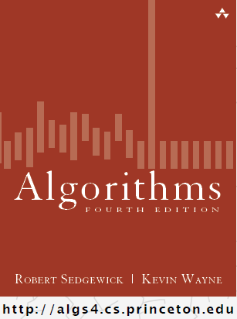
Cycles, DAGs, and Strongly Connected Components
COMP 2100
Otterbein University

Slide 2
Alerts
Lab 7 due Wednesday, 11/30
Project #3 due Friday, 12/2
Homework #8: Due this Friday
Homework #9: available later this week
Final Exam: Friday, December 9
Exam will be at 10:15am

Slide 3
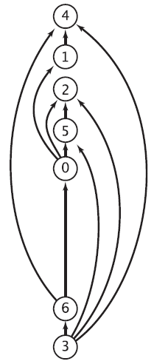
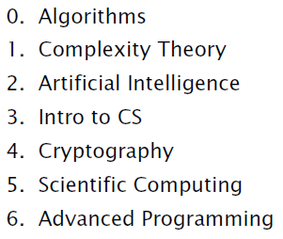
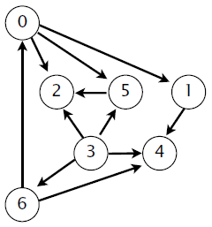
Precedence Scheduling
Given a set of tasks to be completed along with precedence constraints on the ordering of the tasks, how can we determine how to order them?
This is aka Topological Sorting
feasible schedule
tasks
constraints

Slide 4
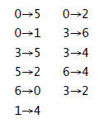
Topological Sorting
Input: a Directed Acyclic Graph (DAG)
Output: List of nodes in sequential order by precedence
Strategy: DFS Demo
topological order
directed edges
DAG

Slide 5
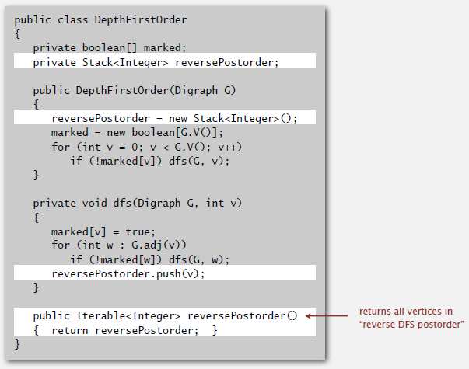
Depth-first search order

Slide 6
Why does it work?
The first vertex in postorder has to be a leaf in the DFS tree (with outdegree 0)
The second vertex in post-order can only point to the last vertex...
0
0
postorder
2
2
5
5
1
4 1 2 5 0 6 3
1
topological order
3 6 0 5 2 1 4
3
3
4
4
6
6

Slide 7
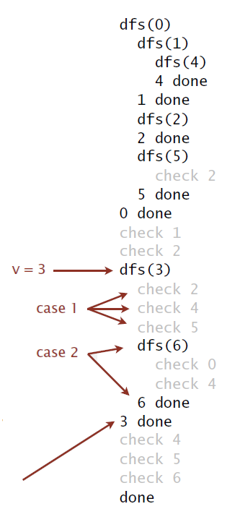
Correctness Proof
Claim: Reverse DFS postorder of a DAG is a topological order
Proof: Consider any edge $v→w$. When dfs(v) is called:
Case 1: dfs(w) has already been called and returned. Thus, w was done before v.
Case 2: dfs(w) has not yet been called. dfs(w) will get called directly or indirectly by dfs(v) and will finish before dfs(v) Thus, w will be done before v.
Case 3: dfs(w) has already been called, but has not yet returned. This can’t happen in a DAG as it implies a cycle exists!

Slide 8
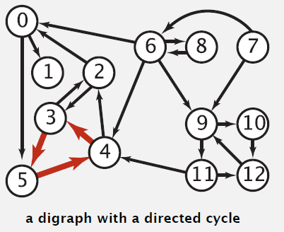
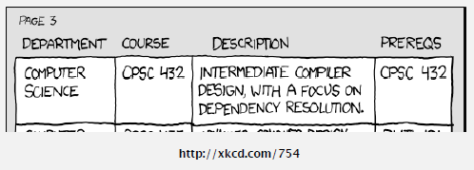
Directed Cycle Detection
Claim: A digraph has a topological order iff it contains no directed cycle

Slide 9
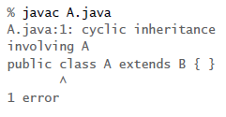
Cyclic Inheritance
The Java compiler does cycle detection
Excel has cycle detection in its formula engine

Slide 10
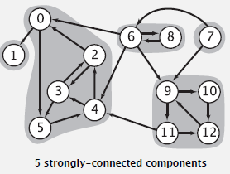
Strongly Connected Components
Vertices v and w are strongly connected if there is both a directed path from v to w and a directed path from w to v
Strong connectivity is an equivalence relation
v is strongly connected to v
if v is strongly connected to w, then w is strongly connected to v
if v is strongly connected to w and w to x, then v is strongly connected to x

Slide 11
Strong component algorithms
1972: Tarjan published the 1st linear-time DFS solution
stack based single pass DFS
complicated calculation to determine order
1978/81: Kosaraju-Sharir developed a two-pass linear-time DFS solution
one pass on the reverse graph
easy to compute
Many other algorithms have been proposed

Slide 12
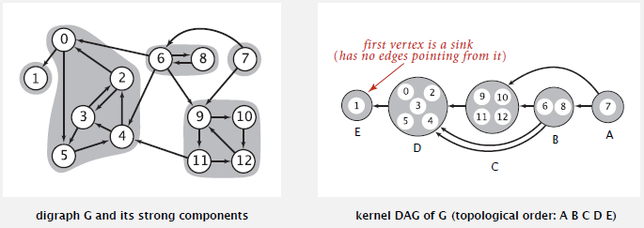
Kosaraju-Sharir: intuition
Calculate reverse graph
a graph and its reverse have the same SCCs
Kernel DAG
Contract each strong component into a single vertex
Algorithm
Compute topological order in kernel DAG
Run DFS, considering vertices in reverse topological order
Demo

Slide 13
Kosaraju-Sharir

Slide 14
Kosaraju-Sharir

Slide 15
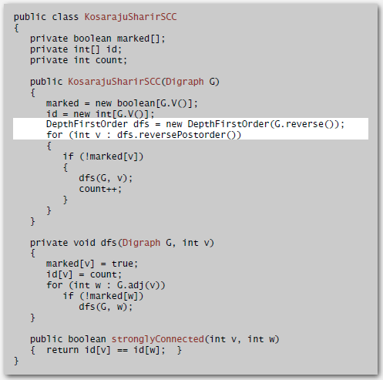
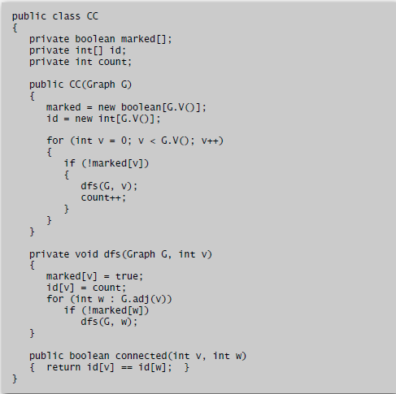
Kosaraju-Sharir

Slide 16
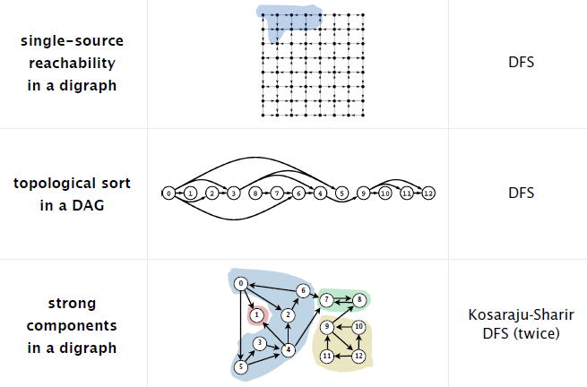
Digraph-processing

