Slide 1

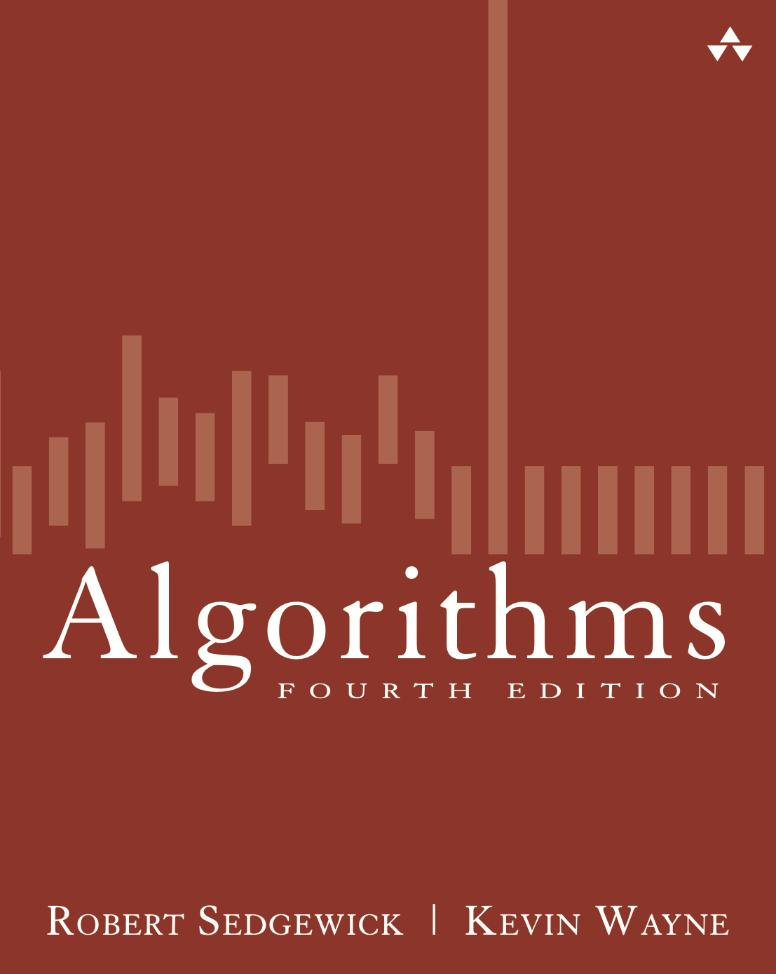
4.2 Directed BFS Demo
Algorithms
Robert Sedgewick | Kevin Wayne
http://algs4.cs.princeton.edu

Slide 2
Directed breadth-first search demo
Repeat until queue is empty:
  Remove vertex v from queue.
  Add to queue all unmarked vertices pointing from v and mark them.
tinyDG2.txt
0
2
V
6
8
5 0
2 4
3 2
1 2
0 1
4 3
3 5
0 2
0
2
E
1
1
3
3
5
5
4
4
graph G

Slide 3
Directed breadth-first search demo
Repeat until queue is empty:
  Remove vertex v from queue.
  Add to queue all unmarked vertices pointing from v and mark them.
0
2
0
0
2
queue
v
edgeTo[]
distTo[]
0
1
2
3
4
5
–
–
–
–
–
–
0
–
–
–
–
–
1
1
3
3
5
5
4
4
add 0 to queue

Slide 4
Directed breadth-first search demo
Repeat until queue is empty:
  Remove vertex v from queue.
  Add to queue all unmarked vertices pointing from v and mark them.
0
2
0
2
queue
v
edgeTo[]
distTo[]
0
1
2
3
4
5
–
–
–
–
–
–
0
–
–
–
–
–
1
1
3
3
5
5
4
4
0
dequeue 0

Slide 5
Directed breadth-first search demo
Repeat until queue is empty:
  Remove vertex v from queue.
  Add to queue all unmarked vertices pointing from v and mark them.
0
2
0
2
2
2
queue
v
edgeTo[]
distTo[]
0
1
2
3
4
5
–
–
–
–
–
–
0
–
–
–
–
–
1
1
0
1
3
3
5
5
4
4
dequeue 0: check 2 and check 1
dequeue 0

Slide 6
Directed breadth-first search demo
Repeat until queue is empty:
  Remove vertex v from queue.
  Add to queue all unmarked vertices pointing from v and mark them.
0
2
0
2
2
queue
v
edgeTo[]
distTo[]
0
1
2
3
4
5
–
–
0
–
–
–
0
–
1
–
–
–
0
1
1
1
1
1
3
3
5
5
4
4
2
dequeue 0: check 2 and check 1

Slide 7
Directed breadth-first search demo
Repeat until queue is empty:
  Remove vertex v from queue.
  Add to queue all unmarked vertices pointing from v and mark them.
0
2
0
2
2
queue
v
edgeTo[]
distTo[]
0
1
2
3
4
5
–
0
0
–
–
–
0
1
1
–
–
–
1
1
1
3
3
1
5
5
4
4
2
0 done

Slide 8
Directed breadth-first search demo
Repeat until queue is empty:
  Remove vertex v from queue.
  Add to queue all unmarked vertices pointing from v and mark them.
0
2
2
queue
v
edgeTo[]
distTo[]
0
1
2
3
4
5
–
0
0
–
–
–
0
1
1
–
–
–
1
1
1
3
3
1
5
5
4
4
2
dequeue 2

Slide 9
Directed breadth-first search demo
Repeat until queue is empty:
  Remove vertex v from queue.
  Add to queue all unmarked vertices pointing from v and mark them.
0
2
2
queue
v
edgeTo[]
distTo[]
0
1
2
3
4
5
–
0
0
–
–
–
0
1
1
–
–
–
1
1
1
2
2
3
3
5
5
4
4
4
4
1
dequeue 2: check 4
dequeue 2

Slide 10
Directed breadth-first search demo
Repeat until queue is empty:
  Remove vertex v from queue.
  Add to queue all unmarked vertices pointing from v and mark them.
0
2
2
queue
v
edgeTo[]
distTo[]
0
1
2
3
4
5
–
0
0
–
2
–
0
1
1
–
2
–
1
1
1
3
3
4
5
5
4
4
4
1
2 done

Slide 11
Directed breadth-first search demo
Repeat until queue is empty:
  Remove vertex v from queue.
  Add to queue all unmarked vertices pointing from v and mark them.
0
2
queue
v
edgeTo[]
distTo[]
0
1
2
3
4
5
–
0
0
–
2
–
0
1
1
–
2
–
1
1
3
3
4
5
5
4
4
4
1
dequeue 1

Slide 12
Directed breadth-first search demo
Repeat until queue is empty:
  Remove vertex v from queue.
  Add to queue all unmarked vertices pointing from v and mark them.
0
2
queue
v
edgeTo[]
distTo[]
0
1
2
3
4
5
–
0
0
–
2
–
0
1
1
–
2
–
1
1
3
3
5
5
4
4
4
4
dequeue 1; check 2
dequeue 1

Slide 13
Directed breadth-first search demo
Repeat until queue is empty:
  Remove vertex v from queue.
  Add to queue all unmarked vertices pointing from v and mark them.
0
2
queue
v
edgeTo[]
distTo[]
0
1
2
3
4
5
–
0
0
–
2
–
0
1
1
–
2
–
1
1
3
3
5
5
4
4
4
4
1 done

Slide 14
Directed breadth-first search demo
Repeat until queue is empty:
  Remove vertex v from queue.
  Add to queue all unmarked vertices pointing from v and mark them.
0
2
queue
v
edgeTo[]
distTo[]
0
1
2
3
4
5
–
0
0
–
2
–
0
1
1
–
2
–
1
3
5
4
4
4
dequeue 4

Slide 15
Directed breadth-first search demo
Repeat until queue is empty:
  Remove vertex v from queue.
  Add to queue all unmarked vertices pointing from v and mark them.
0
2
queue
v
edgeTo[]
distTo[]
0
1
2
3
4
5
–
0
0
–
2
–
0
1
1
–
2
–
1
4
3
3
3
3
3
3
5
4
4
dequeue 4: check 3

Slide 16
Directed breadth-first search demo
Repeat until queue is empty:
  Remove vertex v from queue.
  Add to queue all unmarked vertices pointing from v and mark them.
0
2
queue
v
edgeTo[]
distTo[]
0
1
2
3
4
5
–
0
0
4
2
–
0
1
1
3
2
–
1
3
3
3
5
5
4
4
3
4 done

Slide 17
Directed breadth-first search demo
Repeat until queue is empty:
  Remove vertex v from queue.
  Add to queue all unmarked vertices pointing from v and mark them.
0
2
queue
v
edgeTo[]
distTo[]
0
1
2
3
4
5
–
0
0
4
2
–
0
1
1
3
2
–
1
3
3
5
4
3
dequeue 3

Slide 18
Directed breadth-first search demo
Repeat until queue is empty:
  Remove vertex v from queue.
  Add to queue all unmarked vertices pointing from v and mark them.
0
2
queue
v
edgeTo[]
distTo[]
0
1
2
3
4
5
–
0
0
4
2
–
0
1
1
3
2
–
1
3
3
3
4
5
5
5
5
4
dequeue 3: check 5 and check 2

Slide 19
Directed breadth-first search demo
Repeat until queue is empty:
  Remove vertex v from queue.
  Add to queue all unmarked vertices pointing from v and mark them.
0
2
queue
v
edgeTo[]
distTo[]
0
1
2
3
4
5
–
0
0
4
2
3
0
1
1
3
2
4
1
3
3
5
4
5
dequeue 3: check 5 and check 2

Slide 20
Directed breadth-first search demo
Repeat until queue is empty:
  Remove vertex v from queue.
  Add to queue all unmarked vertices pointing from v and mark them.
0
2
queue
v
edgeTo[]
distTo[]
0
1
2
3
4
5
–
0
0
4
2
3
0
1
1
3
2
4
1
3
3
5
4
5
3 done

Slide 21
Directed breadth-first search demo
Repeat until queue is empty:
  Remove vertex v from queue.
  Add to queue all unmarked vertices pointing from v and mark them.
0
2
queue
v
edgeTo[]
distTo[]
0
1
2
3
4
5
–
0
0
4
2
3
0
1
1
3
2
4
1
3
5
5
4
5
dequeue 5

Slide 22
Directed breadth-first search demo
Repeat until queue is empty:
  Remove vertex v from queue.
  Add to queue all unmarked vertices pointing from v and mark them.
0
2
queue
v
edgeTo[]
distTo[]
0
1
2
3
4
5
–
0
0
4
2
3
0
1
1
3
2
4
1
3
5
5
4
dequeue 5: check 0

Slide 23
Directed breadth-first search demo
Repeat until queue is empty:
  Remove vertex v from queue.
  Add to queue all unmarked vertices pointing from v and mark them.
0
2
queue
v
edgeTo[]
distTo[]
0
1
2
3
4
5
–
0
0
4
2
3
0
1
1
3
2
4
1
3
5
5
4
5 done

Slide 24
Directed breadth-first search demo
Repeat until queue is empty:
  Remove vertex v from queue.
  Add to queue all unmarked vertices pointing from v and mark them.
0
2
v
edgeTo[]
distTo[]
0
1
2
3
4
5
–
0
0
4
2
3
0
1
1
3
2
4
1
3
5
4
done

