Slide 1

Directed Graphs
COMP 2100
Otterbein University

Slide 2
Alerts
Lab 7 due Wednesday, 11/30
Project #3 available tomorrow
Homework #8 due Friday

Slide 3
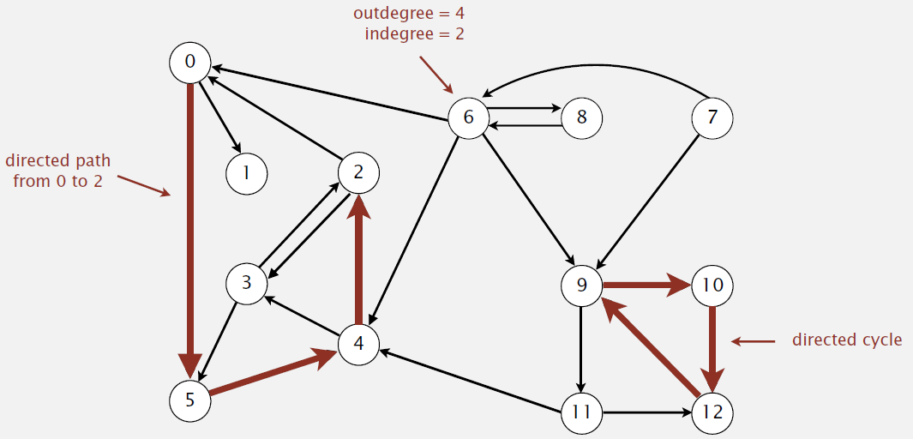
Directed Graphs
If the edges are directed, things get more complicated

Slide 4
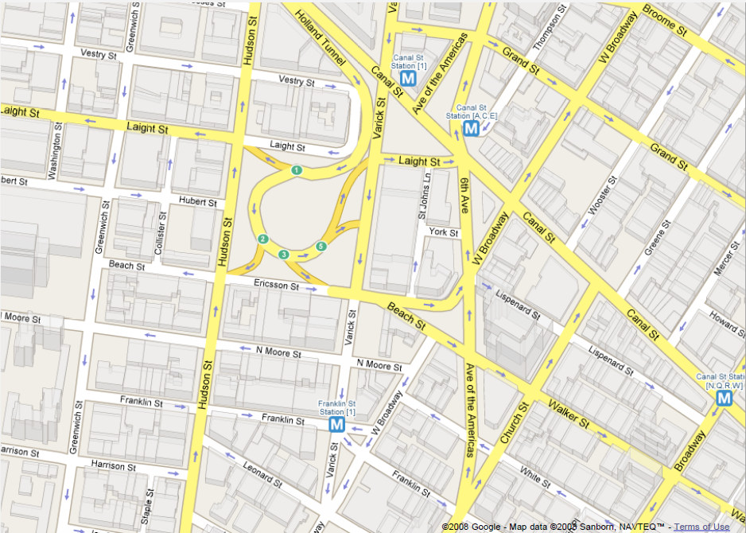
Applications

Slide 5
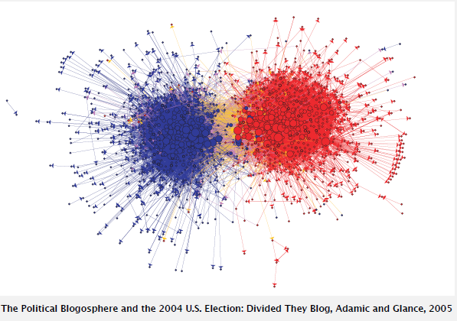
Political Blogosphere

Slide 6
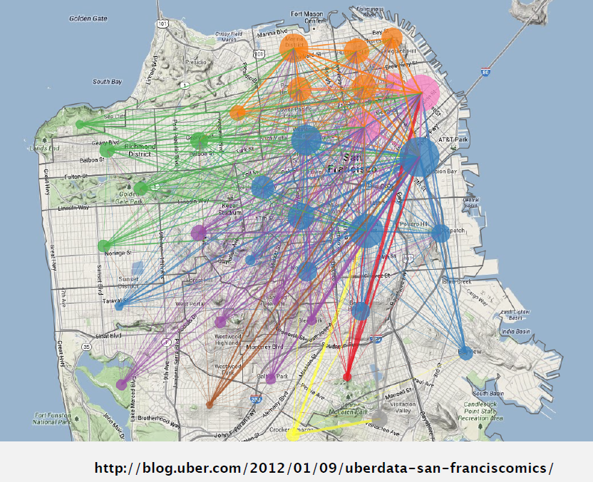
Applications

Slide 7
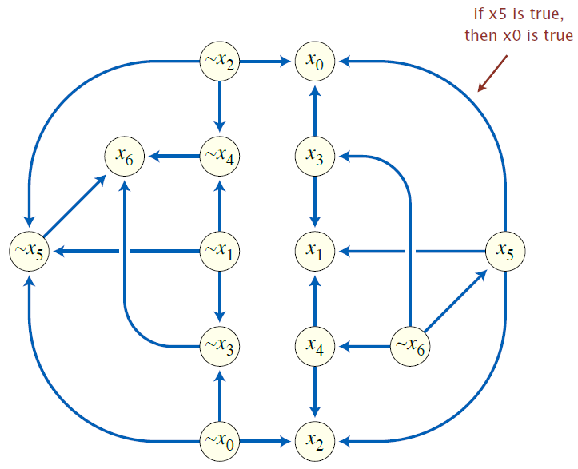
Implication Graph

Slide 8
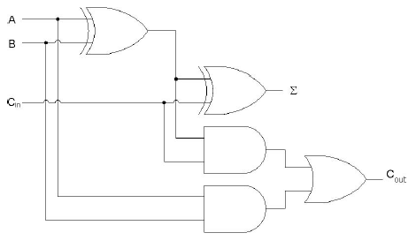
Combinatorial Circuit

Slide 9
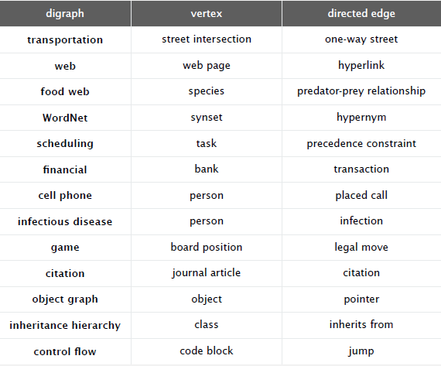
Digraph Applications

Slide 10
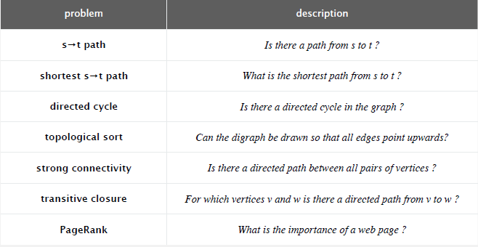
Digraph Problems

Slide 11
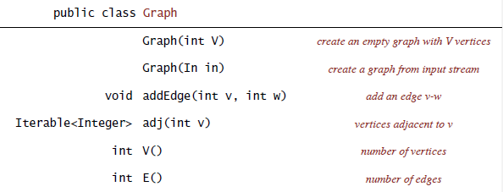
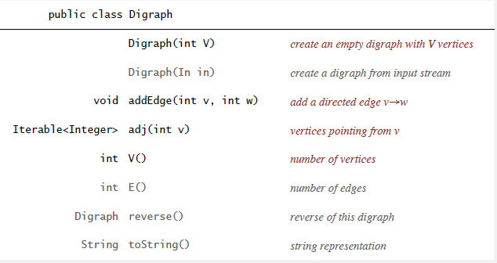
Digraph API

Slide 12
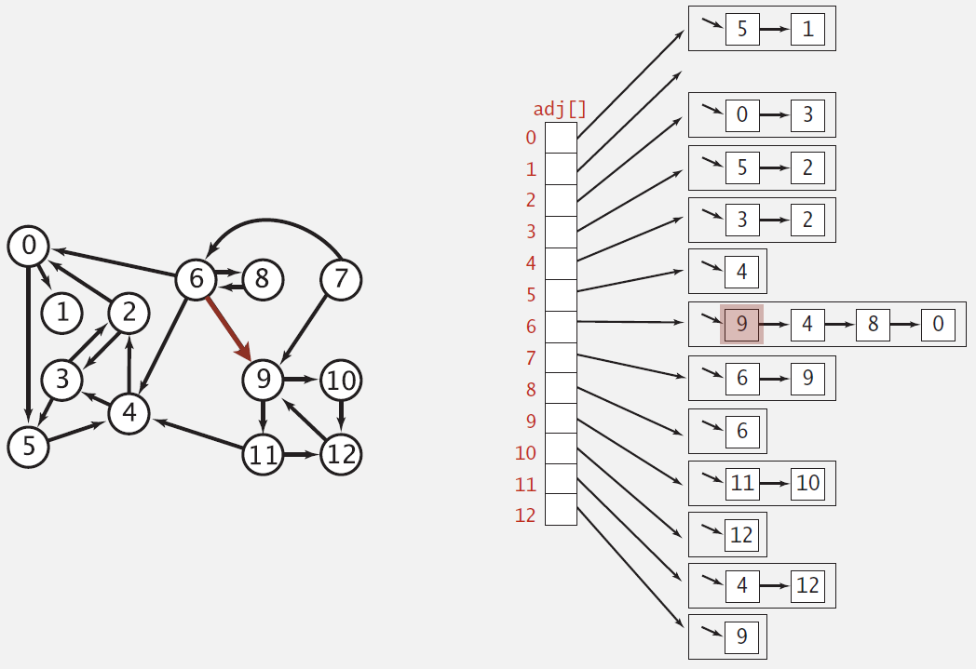
Digraph Adjacency List

Slide 13
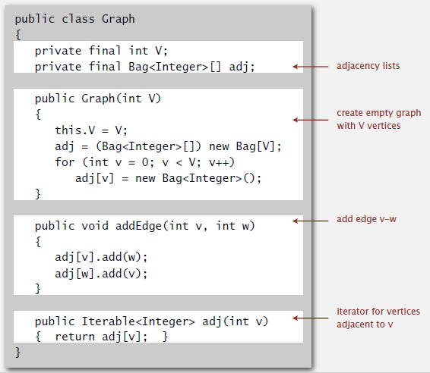
Adjacency List Graph: Java

Slide 14
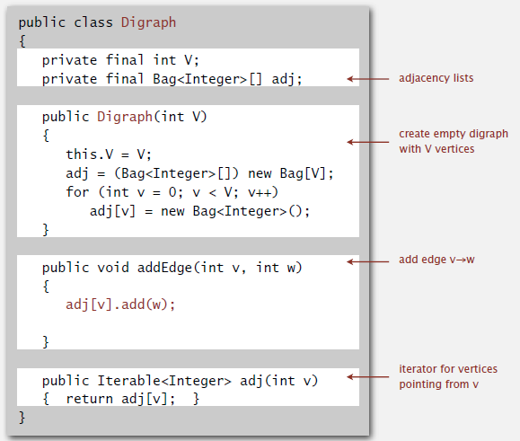
Adjacency List Digraph: Java

Slide 15
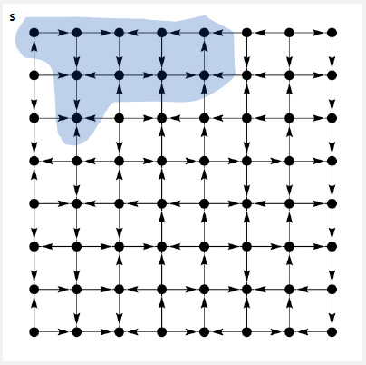
Reachability
The same DFS method we developed for graphs will work for a digraph
Demo

Slide 16
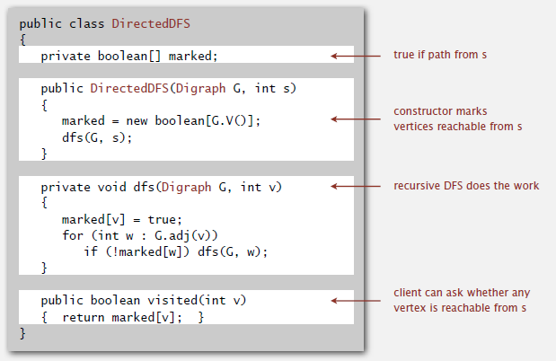
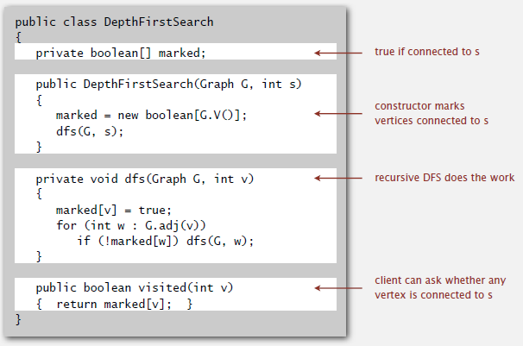
Depth-1st Search: Java

Slide 17
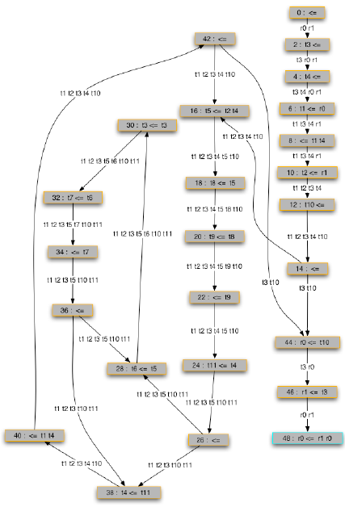
Reachability Application
Program Control-Flow Analysis
  Every program is a digraph
  Vertex: block
  Edge: jump
Dead-code elimination
  unreachable code
Infinite-loop detection
  is exit unreachable?

Slide 18
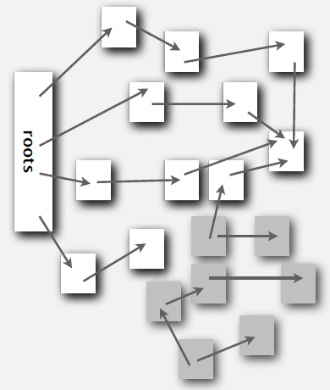
Reachability Application
Mark-Sweep Garbage Collector [McCarthy, 1960]
  Every data structure is
  a digraph
  Vertex: object
  Edge: reference
Roots: objects directly
accessible by program
Reachable objects: those
indirectly accessible

Slide 19
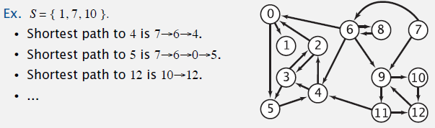
Breadth-1st Search
Again, the same BFS algorithm for graphs works for digraphs
  It computes the shortest directed path from a starting vertex s to every other vertex in time O(E+V)
  Demo
Multiple-source shortest path: Given a set of starting vertices rather than a single vertex
  Can be implemented using BFS where we initialize the queue to contain all the vertices in the set

Slide 20
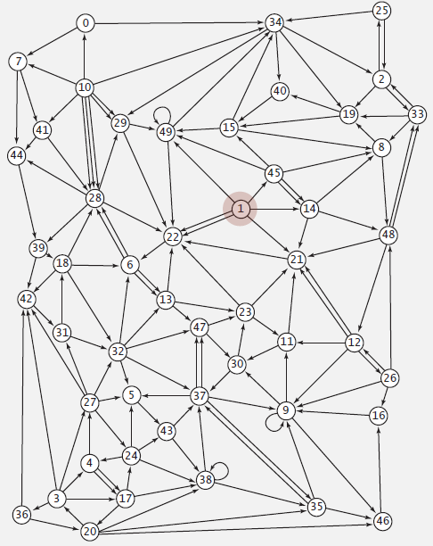
BFS Application: Web-crawler
Algorithm
  Choose web page as initial site
  Maintain a queue of URLs to explore
  Maintain a set of discovered URLs
  Dequeue the next URL and enqueue
  all the URLs that are contained in
  the web page at that address
  (avoiding cycles)
Why not use DFS?
  https://hmpg.net/

Slide 21
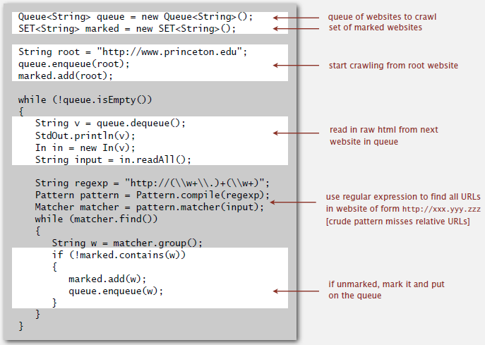
Simple Java Web-crawler

Slide 22
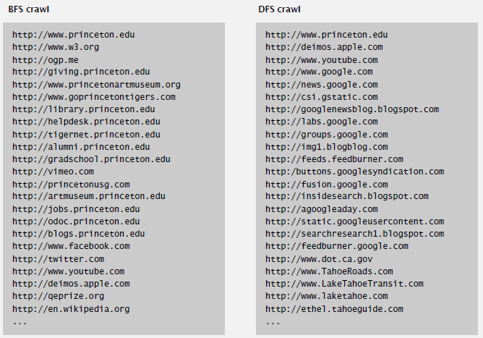
Simple Java Web-crawlers
What’s going on here?

