Slide 1
Graph Navigation
COMP 2100
Otterbein University

Slide 2
Alerts
Lab 7 due Wednesday, 11/30
Homework 7 due today
Project #3 available next Tuesday
Email group info to me
Homework 8 is available now, due next Friday

Slide 3
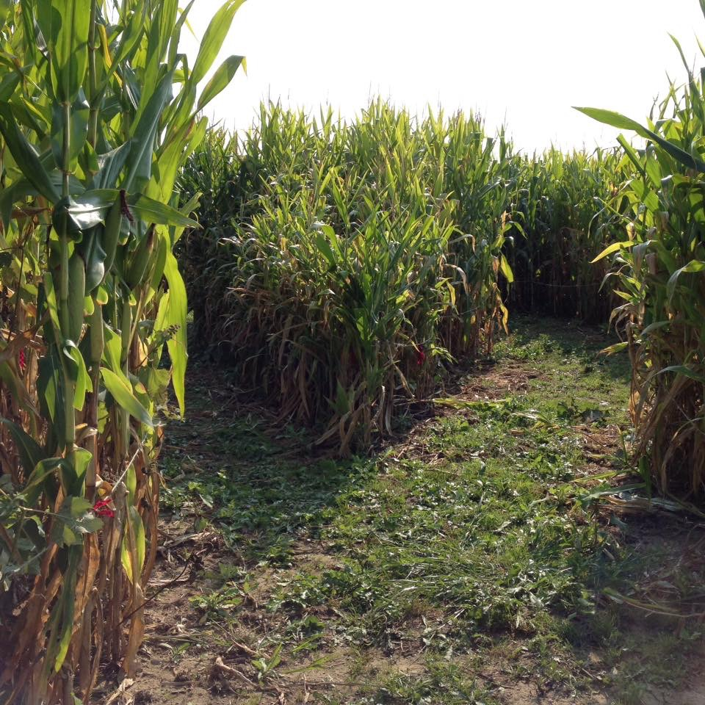
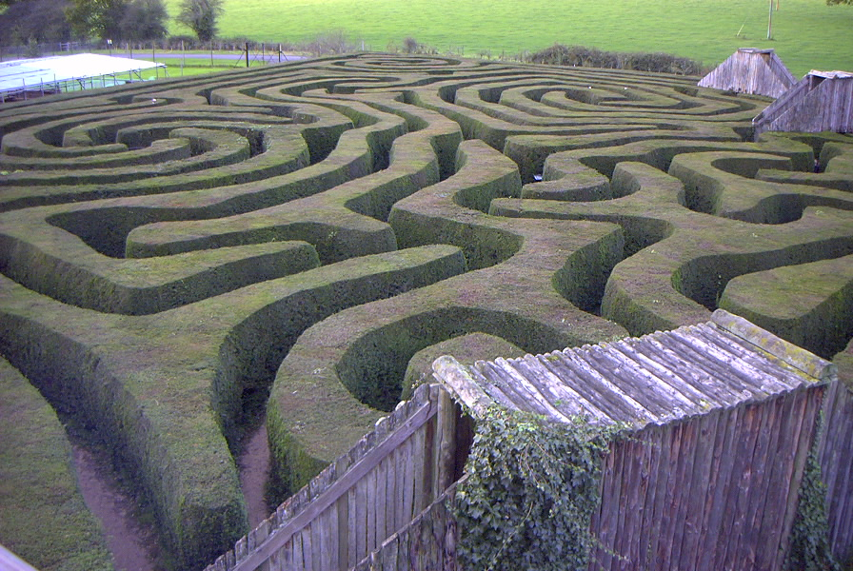
Mazes
We implemented a maze navigation algorithm already, didn’t we?
When?
A maze is just another example of a graph
What was the strategy we used?
Depth-1st search with backtracking

Slide 4
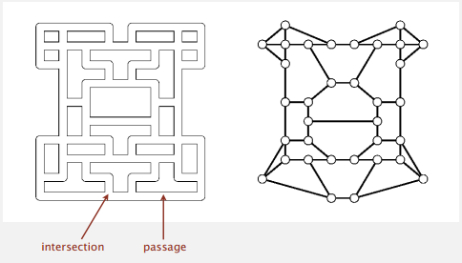
Mazes & Graphs
We can model each intersection with a vertex and each passage with an edge

Slide 5
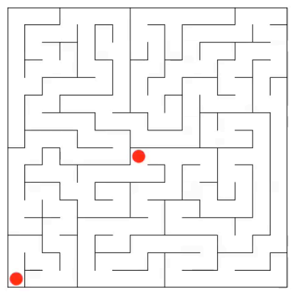
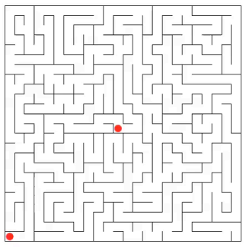
Maze Exploration
Some mazes are easy
Some are more challenging

Slide 6
Maze Exploration
And then there is the ridiculous

Slide 7
Depth-1st Search
A recursive back-tracking algorithm that marks each node as it is visited, and keeps moving forward until it reaches a dead-end.
Data Structures
Boolean array marked[]
Integer array edgeTo[]
Recursive call stack

Slide 8
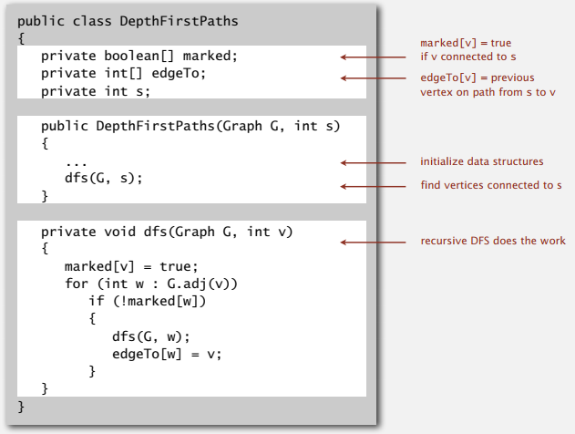
Depth-1st Search: Java
Demo

Slide 9
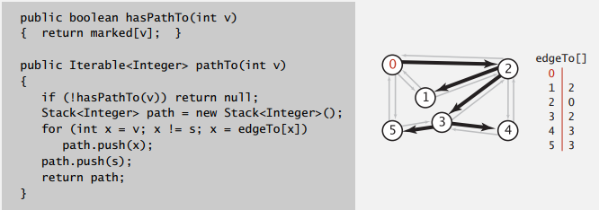
Depth-1st Search
After DFS is run, the marked and edgeTo data structures allow us to answers graph queries:
hasPathTo
pathTo

Slide 10
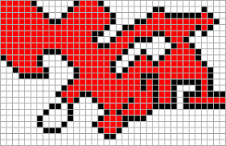
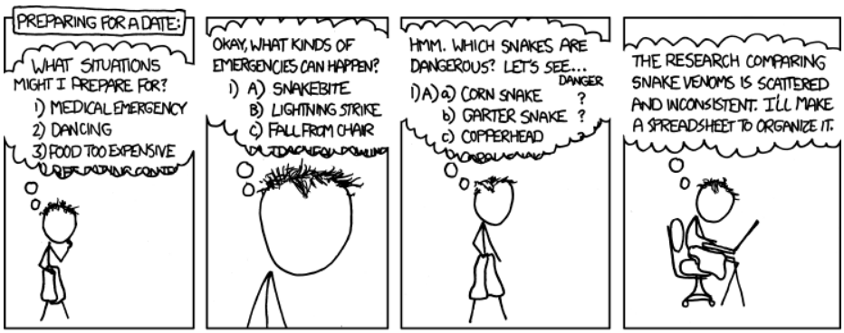
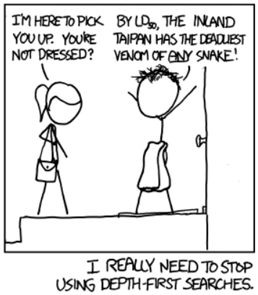
Depth-1st Search
DFS has other applications
flood fill
Vertex = pixel
Edge = adjacent pixels of the same color
Island = all connected pixels of the same color
http://xkcd.com/761

Slide 11
Breadth-1st Search
We want to iterate over the vertices based on increasing distance from starting point
This requires a queue-based algorithm rather than the stack-based algorithm of DFS
Place starting vertex in queue
While the queue is not empty
Remove a vertex from the queue
Add to the queue and mark all its neighbors that are not already marked
Demo

Slide 12
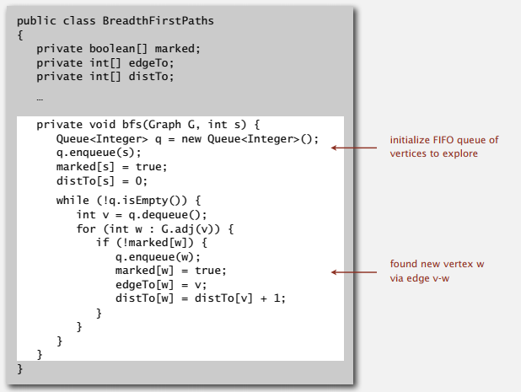
Breadth-1st Search: Java

Slide 13
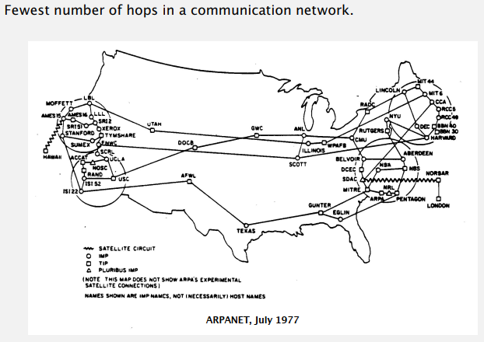
Breadth-1st Search: Application

Slide 14
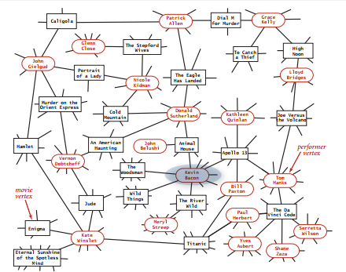
Breadth-1st Search : Application
Six degrees of separation
The Oracle of Bacon
Co-Authors.net
MathSciNet
Include one vertex for each actor and one for each movie

Slide 15
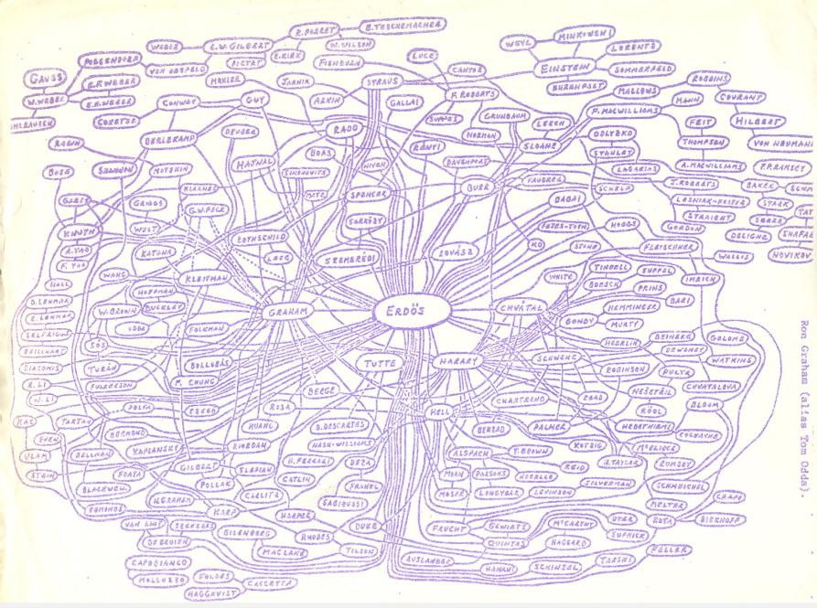
Breadth-1st Search: Application

Slide 16
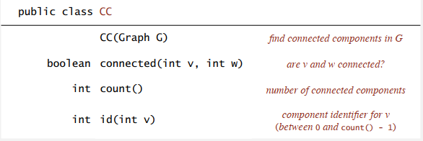
Connected Components
Can we preprocess a graph so that “Is v connected to w?” can be answered in constant time?
Union-Find: nope
DFS: yes!!

Slide 17
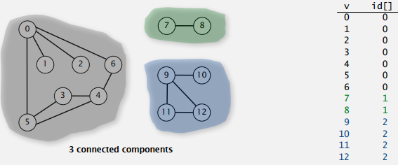
Connected Components
The relation “is connected to” is an equivalence relation
Reflexive: v is connected to v
Symmetric: if v is connected to w, then w is connected to v
Transitive: if v is connected to w and w is connected to x, then v is connected to x
A connected component is a maximal set of connected vertices

Slide 18
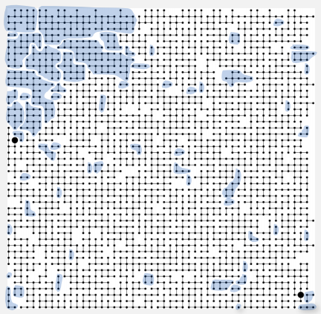
Connected Components
Demo

Slide 19
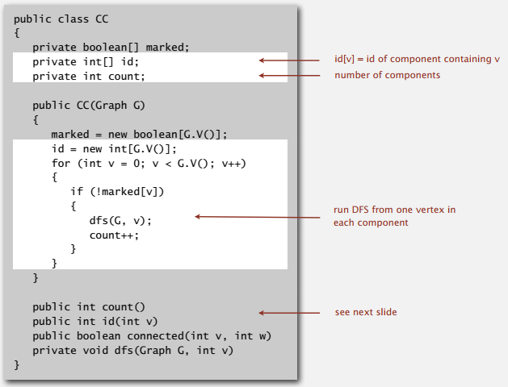
Connected Components: Java

Slide 20
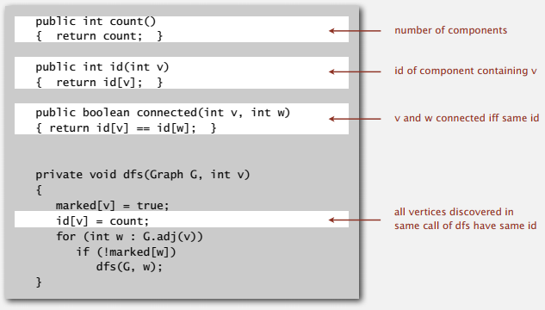
Connected Components: Java

Slide 21
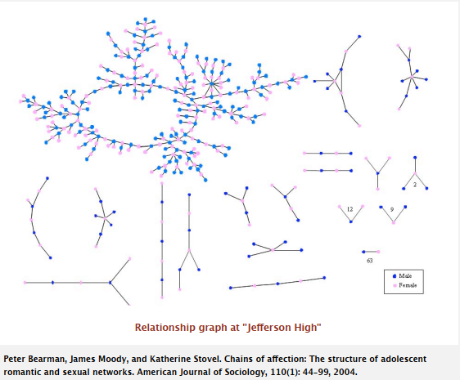
Connected Components Applications

Slide 22
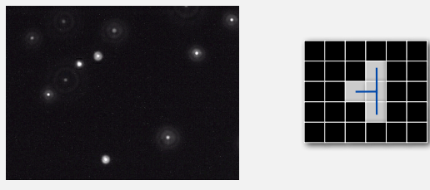
Connected Components Applications
Particle detection
Given a greyscale image of particles, identify “blobs” (like flood fill islands)
Track moving particles over time

Slide 23
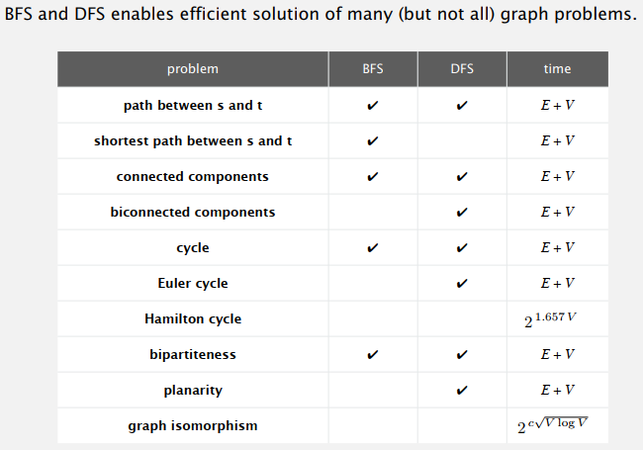
Summary

