Slide 1
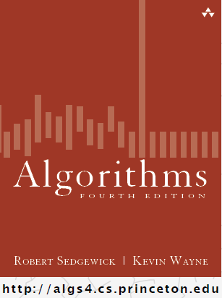
Graphs
COMP 2100
Otterbein University

Slide 2
Alerts
Lab 7 due Wednesday, 11/30
  This is the final lab
Project #3 available next Tuesday
  Email me group selections

Slide 3
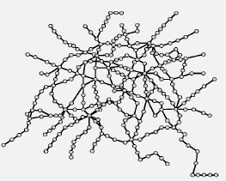
Undirected Graphs
A graph is a set of vertices connected pairwise by edges
What are they good for?
  There are thousands of practical applications
  There are hundreds of known graph algorithms
  It is a versatile and useful abstraction
  Graphs form a challenging branch of computer science and discrete math

Slide 4
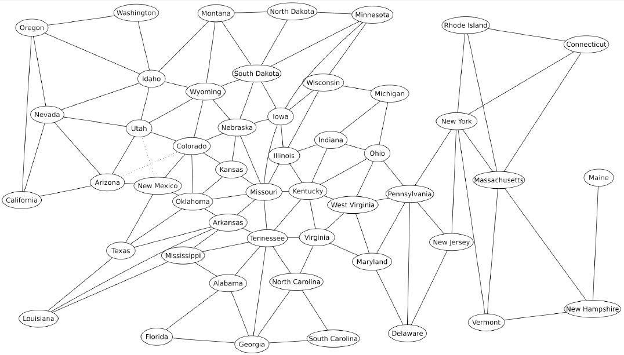
Border graph of USA lower 48

Slide 5
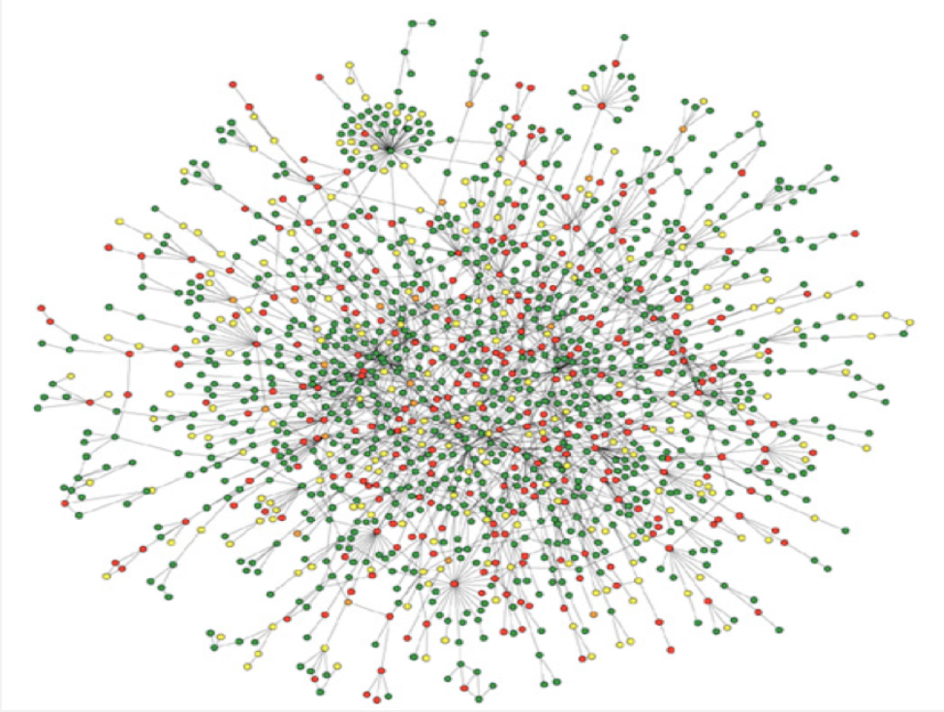
Protein-protein interaction network
Reference: Jeong et al, Nature Review | Genetics

Slide 6
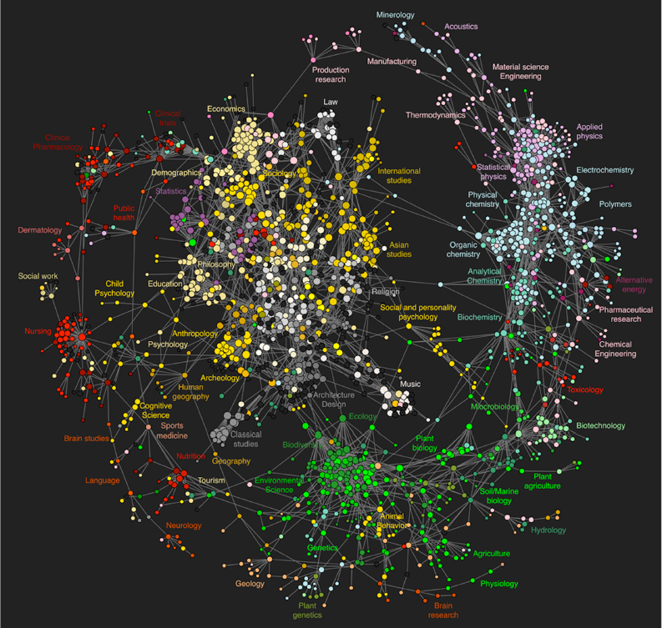
Map of science clickstreams http://www.plosone.org/article/info:doi/10.1371/journal.pone.0004803

Slide 7
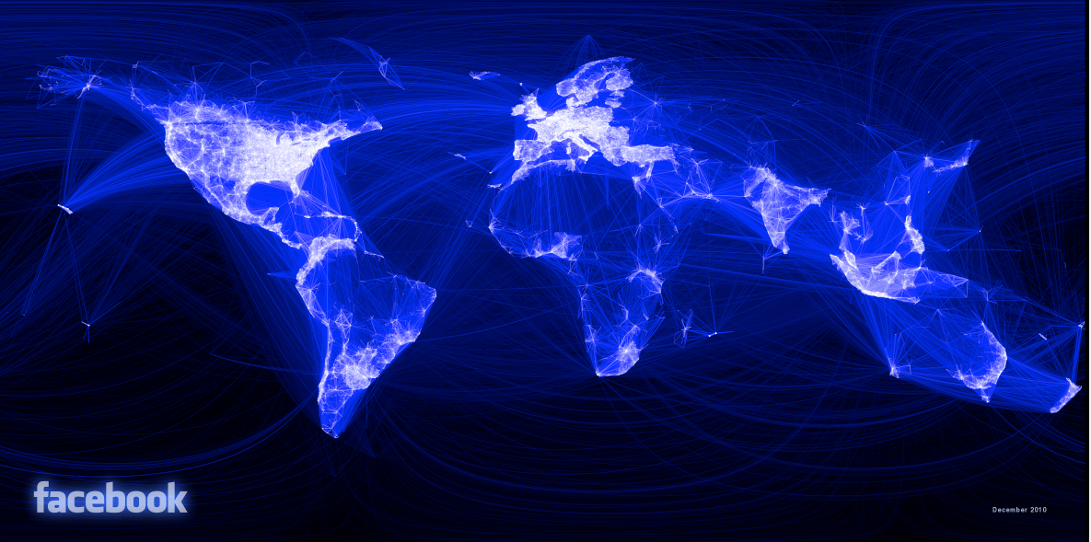
10 Million Facebook Friends
"Visualizing Friendships" by Paul Butler

Slide 8
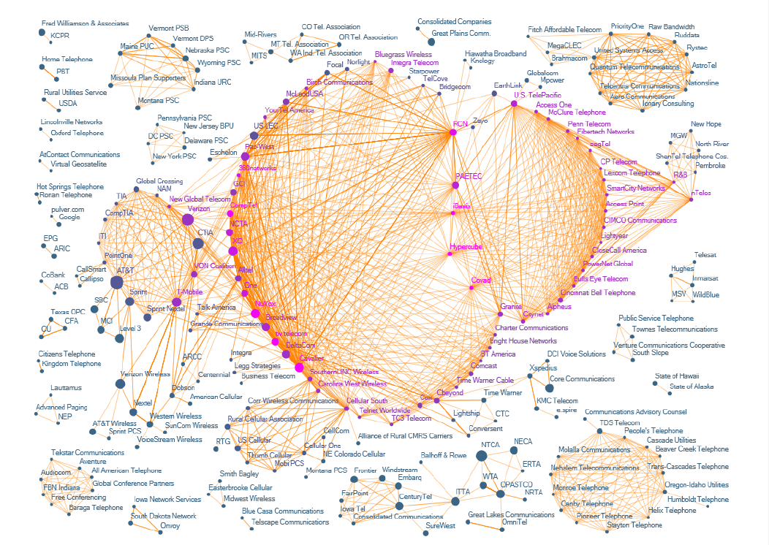
The evolution of FCC lobbying coalitions
“The Evolution of FCC Lobbying Coalitions” by Pierre de Vries in JoSS Visualization Symposium 2010

Slide 9
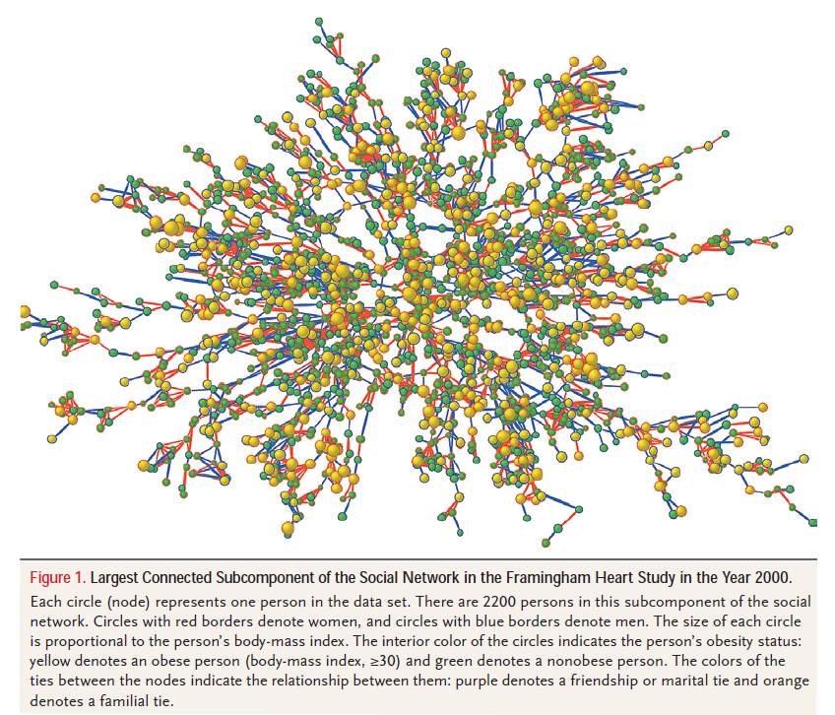
Framingham heart study
“The Spread of Obesity in a Large Social Network over 32 Years” by Christakis and Fowler in New England Journal of Medicine, 2007

Slide 10
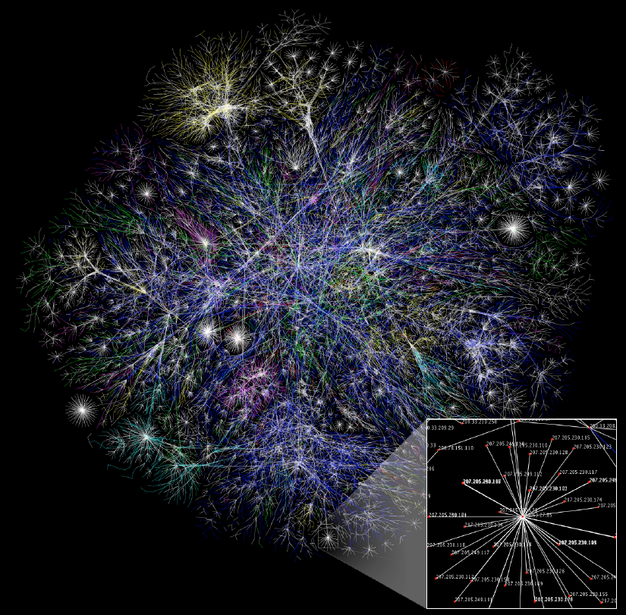
The Internet as mapped by the Opte Project http://en.wikipedia.org/wiki/Internet

Slide 11
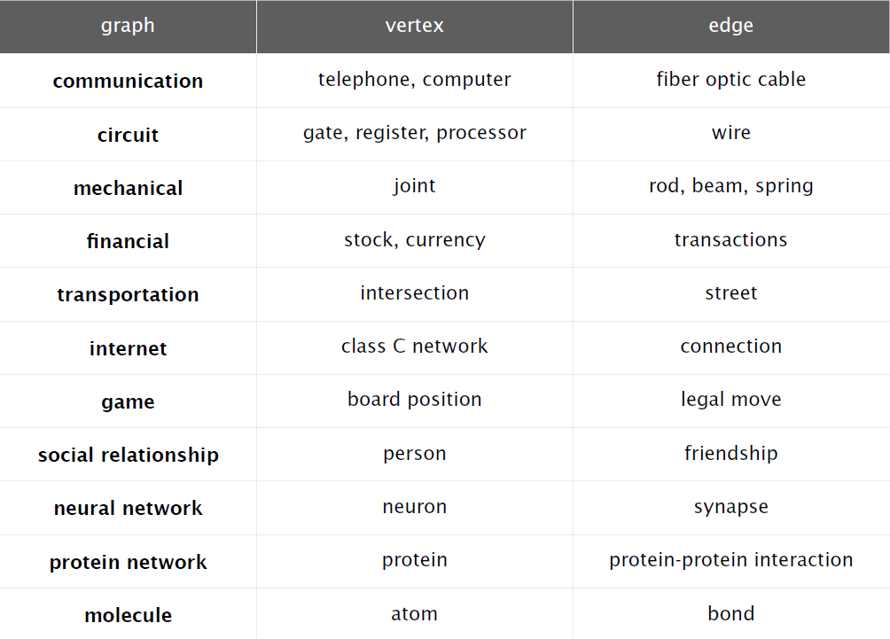

Slide 12
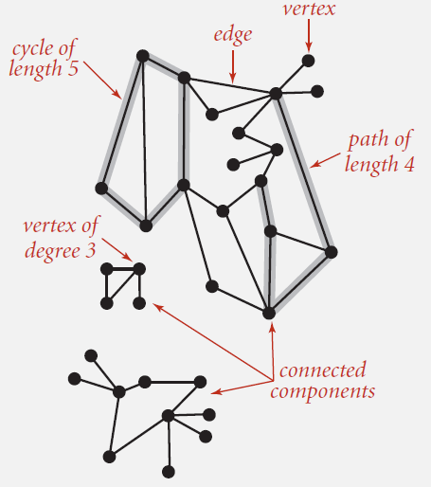
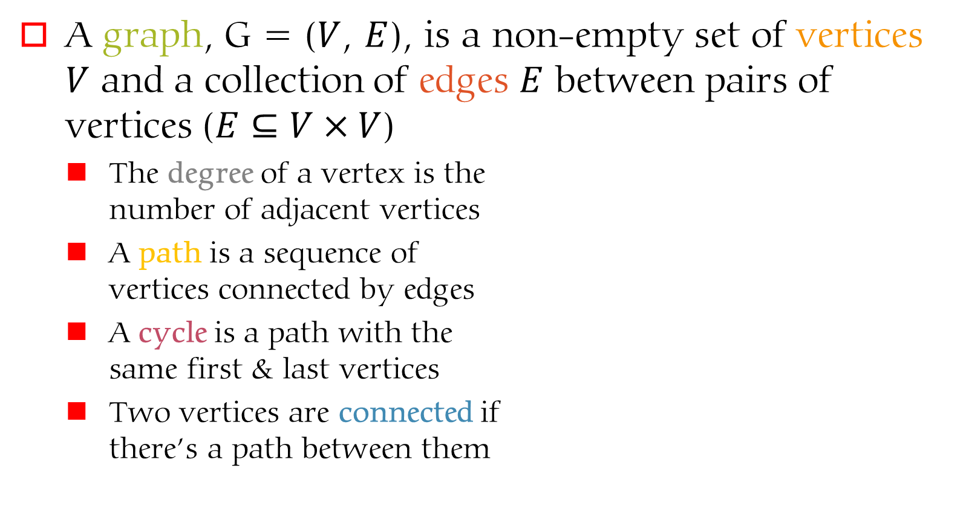
Definitions & Vocabulary
A graph, G = ($V$, $E$), is a non-empty set of vertices $V$ and a collection of edges $E$ between pairs of vertices ($E⊆V×V$)
  The degree of a vertex is the
  number of adjacent vertices
  A path is a sequence of
  vertices connected by edges
  A cycle is a path with the
  same first & last vertices
  Two vertices are connected if
  there’s a path between them

Slide 13
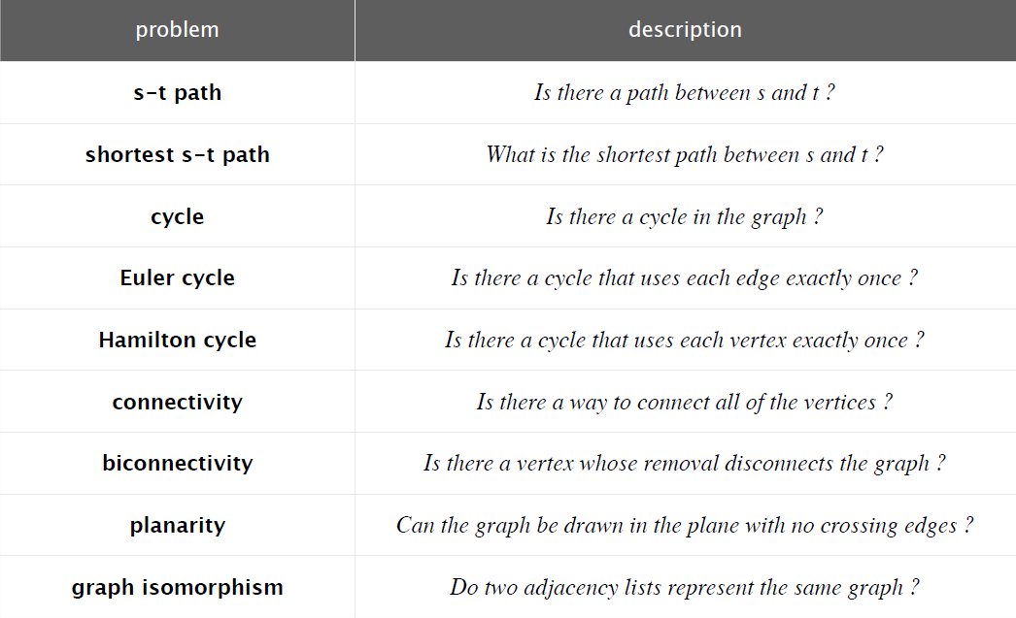
Graph-processing problems
Which of these are easy? Difficult? Intractable?

Slide 14
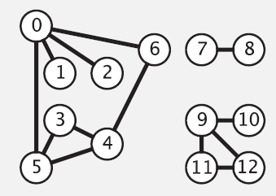
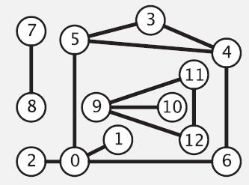
Graph Representation
Pictures are nice, but intuition can be misleading
  Here is a graph
  And here is another
  drawing of the same
  graph

Slide 15

Graph Representation
Vertices can be ‘named’ by numbers in the range between 0 and V – 1
  It is also possible to use a symbol table to use other names that map to this integer scheme
  The advantage is the vertex name can be used as an index to an array
We will largely ignore the possibility of edges that are self-loops, or parallel edges unless it becomes relevant to an application

Slide 16
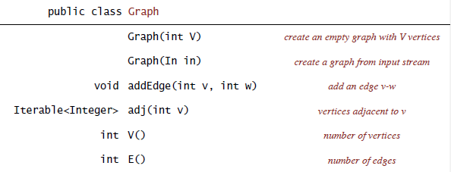
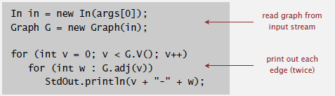
Graph API

Slide 17
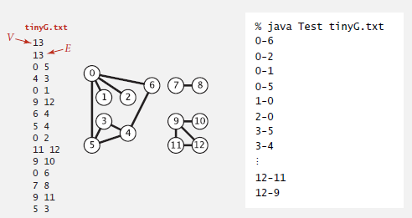
Graph API: sample client

Slide 18
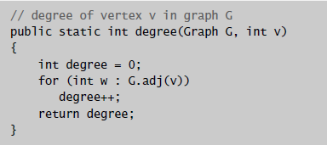
Graph API: sample utility method

Slide 19
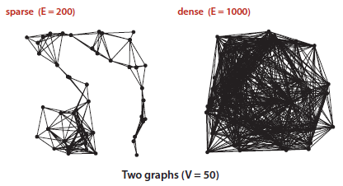
Graph Representation
So how do we represent the edges?
  Keep a list of vertex pairs
  An adjacency matrix
  An adjacency list
Which to use will depend on a variety of factors
  Is the graph sparse or dense?
  Does the graph have parallel edges?
  etc., ...
Let’s consider each...

Slide 20
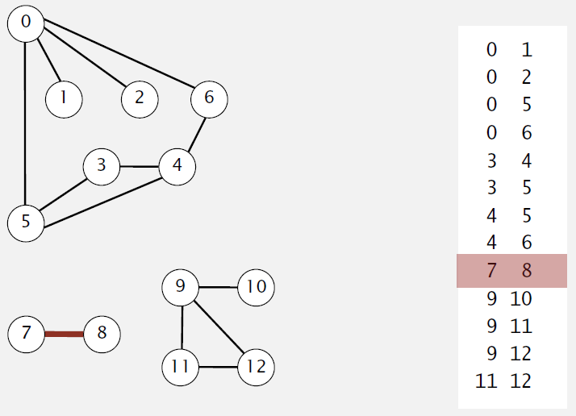
Graph Representation
List of vertex pairs
What is the time complexity of iterating over the vertices adjacent to a given vertex?

Slide 21
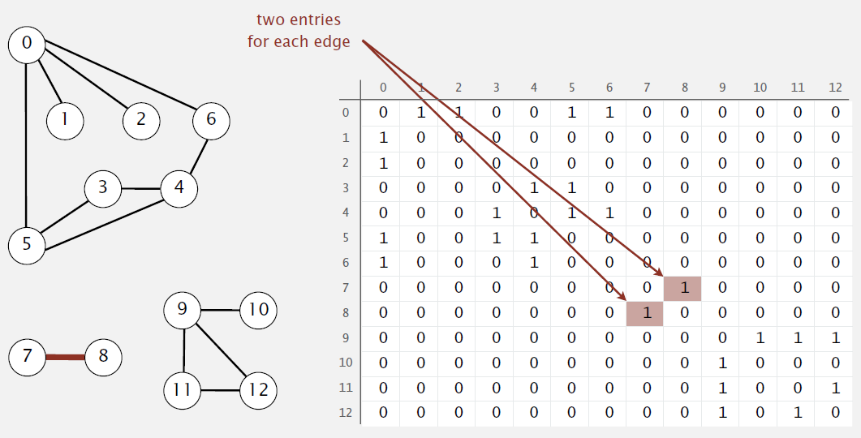
Graph Representation
Adjacency Matrix
What is the time complexity of iterating over the vertices adjacent to a given vertex?

Slide 22
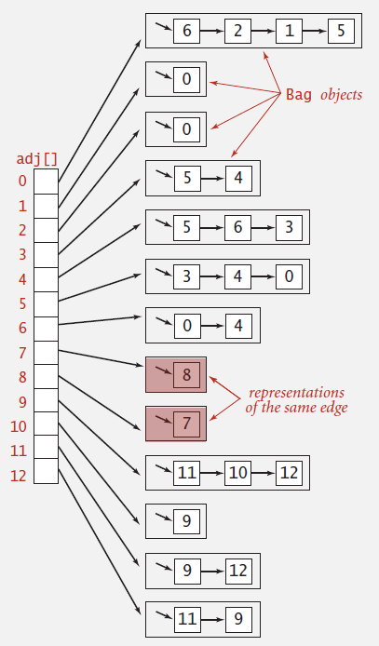
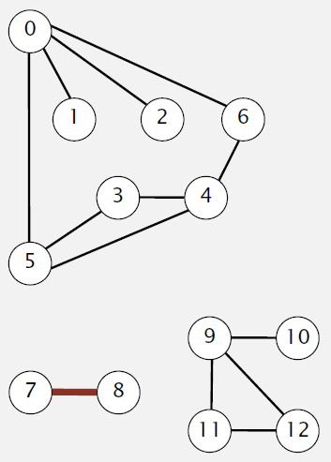
Graph Representation
Adjacency List
What is the time complexity of iterating over the vertices adjacent to a given vertex?

Slide 23
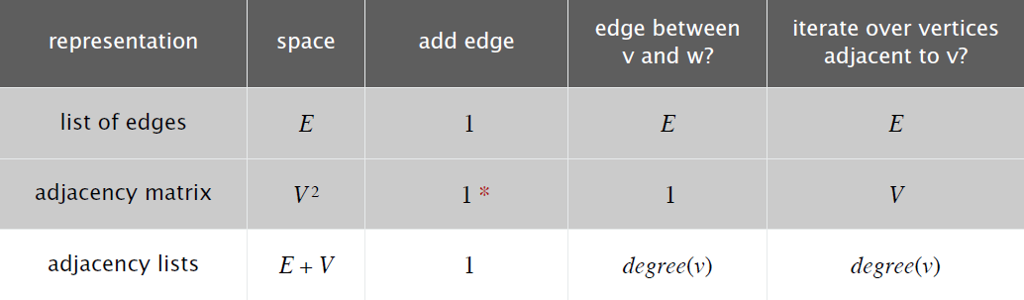
Graph Representation

Slide 24
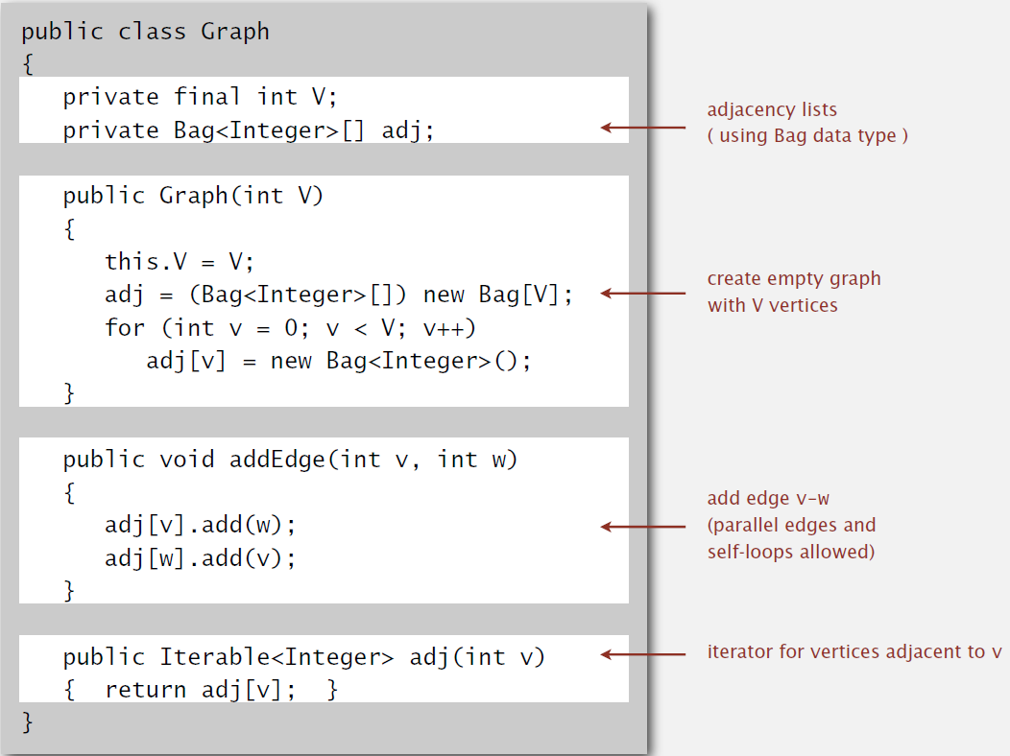
Graph Representation: Java

