Slide 1

Heaps
Heap Sort & Priority Queues
COMP 2100
Otterbein University

Slide 2
Alerts
Homework #7 due Friday
Lab 7 available tomorrow

Slide 3
Quote
“ Show me your code and conceal your data structures, and I shall continue to be mystified. Show me your data structures, and I won’t usually need your code; it'll be obvious.”
— Fred Brooks

Slide 4
Definition
A heap is a binary tree satisfying the properties:
  Partial Order: child ≤ parent (max-heap)
  child ≥ parent (min-heap)
  Complete: all leaves on at most two (adjacent) levels, the upper of which is full, and the lower of which is left justified

Slide 5
A complete binary tree in nature

Slide 6
Example
X
T
P
G
S
M
N
A
E
R
A
I

Slide 7
Logarithmic Height
A heap with n elements has height h(n) ∈ Θ(lg n)
  Proof: it is easy to see that the height of a complete binary tree grows every time the number of nodes becomes a power of 2. So,
  2^{h(n) – 1} ≤ n ≤ 2^{h(n)} – 1
  This can be proven rigorously by mathematical induction from the formula
  Using logarithms and solving for h(n) we get
  lg (n + 1) ≤ h(n) ≤ 1 + lg n

Slide 8
Representation
The completeness property of a heap allows us to use an array or ArrayList to store the tree level by level.
We will use ArrayList for our implementation.
The largest element in the heap, the root of the tree is always at location 0.

Slide 9
Illustration
0
X
1
T
X
0
2
P
3
G
T
1
P
2
4
S
5
M
6
N
G
3
S
4
M
5
N
6
7
A
8
E
A
E
R
A
I
L(i) = 2i+1
R(i) = 2i+2
P(i) = ⎣(i −1)/ 2⎦
9
R
7
8
9
10
11
10
A
11
I

Slide 10
Heap Maintenance
The primary benefit of the heap data structure is that insertion and removal of elements can be done in Θ(lg n) time.
In order to preserve the completeness property, the element to be added or removed must always be the “last” element. But we must also preserve the partial order property…

Slide 11
Insertion
Problem: Insert “Q”
X
T
P
G
S
M
N
A
E
R
A
I

Slide 12
Insertion
Create new node at next available position, i.
Call percolateUp(i).
X
T
P
G
S
M
N
A
E
R
A
I
Q

Slide 13
percolateUp(int i)
percolateUp checks if the new node is greater than its parent. If so, it switches the two and then iterates this process:
    while (i > 0 && heap[i] > heap[(i-1)/2])
      swap (heap[i], heap[(i-1)/2]);
      i = i/2;

Slide 14
Insertion
X
T
P
G
S
M
N
A
E
R
A
I
Q

Slide 15
Insertion
X
T
P
G
S
Q
N
A
E
R
A
I
M

Slide 16
Insertion
X
T
P
G
S
Q
N
A
E
R
A
I
M

Slide 17
Insertion
X
T
Q
G
S
P
N
A
E
R
A
I
M

Slide 18
Insertion
Number of iterations:
less than
h(n) ∈ Θ(lg n)
X
T
Q
G
S
P
N
A
E
R
A
I
M

Slide 19
Remove
Problem: Remove “X”
X
T
Q
G
S
P
N
A
E
R
A
I
M

Slide 20
Remove
X
Can’t remove root without creating hole
Fill hole by moving end element to
root
T
Q
G
S
P
N
A
E
R
A
I
M

Slide 21
Remove
Fix heap properties by calling percolateDown(0)
M
T
Q
G
S
P
N
A
E
R
A
I

Slide 22
percolateDown(int i)
percolateDown checks if the parent is smaller than its largest child. If so, it switches the two and then iterates this process (s is the heap size):
    lc = largestChild(i);
    while (i < s/2 && heap[i]<heap[lc]){
    swap (heap[i], heap[lc]);
    i = lc;
    lc = largestChild(i);
    }

Slide 23
Remove
M
T
Q
G
S
P
N
A
E
R
A
I

Slide 24
Remove
M
T
Q
G
S
P
N
A
E
R
A
I

Slide 25
Remove
T
M
Q
G
S
P
N
A
E
R
A
I

Slide 26
Remove
T
M
Q
G
S
P
N
A
E
R
A
I

Slide 27
Remove
T
S
Q
G
M
P
N
A
E
R
A
I

Slide 28
Remove
T
S
Q
G
M
P
N
A
E
R
A
I

Slide 29
Remove
Number of iterations:
less than
h(n) ∈ Θ(lg n)
T
S
Q
G
R
P
N
A
E
M
A
I

Slide 30

HeapSort
Phase 1: construct a heap (top-down)
      for (int i = 0; i < n; i++)
        s++;
        percolateUp(i);
Phase 2: empty the heap
      for (int i = 0; i < n; i++)
      swap(heap[1],heap[s--]);
        percolateDown(0);
Θ(n lg n)
Θ(n lg n)

Slide 31
Example
0
1
2
3
4
5
6
7
4
5
2
8
6
3
7
1

Slide 32
Example
0
1
2
3
4
5
6
7
4
5
2
8
6
3
7
1
4

Slide 33
Example
0
1
2
3
4
5
6
7
4
5
2
8
6
3
7
1
4
5

Slide 34
Example
0
1
2
3
4
5
6
7
5
4
2
8
6
3
7
1
5
4

Slide 35
Example
0
1
2
3
4
5
6
7
5
4
2
8
6
3
7
1
5
4
2

Slide 36
Example
0
1
2
3
4
5
6
7
5
4
2
8
6
3
7
1
5
4
2
8

Slide 37
Example
0
1
2
3
4
5
6
7
5
8
2
4
6
3
7
1
5
8
2
4

Slide 38
Example
0
1
2
3
4
5
6
7
8
5
2
4
6
3
7
1
8
5
2
4

Slide 39
Example
0
1
2
3
4
5
6
7
8
5
2
4
6
3
7
1
8
5
2
4
6

Slide 40
Example
0
1
2
3
4
5
6
7
8
6
2
4
5
3
7
1
8
6
2
4
5

Slide 41
Example
0
1
2
3
4
5
6
7
8
6
2
4
5
3
7
1
8
6
2
4
5
3

Slide 42
Example
0
1
2
3
4
5
6
7
8
6
3
4
5
2
7
1
8
6
3
4
5
2

Slide 43
Example
0
1
2
3
4
5
6
7
8
6
3
4
5
2
7
1
8
6
3
4
5
2
7

Slide 44
Example
0
1
2
3
4
5
6
7
8
6
7
4
5
2
3
1
8
6
7
4
5
2
3

Slide 45
Example
0
1
2
3
4
5
6
7
8
6
7
4
5
2
3
1
8
6
7
4
5
2
3
1
We have a Heap!!

Slide 46
Example
0
1
2
3
4
5
6
7
1
6
7
4
5
2
3
8
1
6
7
4
5
2
3

Slide 47
Example
0
1
2
3
4
5
6
7
7
6
1
4
5
2
3
8
7
6
1
4
5
2
3

Slide 48
Example
0
1
2
3
4
5
6
7
7
6
3
4
5
2
1
8
7
6
3
4
5
2
1

Slide 49
Example
0
1
2
3
4
5
6
7
1
6
3
4
5
2
7
8
1
6
3
4
5
2

Slide 50
Example
0
1
2
3
4
5
6
7
6
1
3
4
5
2
7
8
6
1
3
4
5
2

Slide 51
Example
0
1
2
3
4
5
6
7
6
5
3
4
1
2
7
8
6
5
3
4
1
2

Slide 52
Example
0
1
2
3
4
5
6
7
2
5
3
4
1
6
7
8
2
5
3
4
1

Slide 53
Example
0
1
2
3
4
5
6
7
5
2
3
4
1
6
7
8
5
2
3
4
1

Slide 54
Example
0
1
2
3
4
5
6
7
5
4
3
2
1
6
7
8
5
4
3
2
1

Slide 55
Example
0
1
2
3
4
5
6
7
1
4
3
2
5
6
7
8
1
4
3
2

Slide 56
Example
0
1
2
3
4
5
6
7
4
1
3
2
5
6
7
8
4
1
3
2

Slide 57
Example
0
1
2
3
4
5
6
7
4
2
3
1
5
6
7
8
4
2
3
1

Slide 58
Example
0
1
2
3
4
5
6
7
1
2
3
4
5
6
7
8
1
NOT DONE!
2
3

Slide 59
Example
0
1
2
3
4
5
6
7
3
2
1
4
5
6
7
8
3
2
1

Slide 60
Example
0
1
2
3
4
5
6
7
1
2
3
4
5
6
7
8
1
2
Still Not Done…

Slide 61
Example
0
1
2
3
4
5
6
7
2
1
3
4
5
6
7
8
2
1

Slide 62
Example
0
1
2
3
4
5
6
7
1
2
3
4
5
6
7
8
1

Slide 63
Example
0
1
2
3
4
5
6
7
1
2
3
4
5
6
7
8

Slide 64
Bottom-Up Heap Construction
Start with leaves of tree as mini-heaps. Merge pairs of heaps by calling downHeap on internal node parents of mini-heaps:
      for (int i = (n-1)/2; i >= 0; i--)
        downHeap(i);
Θ(?)

Slide 65
Example
0
1
2
3
4
5
6
7
4
5
2
8
6
3
7
1
6
3
7
1

Slide 66
Example
0
1
2
3
4
5
6
7
4
5
2
8
6
3
7
1
8
6
3
7
1

Slide 67
Example
0
1
2
3
4
5
6
7
4
5
2
8
6
3
7
1
2
8
6
3
7
1

Slide 68
Example
0
1
2
3
4
5
6
7
4
5
7
8
6
3
2
1
7
8
6
3
2
1

Slide 69
Example
0
1
2
3
4
5
6
7
4
5
7
8
6
3
2
1
5
7
8
6
3
2
1

Slide 70
Example
0
1
2
3
4
5
6
7
4
8
7
5
6
3
2
1
8
7
5
6
3
2
1

Slide 71
Example
0
1
2
3
4
5
6
7
4
8
7
5
6
3
2
1
4
8
7
5
6
3
2
1

Slide 72
Example
0
1
2
3
4
5
6
7
8
4
7
5
6
3
2
1
8
4
7
5
6
3
2
1

Slide 73
Example
0
1
2
3
4
5
6
7
8
6
7
5
4
3
2
1
8
6
7
5
4
3
2
1
We have a Heap!!

Slide 74
Bottom-Up Analysis
The advantage of the bottom-up heap construction is that downHeap is mostly performed on very short heaps.
This makes the analysis a little more complicated, but the end result is a Phase I complexity of Θ(n).

Slide 75
Priority Queue
A priority queue is a queue in which elements are inserted not at the end, but in order based on an assigned priority. Elements are still removed at the front.
PurePriorityQueue interface
Heap class implements PurePriorityQueue
…code…

Slide 76
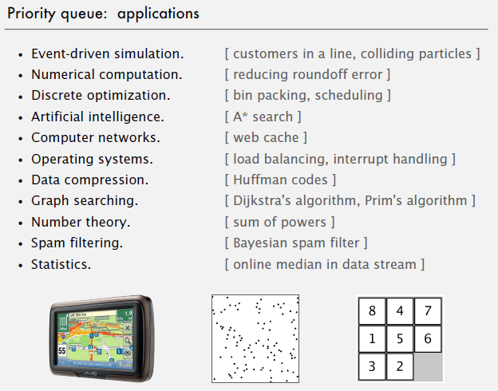
PQ Applications

Slide 77
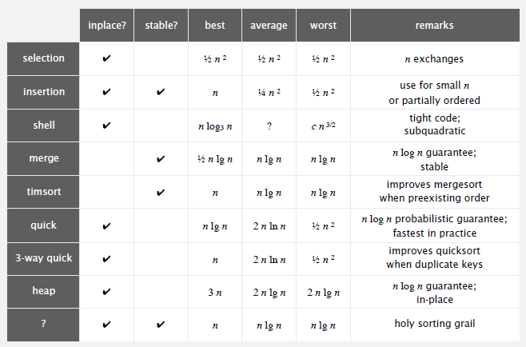
Sorting Comparisons

