Slide 1
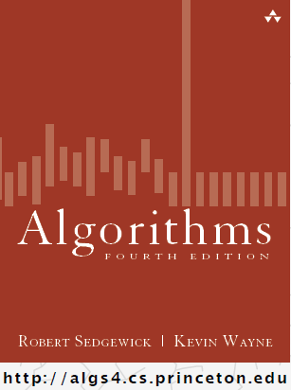
Sorting it Out
COMP 2100
Otterbein University

Slide 2
Alerts
Lab 6 due tomorrow
Homework #6 due on Friday, 10/28

Slide 3
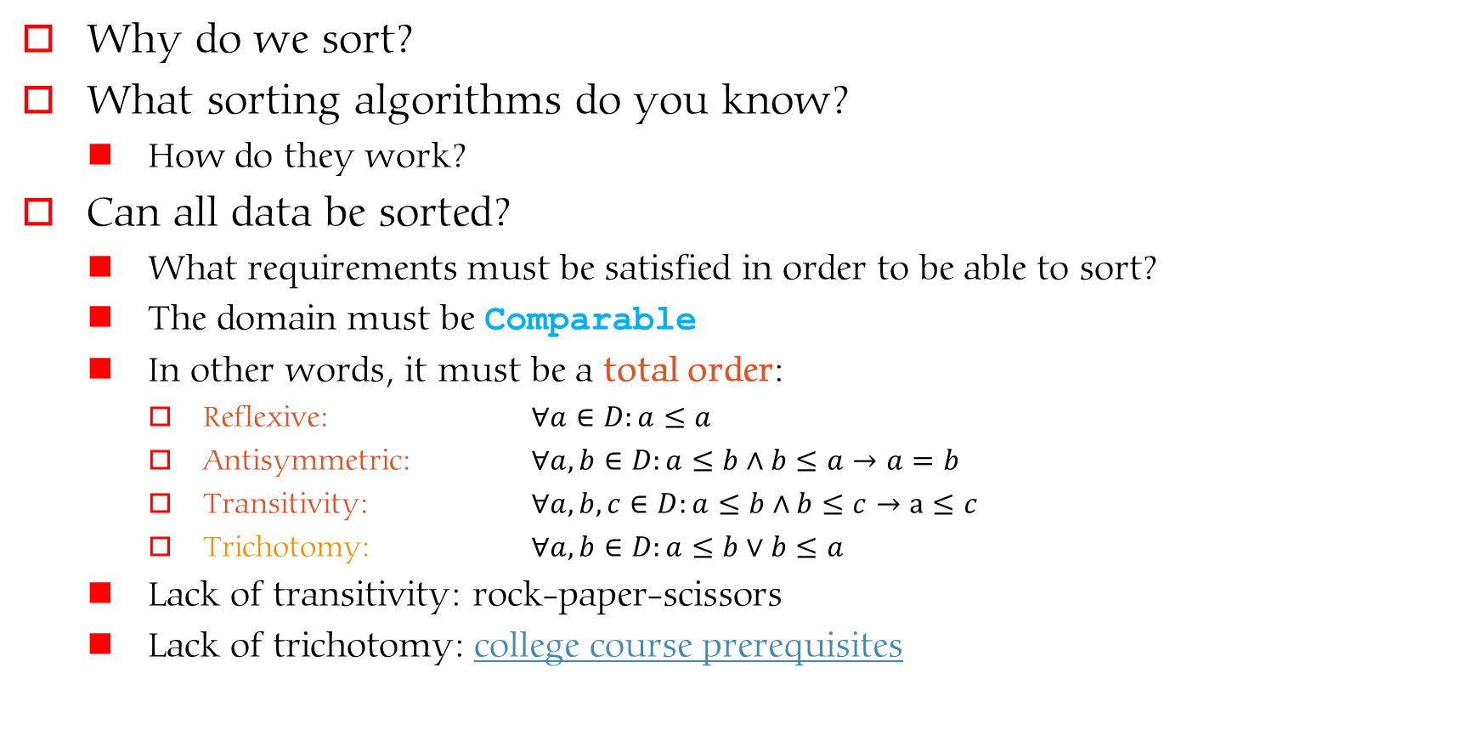
Sorting
Why do we sort?
What sorting algorithms do you know?
  How do they work?
Can all data be sorted?
  What requirements must be satisfied in order to be able to sort?
  The domain must be Comparable
  In other words, it must be a total order:
    Reflexive: $∀a∈D:a≤a$
    Antisymmetric: $∀a,b∈D:a≤b∧b≤a→a=b$
    Transitivity: $∀a,b,c∈D:a≤b∧b≤c→a≤c$
    Trichotomy: $∀a,b∈D:a≤b∨b≤a$
  Lack of transitivity: rock-paper-scissors
  Lack of trichotomy: college course prerequisites

Slide 4
Selection & Insertion
Selection
  On each iteration the sorted portion grows by one
  The leftmost unsorted element is swapped with the smallest unsorted element
  Visualize
Insertion
  On each iteration the sorted portion grows by one
  The leftmost unsorted element is inserted into the sorted portion in the correct position
  Visualize

Slide 5
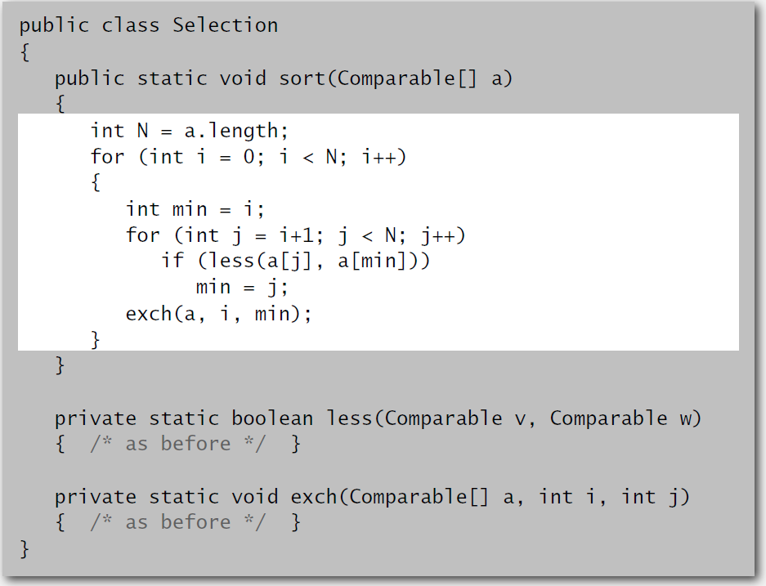
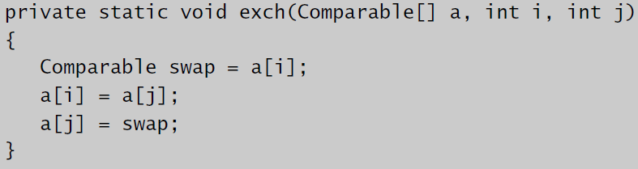
Selection

Slide 6
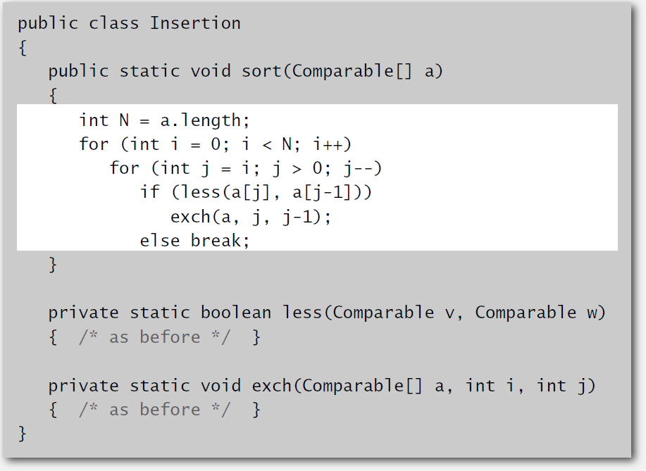
Insertion

Slide 7
Selection & Insertion Analysis
Selection
  A quadratic number of calls to less()
  A linear number of calls to exch()
  Stable
  Every-case algorithm
Insertion
  A quadratic number of calls to both less() and exch()
  Stable
  Best-case: sorted data—O(n)
  Average-case: O(n²)

Slide 8
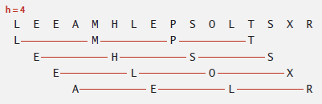
Shell Sort
An optimization of both bubble and insertion sort where entries at regular (but large) distances are sorted first
  An h-sorted array consists of h many interleaved sorted sequences
  By iteratively reducing the value of h (ending with h=1) the array becomes sorted.
  Visualize
  How to choose values of h...is an interesting research question
  Final visualization

