Slide 1
Hashing it Out
COMP 2100
Otterbein University
Notes:
No Day22 (review), Day23 (exam), or Day24 (Project 2 reset/discussion)

Slide 2
Alerts
Immutable Deadlines:
Lab 6 due Tuesday, 10/27
Questions?
Project 2 due today before midnight
Homework #6 due on Friday, 10/28
Class Registration
Computer Science Curriculum

Slide 3
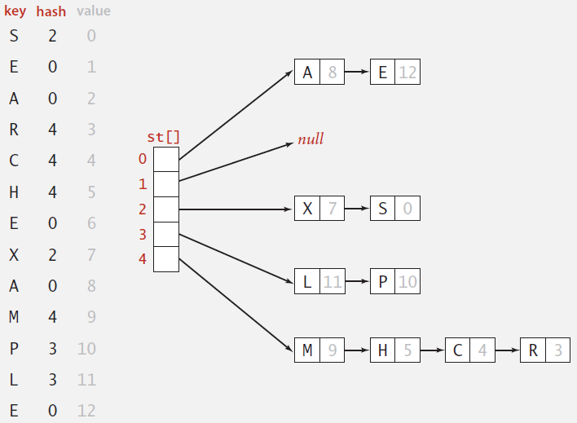
Separate-Chaining
Instead of a simple array of M key/value pairs, use an array of M linked lists [H.P. Luhn, IBM 1953]
Hash: map key to index, as before
Insert: insert key/value pair at front of list located at index
Search: perform sequential search on one linked list

Slide 4
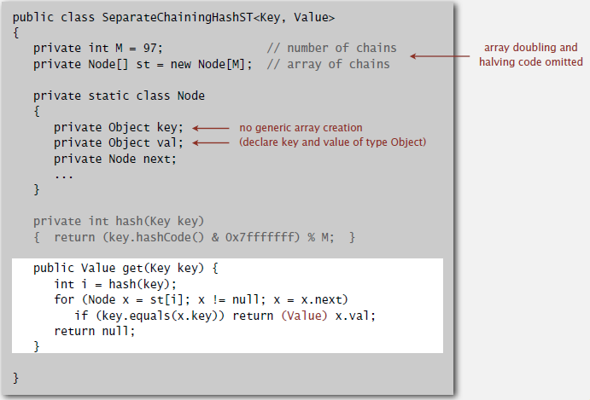
Java Implementation

Slide 5
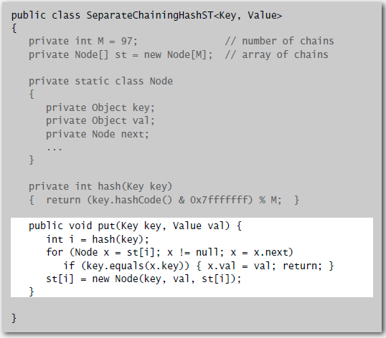
Java Implementation

Slide 6
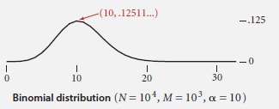
Analysis: Separate-Chaining
Under uniform hashing assumption, the probability that the number of keys in a list is within a constant factor of N/M is extremely close to 1
So the number of times hash() and equals() are called for searches and insertions is proportional to N/M
If M is too large, there will be many empty lists
If M is too small, there will be very long lists
A typical choice to balance these effects is M roughly equal to N/4
If over time it becomes apparent that M is too small, the hash table can be resized with a larger M. All keys would have to be re-hashed.

Slide 7
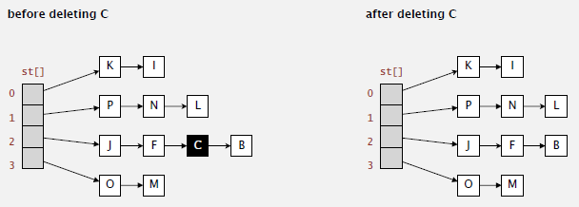
Deletion
How would we perform a deletion in a hash table?
It turns out to be fairly easy
Hash to get the index and then delete from the list

Slide 8
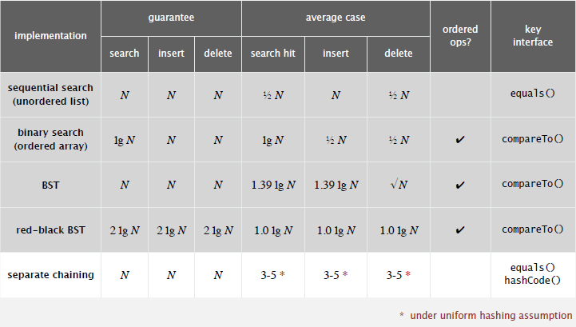
Compare Results

Slide 9
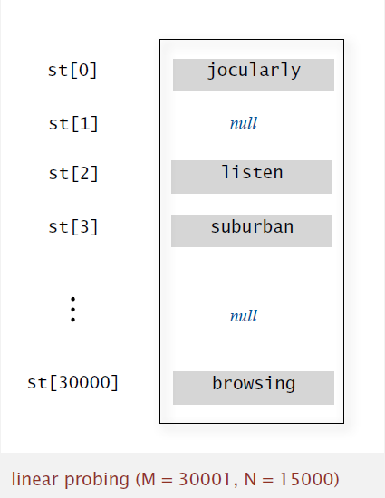
Linear Probing
Also known as Open Addressing [Amdahl-Boehme-Rocherster-Samuel, IBM 1953]
When a new key collides, find the next available sequential slot and put it there.
Hash: Map key to integer i between 0 and M-1
Insert: Put at table index i if free; if not try i+1, i+2, etc. (demo)
Search: Search table index i; if occupied but no match, try i+1, i+2, etc.
Array size M must be greater than the number of key/value pairs N

Slide 10
Linear Probing in Java

Slide 11
Linear Probing in Java

Slide 12
Clustering
A cluster is a contiguous block of occupied cells.
Observation: new keys are likely to hash into the middle of large clusters.
Knuth’s parking problem: cars arrive at a one-way street with M parking spaces. Each desires to park in a random space i: if space is taken, try i+1, i+2, etc.
Question: what is the mean displacement of a car?
Demo
Half-full: with M/2 cars, mean displacement is $\sim 3/2$
Full: with M cars, mean displacement is $\sim \sqrt{\frac{πM}{8}}$

Slide 13
Analysis
Donald Knuth made significant breakthrough in the field of analysis of algorithms when he calculated the average number of probes in linear probing
Assume the N = αM
If M is too large there will be too many empty array cells
If M is too small then search times becomes O(N)
A typical choice for α is ½

Slide 14
Deletion
Deleting a key in a linear probing hash table is complicated

Slide 15
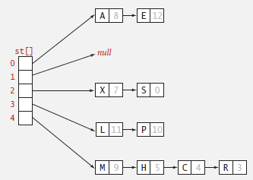
Comparing Collision Handling
Separate chaining
Performance degrades gracefully
Clustering less sensitive to poorly designed hash function
Linear probing
Less wasted space
Better cache performance

Slide 16
Comparing Symbol Tables
Hash tables
Simpler to code
No effective alternative for unordered keys
Faster for simple keys
Better system support in Java for strings (caching hash value)
Balanced search trees
Stronger performance guarantee
Support for ordered ST operations
Easier to implement compareTo() correctly than equals() and hashCode()
Java JCF provides both in java.util package
Red-black BSTs: java.util.TreeMap, java.util.TreeSet
Hash tables: java.util.HashMap, java.util.HashSet, java.util.IdentityHashSet

Slide 17
Variations on Hashing
Two-probe hashing (separate chaining)
Hash to two positions, insert in shorter chain
Reduces expected length of longest chain to log log N
Double hashing (linear probing)
Use linear probing with a variable skip value rather than fixed at 1
Eliminates clustering
Table can become much fuller without performance issues
More difficult delete cases
Cuckoo Hashing (linear probing)
Hash key to two positions, insert into either; if both occupied, reinsert displaced key into its alternative location (recursively)
Constant worst-case time for search

