Slide 1
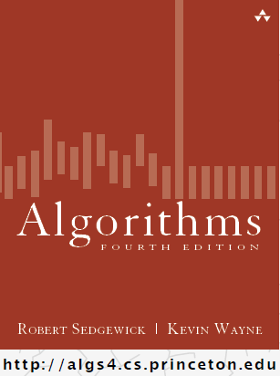
More Red-Black Trees
Midterm Exam Review
COMP 2100
Otterbein University

Slide 2
Alerts
Midterm Friday, 10/14
  more later...
Project 2: due next Friday, 10/21
Lab 6 due 10/27
Lab 7 available 10/25

Slide 3
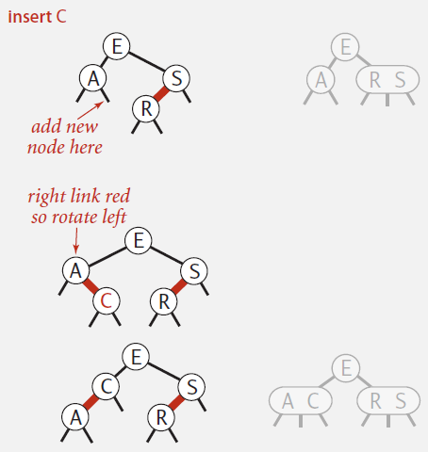
Red-Black BST: Insertion
Case 1: insert into a 2-node leaf
  Perform a standard BST insert; color new link red
  If new red link is a right link, rotate left

Slide 4
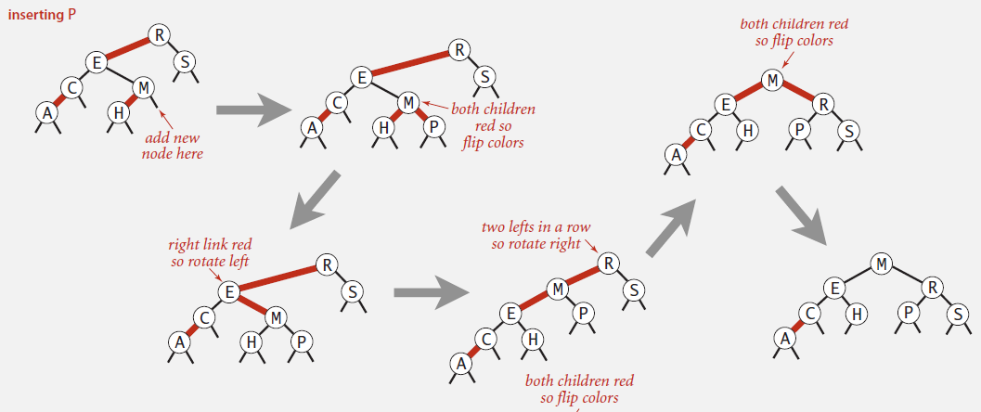
Red-Black BST: Insertion
Case 2: insert into a 3-node leaf
  Perform a standard BST insert; color new link red
  Rotate to balance the 4-node (if needed)
  Flip colors to pass red link up one level
  Rotate to make it lean left (if needed)
  Repeat Case 1 or Case 2 up the tree (if needed)

Slide 5
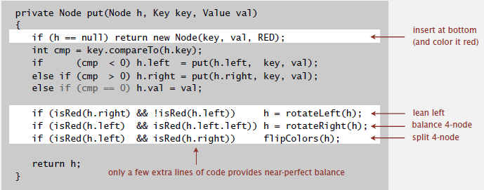
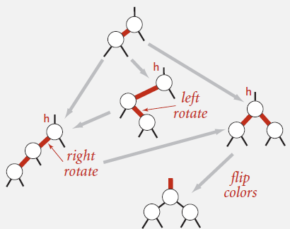




Red-Black BST: Insertion in Java

Slide 6
Reflection
Look back at that code again...
  If we hadn’t developed the conceptual models of 2-3 Trees an Red-Black Trees, would the code make any sense?
Koffman & Wolfgang
  Syllabus
  Red-black definition
Collins
  Red-black definition
  Final paragraph!!

Slide 7
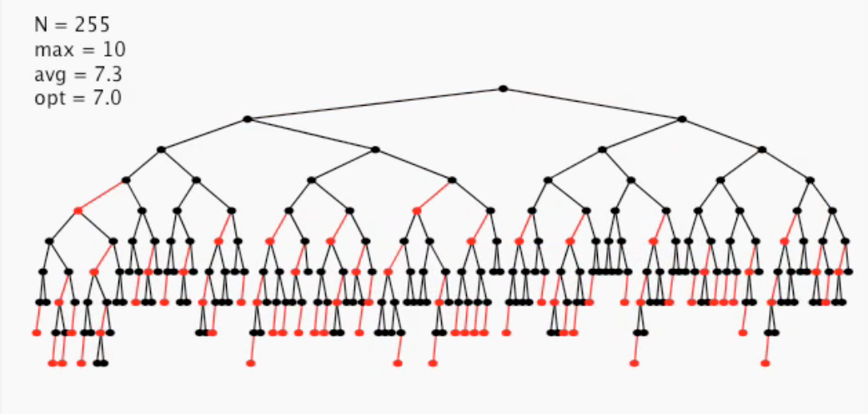
Performance
255 random values added to a RB BST:
  Height is never more than 2 lg N
  Average height is usually ~1.0 lg N

Slide 8
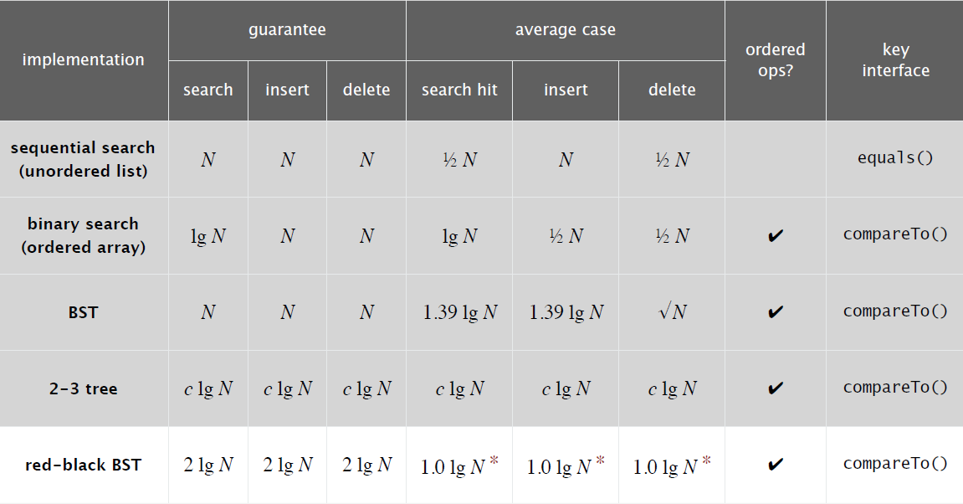
Performance

Slide 9
Midterm Exam
The exam will cover 1.1-1.5 and 1.1-1.3
  Topics
  Textbook
  Labs
Format
  True/False
  Problems (5-6)
    Writing code
    Visual representations of linked structures (references)
    Recursion
    Problem solving with containers (lists, stacks, queues, trees)
  Essays
    There will be N prompts and you will have to choose M of them to answer, where M < N.
    A minimum of a healthy paragraph is expected of a good answer

