Slide 1
Self-Balancing Search Trees
COMP 2100 Otterbein University

Slide 2
Self-Balancing Search Trees
The performance of a binary search tree is proportional to the height of the tree
A full binary tree of height k can hold 2^{k} -1 items
If a binary search tree is full and contains n items, the expected performance is O(log n)
However, if a binary tree is not full, the actual performance is worse than expected
To solve this problem, we introduce self-balancing trees to achieve a balance so that the heights of the right and left subtrees are equal or nearly equal

Slide 3
Tree Balance and Rotation
Foundational Concept

Slide 4
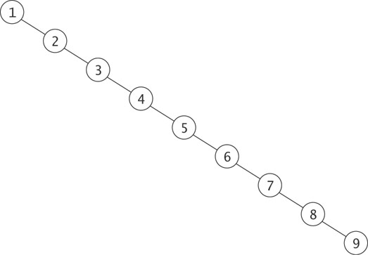
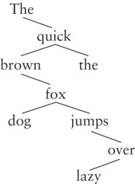
Why Balance is Important
Searches into this unbalanced search tree are O(n), not O(log n)
A realistic example of an unbalanced tree

Slide 5
Rotation
When a tree is out of balance we can restructure it by performing what is called a “rotation at a node”.
1
2
2
1
3
3

Slide 6
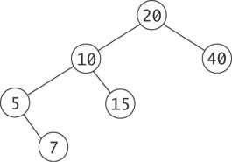
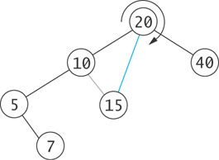
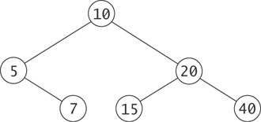
Rotation
Rotation is an operation on a binary tree that changes the relative heights of left and right subtrees, but preserves the binary search tree property

Slide 7
Algorithm for Rotation
root
Node
= left
right =
key = 20
Node
Node
= left
right =
key = 10
= left
right =
key = 40
null
null
Node
Node
= left
right =
key = 5
= left
right =
key = 15
null
null
null
Node
= left
right =
key = 7
null
null

Slide 8
Algorithm for Rotation (cont.)
root
Node
temp
= left
right =
key = 20
Node
Node
= left
right =
key = 10
= left
right =
key = 40
null
null
Node
Node
  Remember value of root.left (temp = root.left)
= left
right =
key = 5
= left
right =
key = 15
null
null
null
Node
= left
right =
key = 7
null
null

Slide 9
Algorithm for Rotation (cont.)
root
Node
temp
= left
right =
key = 20
Node
Node
= left
right =
key = 10
= left
right =
key = 40
null
null
Node
Node
  Remember value of root.left (temp = root.left)
  Set root.left to value of temp.right
= left
right =
key = 5
= left
right =
key = 15
null
null
null
Node
= left
right =
key = 7
null
null

Slide 10
Algorithm for Rotation (cont.)
root
Node
temp
= left
right =
key = 20
Node
Node
= left
right =
key = 10
= left
right =
key = 40
null
null
Node
Node
  Remember value of root.left (temp = root.left)
  Set root.left to value of temp.right
  Set temp.right to root
= left
right =
key = 5
= left
right =
key = 15
null
null
null
Node
= left
right =
key = 7
null
null

Slide 11
Algorithm for Rotation (cont.)
root
Node
temp
= left
right =
key = 20
Node
Node
= left
right =
key = 10
= left
right =
key = 40
null
null
Node
Node
  Remember value of root.left (temp = root.left)
  Set root.left to value of temp.right
  Set temp.right to root
  Set root to temp
= left
right =
key = 5
= left
right =
key = 15
null
null
null
Node
= left
right =
key = 7
null
null

Slide 12
Algorithm for Rotation (cont.)
root
Node
= left
right =
key = 10
Node
Node
= left
right =
key = 5
= left
right =
key = 20
null
Node
Node
Node
= left
right =
key = 7
= left
right =
key = 15
= left
right =
key = 40
null
null
null
null
null
null

Slide 13
Implementing Rotation (cont.)
VS Code

Slide 14
AVL Trees
How to use rotations to achieve balance

Slide 15
AVL Trees
In 1962 G.M. Adel´son-Vel´skiî and E.M. Landis developed a self-balancing tree. The tree is known by their initials: AVL
The AVL tree algorithm keeps track, at each node, of the difference in height of each subtree
As items are added to or removed from a tree, the balance of each subtree from the insertion or removal point up to the root is updated
If the balance gets out of the range -1 to +1, the tree is rotated to bring it back into balance

Slide 16
Balancing a Left-Left Tree
50
25
c
a
b
Each light purple triangle represents a tree of height k

Slide 17
Balancing a Left-Left Tree (cont.)
50
25
c
a
b
The dark purple trapezoid represents an insertion into this tree, making its height k + 1

Slide 18
Balancing a Left-Left Tree (cont.)
The heights of the left and right subtrees are unimportant; only the relative difference matters when balancing
50
k – (k + 2)
-2
25
c
k - (k + 1)
-1
a
b
The formula
h_{R} – h_{L}
is used to calculate the balance of each node

Slide 19
Balancing a Left-Left Tree (cont.)
When the root and left subtree are both left-heavy, the tree is called a Left-Left tree
50
-2
25
c
-1
a
b

Slide 20
Balancing a Left-Left Tree (cont.)
A Left-Left tree can be balanced by a rotation right
50
-2
25
c
-1
a
b

Slide 21
Balancing a Left-Left Tree (cont.)
25
0
a
50
0
b
c

Slide 22
Balancing a Left-Left Tree (cont.)
Even after insertion, the overall height has not increased

Slide 23
Balancing a Left-Right Tree
k - (k + 2)
50
-2
25
c
+1
(k + 1) - k
a
b

Slide 24
Balancing a Left-Right Tree (cont.)
50
-2
25
c
+1
a
b
A Left-Right tree cannot be balanced by a simple rotation right

Slide 25
Balancing a Left-Right Tree (cont.)
50
-2
25
c
+1
a
b
Subtree b needs to be expanded into its subtrees b_{L} and b_{R}

Slide 26
Balancing a Left-Right Tree (cont.)
50
-2
25
c
+1
a
40
-1
40 is left-heavy. The left substree can now be rotated left
b_{L}
b_{R}

Slide 27
Balancing a Left-Right Tree (cont.)
50
-2
40
c
-2
25
0
b_{R}
The overall tree is now Left-Left and a rotation right will balance it.
a
b_{L}

Slide 28
Balancing a Left-Right Tree (cont.)
40
0
25
50
+1
0
a
c
b_{L}
b_{R}

Slide 29
Balancing a Left-Right Tree (cont.)
50
-2
25
c
+1
a
40
+1
In the previous example, an item was inserted in b_{L.}
We now show the steps if an item was inserted into b_{R} instead
b_{L}
b_{R}

Slide 30
Balancing a Left-Right Tree (cont.)
50
-2
25
c
+1
a
40
+1
Rotate the left subtree left
b_{L}
b_{R}

Slide 31
Balancing a Left-Right Tree (cont.)
Rotate the tree right
50
-2
40
-1
c
25
-1
a
b_{R}
b_{L}

Slide 32
Balancing a Left-Right Tree (cont.)
40
0
25
50
-1
0
a
c
b_{L}
b_{R}

Slide 33
Four Kinds of Critically Unbalanced Trees
Left-Left (parent balance is -2, left child balance is -1)
  Rotate right around parent
Left-Right (parent balance -2, left child balance +1)
  Rotate left around child
  Rotate right around parent
Right-Right (parent balance +2, right child balance +1)
  Rotate left around parent
Right-Left (parent balance +2, right child balance -1)
  Rotate right around child
  Rotate left around parent

Slide 34
AVL Tree Example
Build an AVL tree from the words in
"The quick brown fox jumps over the lazy dog"

Slide 35
AVL Tree Example (cont.)
The
+2
quick
-1
brown
0
The overall tree is right-heavy (Right-Left)
parent balance = +2
right child balance = -1

Slide 36
AVL Tree Example (cont.)
The
+2
quick
-1
brown
0
Rotate right around the child

Slide 37
AVL Tree Example (cont.)
The
+2
brown
+1
quick
0
Rotate right around the child

Slide 38
AVL Tree Example (cont.)
The
+2
brown
+1
quick
0
Rotate right around the child
Rotate left around the parent

Slide 39
AVL Tree Example (cont.)
brown
0
The
0
quick
0
Rotate right around the child
Rotate left around the parent

Slide 40
AVL Tree Example (cont.)
brown
0
Insert fox
The
0
quick
0

Slide 41
AVL Tree Example (cont.)
brown
+1
Insert fox
The
0
quick
-1
fox
0

Slide 42
AVL Tree Example (cont.)
brown
+1
Insert jumps
The
0
quick
-1
fox
0

Slide 43
AVL Tree Example (cont.)
brown
+2
Insert jumps
The
0
quick
-2
fox
+1
jumps
0

Slide 44
AVL Tree Example (cont.)
brown
+2
The
0
quick
-2
fox
+1
jumps
0
The tree is now left-heavy about quick (Left-Right case)

Slide 45
AVL Tree Example (cont.)
brown
+2
The
0
quick
-2
fox
+1
jumps
0
Rotate left around the child

Slide 46
AVL Tree Example (cont.)
brown
+2
The
0
quick
-2
jumps
-1
fox
0
Rotate left around the child

Slide 47
AVL Tree Example (cont.)
brown
+2
The
0
quick
-2
jumps
-1
fox
0
Rotate left around the child
Rotate right around the parent

Slide 48
AVL Tree Example (cont.)
brown
+1
The
0
jumps
0
fox
0
quick
0
Rotate left around the child
Rotate right around the parent

Slide 49
AVL Tree Example (cont.)
brown
+1
Insert over
The
0
jumps
0
fox
0
quick
0

Slide 50
AVL Tree Example (cont.)
brown
+2
Insert over
The
0
jumps
+1
fox
0
quick
-1
over
0

Slide 51
AVL Tree Example (cont.)
brown
+2
The
0
jumps
+1
fox
0
quick
-1
over
0
We now have a Right-Right imbalance

Slide 52
AVL Tree Example (cont.)
brown
+2
The
0
jumps
+1
fox
0
quick
-1
over
0
1. Rotate left around the parent

Slide 53
AVL Tree Example (cont.)
jumps
0
brown
0
quick
-1
The
0
fox
0
over
0
1. Rotate left around the parent

Slide 54
AVL Tree Example (cont.)
jumps
0
Insert the
brown
0
quick
-1
The
0
fox
0
over
0

Slide 55
AVL Tree Example (cont.)
jumps
0
Insert the
brown
0
quick
0
The
0
fox
0
over
0
the
0

Slide 56
AVL Tree Example (cont.)
jumps
0
Insert lazy
brown
0
quick
0
The
0
fox
0
over
0
the
0

Slide 57
AVL Tree Example (cont.)
jumps
+1
Insert lazy
brown
0
quick
-1
The
0
fox
0
over
-1
the
0
lazy
0

Slide 58
AVL Tree Example (cont.)
jumps
+1
Insert dog
brown
0
quick
-1
The
0
fox
0
over
-1
the
0
lazy
0

Slide 59
AVL Tree Example (cont.)
jumps
0
Insert dog
brown
+1
quick
-1
The
0
fox
-1
over
-1
the
0
dog
0
lazy
0

Slide 60
The AVLNode Class
VS Code

Slide 61
Inserting into an AVL Tree
The easiest way to keep a tree balanced is never to let it become unbalanced
If any node becomes critical, rebalance immediately
Identify critical nodes by checking the balance at the root node as you return along the insertion path

Slide 62
Inserting into an AVL Tree (cont.)
Algorithm for Insertion into an AVL Tree
1. if the root is null
2. Create a new tree with the item at the root and return true.
else if the item is equal to root.key
3. The item is already in the tree; return false.
else if the item is less than root.key
4. Recursively insert the item in the left subtree.
5. if the height of the left subtree has increased (increase is true)
6. Decrement balance.
7. if balance is zero, reset increase to false.
8. if balance is less than –1
9. Reset increase to false.
10. Perform a rebalanceLeft.
else if the item is greater than root.key
11. The processing is symmetric to Steps 4 through 10.
Note that balance is incremented if increase is true.

Slide 63
Initial Algorithm for rebalanceLeft
Initial Algorithm for rebalanceLeft
1. if the left subtree has a positive balance (Left-Right case)
2. Rotate left around left subtree root.
3. Rotate the local root right.

Slide 64
Effect of Rotations on Balance
The rebalance algorithm on the previous slide was incomplete as the balance of the nodes was not adjusted
For a Left-Left tree the balances of the new root node and of its right child are 0 after a right rotation
Left-Right is more complicated:
  the balance of the root is 0

Slide 65
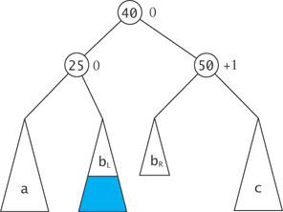
Effect of Rotations on Balance (cont.)
  if the critically unbalanced situation was due to an insertion into
    subtree b_{L} (Left-Right-Left case), the balance of the root's left child is 0 and the balance of the root's right child is +1

Slide 66
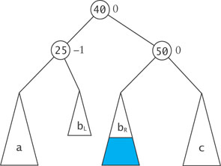
Effect of Rotations on Balance (cont.)
  if the critically unbalanced situation was due to an insertion into
    subtree b_{R} (Left-Right-Right case), the balance of the root's left child is -1 and the balance of the root's right child is 0

Slide 67
Revised Algorithm for rebalanceLeft
Revised Algorithm for rebalanceLeft
1. if the left subtree has a positive balance (Left-Right case)
2. if the left-left subtree has a negative balance (Left-Right-Left case)
3. Set the left subtree (new left subtree) balance to 0.
4. Set the left-left subtree (new root) balance to 0.
5. Set the local root (new right subtree) balance to +1.
else (Left-Right-Right case)
6. Set the left subtree (new left subtree) balance to –1.
7. Set the left-left subtree (new root) balance to 0.
8. Set the local root (new right subtree) balance to 0.
9. Rotate left around left subtree root
else (Left-Left case)
10. Set the left subtree balance to 0.
11. Set the local root balance to 0.
12. Rotate the local root right.

Slide 68
Method rebalanceLeft
VS Code

Slide 69
Method rebalanceRight
The rebalanceRight method is symmetric with respect to the rebalanceLeft method

Slide 70
Method decrementBalance
As we return from an insertion into a node's left subtree, we need to decrement the balance of the node
We also need to indicate if the subtree height at that node has not increased (setting increase to false)

Slide 71
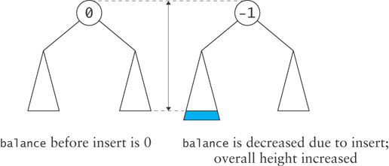
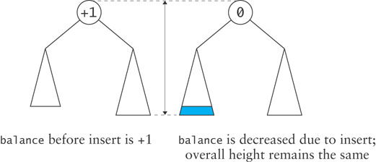
Method decrementBalance (cont.)
Two cases to consider:
  a balanced node – insertion into its left subtree will make it left-heavy and its height will increase by 1
  a right-heavy node – insertion into its left subtree will cause it to become balanced and its height will not increase

Slide 72
Removal from an AVL Tree
Removal
  from a left subtree, increases the balance of the local root
  from a right subtree, decreases the balance of the local root
The binary search tree removal method can be adapted for removal from an AVL tree
A key field decrease tells the previous level in the recursion that there was a decrease in the height of the subtree from which the return occurred
The local root balance is incremented or decremented based on this field
If the balance is outside the threshold, a rebalance method is called to restore balance

Slide 73
Removal from an AVL Tree (cont.)
Methods decrementBalance, incrementBalance, rebalanceLeft, and rebalanceRight need to be modified to set the value of decrease and increase after a node’s balance is decremented
Each recursive return can result in a further need to rebalance

Slide 74
Performance of the AVL Tree
Since each subtree is kept as close to balanced as possible, the AVL has expected O(log n)
Each subtree is allowed to be out of balance ±1 so the tree may contain some holes
In the worst case (which is rare) an AVL tree can be 1.44 times the height of a full binary tree that contains the same number of items
Ignoring constants, this still yields O(log n) performance
Empirical tests show that on average log n + 0.25 comparisons are required to insert the nth item into an AVL tree – close to a corresponding complete binary search tree

Slide 75
Have a Great MONDAY!

Slide 76
Red-Black Trees
Section 9.3

Slide 77
Red-Black Trees
Rudolf Bayer developed the red-black tree as a special case of his B-tree
Leo Guibas and Robert Sedgewick refined the concept and introduced the color convention

Slide 78
Red-Black Trees (cont.)
A red-black tree maintains the following invariants:
  A node is either red or black
  The root is always black
  A red node always has black children (a null reference is considered to refer to a black node)
  The number of black nodes in any path from the root to a leaf is the same
11
2
14
1
7
5
8

Slide 79
Red-Black Trees (cont.)
Height is determined by counting only black nodes
A red-black tree is always balanced because the root node’s left and right subtrees must be the same height

Slide 80
Insertion into a Red-Black Tree
The algorithm follows the same recursive search process used for all binary search trees to reach the insertion point
When a leaf is found, the new item is inserted and initially given the color red
If the parent is black, we are done; otherwise there is some rearranging to do
We introduce three situations ("cases") that may occur when a node is inserted; more than one can occur after an insertion

Slide 81
Insertion into a Red-Black Tree (cont.)
CASE 1
Invariants:
  A node is either red or black
  The root is always black
  A red node always has black children (a null reference is considered to refer to a black node)
  The number of black nodes in any path from the root to a leaf is the same
20
10
30

Slide 82
Insertion into a Red-Black Tree (cont.)
CASE 1
Invariants:
  A node is either red or black
  The root is always black
  A red node always has black children (a null reference is considered to refer to a black node)
  The number of black nodes in any path from the root to a leaf is the same
20
10
30
35
If a parent is red, and its sibling is also red, they can both be changed to black, and the grandparent to red

Slide 83
Insertion into a Red-Black Tree (cont.)
CASE 1
Invariants:
  A node is either red or black
  The root is always black
  A red node always has black children (a null reference is considered to refer to a black node)
  The number of black nodes in any path from the root to a leaf is the same
20
10
30
35
If a parent is red, and its sibling is also red, they can both be changed to black, and the grandparent to red

Slide 84
Insertion into a Red-Black Tree (cont.)
CASE 1
Invariants:
  A node is either red or black
  The root is always black
  A red node always has black children (a null reference is considered to refer to a black node)
  The number of black nodes in any path from the root to a leaf is the same
20
10
30
35
The root can be changed to black and still maintain invariant 4

Slide 85
Insertion into a Red-Black Tree (cont.)
CASE 1
Invariants:
  A node is either red or black
  The root is always black
  A red node always has black children (a null reference is considered to refer to a black node)
  The number of black nodes in any path from the root to a leaf is the same
20
10
30
35
The root can be changed to black and still maintain invariant 4

Slide 86
Insertion into a Red-Black Tree (cont.)
CASE 1
Invariants:
  A node is either red or black
  The root is always black
  A red node always has black children (a null reference is considered to refer to a black node)
  The number of black nodes in any path from the root to a leaf is the same
20
10
30
35
Balanced tree

Slide 87
Insertion into a Red-Black Tree (cont.)
CASE 2
Invariants:
  A node is either red or black
  The root is always black
  A red node always has black children (a null reference is considered to refer to a black node)
  The number of black nodes in any path from the root to a leaf is the same
20
30

Slide 88
Insertion into a Red-Black Tree (cont.)
CASE 2
Invariants:
  A node is either red or black
  The root is always black
  A red node always has black children (a null reference is considered to refer to a black node)
  The number of black nodes in any path from the root to a leaf is the same
20
30
35
If a parent is red (with no sibling), it can be changed to black, and the grandparent to red

Slide 89
Insertion into a Red-Black Tree (cont.)
CASE 2
Invariants:
  A node is either red or black
  The root is always black
  A red node always has black children (a null reference is considered to refer to a black node)
  The number of black nodes in any path from the root to a leaf is the same
20
30
35
If a parent is red (with no sibling), it can be changed to black, and the grandparent to red

Slide 90
Insertion into a Red-Black Tree (cont.)
CASE 2
Invariants:
  A node is either red or black
  The root is always black
  A red node always has black children (a null reference is considered to refer to a black node)
  The number of black nodes in any path from the root to a leaf is the same
20
30
35
There is one black node on the right and none on the left, which violates invariant 4

Slide 91
Insertion into a Red-Black Tree (cont.)
CASE 2
Invariants:
  A node is either red or black
  The root is always black
  A red node always has black children (a null reference is considered to refer to a black node)
  The number of black nodes in any path from the root to a leaf is the same
20
30
35
Rotate left around the grandparent to correct this

Slide 92
Insertion into a Red-Black Tree (cont.)
CASE 2
Invariants:
  A node is either red or black
  The root is always black
  A red node always has black children (a null reference is considered to refer to a black node)
  The number of black nodes in any path from the root to a leaf is the same
30
20
35
Rotate left around the grandparent to correct this

Slide 93
Insertion into a Red-Black Tree (cont.)
CASE 2
Invariants:
  A node is either red or black
  The root is always black
  A red node always has black children (a null reference is considered to refer to a black node)
  The number of black nodes in any path from the root to a leaf is the same
30
20
35
Balanced tree

Slide 94
Insertion into a Red-Black Tree (cont.)
CASE 3
Invariants:
  A node is either red or black
  The root is always black
  A red node always has black children (a null reference is considered to refer to a black node)
  The number of black nodes in any path from the root to a leaf is the same
20
30

Slide 95
Insertion into a Red-Black Tree (cont.)
CASE 3
Invariants:
  A node is either red or black
  The root is always black
  A red node always has black children (a null reference is considered to refer to a black node)
  The number of black nodes in any path from the root to a leaf is the same
20
30
25
If a parent is red (with no sibling), it can be changed to black, and the grandparent to red

Slide 96
Insertion into a Red-Black Tree (cont.)
CASE 3
Invariants:
  A node is either red or black
  The root is always black
  A red node always has black children (a null reference is considered to refer to a black node)
  The number of black nodes in any path from the root to a leaf is the same
20
30
25
If a parent is red (with no sibling), it can be changed to black, and the grandparent to red

Slide 97
Insertion into a Red-Black Tree (cont.)
CASE 3
Invariants:
  A node is either red or black
  The root is always black
  A red node always has black children (a null reference is considered to refer to a black node)
  The number of black nodes in any path from the root to a leaf is the same
20
30
25
A rotation left does not fix the violation of #4

Slide 98
Insertion into a Red-Black Tree (cont.)
CASE 3
Invariants:
  A node is either red or black
  The root is always black
  A red node always has black children (a null reference is considered to refer to a black node)
  The number of black nodes in any path from the root to a leaf is the same
30
20
25
A rotation left does not fix the violation of #4

Slide 99
Insertion into a Red-Black Tree (cont.)
CASE 3
Invariants:
  A node is either red or black
  The root is always black
  A red node always has black children (a null reference is considered to refer to a black node)
  The number of black nodes in any path from the root to a leaf is the same
20
30
25
Back-up to the beginning (don't perform rotation or change colors)

Slide 100
Insertion into a Red-Black Tree (cont.)
CASE 3
Invariants:
  A node is either red or black
  The root is always black
  A red node always has black children (a null reference is considered to refer to a black node)
  The number of black nodes in any path from the root to a leaf is the same
20
30
25
Rotate right about the parent so that the red child is on the same side of the parent as the parent is to the grandparent

Slide 101
Insertion into a Red-Black Tree (cont.)
CASE 3
Invariants:
  A node is either red or black
  The root is always black
  A red node always has black children (a null reference is considered to refer to a black node)
  The number of black nodes in any path from the root to a leaf is the same
20
25
30
Rotate right about the parent so that the red child is on the same side of the parent as the parent is to the grandparent

Slide 102
Insertion into a Red-Black Tree (cont.)
CASE 3
Invariants:
  A node is either red or black
  The root is always black
  A red node always has black children (a null reference is considered to refer to a black node)
  The number of black nodes in any path from the root to a leaf is the same
20
25
30
NOW, change colors

Slide 103
Insertion into a Red-Black Tree (cont.)
CASE 3
Invariants:
  A node is either red or black
  The root is always black
  A red node always has black children (a null reference is considered to refer to a black node)
  The number of black nodes in any path from the root to a leaf is the same
20
25
30
NOW, change colors

Slide 104
Insertion into a Red-Black Tree (cont.)
CASE 3
Invariants:
  A node is either red or black
  The root is always black
  A red node always has black children (a null reference is considered to refer to a black node)
  The number of black nodes in any path from the root to a leaf is the same
20
25
30
and rotate left . . .

Slide 105
Insertion into a Red-Black Tree (cont.)
CASE 3
Invariants:
  A node is either red or black
  The root is always black
  A red node always has black children (a null reference is considered to refer to a black node)
  The number of black nodes in any path from the root to a leaf is the same
25
20
30
and rotate left. . .

Slide 106
Insertion into a Red-Black Tree (cont.)
CASE 3
Invariants:
  A node is either red or black
  The root is always black
  A red node always has black children (a null reference is considered to refer to a black node)
  The number of black nodes in any path from the root to a leaf is the same
25
20
30
Balanced tree

Slide 107
Insertion into a Red-Black Tree (cont.)
Invariants:
  A node is either red or black
  The root is always black
  A red node always has black children (a null reference is considered to refer to a black node)
  The number of black nodes in any path from the root to a leaf is the same
11
2
14
1
7
5
8

Slide 108
Insertion into a Red-Black Tree (cont.)
Invariants:
  A node is either red or black
  The root is always black
  A red node always has black children (a null reference is considered to refer to a black node)
  The number of black nodes in any path from the root to a leaf is the same
11
2
14
1
7
5
8
4

Slide 109
Insertion into a Red-Black Tree (cont.)
Invariants:
  A node is either red or black
  The root is always black
  A red node always has black children (a null reference is considered to refer to a black node)
  The number of black nodes in any path from the root to a leaf is the same
11
2
14
1
7
CASE 1
5
8
If a parent is red, and its sibling is also red, they can both be changed to black, and the grandparent to red
4

Slide 110
Insertion into a Red-Black Tree (cont.)
Invariants:
  A node is either red or black
  The root is always black
  A red node always has black children (a null reference is considered to refer to a black node)
  The number of black nodes in any path from the root to a leaf is the same
11
2
14
1
7
CASE 1
5
8
If a parent is red, and its sibling is also red, they can both be changed to black, and the grandparent to red
4

Slide 111
Insertion into a Red-Black Tree (cont.)
Invariants:
  A node is either red or black
  The root is always black
  A red node always has black children (a null reference is considered to refer to a black node)
  The number of black nodes in any path from the root to a leaf is the same
11
2
14
1
7
5
8
The problem has now shifted up the tree
4

Slide 112
Insertion into a Red-Black Tree (cont.)
Invariants:
  A node is either red or black
  The root is always black
  A red node always has black children (a null reference is considered to refer to a black node)
  The number of black nodes in any path from the root to a leaf is the same
11
2
14
1
7
CASE 3
5
8
We cannot change 2 to black because its sibling 14 is already black (both siblings have to be red (unless there is no sibling) to do the color change
4

Slide 113
Insertion into a Red-Black Tree (cont.)
Invariants:
  A node is either red or black
  The root is always black
  A red node always has black children (a null reference is considered to refer to a black node)
  The number of black nodes in any path from the root to a leaf is the same
11
2
14
1
7
CASE 3
5
8
We need to rotate left around 2 so that the red child is on the same side of the parent as the parent is to the grandparent
4

Slide 114
Insertion into a Red-Black Tree (cont.)
Invariants:
  A node is either red or black
  The root is always black
  A red node always has black children (a null reference is considered to refer to a black node)
  The number of black nodes in any path from the root to a leaf is the same
11
7
14
2
8
CASE 3
1
5
We need to rotate left around 2 so that the red child is on the same side of the parent as the parent is to the grandparent
4

Slide 115
Insertion into a Red-Black Tree (cont.)
Invariants:
  A node is either red or black
  The root is always black
  A red node always has black children (a null reference is considered to refer to a black node)
  The number of black nodes in any path from the root to a leaf is the same
11
7
14
2
8
CASE 3
1
5
Change colors
4

Slide 116
Insertion into a Red-Black Tree (cont.)
Invariants:
  A node is either red or black
  The root is always black
  A red node always has black children (a null reference is considered to refer to a black node)
  The number of black nodes in any path from the root to a leaf is the same
11
7
14
2
8
CASE 3
1
5
Change colors
4

Slide 117
Insertion into a Red-Black Tree (cont.)
Invariants:
  A node is either red or black
  The root is always black
  A red node always has black children (a null reference is considered to refer to a black node)
  The number of black nodes in any path from the root to a leaf is the same
11
7
14
2
8
CASE 3
1
5
Rotate right around 11 to restore the balance
4

Slide 118
Insertion into a Red-Black Tree (cont.)
Invariants:
  A node is either red or black
  The root is always black
  A red node always has black children (a null reference is considered to refer to a black node)
  The number of black nodes in any path from the root to a leaf is the same
7
2
11
1
5
8
14
CASE 3
4
Rotate right around 11 to restore the balance

Slide 119
Insertion into a Red-Black Tree (cont.)
Invariants:
  A node is either red or black
  The root is always black
  A red node always has black children (a null reference is considered to refer to a black node)
  The number of black nodes in any path from the root to a leaf is the same
7
2
11
1
5
8
14
4
Balanced tree

Slide 120
Red-Black Tree Example
Build a Red-Black tree for the words in
"The quick brown fox jumps over the lazy dog"

Slide 121
Red-Black Tree Example (cont.)
Invariants:
  A node is either red or black
  The root is always black
  A red node always has black children (a null reference is considered to refer to a black node)
  The number of black nodes in any path from the root to a leaf is the same
The
quick

Slide 122
Red-Black Tree Example (cont.)
Invariants:
  A node is either red or black
  The root is always black
  A red node always has black children (a null reference is considered to refer to a black node)
  The number of black nodes in any path from the root to a leaf is the same
The
quick
brown
CASE 3
Rotate so that the child is on the same side of its parent as its parent is to the grandparent

Slide 123
Red-Black Tree Example (cont.)
Invariants:
  A node is either red or black
  The root is always black
  A red node always has black children (a null reference is considered to refer to a black node)
  The number of black nodes in any path from the root to a leaf is the same
The
brown
quick
CASE 3
Change colors

Slide 124
Red-Black Tree Example (cont.)
Invariants:
  A node is either red or black
  The root is always black
  A red node always has black children (a null reference is considered to refer to a black node)
  The number of black nodes in any path from the root to a leaf is the same
The
brown
quick
CASE 3
Change colors

Slide 125
Red-Black Tree Example (cont.)
Invariants:
  A node is either red or black
  The root is always black
  A red node always has black children (a null reference is considered to refer to a black node)
  The number of black nodes in any path from the root to a leaf is the same
The
brown
quick
CASE 3
Rotate left

Slide 126
Red-Black Tree Example (cont.)
Invariants:
  A node is either red or black
  The root is always black
  A red node always has black children (a null reference is considered to refer to a black node)
  The number of black nodes in any path from the root to a leaf is the same
brown
The
quick

Slide 127
Red-Black Tree Example (cont.)
Invariants:
  A node is either red or black
  The root is always black
  A red node always has black children (a null reference is considered to refer to a black node)
  The number of black nodes in any path from the root to a leaf is the same
brown
The
quick
fox

Slide 128
Red-Black Tree Example (cont.)
Invariants:
  A node is either red or black
  The root is always black
  A red node always has black children (a null reference is considered to refer to a black node)
  The number of black nodes in any path from the root to a leaf is the same
brown
The
quick
fox
CASE 1
fox's parent and its parent's sibling are both red. Change colors.

Slide 129
Red-Black Tree Example (cont.)
Invariants:
  A node is either red or black
  The root is always black
  A red node always has black children (a null reference is considered to refer to a black node)
  The number of black nodes in any path from the root to a leaf is the same
brown
The
quick
fox
CASE 1
fox's parent and its parent's sibling are both red. Change colors.

Slide 130
Red-Black Tree Example (cont.)
Invariants:
  A node is either red or black
  The root is always black
  A red node always has black children (a null reference is considered to refer to a black node)
  The number of black nodes in any path from the root to a leaf is the same
brown
The
quick
fox
CASE 1
We can change brown's color to black and not violate #4

Slide 131
Red-Black Tree Example (cont.)
Invariants:
  A node is either red or black
  The root is always black
  A red node always has black children (a null reference is considered to refer to a black node)
  The number of black nodes in any path from the root to a leaf is the same
brown
The
quick
fox
CASE 1
We can change brown's color to black and not violate #4

Slide 132
Red-Black Tree Example (cont.)
Invariants:
  A node is either red or black
  The root is always black
  A red node always has black children (a null reference is considered to refer to a black node)
  The number of black nodes in any path from the root to a leaf is the same
brown
The
quick
fox
jumps

Slide 133
Red-Black Tree Example (cont.)
Invariants:
  A node is either red or black
  The root is always black
  A red node always has black children (a null reference is considered to refer to a black node)
  The number of black nodes in any path from the root to a leaf is the same
brown
The
quick
fox
jumps
CASE 3
Rotate so that red child is on same side of its parent as its parent is to the grandparent

Slide 134
Red-Black Tree Example (cont.)
Invariants:
  A node is either red or black
  The root is always black
  A red node always has black children (a null reference is considered to refer to a black node)
  The number of black nodes in any path from the root to a leaf is the same
brown
The
quick
jumps
fox
CASE 3
Change fox's parent and grandparent colors

Slide 135
Red-Black Tree Example (cont.)
Invariants:
  A node is either red or black
  The root is always black
  A red node always has black children (a null reference is considered to refer to a black node)
  The number of black nodes in any path from the root to a leaf is the same
brown
The
quick
jumps
fox
CASE 3
Change fox's parent and grandparent colors

Slide 136
Red-Black Tree Example (cont.)
Invariants:
  A node is either red or black
  The root is always black
  A red node always has black children (a null reference is considered to refer to a black node)
  The number of black nodes in any path from the root to a leaf is the same
brown
The
quick
jumps
fox
CASE 3
Rotate right about quick

Slide 137
Red-Black Tree Example (cont.)
Invariants:
  A node is either red or black
  The root is always black
  A red node always has black children (a null reference is considered to refer to a black node)
  The number of black nodes in any path from the root to a leaf is the same
brown
The
jumps
fox
quick
CASE 3
Rotate right about quick

Slide 138
Red-Black Tree Example (cont.)
Invariants:
  A node is either red or black
  The root is always black
  A red node always has black children (a null reference is considered to refer to a black node)
  The number of black nodes in any path from the root to a leaf is the same
brown
The
jumps
fox
quick
over

Slide 139
Red-Black Tree Example (cont.)
Invariants:
  A node is either red or black
  The root is always black
  A red node always has black children (a null reference is considered to refer to a black node)
  The number of black nodes in any path from the root to a leaf is the same
brown
The
jumps
fox
quick
over
CASE 1
Change colors of parent, parent's sibling and grandparent

Slide 140
Red-Black Tree Example (cont.)
Invariants:
  A node is either red or black
  The root is always black
  A red node always has black children (a null reference is considered to refer to a black node)
  The number of black nodes in any path from the root to a leaf is the same
brown
The
jumps
fox
quick
over
CASE 1
Change colors of parent, parent's sibling and grandparent

Slide 141
Red-Black Tree Example (cont.)
Invariants:
  A node is either red or black
  The root is always black
  A red node always has black children (a null reference is considered to refer to a black node)
  The number of black nodes in any path from the root to a leaf is the same
brown
The
jumps
fox
quick
over
the
No changes needed

Slide 142
Red-Black Tree Example (cont.)
Invariants:
  A node is either red or black
  The root is always black
  A red node always has black children (a null reference is considered to refer to a black node)
  The number of black nodes in any path from the root to a leaf is the same
brown
The
jumps
fox
quick
over
the
lazy

Slide 143
Red-Black Tree Example (cont.)
Invariants:
  A node is either red or black
  The root is always black
  A red node always has black children (a null reference is considered to refer to a black node)
  The number of black nodes in any path from the root to a leaf is the same
brown
The
jumps
fox
quick
over
the
lazy
CASE 1
Because over and the are both red, change parent, parent's sibling and grandparent colors

Slide 144
Red-Black Tree Example (cont.)
Invariants:
  A node is either red or black
  The root is always black
  A red node always has black children (a null reference is considered to refer to a black node)
  The number of black nodes in any path from the root to a leaf is the same
brown
The
jumps
fox
quick
over
the
lazy
CASE 2

Slide 145
Red-Black Tree Example (cont.)
Invariants:
  A node is either red or black
  The root is always black
  A red node always has black children (a null reference is considered to refer to a black node)
  The number of black nodes in any path from the root to a leaf is the same
brown
The
jumps
fox
quick
over
the
lazy
CASE 2

Slide 146
Red-Black Tree Example (cont.)
Invariants:
  A node is either red or black
  The root is always black
  A red node always has black children (a null reference is considered to refer to a black node)
  The number of black nodes in any path from the root to a leaf is the same
jumps
brown
quick
The
fox
over
the
lazy
CASE 2

Slide 147
Red-Black Tree Example (cont.)
Invariants:
  A node is either red or black
  The root is always black
  A red node always has black children (a null reference is considered to refer to a black node)
  The number of black nodes in any path from the root to a leaf is the same
jumps
brown
quick
The
fox
over
the
dog
lazy

Slide 148
Red-Black Tree Example (cont.)
Invariants:
  A node is either red or black
  The root is always black
  A red node always has black children (a null reference is considered to refer to a black node)
  The number of black nodes in any path from the root to a leaf is the same
jumps
brown
quick
The
fox
over
the
dog
lazy
Balanced tree

Slide 149
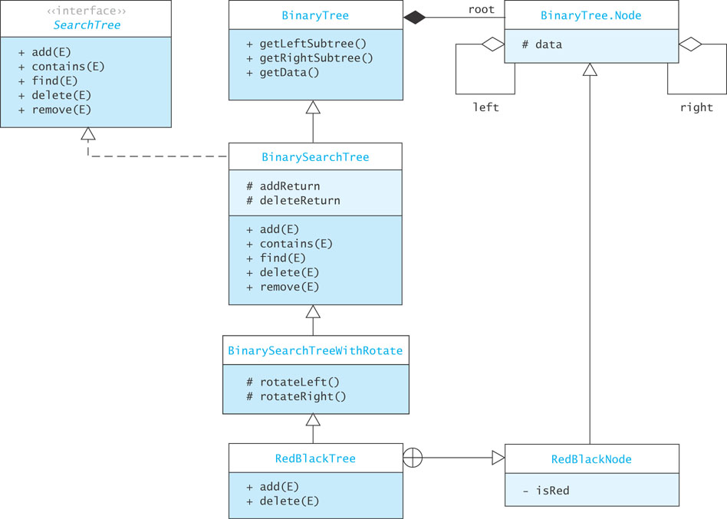
Implementation of a Red-Black Tree Class

Slide 150
Implementation of a Red-Black Tree Class (cont.)
Listing 9.4 (RedBlackTree.java, page 497)

Slide 151
Algorithm for Red-Black Tree Insertion
The insertion algorithm can be implemented with a data structure that has a reference to the parent of each node
The following algorithm detects the need for fix-ups from the grandparent level
Also, whenever a black node with two children is detected on the way down the tree, it is changed to red and the children are changed to black; any resulting problems can be fixed on the way back up

Slide 152
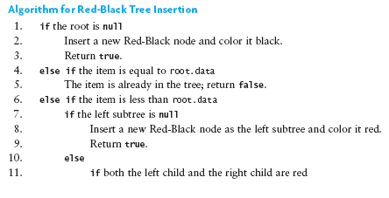
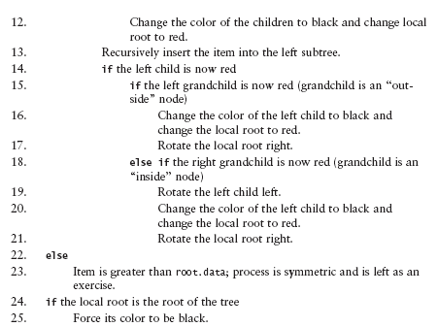
Algorithm for Red-Black Tree Insertion (cont.)

Slide 153
add Starter Method
public boolean add(E item) {
if (root == null) {
root = new RedBlackNode<E>(item);
((RedBlackNode<E>) root).isRed = false; // root is black.
return true;
}
. . .
else {
root = add((RedBlackNode<E>) root, item);
((RedBlackNode<E>) root).isRed = false; // root is always black.
return addReturn;
}

Slide 154
The Recursive add Method
private Node<E> add(RedBlackNode<E> localRoot, E item) {
if (item.compareTo(localRoot.key) == 0) {
// item already in the tree.
addReturn = false;
return localRoot;
}
. . .
else if (item.compareTo(localRoot.key) < 0) {
// item < localRoot.key.
if (localRoot.left == null) {
// Create new left child.
localRoot.left = new RedBlackNode<E>(item);
addReturn = true;
return localRoot;
}
. . .
else { // Need to search.
// Check for two red children, swap colors if found.
moveBlackDown(localRoot);
// Recursively add on the left.
localRoot.left = add((RedBlackNode<E>) localRoot.left, item);
. . .
// See whether the left child is now red
if (((RedBlackNode<E>) localRoot.left).isRed) {
. . .

Slide 155
The Recursive add Method (cont.)
if (localRoot.left.left != null
&& ((RedBlackNode<E>) localRoot.left.left).isRed) {
// Left-left grandchild is also red.
. . .
// Single rotation is necessary.
((RedBlackNode<E>) localRoot.left).isRed = false;
localRoot.isRed = true;
return rotateRight(localRoot);
else if (localRoot.left.right != null
&& ((RedBlackNode<E>) localRoot.left.right).isRed) {
// Left-right grandchild is also red.
// Double rotation is necessary.
localRoot.left = rotateLeft(localRoot.left);
((RedBlackNode<E>) localRoot.left).isRed = false;
localRoot.isRed = true;
return rotateRight(localRoot);
}

Slide 156
Removal from a Red-Black Tree
Remove a node only if it is a leaf or has only one child
Otherwise, the node containing the inorder predecessor of the value being removed is removed
If the node removed is red, nothing further is done
If the node removed is black and has a red child, then the red child takes its place and is colored black
If a black leaf is removed, the black height becomes unbalanced
A programming project at the end of the chapter describes other cases

Slide 157
Performance of a Red-Black Tree
The upper limit in the height for a Red-Black tree is 2 log₂n + 2 which is still O(log n)
As with AVL trees, the average performance is significantly better than the worst-case performance
Empirical studies show that the average cost of searching a Red-Black tree built from random values is 1.002 log₂n
Red-Black trees and AVL trees both give performance close to that of a complete binary tree

Slide 158
TreeMap and TreeSet Classes
The Java API has a TreeMap class that implements a Red-Black tree
It implements SortedMap so some of the methods it defines are:
  get
  put
  remove
  containsKey
All are O(log n) operations
TreeSet implements SortedSet and is an adapter of the TreeMap class

