Slide 1
Binary Search Trees (Part II)
COMP 2100
Otterbein University

Slide 2
Ordered Symbol Tables
One of the benefits of the BST as an implementation for Symbol Tables is that BSTs support ordered keys.
You can iterate over the elements of a BST Symbol Table using this order by performing an in-order traversal of the tree
Traverse left subtree
Enqueue key
Traverse right subtree

Slide 3
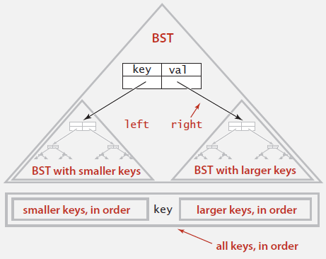
In-Order Traversal
public Iterable<Key> keys() {
Queue<Key> q = new Queue<Key>();
inorder(root, q);
return q;
}
private void inorder(Node x, Queue<Key> queue) {
if (x == null) return;
inorder(x.left, q);
q.enqueue(x.key);
inorder(x.right, q);
}

Slide 4
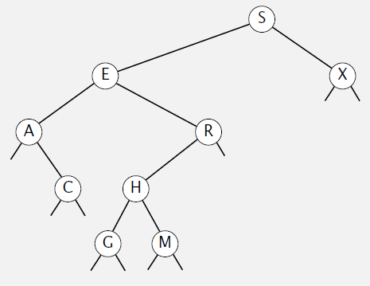
Finding the extremes
Where will you always find the smallest key in a BST?
What about the largest?
private Node max(Node x) {
if (x.right == null) {
return x;
} else {
return max(x.right);
}
}
private Node min(Node x) {
if (x.left == null) {
return x;
} else {
return min(x.left);
}
}

Slide 5
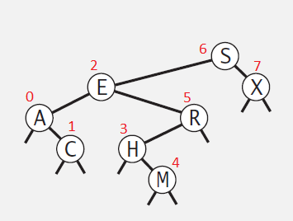
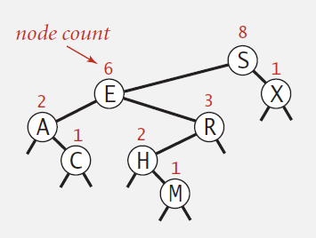
Rank
The rank of a node is the position that it would have in a list sorted by key
How could we compute this?
Recall that we have a size associated with each node
How does that help?
3 cases
key = x.key
key < x.key
key > x.key

Slide 6
Rank
private int rank(Key key, Node x) {
if (x == null) return 0;
int cmp = key.compareTo(x.key);
if (cmp == 0) {
return size(x.left);
} else if (cmp < 0) {
return rank(key, x.left);
} else { // if (cmp > 0) {
return 1 + size(x.left) + rank(key, x.right);
}
}

Slide 7
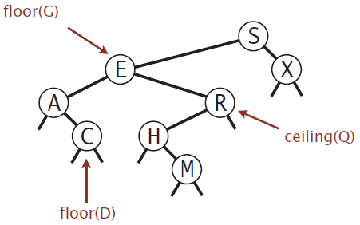
Floor & Ceiling
You recall $\left\lfloor x\right\rfloor$ & $\left\lceil x\right\rceil$?
$\left\lfloor 4.6\right\rfloor =4$ & $\left\lceil 4.6\right\rceil =5$
In an ordered Symbol Table, they take on a related, but subtly different meaning
Floor(x): the largest key ≤ x
Ceiling(x): the smallest key ≥ x

Slide 8
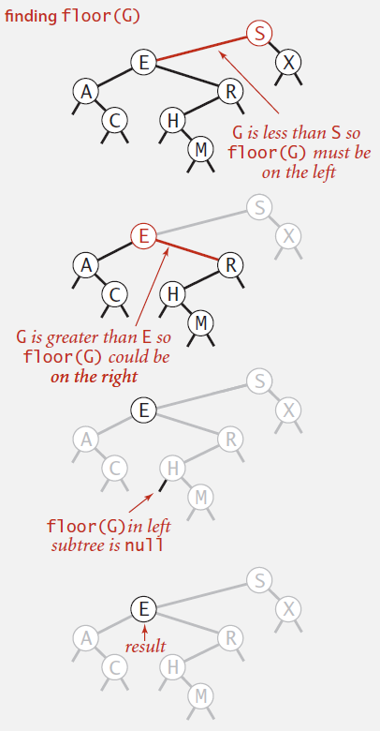
Computing the Floor
Case 1: key = x.key
Floor(key) = key
Case 2: key < x.key
Floor(key) = Floor(key, x.left)
Case 3: key > x.key
Case 3a: Floor(key, x.right) = null
Floor(key) = x.key
Case 3b: Otherwise,
Floor(key) = Floor(key, x.right)

Slide 9
Floor
private Node floor(Node x, Key key) {
if (x == null) return null;
int cmp = key.compareTo(x.key);
if (cmp == 0) {
return x;
} else if (cmp < 0) {
return floor(x.left, key);
} else {
Node t = floor(x.right, key);
if (t != null) return t;
else return x;
}
}

Slide 10
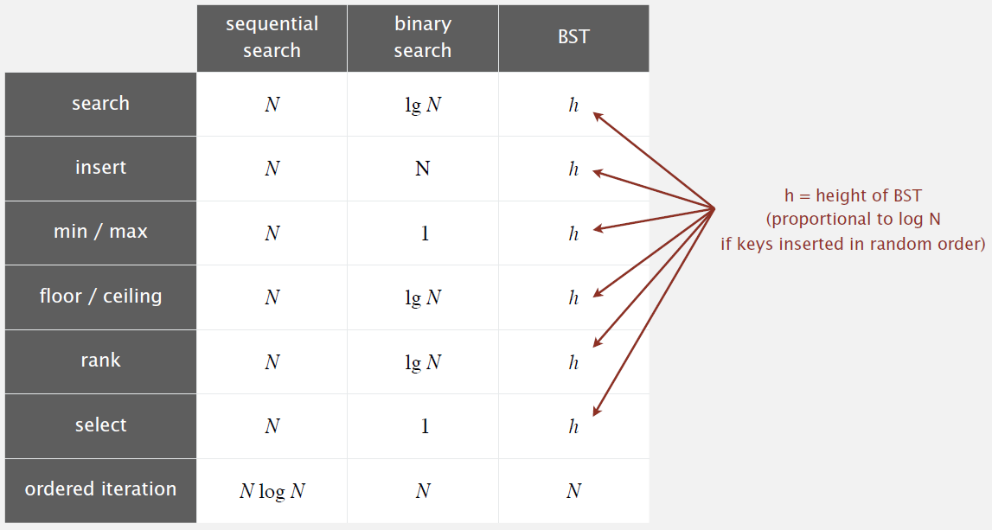
Analysis

Slide 11
Deletion
We’ve saved the hardest for last...
Suppose that we want to delete E
What problem arises?

Slide 12
Third time’s a charm...
Again, there are three cases, but this time it breaks down based on how many children the node targeted for deletion has

Slide 13
public void delete(Key key) {
root = delete(root, key);
}
private Node delete(Node x, Key key) {
if (x == null) return null;
int cmp = key.compareTo(x.key);
if (cmp < 0) {
x.left = delete(x.left, key);
} else if (cmp > 0) {
x.right = delete(x.right, key);
} else {
if (x.right == null) return x.left;
if (x.left == null) return x.right;
Node t = x;
x = min(t.right);
x.right = deleteMin(t.right);
x.left = t.left;
}
x.size = size(x.left) + size(x.right) + 1;
return x;
}
client method
key not found
navigating the tree to find the key & adjusting links on the way back up
0 or 1 children
1 child on right
2 children: here is the tricky part
updating sizes on the way back up

Slide 14
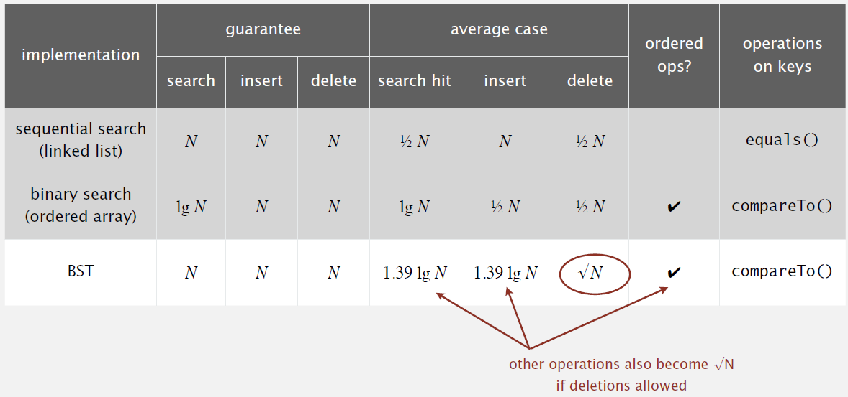
Final Comparative Analysis

