Slide 1
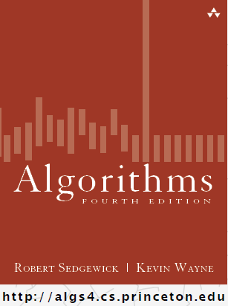
Binary Search Trees
COMP 2100
Otterbein University

Slide 2
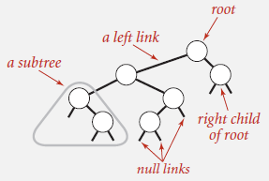
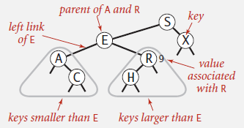
Binary Search Trees
Definition: A BST is a binary tree in symmetric order
A binary tree is either:
  empty
  Two disjoint binary trees (left & right)
A tree in symmetric order: each node has a key that is
  Larger than all keys in its left subtree
  Smaller than all keys in its right subtree
but smaller than S

Slide 3
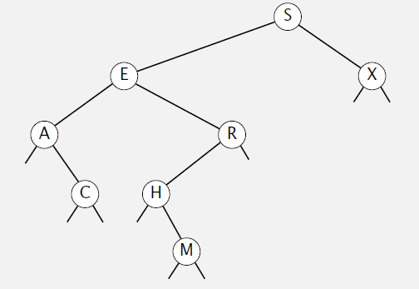
Search a BST: get(key)
If key is less than key in current node, go to the left; if greater then go right; otherwise it is a hit
  key: C
  key: K

Slide 4
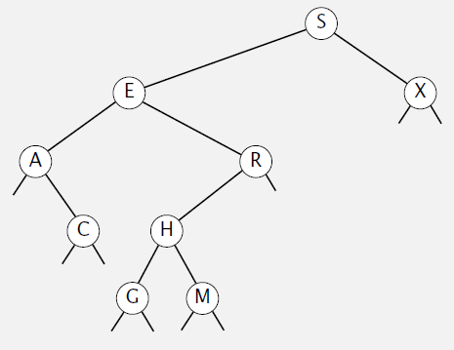
Update a BST: put(key, value)
key: G

Slide 5
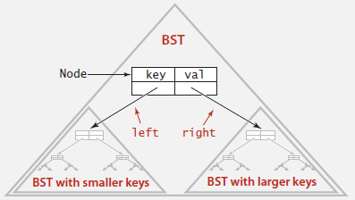
BST Representation
A BST Node: 4 fields
  Key and Value references
  Left and Right references
VS Code
Awkward Language Sidebar
  Conceptually we want to define BST recursively as we have
  This leads Sedgewick & Wayne to use IS-A language
    A BST is a reference to a root Node
  However, in terms of our Java implementation, we want to present a BST API that doesn’t reveal to the client any implementation details, so our implementation must use a HAS-A approach
    A Java BST has a reference to a root Node
  In other words, the client interacts with the BST only in terms of keys/values, not in terms of Nodes (which are hidden)

Slide 6
Implementing get(key)
Public method from API delegates all of its work to a private recursive method, starting at the root
VS Code
Performance
  Two cases:
    Key found in tree: time proportional to depth of node
    Key not found: time proportional to depth of node where insertion would take place to add it

Slide 7
Implementing put(key, value)
Again, public method delegates to private recursive method
Also two cases
  Key already in tree: update value in corresponding node
  Key not in tree: add new node & update size of all the ancestors

Slide 8
Implementing put(key, value)
public void put (Key key, Value value) {
if (root == null) {
root = new Node(key, value, 1);
} else {
put(root, key, value);
}
}

Slide 9
Implementing put(key, value)
public void put (Node x, Key key, Value value) {
int cmp = key.compareTo(x.key);
if (cmp == 0) {
x.val = value;
} else if (cmp < 0){
if (x.left == null) {
x.left = new Node(key, value, 1);
} else {
put(x.left, key, value);
}
} else {
if (x.right == null) {
x.right = new Node(key, value, 1);
} else {
put(x.right, key, value);
}
}
x.size = 1 + size(x.left) + size(x.right);
}

Slide 10

Recursion detour
If we think about the abstract structure of a recursive algorithm that contains a single recursive call, it looks something like this:
method recur (params) {
code segment A;
recur (args);
code segment B;
}
If you think of the chain of recursive calls, when is code segment A executed? Segment B?

Slide 11
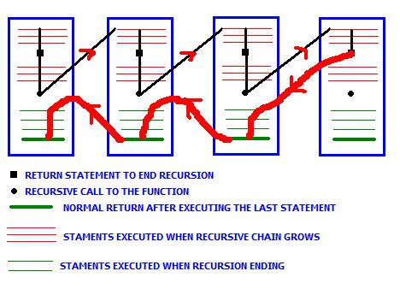
Recursion detour
Here is a graphical answer:
A
B

Slide 12
Recursion detour
Some recursive algorithms do all their work on the way down, like quicksort
  algorithm quicksort(A, lo, hi) is
  if lo < hi then
  p := partition(A, lo, hi)
  quicksort(A, lo, p - 1)
  quicksort(A, p + 1, hi)

Slide 13
Recursion detour
While others do all their work on the way up, like mergesort
  algorithm mergesort(A, lo, hi) is
  if lo < hi then
  m := (lo + hi) / 2
  mergesort(A, lo, m)
  mergesort(A, m + 1, hi)
  merge(A, lo, m, hi)
So let’s look at put(key, value) again

Slide 14
Implementing put(key, value)
public void put (Node x, Key key, Value value) {
int cmp = key.compareTo(x.key);
if (cmp == 0) {
x.val = value;
} else if (cmp < 0){
if (x.left == null) {
x.left = new Node(key, value, 1);
} else {
put(x.left, key, value);
}
} else {
if (x.right == null) {
x.right = new Node(key, value, 1);
} else {
put(x.right, key, value);
}
}
x.size = 1 + size(x.left) + size(x.right);
}

Slide 15
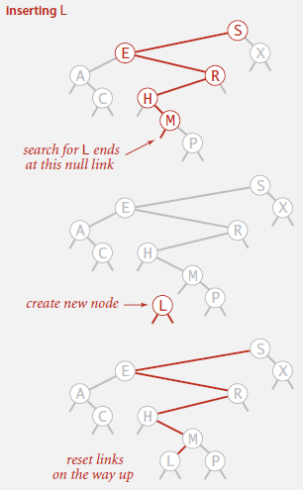
Implementing put(key, value)
We are doing a check on the way down every time we don’t have a hit: is the subtree in the direction that we need to go empty or not?
The authors realized that there is a cleaner way to implement this...
VS Code

Slide 16
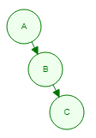
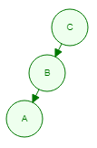
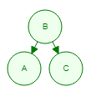
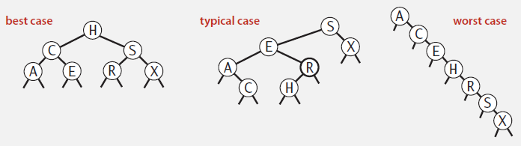
Analysis
There are many possible trees for any set of keys, depending on the order of insertion
A B C B C A C B A

Slide 17
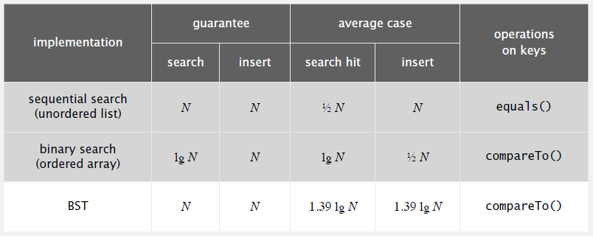
Analysis
Statistical studies have shown that the worst case can be mitigated if it is possible to randomly shuffle the keys: N gets reduced to around 4.31 ln N

