Slide 1
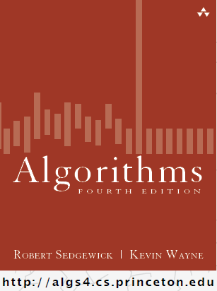
Infix & Postfix
COMP 2100
Otterbein University

Slide 2
Alerts
Read 3.2
Questions on Lab 5?
HW 4 due Friday
Project 2: teams will be finalized today

Slide 3
Infix & Postfix
In infix notation, an operator is placed between its operands
a + b
c – d + (e * f – g * h) / i
Originally, compilers would translate infix expressions in code directly into machine language
This gets messy because of parentheses
What function do parentheses serve? Why are they there?
Compilers now translate first to postfix notation and then to machine language

Slide 4
Infix & Postfix
In postfix notation, an operator is placed immediately following its operands
Infix Postfix
a + b a b +
a + b * c a b c * +
a * b + c a b * c +
(a + b) * c a b + c *
a * (b + c) a b c + *
Notice that no parentheses are needed in the postfix versions

Slide 5
Infix & Postfix
Infix Postfix
a + b a b +
a + b * c a b c * +
a * b + c a b * c +
(a + b) * c a b + c *
a * (b + c) a b c + *
The operands appear in the exact same relative order
The operators don't necessarily appear in the same exact relative order
The operators always appear further to the right in the postfix than they do in the infix, relative to the operands

Slide 6
Infix & Postfix
So how would we convert this expression?
c – d + (e * f – g * h) / i
We know the operands will still be like this:
c d e f g h i
The question is "Where to put the operands?"
What are the operands of the first subtraction?
c d – e f g h i
Now what?
c d – e f * g h * i
c d – e f * g h * – i / +

Slide 7
Infix & Postfix
How could we automate this?
With a stack!!
As we scan the expression left to right, we will immediately place any operands in the result
If we see an operator (including parens) then we will perform stack operations
Why?
Recall, the operators are always shifted right, so we never put them in the output immediately, but only after their second operand is dealt with
There are three cases...

Slide 8
Infix & Postfix
Left paren:
push it on the stack
Right paren:
iterate popping from stack and placing in result until the first left paren on stack is reached; throw matching parens away
Otherwise:
iterate popping from stack and placing in result until the stack is empty or the top of the stack has lower precedence than the current operator
push the current operator on the stack
Empty the stack into the result at the end

Slide 9
Infix & Postfix
Input Output
c – d + (e * f – g * h) / i
Stack

Slide 10
Infix & Postfix
Input Output
– d + (e * f – g * h) / i c
Stack

Slide 11
Infix & Postfix
Input Output
d + (e * f – g * h) / i c
Stack
–

Slide 12
Infix & Postfix
Input Output
+ (e * f – g * h) / i c d
Stack
–

Slide 13
Infix & Postfix
Input Output
+ (e * f – g * h) / i c d –
Stack

Slide 14
Infix & Postfix
Input Output
(e * f – g * h) / i c d –
Stack
+

Slide 15
Infix & Postfix
Input Output
e * f – g * h) / i c d –
Stack
+ (

Slide 16
Infix & Postfix
Input Output
* f – g * h) / i c d – e
Stack
+ (

Slide 17
Infix & Postfix
Input Output
f – g * h) / i c d – e
Stack
+ ( *

Slide 18
Infix & Postfix
Input Output
– g * h) / i c d – e f
Stack
+ ( *

Slide 19
Infix & Postfix
Input Output
– g * h) / i c d – e f *
Stack
+ (

Slide 20
Infix & Postfix
Input Output
g * h) / i c d – e f *
Stack
+ ( –

Slide 21
Infix & Postfix
Input Output
* h) / i c d – e f * g
Stack
+ ( –

Slide 22
Infix & Postfix
Input Output
h) / i c d – e f * g
Stack
+ ( – *

Slide 23
Infix & Postfix
Input Output
) / i c d – e f * g h
Stack
+ ( – *

Slide 24
Infix & Postfix
Input Output
) / i c d – e f * g h *
Stack
+ ( –

Slide 25
Infix & Postfix
Input Output
) / i c d – e f * g h * –
Stack
+ (

Slide 26
Infix & Postfix
Input Output
/ i c d – e f * g h * –
Stack
+

Slide 27
Infix & Postfix
Input Output
i c d – e f * g h * –
Stack
+ /

Slide 28
Infix & Postfix
Input Output
c d – e f * g h * – i
Stack
+ /

Slide 29
Infix & Postfix
Input Output
c d – e f * g h * – i /
Stack
+

Slide 30
Infix & Postfix
Input Output
c d – e f * g h * – i / +
Stack

Slide 31
Infix & Postfix
Evaluating a postfix expression
Also uses a stack!
This time for operands
Scan left to right through expression
Immediately place operands on stack
For operators, pop top two values off the stack, perform the operation on them, and then push the result back on the stack

Slide 32
Infix & Postfix
Input Output
2 5 + 7 *
Stack

Slide 33
Infix & Postfix
Input Output
5 + 7 *
Stack
2

Slide 34
Infix & Postfix
Input Output
+ 7 *
Stack
2 5

Slide 35
Infix & Postfix
Input Output
+ 7 *
2 + 5 = 7
Stack

Slide 36
Infix & Postfix
Input Output
7 *
Stack
7

Slide 37
Infix & Postfix
Input Output
*
Stack
7 7

Slide 38
Infix & Postfix
Input Output
*
7 * 7 = 49
Stack

Slide 39
Infix & Postfix
Input Output
Stack
49

Slide 40
Infix & Postfix
Input Output
49
Stack

Slide 41
Introduction to Trees
COMP 2100
Otterbein University

Slide 42
Trees
Our first non-linear data structure!
Trees are hierarchical
Trees borrow terminology from both botany (e.g. maple trees) and genealogy (e.g., family trees)
Instead of references to next (or previous, in a doubly-linked list) trees nodes have references to children (and maybe parent)
A node can have at most one parent
A node can have any number of children

Slide 43
Tree Terminology
A tree consists of a collection of elements or nodes, with each node linked to its successors
Each node in a tree has exactly one parent except for the root node, which has no parent
The node at the top of a tree is called its root
Leaf nodes also are known as external nodes, and nonleaf nodes are known as internal nodes
The successors of a node are called its children
Nodes that have the same parent are siblings
The links from a node to its successors are called branches
A node that has no children is called a leaf node
dog
The predecessor of a node is called its parent
cat
wolf
A subtree of a node is a tree whose root is a child of that node
A generalization of the parent-child relationship is the ancestor-descendant relationship
canine

Slide 44
Trees & Recursion
A tree node will be defined with structural recursion (as linked list nodes were)
The tree itself can also be defined recursively
Many of the common algorithms for manipulating and processing trees are recursive
In some specific cases or applications a tree may be represented by an array (using a very clever bit of math)

Slide 45
Binary Trees
A binary tree is a tree in which each node has at most two children
Equivalently, in a binary tree each node has two subtrees, called left and right
A tree T is a binary tree if and only if
T is empty, or
The root node of T has two subtrees T_{R} & T_{L} such that T_{R} & T_{L} are both binary trees

Slide 46
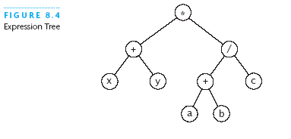
Expression Trees
Each node contains an operator or an operand
Operands are stored in leaf nodes
Parentheses are not stored in the tree because the tree structure dictates the order of operand evaluation
Operators in nodes at higher tree levels are evaluated after operators in nodes at lower tree levels
(x + y) * ((a + b) / c)

Slide 47
Huffman Tree
A Huffman tree represents Huffman codes for characters that might appear in a text file
As opposed to ASCII or Unicode, Huffman code uses different numbers of bits to encode letters; more common characters use fewer bits
Many programs that compress files use Huffman codes

Slide 48
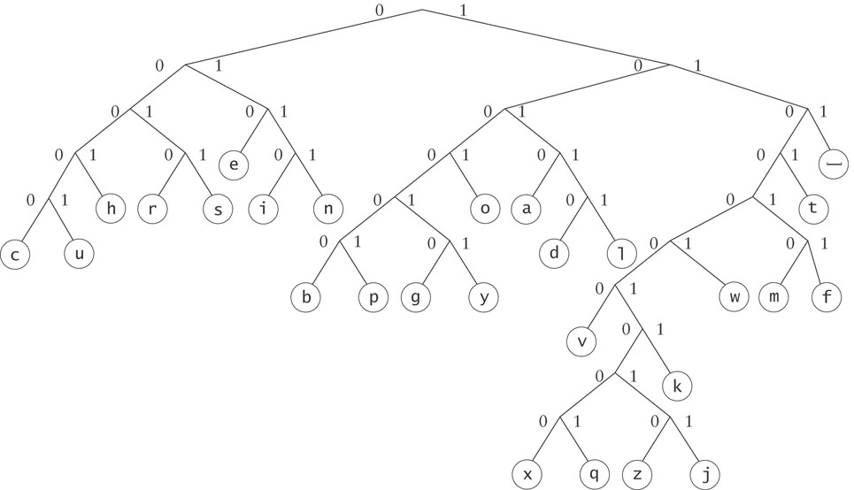
Huffman Tree
To form a code, traverse the tree from the root to the chosen character, appending 0 if you branch left, and 1 if you branch right.

Slide 49
Huffman Tree
Examples:
d : 10110
e : 010

Slide 50
Binary Search Tree
Next time...

