Slide 1
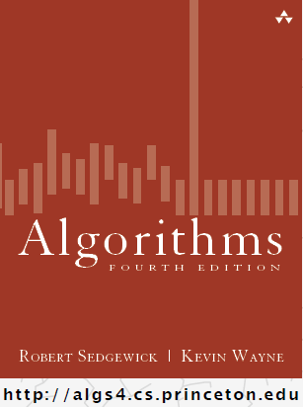
Symbol Tables
COMP 2100
Otterbein University

Slide 2
Alerts
Read 3.1-3.2
Questions on Lab 5?
HW 3 due today
Project 2: form your teams post haste!
  released next Tuesday

Slide 3
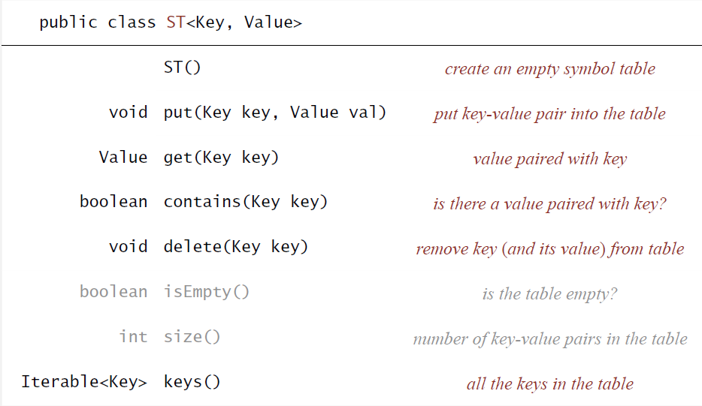
Symbol Table API

Slide 4
Associative Array Application
Letter frequency analysis
  Used in cryptanalysis
public static void main(String[] args) {
LetterFrequency lf = new LetterFrequency();
lf.getFile("great_expectations.txt");
lf.printFrequencies();
}
DEMO
public void printFrequencies() {
for (char key: freq.keys()) {
System.out.println("The frequency of " +
key + " is " + freq.get(key));
}
}

Slide 5
Associative Array Application
import java.util.*;
import java.io.*;
public class LetterFrequency {
SimpleST<Character, Integer> freq;
public LetterFrequency() {
freq = new MySimpleST<Character, Integer>();
}

Slide 6
public SimpleST<Character, Integer> getFile(String input) {
try {
BufferedReader br =
new BufferedReader(new FileReader(input));
String s;
while ((s = br.readLine()) != null) {
for (int i = 0; i < s.length(); i++) {
char c = s.charAt(i);
if (freq.contains(c)) {
freq.put(c, freq.get(c) + 1);
} else {
freq.put(c, 1);
}
}
}
} catch (Exception e) {
e.printStackTrace();
}
return freq;
}

Slide 7
Implementing Symbol Table
So when we instantiate ST:
  freq = new MySimpleST<Character, Integer>();
  There must be an internal representation of the symbol table that gets instantiated and initialized as well
  What are the range of options we could consider for this internal representation?
    Linked list?
    Array?

Slide 8
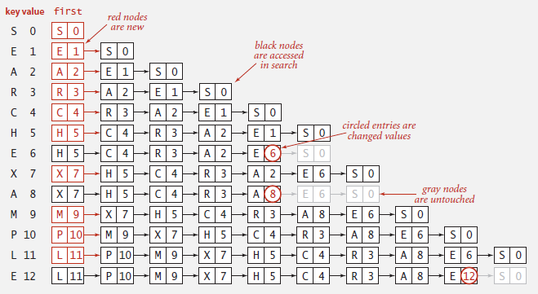
Linked List?
The nodes in the list would have both the key and the value, as well as the next pointer
No advantages in keeping the list ordered
Insertion could happen at the front, but would still be linear time (WHY??)

Slide 9
Linked List?
Performance:
  get(key)
    O(N)
  put(key, value)
    O(N)
  delete(key)
    O(N)
  contains(key)
    O(N)
So N searches would take O(N²) time
  Oof ☹

Slide 10
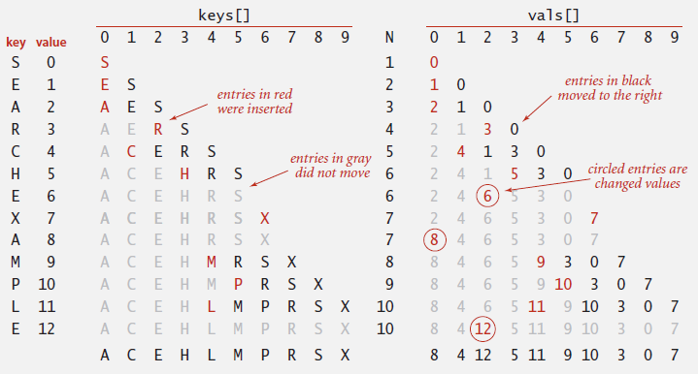
Array?
We could use two (parallel) arrays, one for the keys and one for the values, with corresponding elements in the same index locations in each array
There IS an advantage in keeping the list ordered, since arrays are random access: we could use binary search

Slide 11
Array?
Performance:
  get(key)
    O(lg N)
  put(key, value)
    O(N)
  delete(key)
    O(N)
  contains(key)
    O(lg N)
So N searches would take O(N lg N) time
  Better!
  But insertion and deletion is still a problem

Slide 12
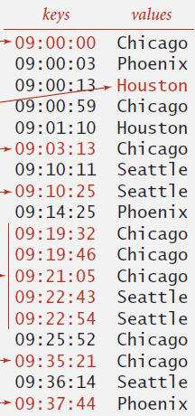
Ordered ST?
There are many applications where we don't care whether the key/value pairs can be iterated in any particular order
But there are some where it matters
  Suppose that the keys are times
  Then we might want to ask other
  interesting questions:
    min
    max
    rank
  This can lead to an ST sub-interface
  OrderedST

Slide 13
Goal
Find an internal representation for ST that provides better performance
  If the symbol table is ordered, then O(lg) for all operations is the goal
  If the symbol table is not ordered, then O(1) for all operations is the goal

