Slide 1
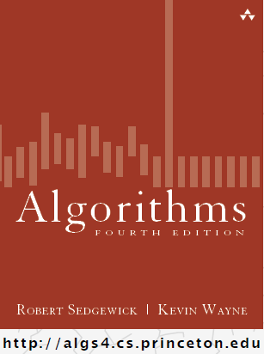
Introduction to Symbol Tables
COMP 2100
Otterbein University

Slide 2
Alerts
Read 3.1-3.2
Lab 5 available
HW 3 due Friday
Project 2: forms teams now!
  released on Tuesday

Slide 3
Symbol Tables
An abstract concept that has had numerous software incarnations over many decades
  A data structure in which the elements are key/value pairs
  A kind of container
  Keys and values can be of any type
  Keys must be unique, non-null values
  Elements may or may not be ordered, depending on application/implementation
  As with all containers, iteration must be supported

Slide 4
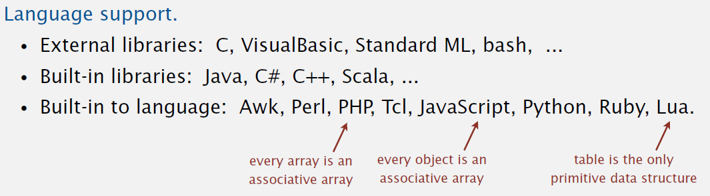
Equivalent concepts
Dictionary: Python, C#, Julia, Smalltalk, Tcl
Associative Array: awk, Go, LISP, Perl, PHP
Map: Java, C++, Red, YAML, OCaml, Scala
Table: SNOBOL, SQL, Lua
Object (non-standard): JavaScript, JSON

Slide 5
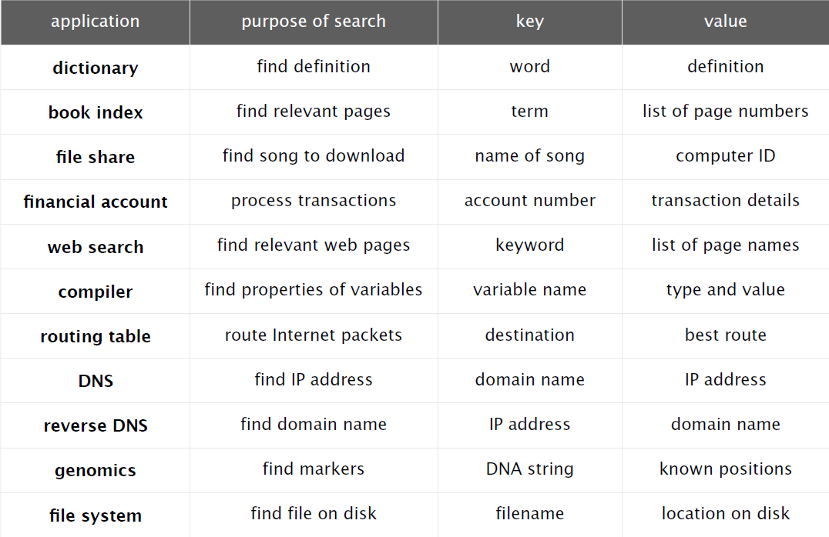
Symbol Table Applications

Slide 6
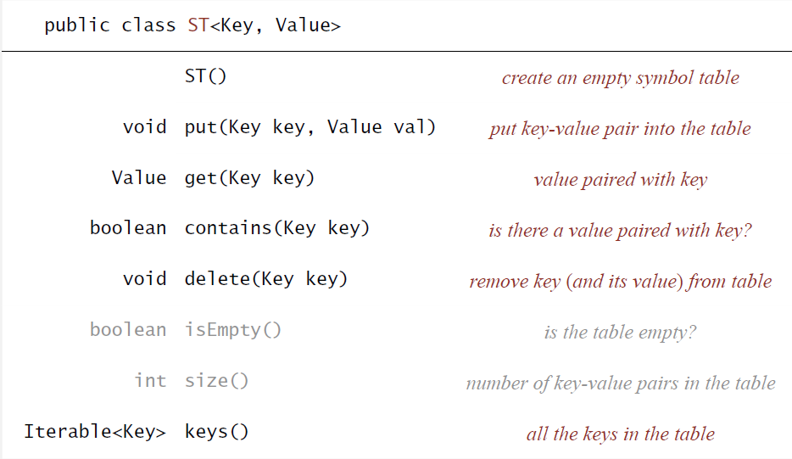
Symbol Table API

Slide 7
Conventions
Values are not null (beware of Java)
get() returns null if key not present
put() overwrites old value with new value
contains() is easy to implement
public boolean contains(Key key) {
return get(key) != null;
}
delete() can be implemented lazy
public void delete(Key key) {
put(key, null);
}

Slide 8
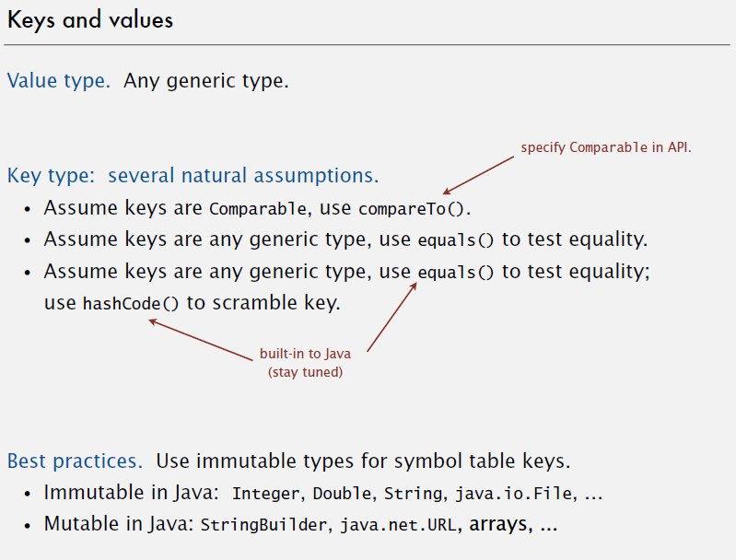
Keys & Values

Slide 9
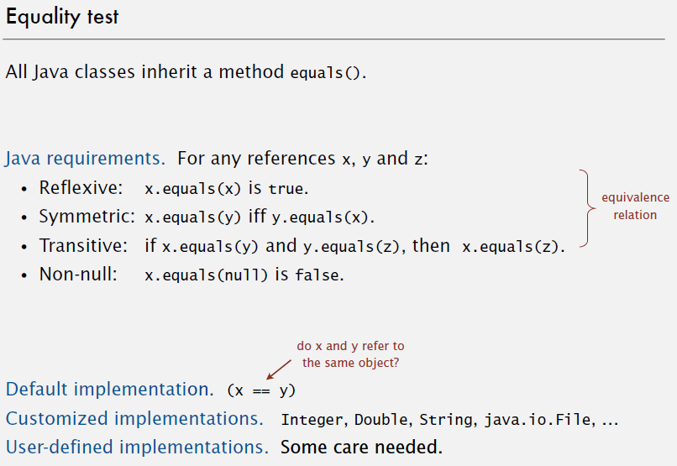
Equality

Slide 10
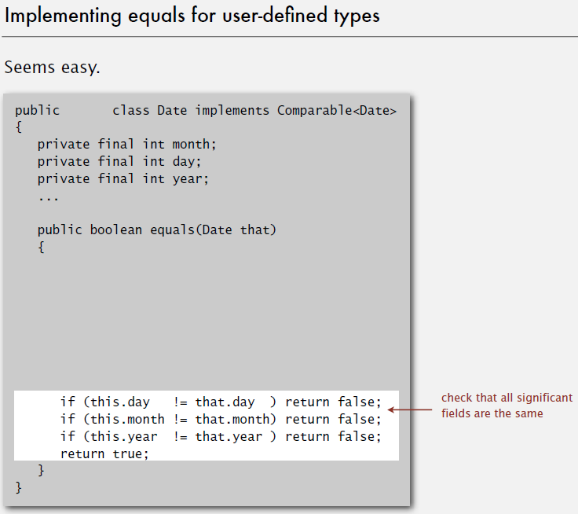

Slide 11
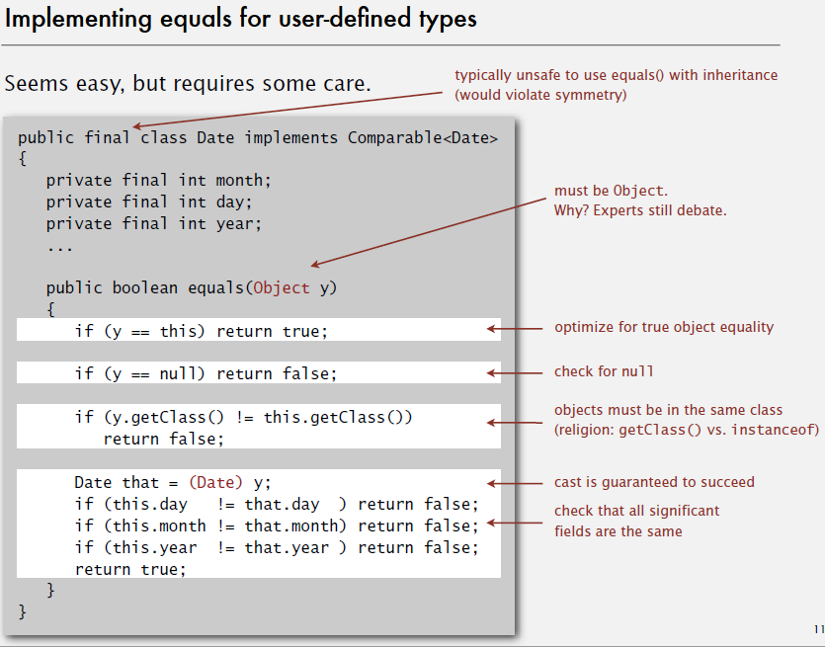

Slide 12
